Slide 1


Principles & Practices
of Open Research
An online module for undergraduate and Masters students

Slide 2

Why is Open Research Important?

Slide 3


Why is open research important?
The open research movement is rapidly growing worldwide, with more researchers, funders and publishers embracing it
1
Why is open research important?
There are benefits of open research for research, researchers and students, and society
2

Slide 4
Why is open research important?
Benefits of open research for research include:
Increased research transparency and reproducibility
Enhanced accessibility
and reusability of data
Less poor research practices and greater research accountability
Increased opportunities
for research collaboration
Improved visibility of research findings
Encouragement of broader society participation in research

Slide 5


Slide 6
Principles & Practices
of Open Research
An online module for undergraduate and Masters students

Slide 7


Increased research transparency and reproducibility

Slide 8




How does open research increase transparency and reproducibility of research outputs?
By being very clear and outlining exactly what was done and how it was done
In what ways does open research increase transparency and reproducibility of research outputs?
This can include clearly stating what, when and/or how archives or repositories were searched to identify research documents
It could also include clearly outlining all steps in an experimental study and/or all the steps and statistical code used to analyse data

Slide 9





How does open research increase transparency and reproducibility of research outputs?
Data is information collected, recorded or created during the research process to validate research findings
Open data helps other researchers to independently validate (or attempt to reproduce) the research
Open research also encourages researchers to share their data with other researchers
Data can be made available on online repositories

Slide 11
Principles & Practices
of Open Research
An online module for undergraduate and Masters students

Slide 12



Enhanced accessibility
and reusability of data

Slide 13



What is open data?
Research data is information collected, generated, recorded or used to validate/underpin the primary findings of a research project or study
Open data is research data that anyone can use access and share
Data can exist in many formats, like images, datasets, musical compositions, guidelines, multimedia, code, software and more!
Making data open and available is an important part of open research

Slide 14




What is open data?
In the past, open data has not been the norm
Technological developments have removed many of the barriers to data sharing
Open data is not yet universal but is increasingly standard practice
Open data requires a minimum standard of data quality to ensure its reusability
Adoption of minimum standards for open data is still in its infancy
But as the culture of Open Research grows so too does the development of open data standards

Slide 15




How does open data facilitate data accessibility and reusability?
By making data open researchers are enhancing the reproducibility and transparency of their research outputs
1
Making data open means the data can be accessed by and presented to a larger audience
2
The data can be reused by different researchers over time to answer new research questions
3
4
Making data open can save time in data collection and maximises research resources

Slide 17
Principles & Practices
of Open Research
An online module for undergraduate and Masters students

Slide 18

Less poor research practices and greater research accountability

Slide 19


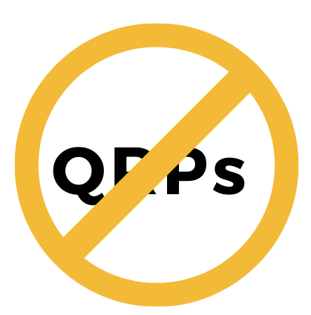

How does open research discourage poor research practices?
Open research encourages researchers to publicly disclose the details of their methods
These can then be reviewed, assessed, and validated by other researchers
This may discourage use of questionable research practices

Slide 20

How does open research help us identify methodological issues in research?
The Case of COVID-19
  The COVID-19 pandemic provides a stark example of the ways poor research design can lead to poor outcomes
  It also shows how open research can help us identify invalid results before they become the basis for bad clinical practice!

Slide 21





How does open research help us identify methodological issues in research?
For example, during the pandemic, a trial was conducted to assess the use of hydroxychloroquine (an anti-malarial drug) to treat severe COVID-19
The study reported reduced mortality in patients who received the drug
As a result, hydroxychloroquine began to be touted as a ‘cure’

Slide 22


How does open research help us identify methodological issues in research?
This flaw likely
affected the results,
so the paper was withdrawn; and hydroxychloroquine
is not an approved
treatment for COVID-19
But when a preprint of the study was published and other researchers began to review it, they identified a major flaw in the study design

Slide 24
Principles & Practices
of Open Research
An online module for undergraduate and Masters students

Slide 25

Increased opportunities for research collaboration

Slide 26

How does open research encourage collaboration?
Open Research enhances worldwide and interdisciplinary collaboration among researchers. This is facilitated by:
1. Open data whereby data of any kind is openly accessible
2. Collaborative platforms for sharing information, tools and resources
Open research collaboration accelerates discovery and design by bringing together knowledge, tools and expertise

Slide 27

How does open research encourage collaboration?
The case of COVID-19
  During the pandemic, researchers from across the globe collaborated and shared data to better understand the disease and work towards preventive and treatment approaches.

Slide 28
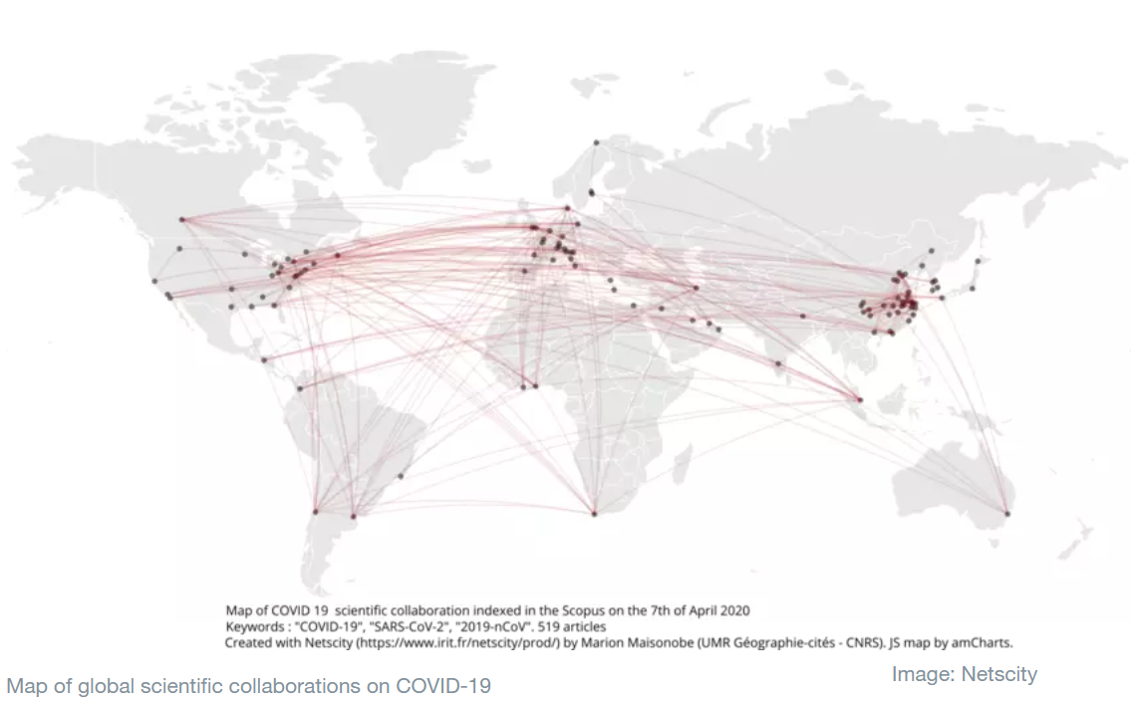
How does open research encourage collaboration?
The case of COVID-19
  There are also open research repositories dedicated specifically to COVID-19 research
    For example, the World Economic Forum-Global Science Collaboration Covid-19

Slide 30
Principles & Practices
of Open Research
An online module for undergraduate and Masters students

Slide 31

Improved visibility of research findings

Slide 32




How does open research improve visibility and engagement with research?
It can also include engaging in alternative ways of sharing research
Open research also tends to get more media attention, increasing visibility
Open research includes making final research products openly accessible
This can increase the likelihood that research will be read and engaged with

Slide 33

How does open research improve visibility and engagement with research?
Take a look at this TedX talk about memory to see how the speaker makes the research topic engaging and interesting!

Slide 35
Principles & Practices
of Open Research
An online module for undergraduate and Masters students

Slide 36
Encouragement of broader society participation in research

Slide 37



How does open research encourage societal participation in research?
Including members of the public when conducting research is important for a number of reasons.
1
It enhances the relevance and impact of your research
It helps to ensure fairer access to knowledge and reduce inequalities
2
Inclusion of the public in conducting research is called Citizen Research
3

Slide 38


How does open research encourage societal participation in research?
1
Open research findings and outputs can be freely accessed by the public
This means there are no fees or need to use an institutional login
2
Open research makes it easier for research to reach the public
This means people outside academia can engage with research outputs
3
It is not just research papers that can be made freely available
Textbooks can be made openly available too, e.g. via Open Textbook Library

Slide 39


How does open research encourage societal participation in research?
Sharing of knowledge in open research also involves non-traditional routes, including:
Using diverse approaches to share knowledge and research increases the likelihood that people can and will engage with it.
Social media
Public talks
Blogs
Visuals and infographics

Slide 40
Take a look at the next set of slides and/or recording to see why open research is important for you!

Slide 42
Principles & Practices
of Open Research
An online module for undergraduate and Masters students

Slide 43



Why is open research important for me?

Slide 44




Why is open research important for me?
We come across research findings every day -- in the news, on television, and online.
Having a better understanding of open research allows you to better engage with the research you read and hear about.

Slide 45

Why is open research important for me?
Understanding good practices (and spotting bad practices!) means you can judge how reliable and trustworthy a piece of research is
If you go on to apply
for Masters or PhD funding, research funders increasingly require open research practices for grant applications
If you decide to publish your project, many journals now
encourage open practices, including registering studies in advance and sharing data
Some journals also award badges for open research practices

Slide 46


Why is open research important for me?
By sharing drafts of research early, you can
Sharing your research also means it is more likely to be read and/or engaged with. Meaning you have a greater chance of making an impact with your research!
get feedback from researchers all over the world to help improve your research
This can be
scary, but it can also be
worth it!

Slide 47



Why is open research important for me?
Sharing data and
research materials online also means they can be cited by other researchers because they are assigned Digital Object Identifiers (DOIs)
If you use open research
approaches, future prospective employers will be able to see your research outputs and processes. This can enhance your job applications, including outside research and academia
How often your work is cited is an 'academic metric' that is often used to decide on job opportunities and promotions

Slide 48
Activity
Complete the activity on Canvas to reflect on how your research goals and priorities align with the benefits of open research

