Slide 1


Principles & Practices
of Open Research
An online module for undergraduate and Masters students

Slide 2

What does Open Research Involve?

Slide 3
Open Research Practices
Now that you have a sense of what open research is about in terms of the principles of open research, we will provide an introduction to using open research practices
Practices
Research Integrity
Pre-registration
Reproducible practices
Research data management
Open reporting
Knowledge dissemination
Principles
Transparency
Reproducibility
Accountability
Collaboration
Societal engagement
Notes:
Adapted from FOSTER Open Science Training Handbook

Slide 4
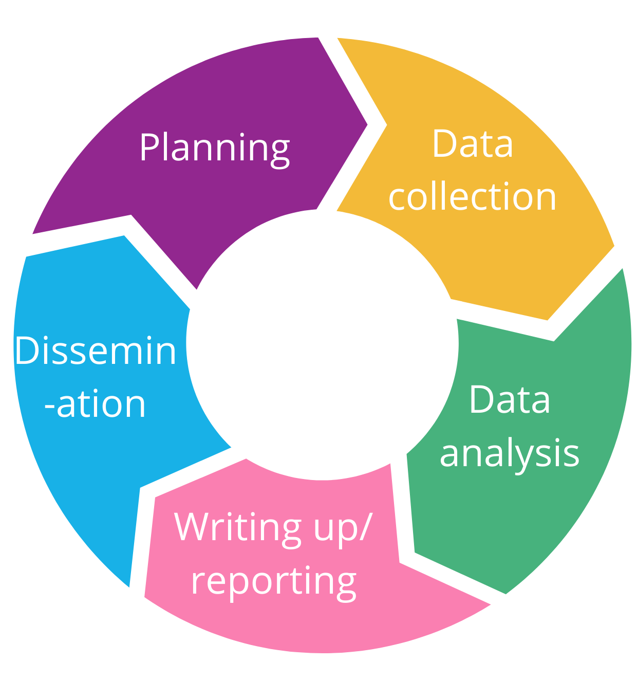
Open Research Practices
Open research practices, or methods are relevant at all stages of the research process, including:
  Research planning
  Data collection
  Data analysis
  Writing up and publishing
  findings
  Disseminating and sharing
  your research

Slide 5
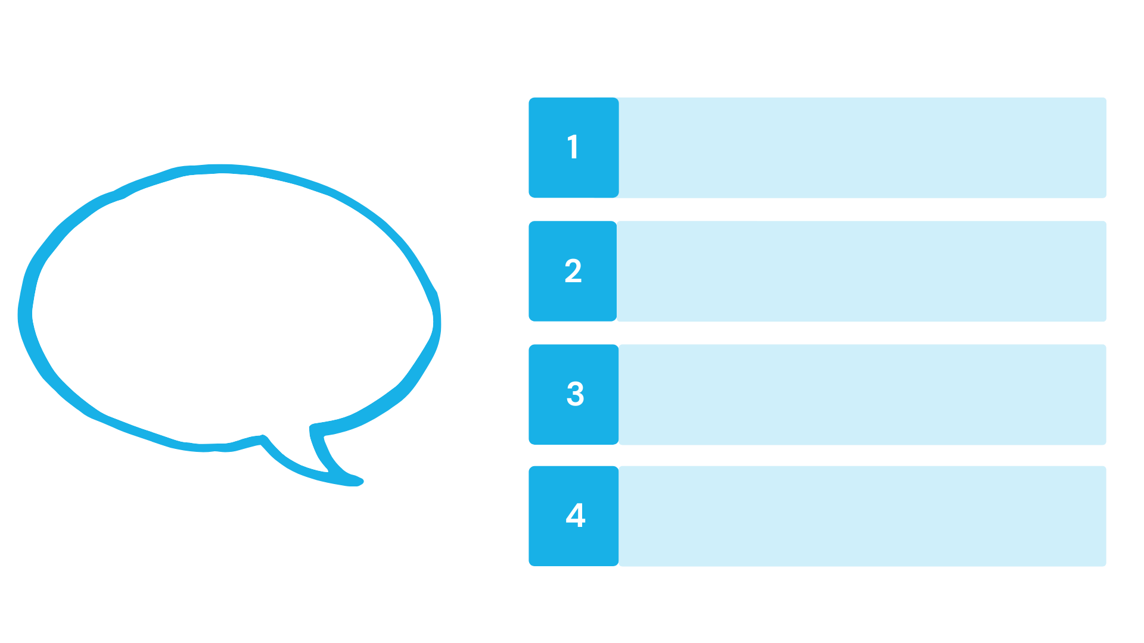

Each of the open research practices introduced here are discussed in the next sections

Slide 6


Slide 7
Principles & Practices
of Open Research
An online module for undergraduate and Masters students

Slide 8


Research Integrity

Slide 9
Guiding Principles of Research Integrity
Research integrity involves making honest and responsible decisions at all stages of the research cycle. It prioritises:
Reliability
Ensuring quality of research at all stages
of the research process
Honesty
Developing, conducting, sharing & engaging
with research in fair, transparent ways
Respect
For research participants, colleagues, society, culture, and the environment
For the research, its management, and for wider impacts
Accountability

Slide 10
Research Integrity
1
It reduces the likelihood of research misconduct
Why is research integrity important?
2
It ensures the validity of research results
3
It facilitates trust between researchers
4
It promotes trust in data and research expertise

Slide 12
Principles & Practices
of Open Research
An online module for undergraduate and Masters students

Slide 13


Pre-registration

Slide 14






Pre-registration
A pre-registration is a record of research processes
It is created and shared before data are collected or become accessible
It is a time-stamped record of decisions about study design, methods and analysis
Pre-registration documents should be publicly available
There are dedicated repositories to make pre-registrations
available

Slide 15
Pre-registration
1
It encourages researchers to identify the goals of their project before collecting any data
2
It creates accountability in research
Why is pre-registration important?
It discourages researchers from conducting “after-the-fact analyses” to find significant, novel and/or exciting results
3
4
It makes research findings easier to find

Slide 17
Principles & Practices
of Open Research
An online module for undergraduate and Masters students

Slide 18


Reproducible Research Practices

Slide 19
Reproducible Research Practices
    Reproducibility means that research is conducted and reported in such a way that another researcher could reach the same result and conclusions using the same methods

Slide 20




Reproducible Research Practices
Reproducible research involves:
Sharing data and research procedures
Making these available for public/peer evaluation
Taking steps in the study design process to minimise bias

Slide 21


Reproducible Research Practices
In qualitative research and/or arts and humanities reproducibility relates to transparency in the research methods used
    Because data replication may not be feasible or useful in some instances

Slide 22
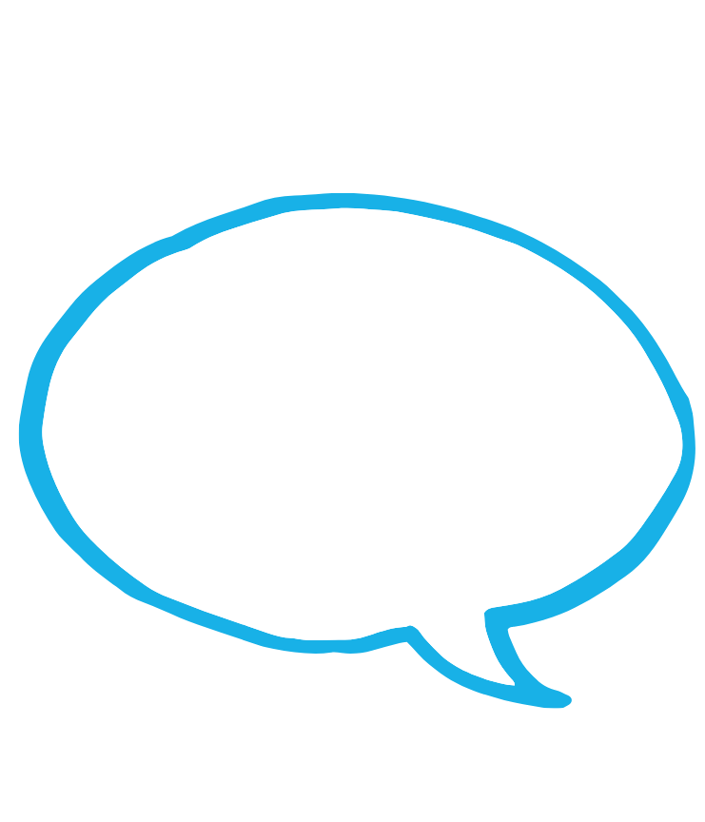

Reproducible Research Practices
1
It ensures research can be assessed, verified and confirmed by other researchers
Why is reproducibility important?
It helps identify and correct situations where researchers have engaged in questionable
research practices
2
Creating a culture of reproducibility can
discourage researchers from reporting only
those findings that are significant/exciting
3

Slide 24
Principles & Practices
of Open Research
An online module for undergraduate and Masters students

Slide 25


Data Management

Slide 26




Data Management
Data is all information collected, observed, recorded or created throughout the research process
It can include spreadsheets, videos, audios, notes, diaries, images

Slide 27
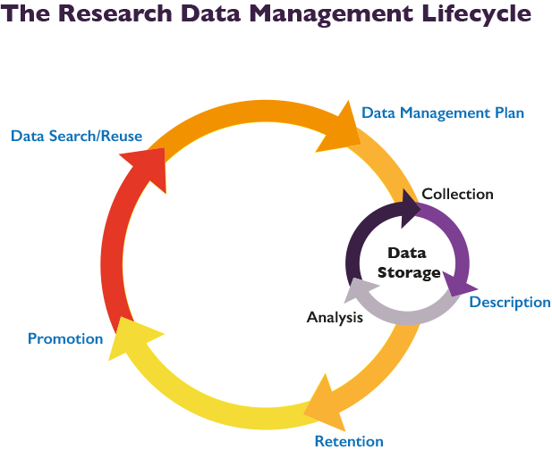
Data Management
Research Data Management (RDM) is the organisation, storage and preservation of research data during active research and post-project.
Notes:
Adapted from: The University of California, Santa Cruz, Data Management LibGuide, Research Data Management Lifecycle

Slide 28

Data Management
A Data Management Plan (DMP) is a living document which describes the organization, storage, preservation and potential sharing of research data, and is an integral part of open research practice

Slide 29
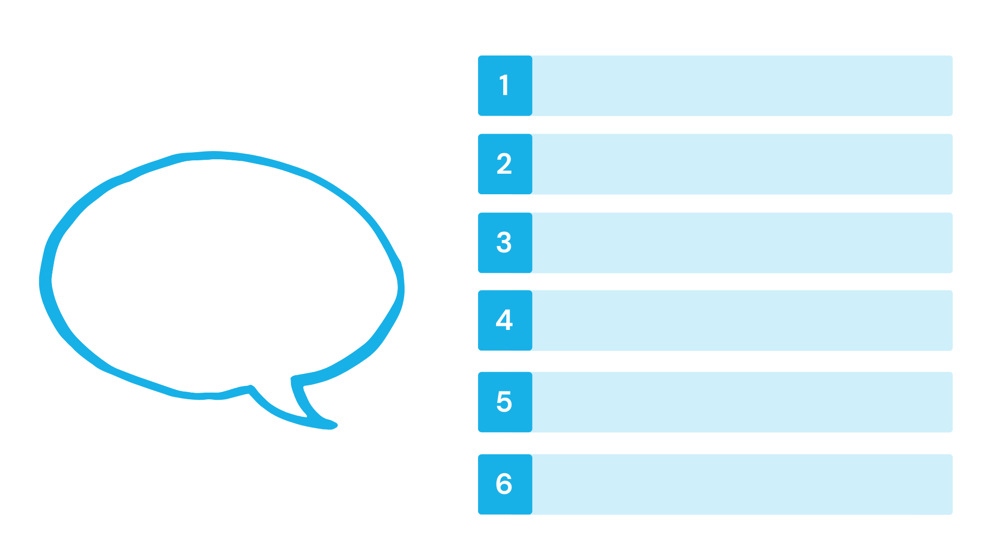
Data Management
1
It helps you keep track of your own work
2
It protects against data loss
Why is data management important?
3
It increases research efficiency
4
It minimises errors and data omission
5
There are funding and publishing
incentives related to data management
6
There are institutional and/or legal data management requirements

Slide 30

Data Management
1
It enhances accountability
2
It enhances transparency
Why is
open data important?
3
It enhances reproducibility
4
It facilitates revisiting and building on existing data
5
It facilitates better and stronger collaborations
Remember that open data is data made publicly available
6
It is better value for the public money that funds much research

Slide 32
Principles & Practices
of Open Research
An online module for undergraduate and Masters students

Slide 33

Open reporting

Slide 34


Open Reporting
Research involves choices and revisions at each stage
Open reporting allows us to make our processes and our outputs transparent
It is supported by use of open reporting checklists
Open reporting involves providing a full, clear, and specific account of how research was conducted

Slide 35
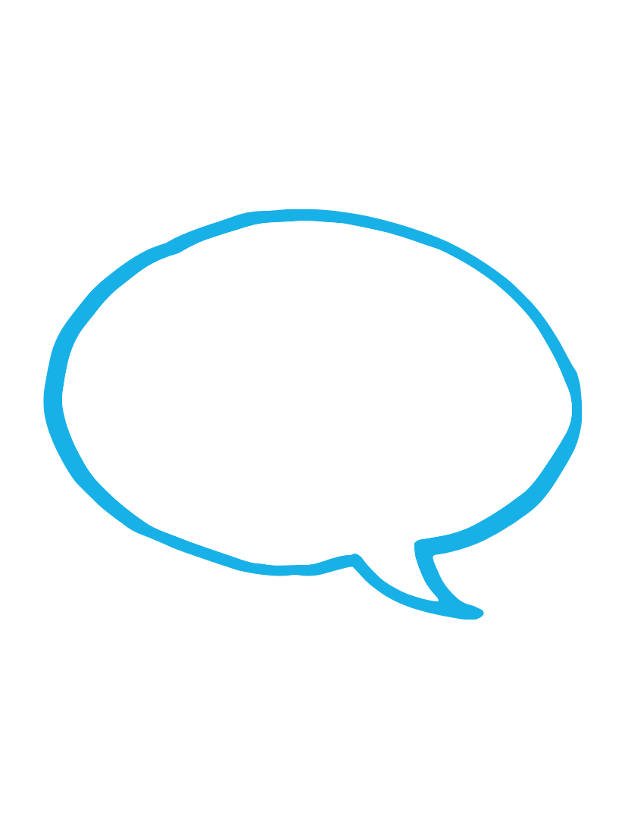
Open Reporting
It allows researchers to detail their processes and decisions at all stages of the research cycle
1
2
It enhances other researchers’ ability to evaluate a study’s results
Why is open reporting important?
3
It enhances other researchers’ abilities to reproduce a study’s results
It benefits decision-making at individual and societal levels, because decisions can be made on transparent processes and findings
4

Slide 37
Principles & Practices
of Open Research
An online module for undergraduate and Masters students

Slide 38

Open knowledge dissemination

Slide 39




Open Knowledge Dissemination
Open knowledge dissemination means communicating knowledge gained from research in open and accessible ways
This expands on the traditional approach to sharing research knowledge, which involves publishing it in an academic journal that often can only be accessed by paying a fee

Slide 40
Open Knowledge Dissemination
Approaches to open knowledge dissemination include:
Open access publishing
Anyone can access the published research, without paying a fee
Pre-prints
Versions of research papers made available online before being peer-reviewed and published
Repositories
Databases people can use to store and access research papers and/or datasets
Science communication
Sharing research in a way that increases appreciation, excitement, understanding and impact of research
Data visualisation
Representing data graphically or visually to increase its accessibility

Slide 41

Open Knowledge Dissemination
It increases public access to and interest in research
1
Why is open knowledge dissemination important?
2
It increases the transparency and openness of research
3
It helps reshape what is considered important in research and academia

Slide 42

What does open research involve?
Activity
ACTIVITY SLIDE HERE
Complete the activity on Canvas to reflect on where in the research cycle different open research practices are relevant

