Slide 1


Principles & Practices
of Open Research
An online module for undergraduate and Masters students

Slide 2

What is Open Research?

Slide 3

What is open research?
1
Open research involves approaches to conducting and disseminating research in a way that makes it open, transparent, and accessible to everyone in society
2
What is open research?
Open research incorporates a range of actions taken at all stages of the research cycle
3
Open research helps to make all aspects of the research process more transparent, and helps make knowledge generated by research publicly available

Slide 4


What is open research?
Many people have heard the term ‘open science’
Open science can be defined as “the movement to make scientific research, data and dissemination accessible to all levels of an inquiring society” (Foster Open Science)
What is open research?
It can also be viewed as research simply done properly (Open Science MOOC)

Slide 5


What is open research?
In this course we use
the term ‘open research’ instead of ‘open science’
This is to reflect the inclusion of all disciplines
in which research is conducted

Slide 6


What is open research?
Some aspects and practices of open research can differ depending on
the area you are
studying
This introductory
course will help you identify what aspects are useful overall and for your specific context

Slide 7
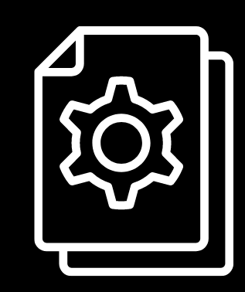


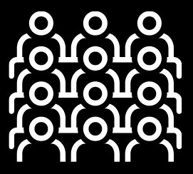
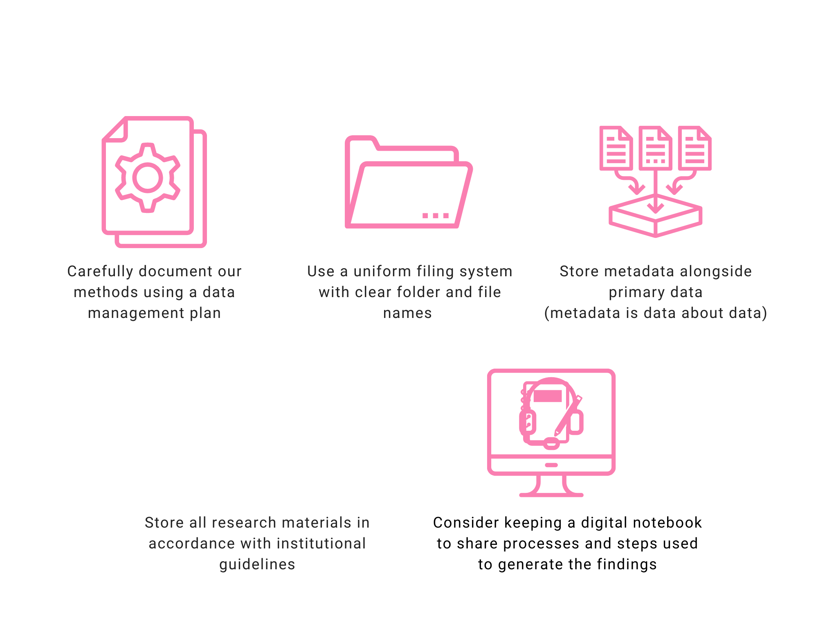
There are 5 schools of thought about open research
The Infrastructure School
Relates to making research platforms, tools and services openly available
The Pragmatic School
Relates to enhancing efficiency of knowledge creation in research
The Public School
Relates to making research accessible to the public
The Democratic School
Relates to making knowledge available to everyone
The Measurement School
Relates to developing and using alternative approaches to measuring impact

Slide 8
Activity
Complete the four questions on Canvas to reflect on your own experiences with research

Slide 9


