Slide 1


Principles & Practices
of Open Research
An online module for undergraduate and Masters students

Slide 2

What is Research Integrity?

Slide 3
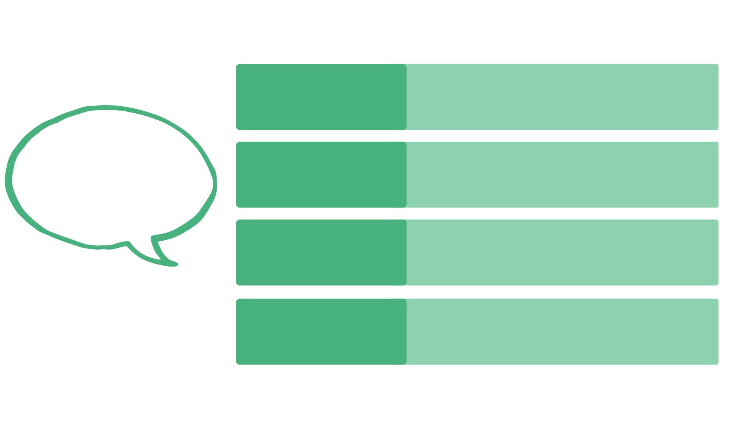
Research Integrity
Reliability
Ensuring quality of research, in all stages of the research process
Developing, conducting, sharing and engaging with research in fair and transparent ways
Guiding Principles of Research Integrity
Honesty
For research participants, colleagues, society, culture and the environment
Respect
Accountability
For the research, its management, and its wider impacts
Adapted from the European Code of Conduct for Research Integrity
Notes:
The European Code of Conduct for Research Integrity can be accessed at https://allea.org/wp-content/uploads/2017/05/ALLEA-European-Code-of-Conduct-for-Research-Integrity-2017.pdf

Slide 4
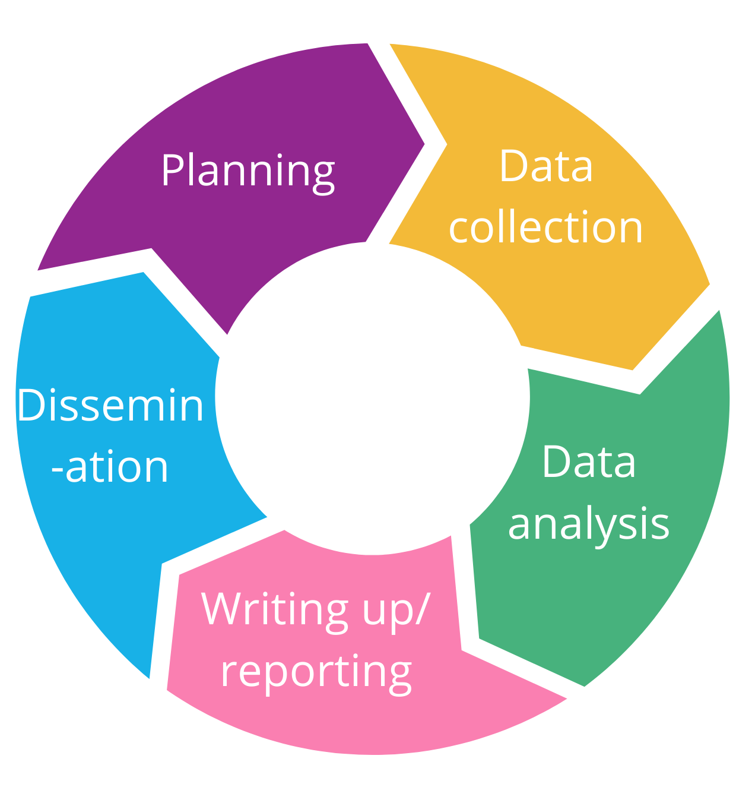
What is research integrity?
Research integrity involves making honest, responsible decisions at all stages of the research cycle

Slide 5
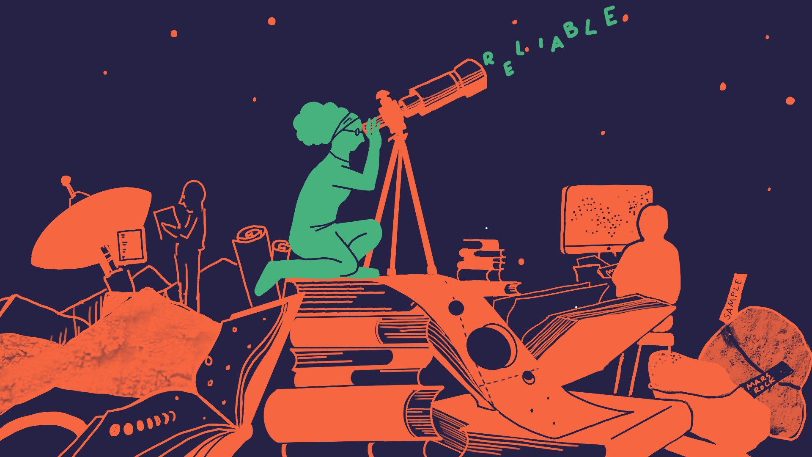

Slide 6
Principles & Practices
of Open Research
An online module for undergraduate and Masters students

Slide 7
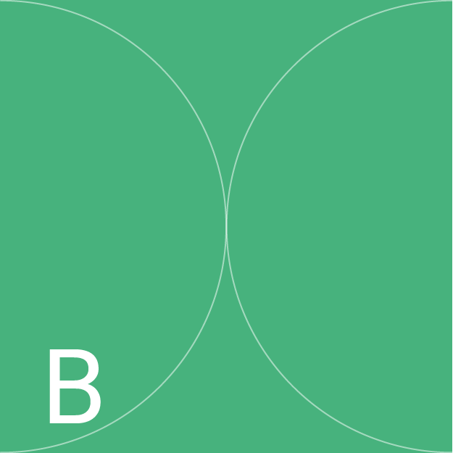
Why is Research Integrity Important?

Slide 8
Why is research integrity important?
1
It reduces the likelihood of research misconduct
Why is research integrity important?
2
It ensures the validity of research results
3
It facilitates trust between researchers
4
It promotes trust in data and research expertise

Slide 9




Why is research integrity important for you?
So as a research student, you should focus on building your skills
The research
practices that you learn will influence how
you conduct and use research -
now and in the future!
Or data interpretation.
By learning best practices for data analysis and reporting in your
discipline, you can be
sure to report your
findings accurately
Skills like academic
honesty, including learning to cite sources completely and accurately, so that you can give credit where credit is due

Slide 10

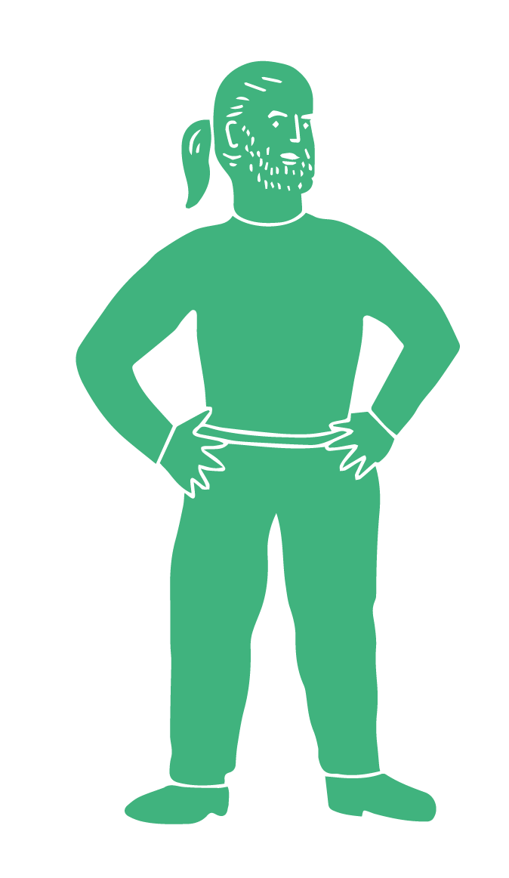

Why is research integrity important for you?
Research integrity can also help you to minimise research waste
By making responsible decisions about whether research should be done, and how it should be done, you can
minimise waste of time
and resources

Slide 11


Why is research integrity important for you?
Wasteful
behaviours include conducting
unnecessary research on topics that have already been
addressed
Conducting research without being transparent about what you did can also be wasteful
Not properly designing your study or being careless in your research activities are wasteful
behaviours

Slide 13
Principles & Practices
of Open Research
An online module for undergraduate and Masters students

Slide 14

What practices can compromise research integrity?

Slide 15





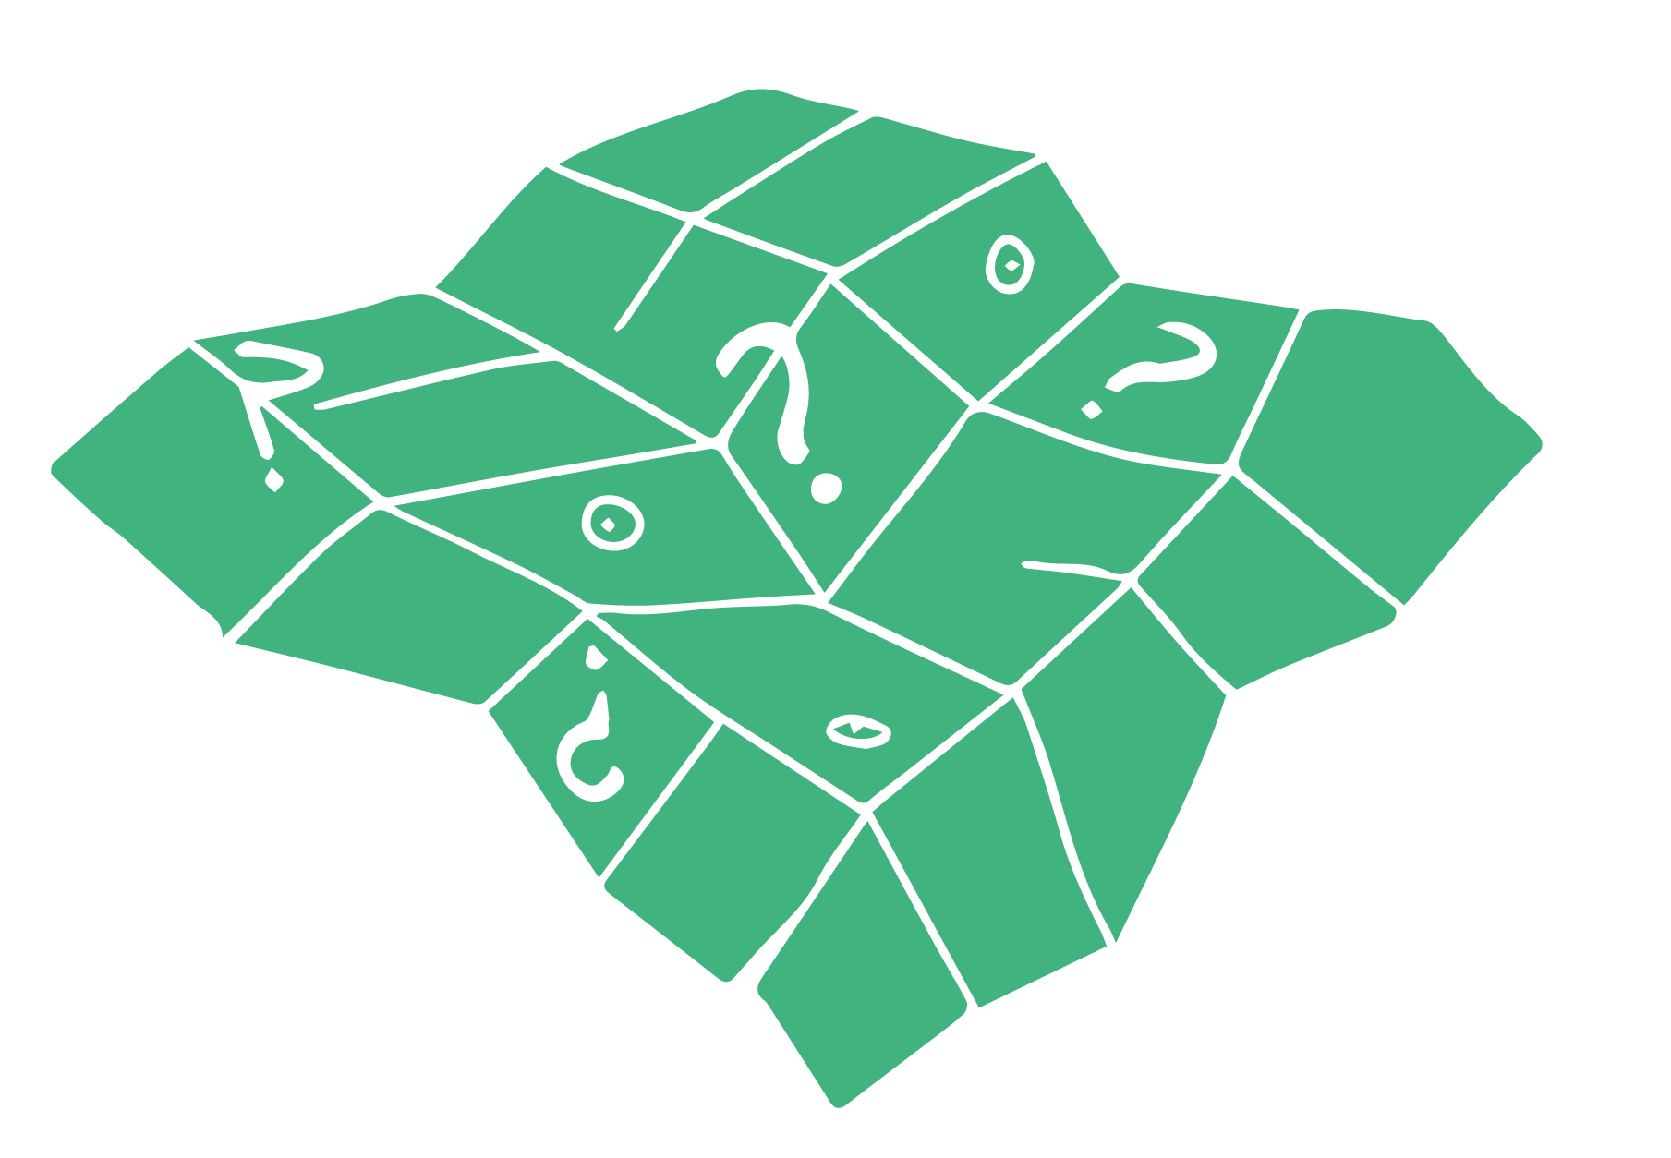
What practices can compromise research integrity?
Plagiarism
(including self-plagiarism)
Giving or taking
credit for work inappropriately
Fabricating data
Misrepresenting
data
Manipulation of
images or other materials
Undeclared
conflicts of interest

Slide 16

What is plagiarism?
It is also possible to self-plagiarise. This happens when an author passes off old work as new
For example, by submitting one paper for credit in two separate modules
Plagiarism is the practice of misrepresenting somebody else’s words or ideas as your own

Slide 17

Avoiding Plagiarism
1
Always acknowledge the work and contributions of other people
How do you avoid plagiarism?
2
When paraphrasing or summarising someone elses work, include a citation
If including text from someone elses work verbatim, use quotation marks and include a citation
3
Cite primary sources of information, rather than secondary or tertiary sources
4
Adapted from ori.hhs.gov/plagiarism-0

Slide 18


Avoiding Plagiarism
Your university will have resources to help you avoid plagiarism too.
In UCC, for example, a Citing, Referencing and Plagiarism course is available here
And check out this video on how to cite sources
And this one on examples of plagiarism
They are short but very useful!

Slide 19



Giving or Taking Credit for Work Inappropriately
If someone makes a
meaningful contribution to a research project they should receive credit for their contribution
There is guidance to determine if someone made a meaningful contribution, like the ICJME criteria
This might mean they are an author on a final paper, or receive an
acknowledgement
on that paper

Slide 20


Giving or Taking Credit for Work Inappropriately
You might also ask yourself:
Did they contribute to the study idea/design?
Did they conduct analyses or contribute to interpreting findings?
Did they assist with
writing up the final report/paper?

Slide 21

Giving or Taking Credit for Work Inappropriately
If someone doesn’t make a meaningful contribution, they shouldn’t be given
credit
These kinds of authors are sometimes called ‘ghost authors’
For instance, listing uninvolved members of a research group, or more senior academics who only looked at the final paper

Slide 22





Data Fabrication
For example, an anthropologist might write transcripts of interviews they never conducted
Data fabrication is the process of manufacturing, or “making up,” data
These transcripts - false data - might become part of the
research record
This can result in
unreliable data and waste research resources through attempted replications

Slide 23


Data Fabrication
COVID-19 Example
A paper published in 2020 reported increased risk of death for people hospitalised with COVID-19 if they had underlying cardiovascular disease

Slide 24

Data Fabrication
COVID-19 Example
Findings were based on data supposedly collected by the company of one of the study authors
It quickly became apparent that the data was fraudulent
The paper was retracted but such questionable practices can undermine trust in research

Slide 25


Data Misrepresentation
Data misrepresentation is the practice of presenting “real” data in a misleading way
Researchers might emphasise exciting or novel findings only
Researchers might also distort or duplicate images of their findings
Some researchers even magnified or reversed their images to try and avoid detection!

Slide 26
Data Misrepresentation
Data misrepresentation gives an incomplete picture of the research findings
Like other questionable research practices, it can result in unreliable data
It can also waste research resources through attempted replications

Slide 27



Piracy and Manipulation of Images/Other Materials
Sometimes researchers manipulate figures, images or other resources to include
them in multiple research papers
Often these
manipulated materials
come from organisations known as ‘paper mills.’

Slide 28


Piracy and Manipulation of Images/Other Materials
But there are also researchers working to identity this manipulated content so it can be retracted
Paper mills churn out fake data, images, and whole papers to meet demand from researchers

Slide 29

Undeclared Conflicts of Interest
A conflict of interest is when a researchers’ other
interests lead to intentional or unintentional biases in research
Conflicts of interest may, in turn, compromise the validity of the results

Slide 30

Undeclared Conflicts of Interest
For example, a researcher
receiving funding for pharmaceutical development may be incentivised to demonstrate that competitors’ drugs
are unsafe or inferior
This may shape how they conduct their research and impact the findings, which will influence people’s health and care in the future

Slide 31



Why do people engage in research misconduct?
There are several factors that can motivate research misconduct
Misconduct may also be
motivated by external
pressures, like pressure
from supervisors to achieve
a certain result
Some are emotional, like fear of failure
Worries about
personal circumstances
like employment status might also motivate misconduct
Researchers may also
feel pressured to perform due to the competitiveness of academic culture

Slide 33
Principles & Practices
of Open Research
An online module for undergraduate and Masters students

Slide 34

How can you maintain high levels of research integrity?

Slide 35


How can I help reduce the effects of research misconduct?
Follow best practices in research integrity and open research at all stages of the research process
1
2
Avoid plagiarism
3
Accurately and honestly represent your data
4
Give credit where it is due
Be transparent and responsible in all aspects of, and decisions about, your research
5

Slide 36
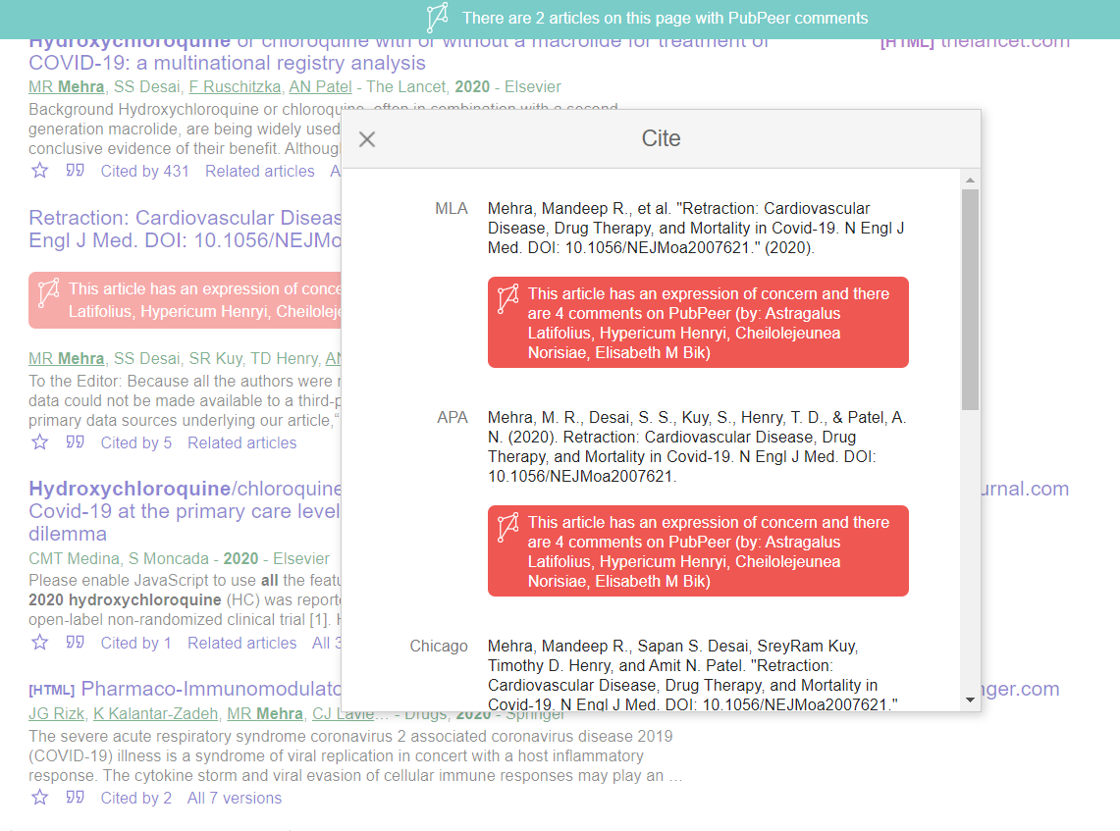

How can I help reduce the effects of research misconduct?
You can also comment on and review already published papers using platforms like
PubPeer
This helps flag issues in research that are already in the public domain

Slide 37
How can I help reduce the effects of research misconduct?
PubPeer is an “online journal club” that exists as an app on the Chrome browser
It allows researchers
to comment on published journal articles.
This is called post-publication peer review
PubPeer has
contributed to many
corrections and retractions
of published articles
Researchers can highlight problems in analysis, interpretation and/or reporting of results

Slide 38
How can I help reduce the effects of research misconduct?
Most universities have a
Research Code of Conduct that outlines what to do if you suspect research misconduct in your university
Research misconduct can usually be reported in writing to an established Research Integrity Officer in your institution.
This is someone trained to follow up and investigate suspected misconduct

Slide 39
How can I help reduce the effects of research misconduct?
If you suspect research misconduct outside of your university, you can contact the editors or administrators of the journal/website where the
work appears

Slide 40



How can I help reduce the effects of research misconduct?
What happens then?
Processes are in place in your university to manage the outcomes of research integrity issues. Your research support office can guide you on this
The paper is withdrawn from the journal in which it was published.
It may still be available online, but will include a notification that it has been retracted
When research integrity issues or misconduct are identified in published research, these studies are retracted

Slide 41

How can I help reduce the effects of research misconduct?
The Retraction Watch
database contains
entries for each
retracted paper
Retraction Watch,
which was launched in 2010, is a blog that tracks retracted
papers
By the end of
2020, there were nearly
25,000 retracted papers
in the database

Slide 42
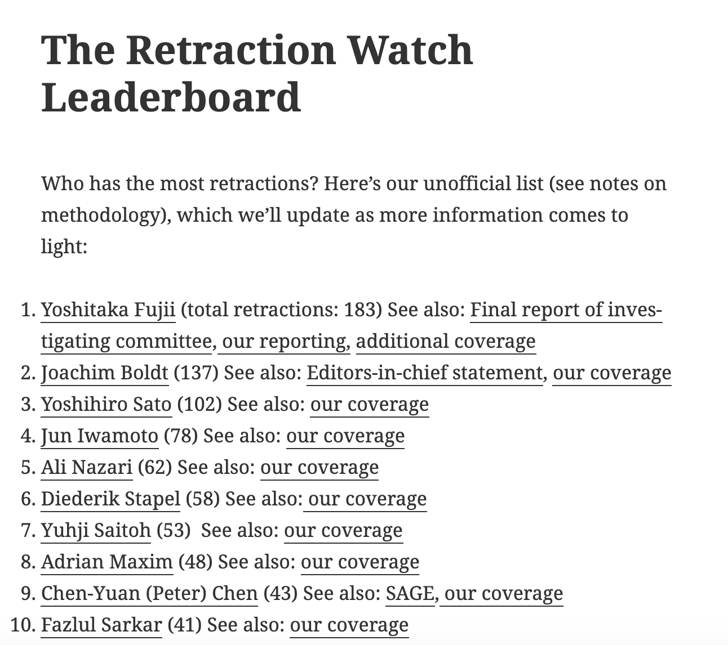
How can I help reduce the effects of research misconduct?
Retraction Watch also keeps track of individual researchers with multiple retractions in its Leaderboard
You can check
out Retraction Watch here
Notes:
Leaderboard correct as of February 2021

Slide 43


How can you demonstrate research integrity?
Educate yourself about research integrity
Follow institutional codes of conduct for research
  University College Cork’s Research Code of Conduct is available here

Slide 45
Principles & Practices
of Open Research
An online module for undergraduate and Masters students

Slide 46

What resources are available to help us maintain and promote research integrity?

Slide 47
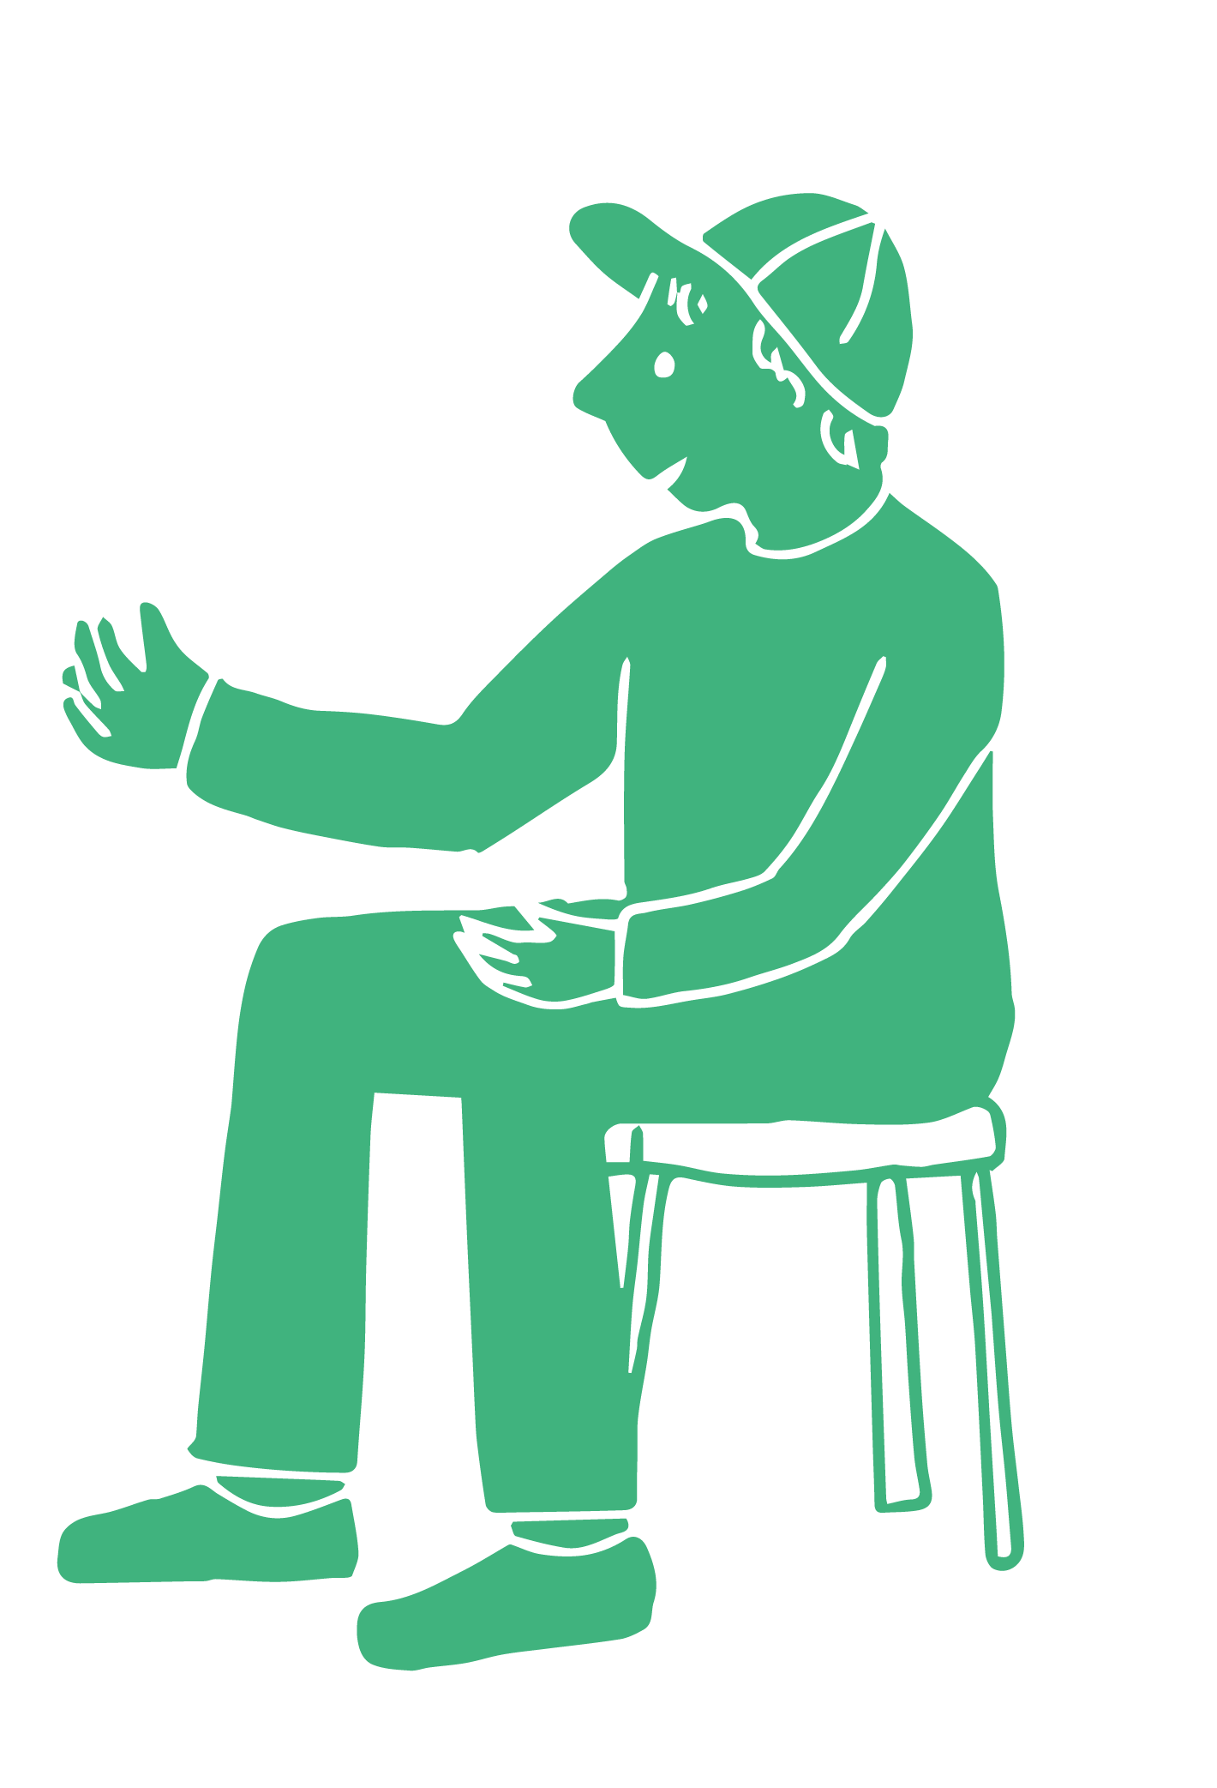

What resources are available to help us maintain and promote research integrity?
Many universities have research integrity offices and/or faculty you can contact to discuss matters related to research integrity
University College Cork Research Integrity support can be accessed here
University College Cork Research Support Services can be accessed here

Slide 48
What resources are available to help us maintain and promote research integrity?
Universities may also organise research integrity workshops and training
In UCC, these include short workshops like
  Research Integrity, Ethics, & Open Science
  Epigeum Online Course on Research Integrity

Slide 49
What resources are available to help us maintain and promote research integrity?
In addition to your own university, external organisations can also provide support and guidance
For example,
  National Research Integrity Forum (part of the Irish Universities Association)
  UK Research Integrity Office
  US Office for Research Integrity

Slide 50
Activity
Complete the activity on Canvas to reflect on what you could to enhance research integrity in your research.

Slide 52
Principles & Practices
of Open Research
An online module for undergraduate and Masters students

Slide 53
Additional Resources

Slide 54
Want to know more about...
  Research Integrity Guidance?
  Take a look at European Code of Conduct for Research Integrity
  How to present data with integrity?
See the Office of Research Integrity guidelines here
Current issues in research integrity?
Read the Science Integrity Digest blog by Dr Elisabeth Bik

Slide 55
Want to know more about...
  The state of research integrity and science and how to improve it?
  Titus, S., Wells, J. & Rhoades, L. Repairing research integrity (2008). Nature, 453, 980–982.
  Whose responsibility is research integrity?
  Mitcham, C. Co-responsibility for research integrity (2003). Science and Engineering Ethics, 9, 273–290.

Slide 56
Want to know more about. . .
Research integrity and public trust in data?
  TEDTalk: Trust in research -- the ethics of knowledge production
    This is a clear 12-minute talk on research integrity
  The Vaccine-Autism Myth Started 20 Years Ago. Here's Why It Still Endures Today
    This is a short article outlining a good example of the importance of trust in research

Slide 57
Want to know more about. . .
Practices that undermine research integrity?
  Take a look at this video on threats to research integrity
  Read this newspaper article outlining a case of research misconduct
  How common questionable research practices are?
  John, L. K., Loewenstein, G., & Prelec, D. (2012). Measuring the prevalence of questionable research practices with incentives for truth telling. Psychological Science, 23(5), 524-532.

