Slide 1
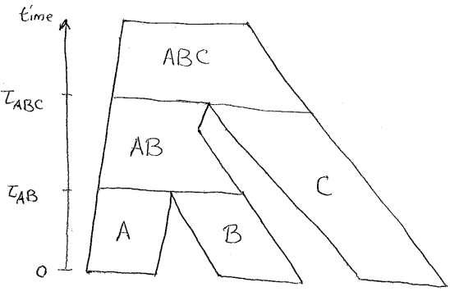
Effect of Intralocus Recombination
on Species Tree Inference

Slide 2
Research Question
Observed genes are commonly assumed to be identical by descent (i.e. that every portion of the gene shares the same genealogical history as every other portion).
But this assumption is violated when genes are subject to recombination events; in particular in the case where recombination breakpoints can occur within the gene, which I refer to as intralocus recombination.
Intralocus recombination can cause different segments of a gene to have different genealogical histories.
Does this matter?

Slide 3
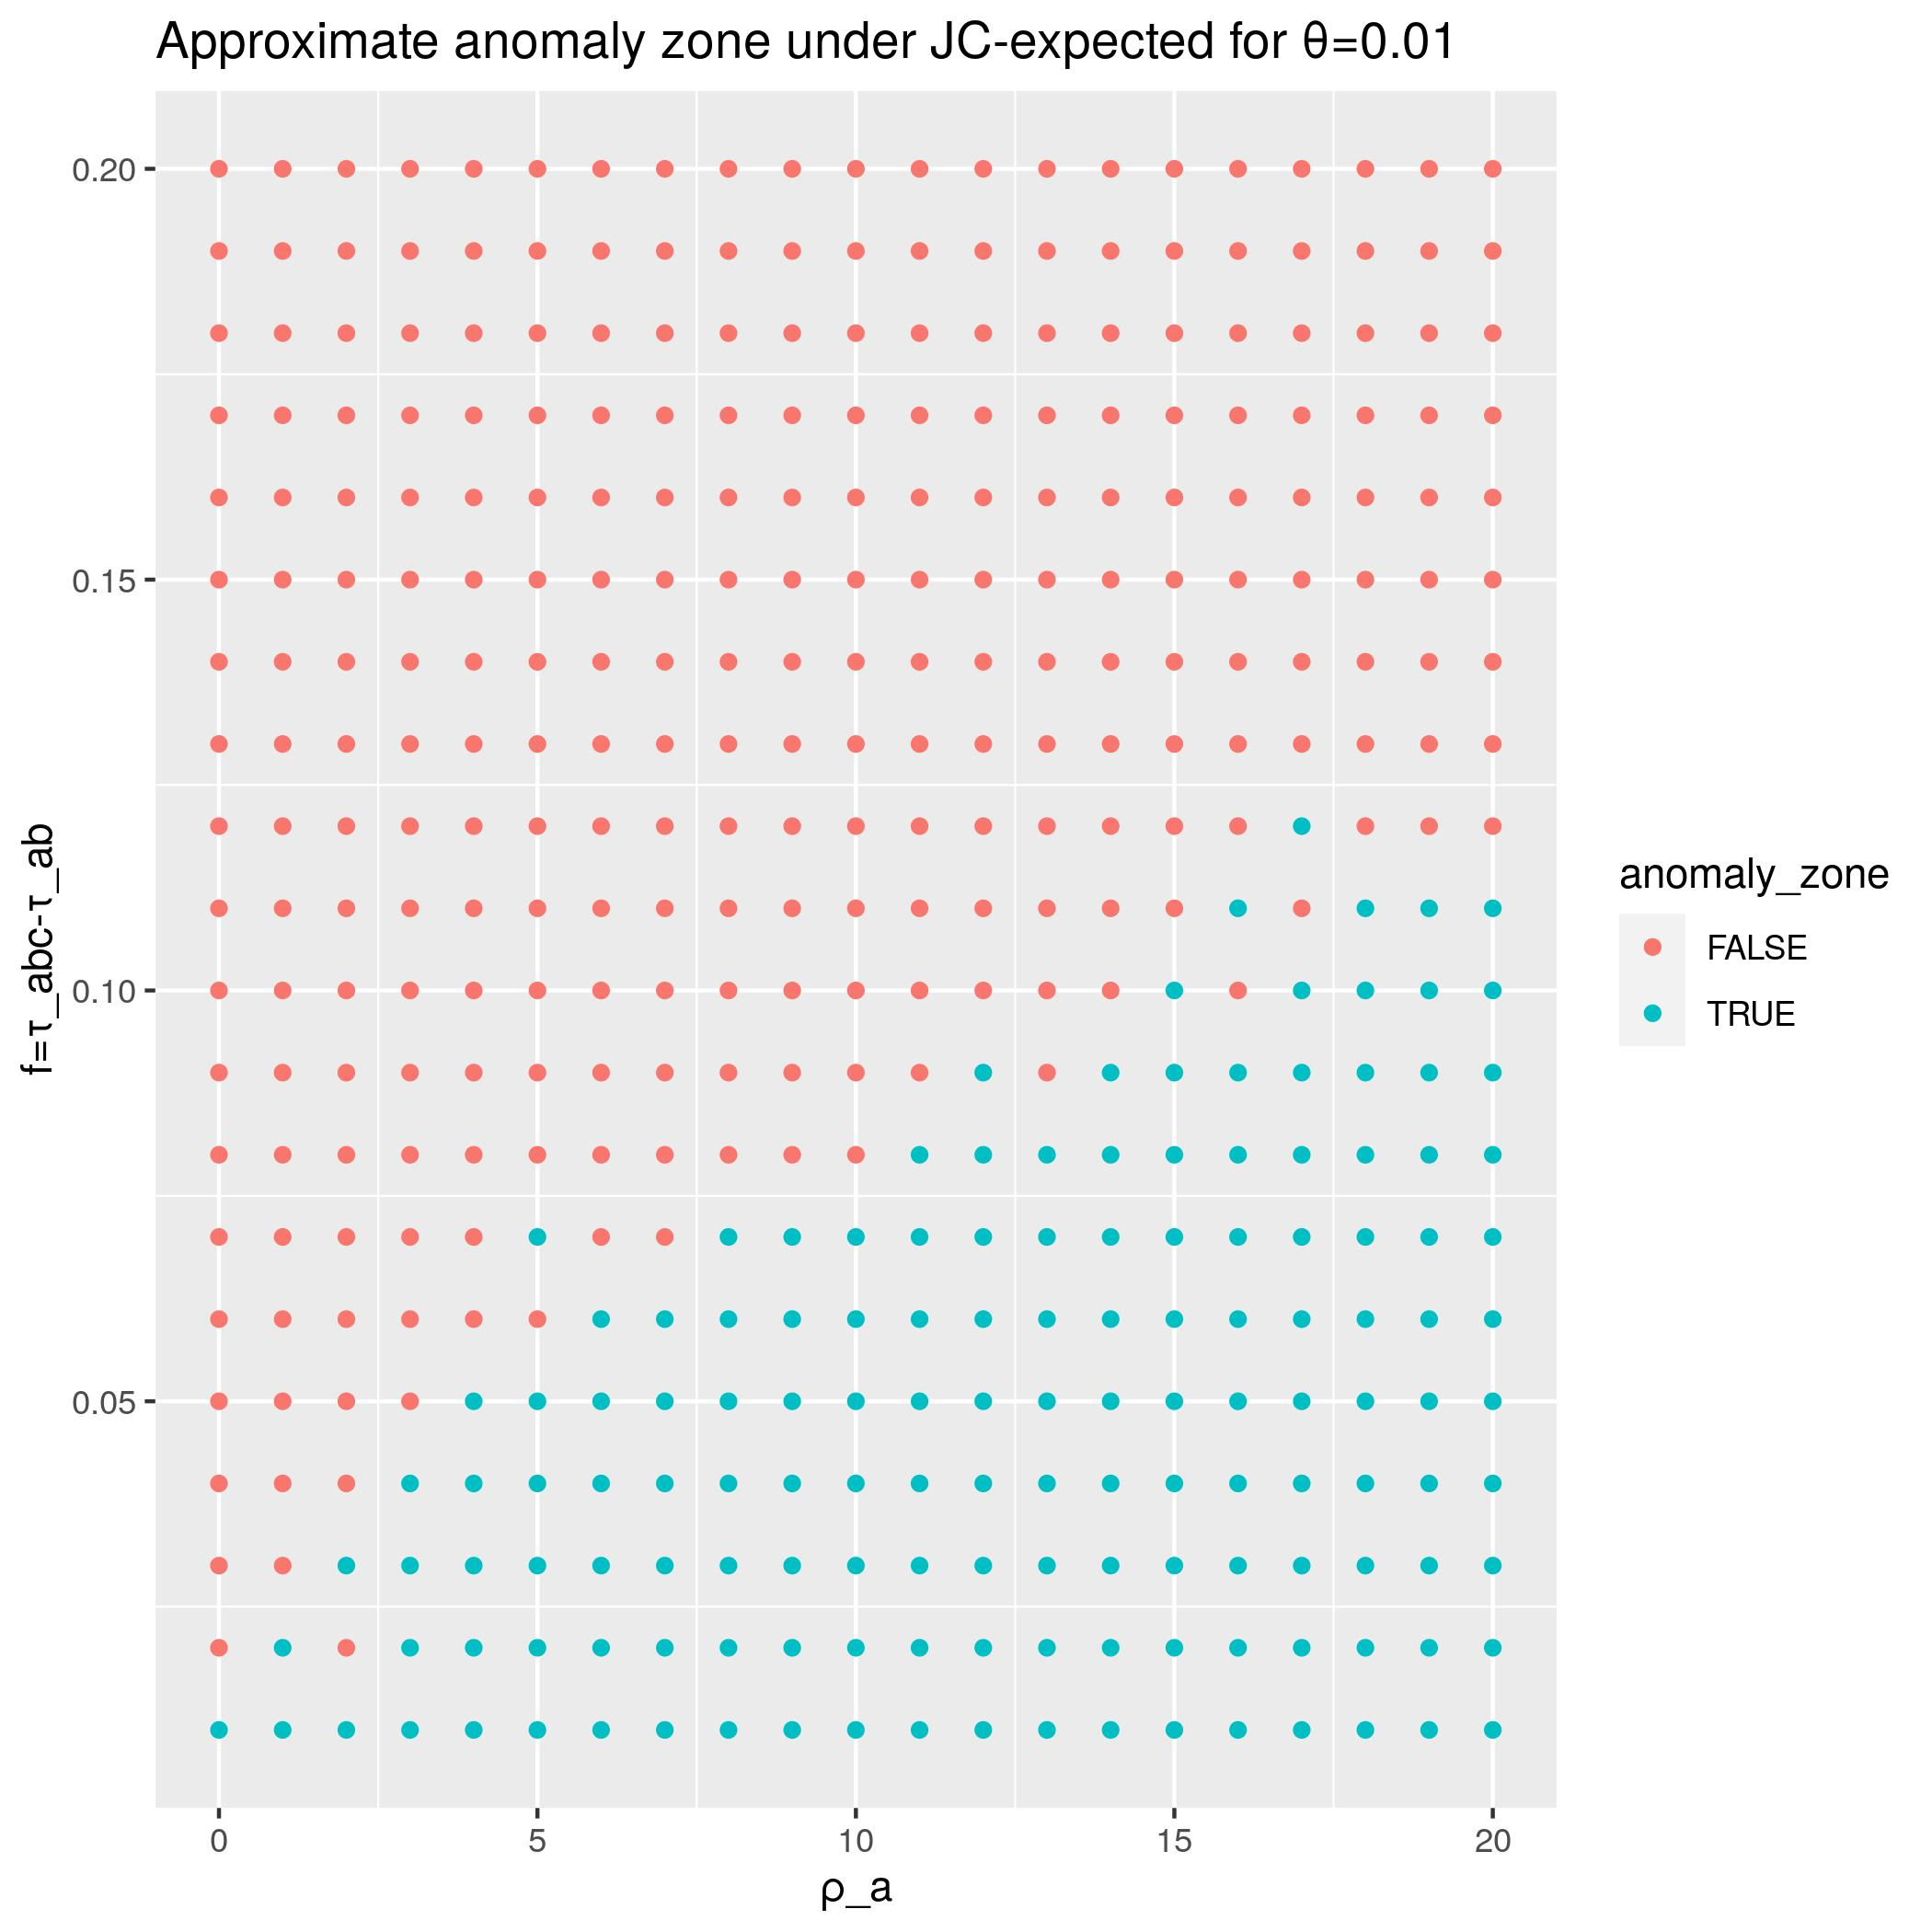
Approach & Results
In this project I simulated genetic data subject to intralocus recombination under various parameter regimes to test 3 different summary tree methods.
There appear to be biologically plausible parameter regimes in which intralocus recombination leads to incorrect inference of the summary methods considered.

Slide 4
Simulation Pipeline
Simulations consist of two parts:
  Part 1: data generation step
  Part 2: inference procedure
Then we evaluate how well the inference procedure performed on the simulated data.

Slide 5
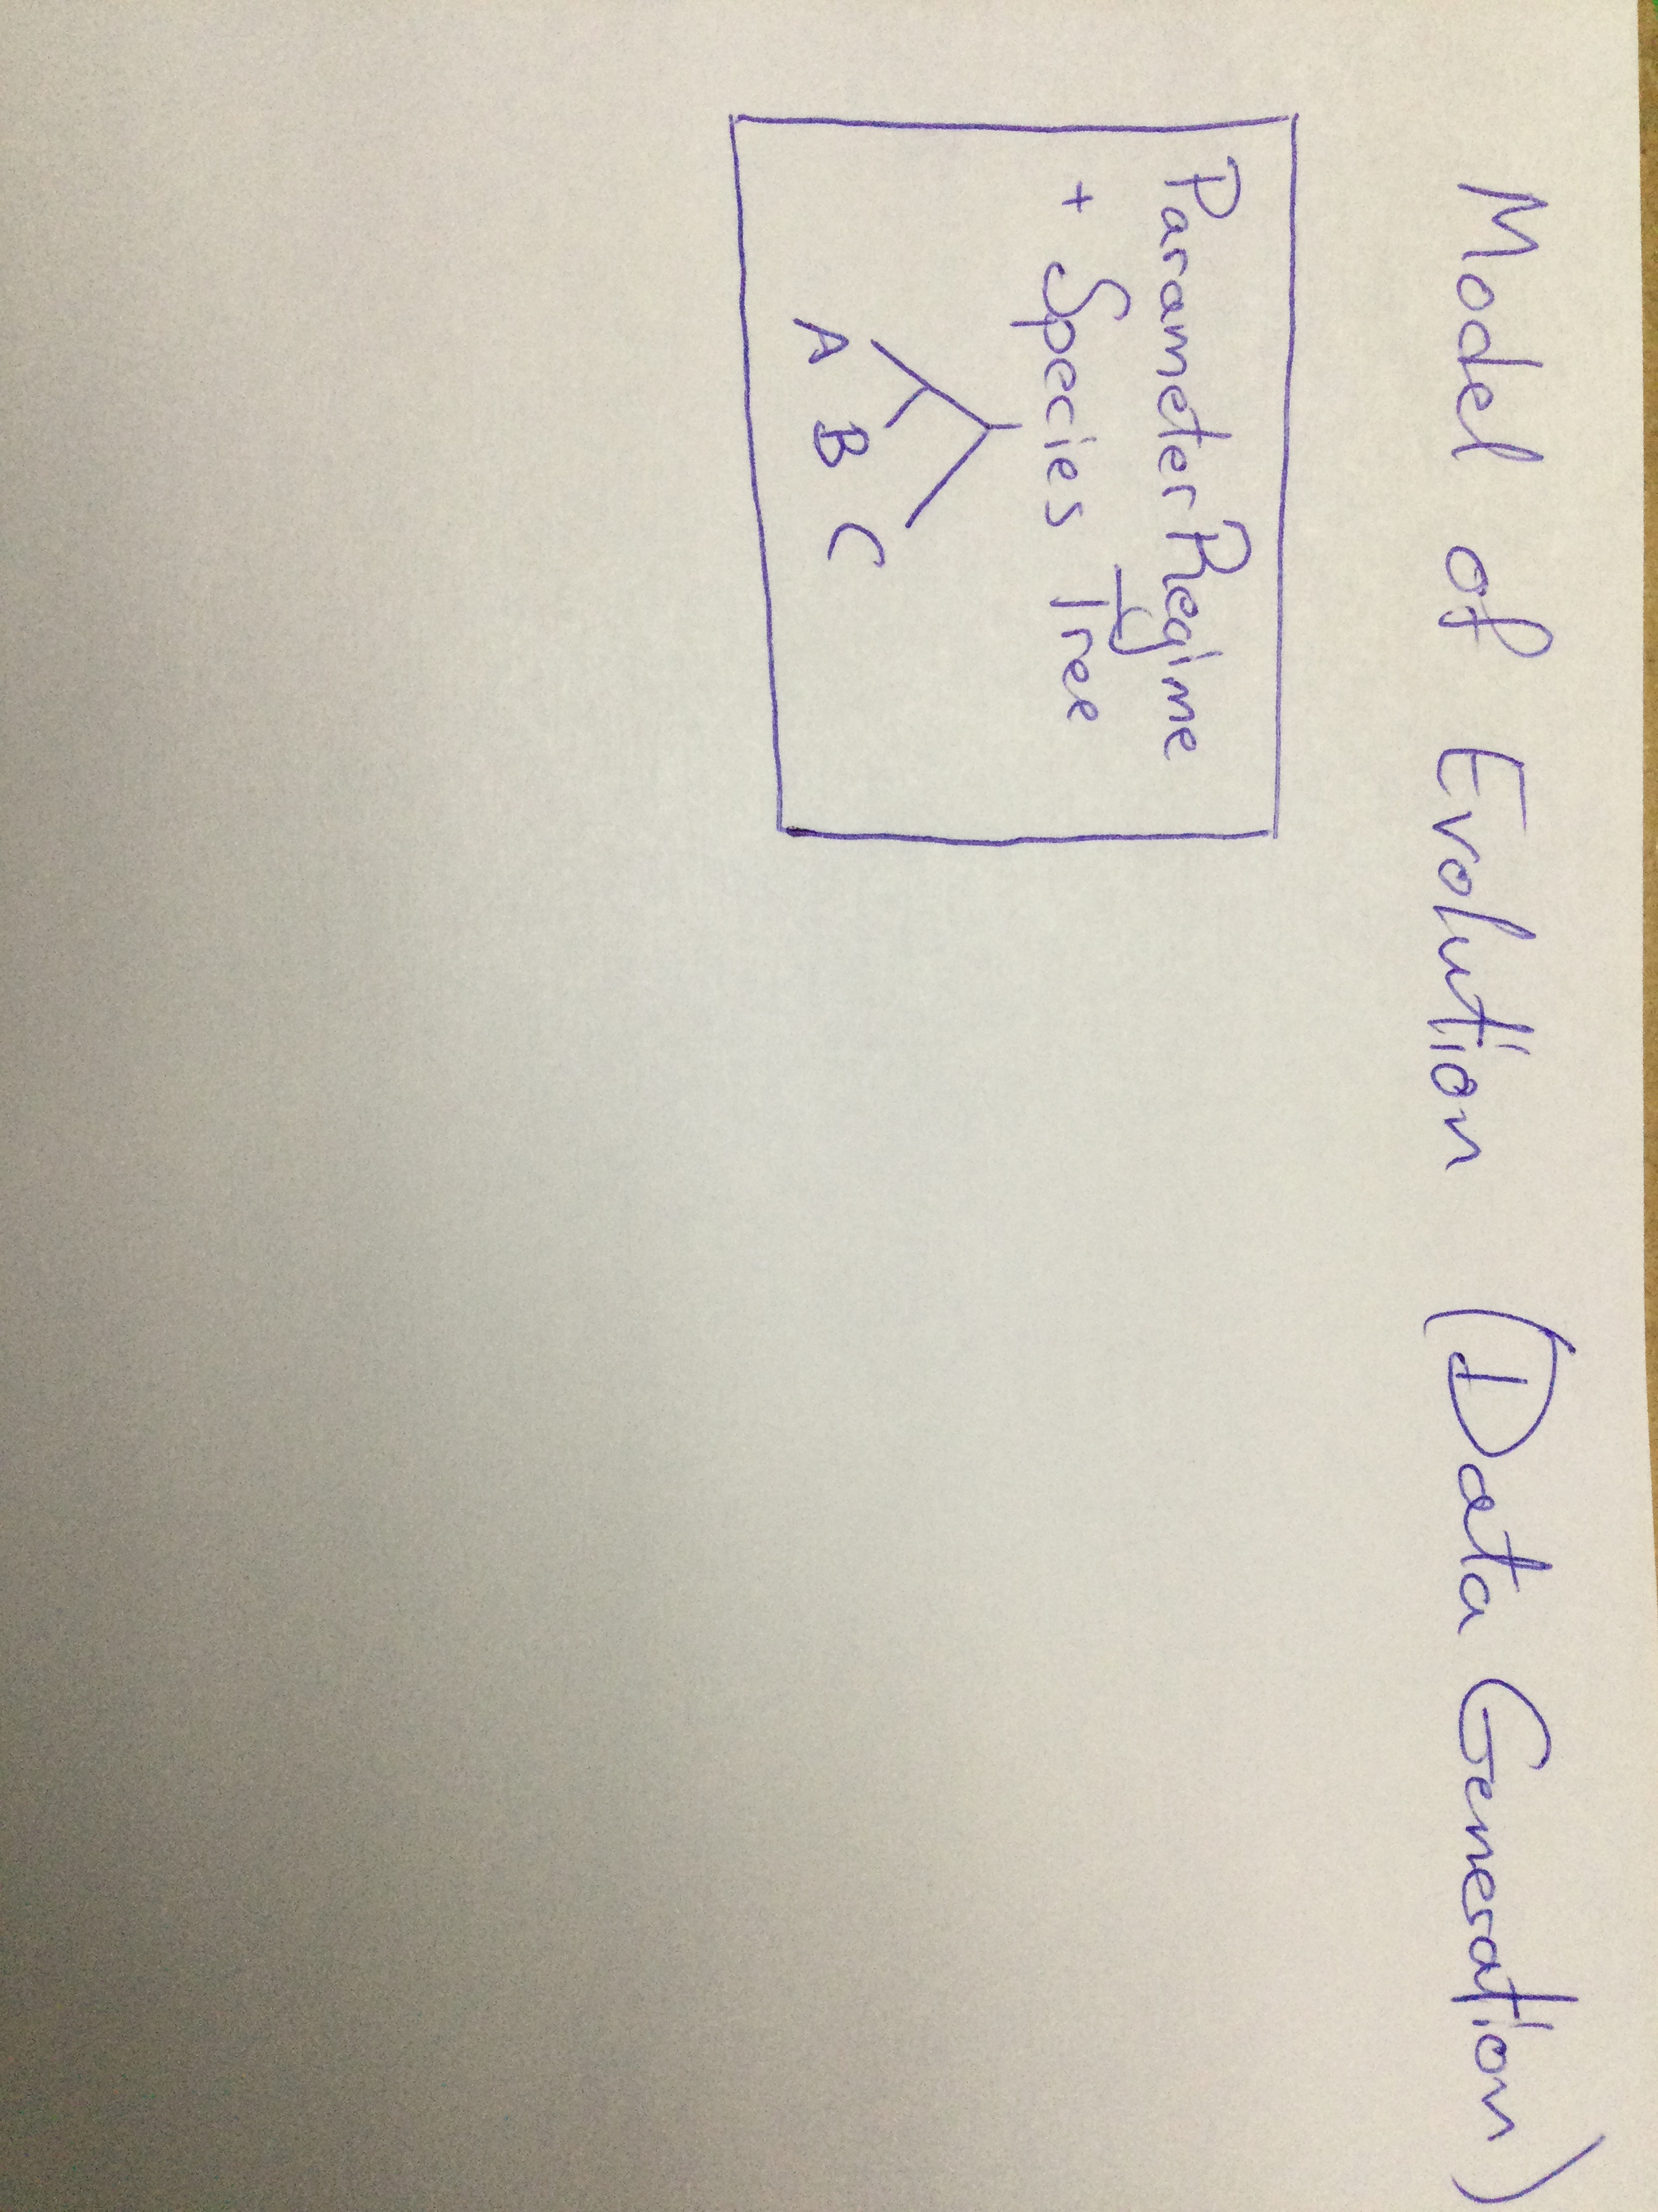

Slide 6
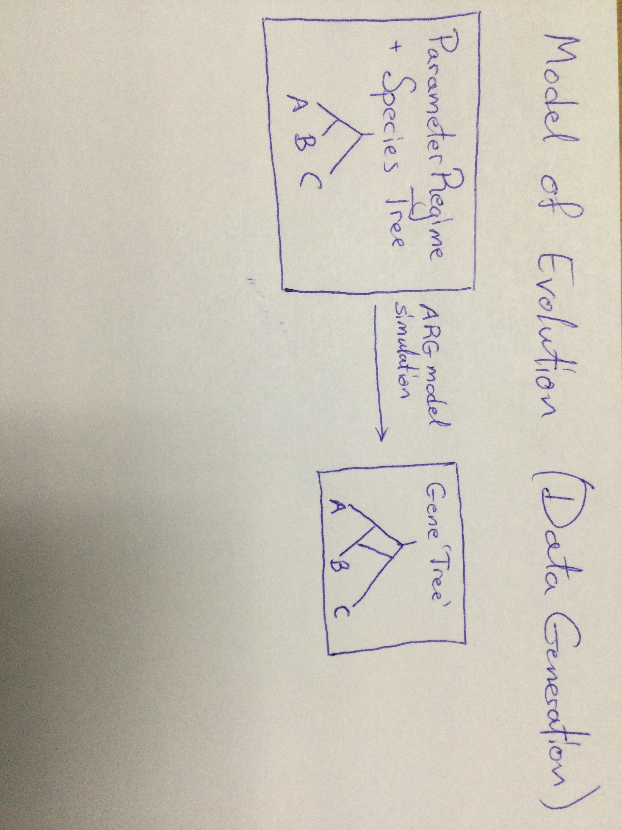

Slide 7
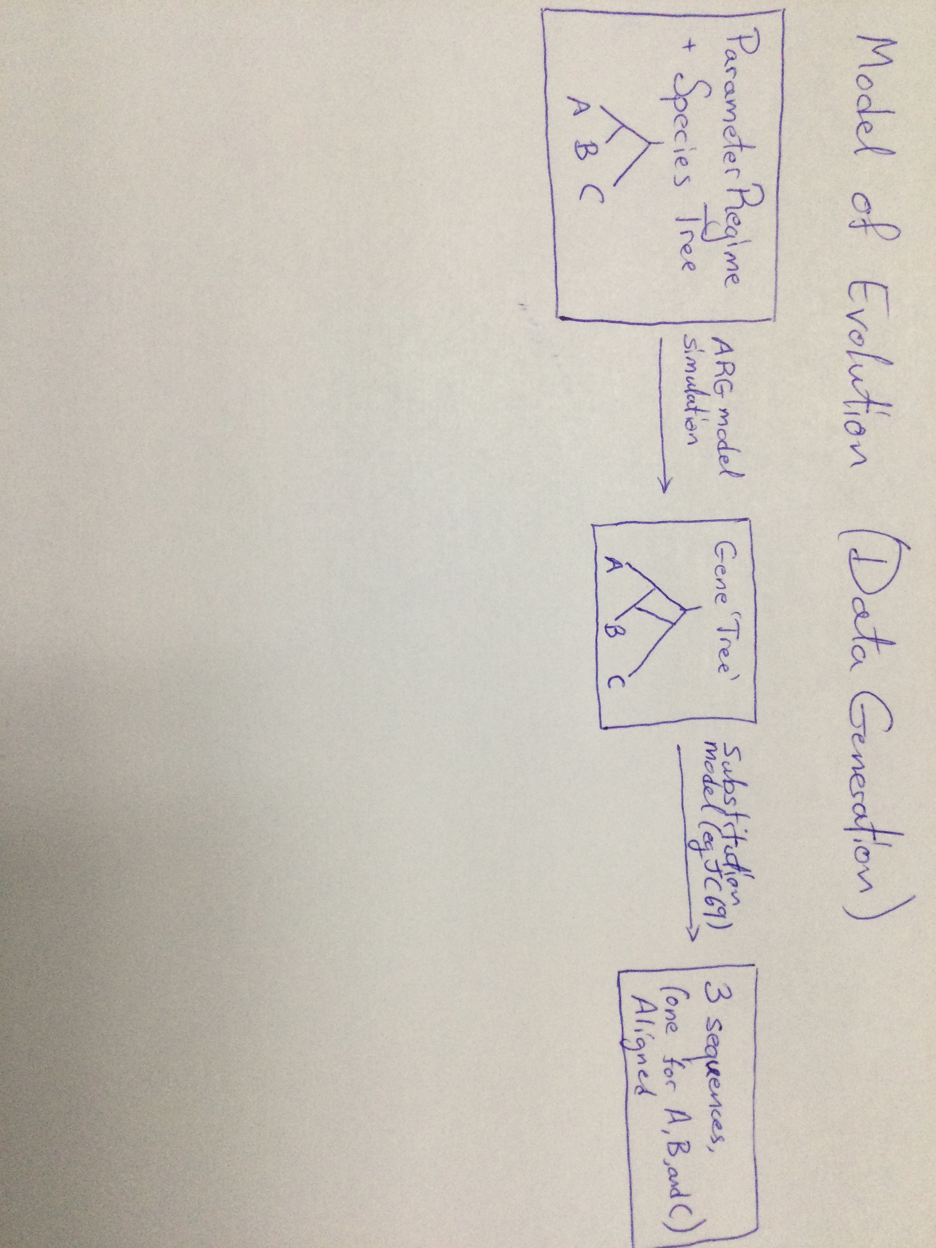

Slide 8
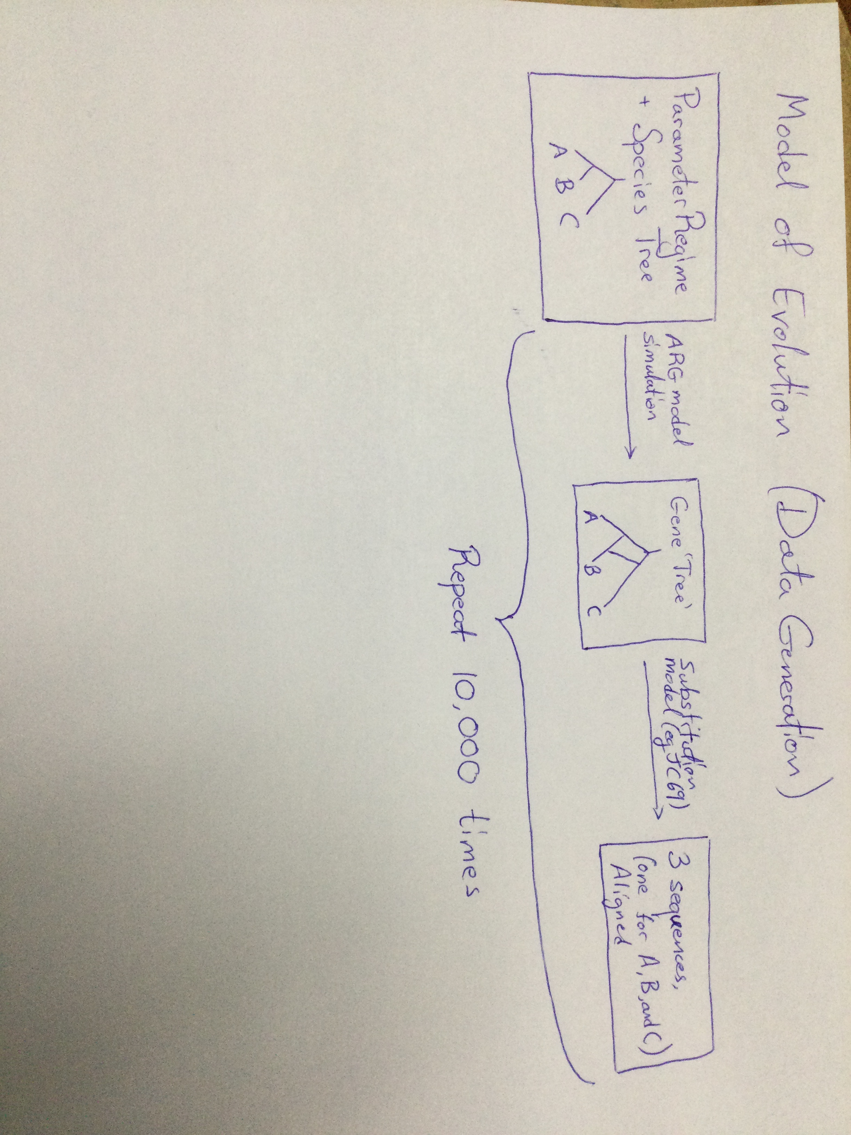

Slide 9
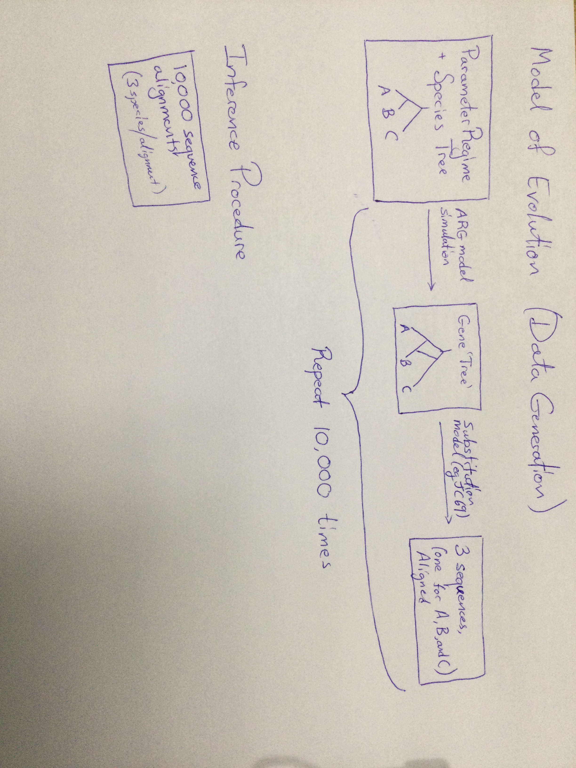

Slide 10
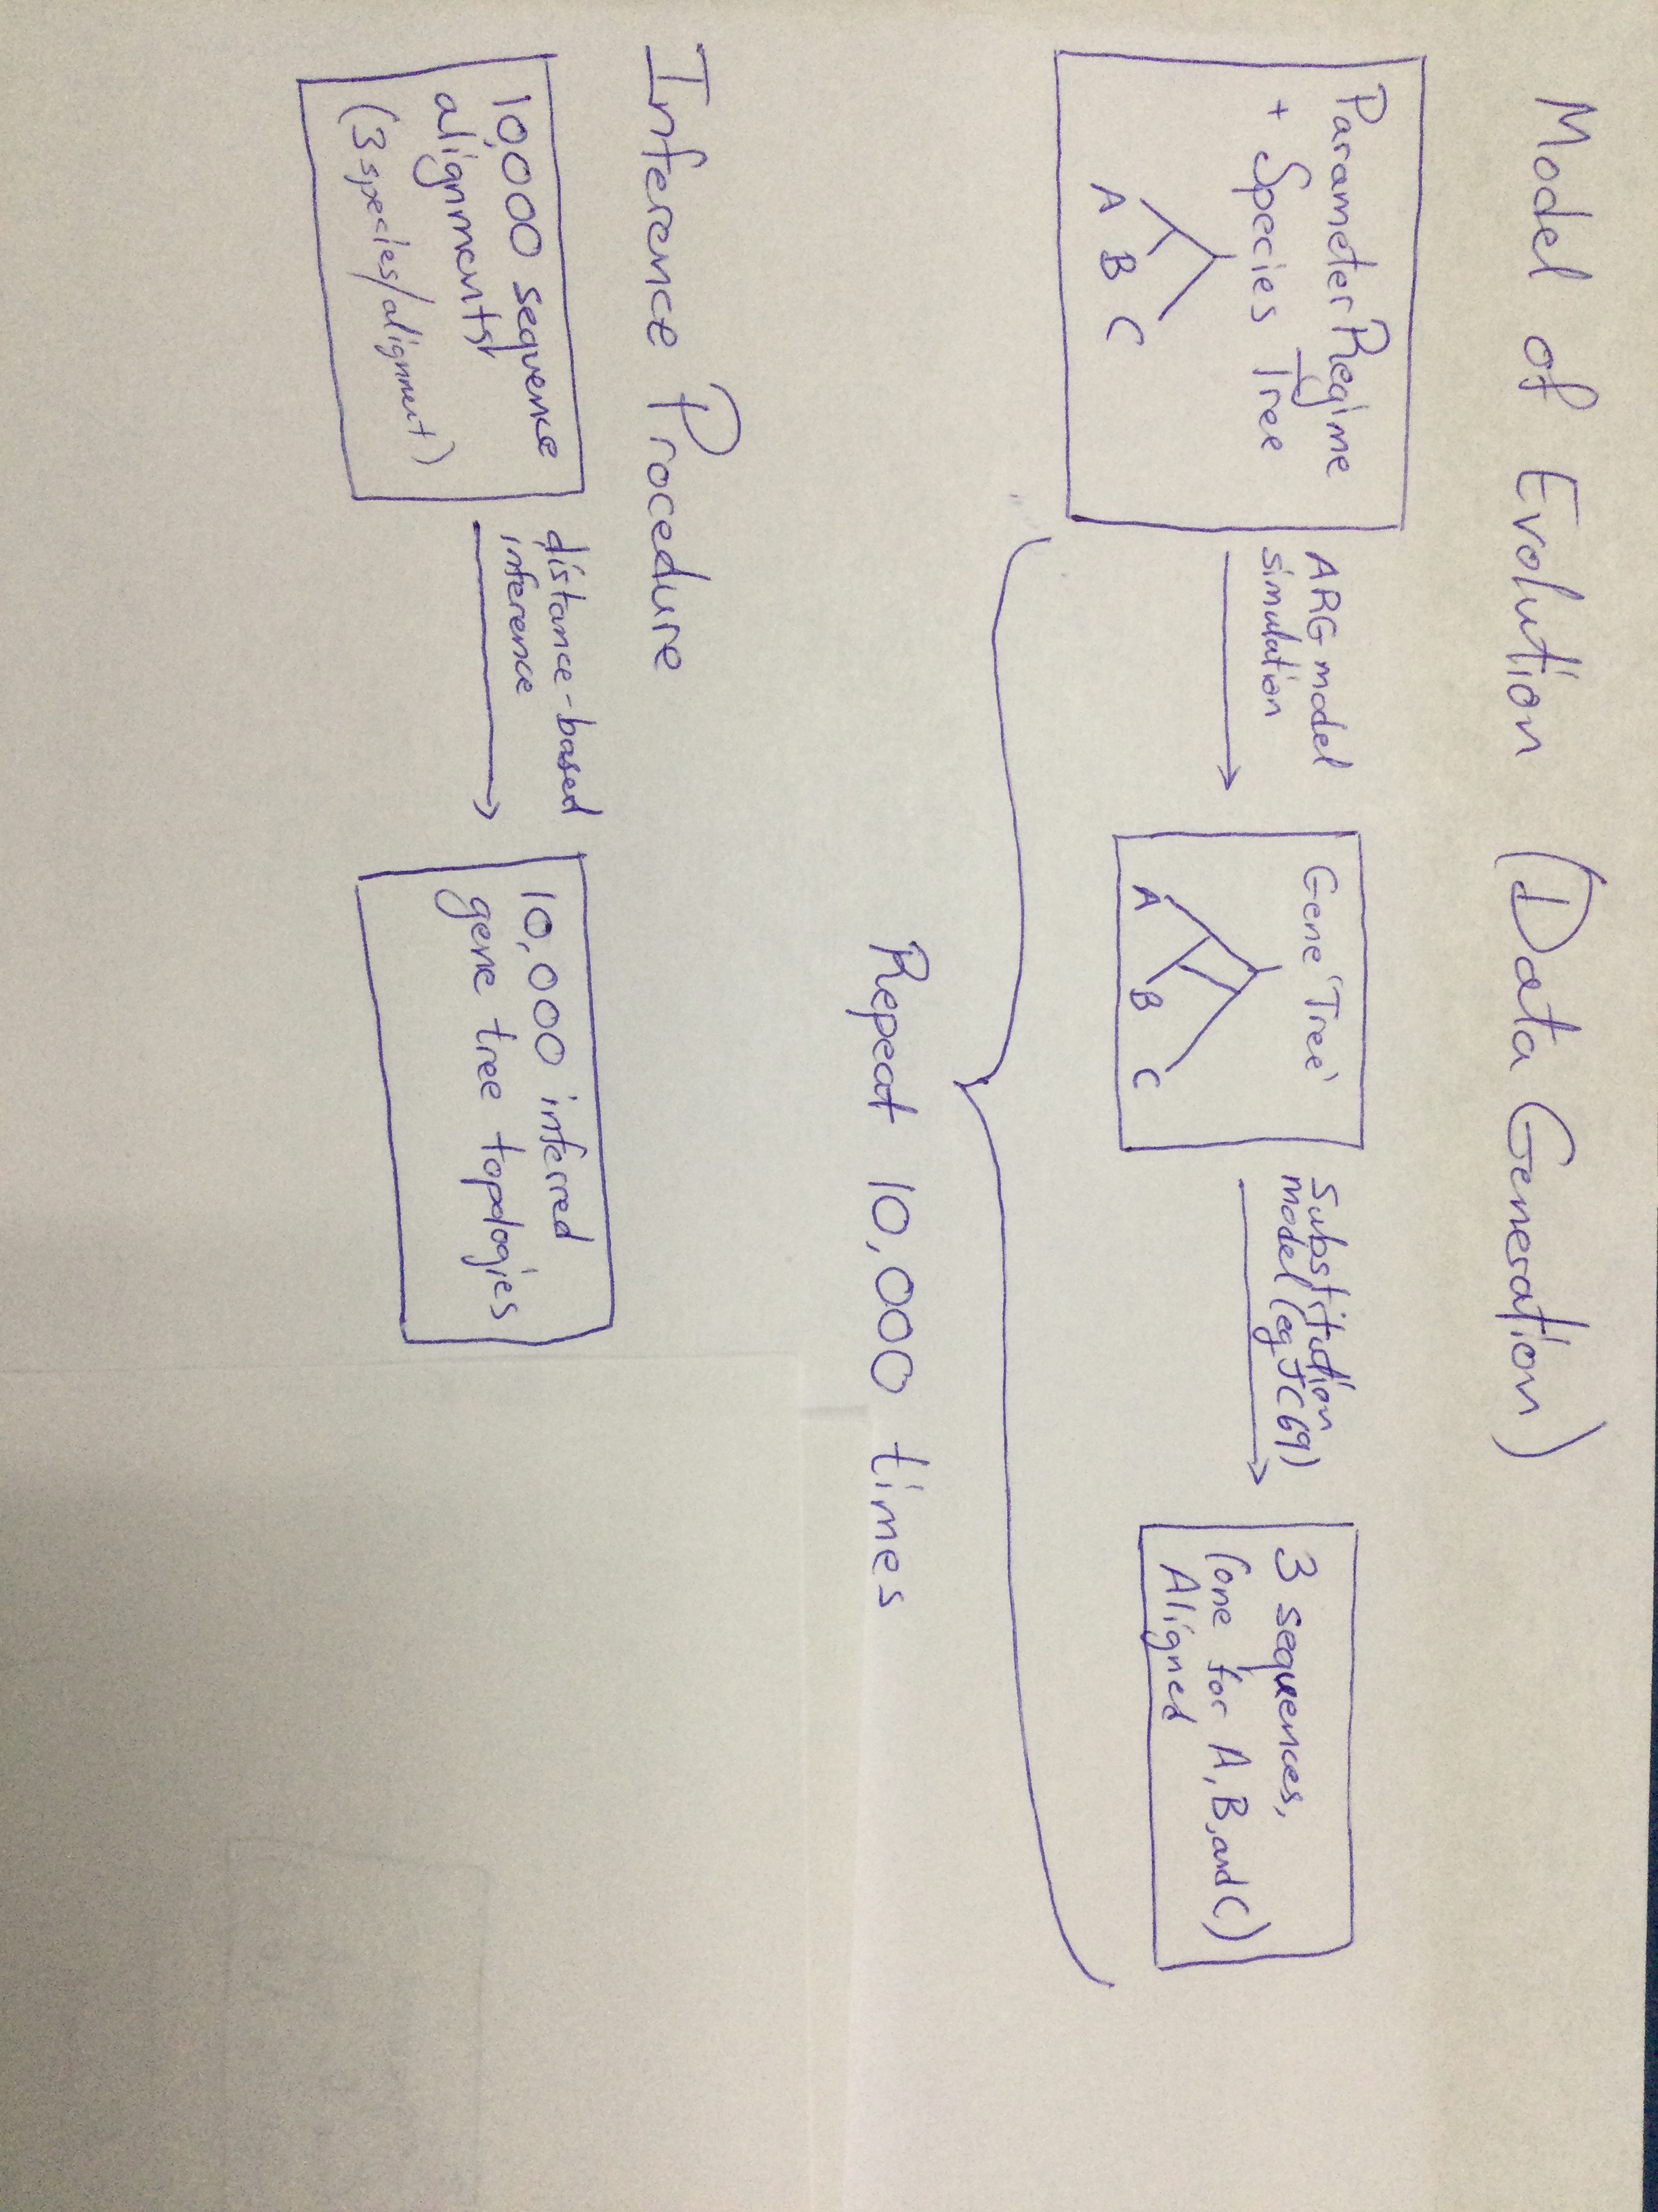

Slide 11
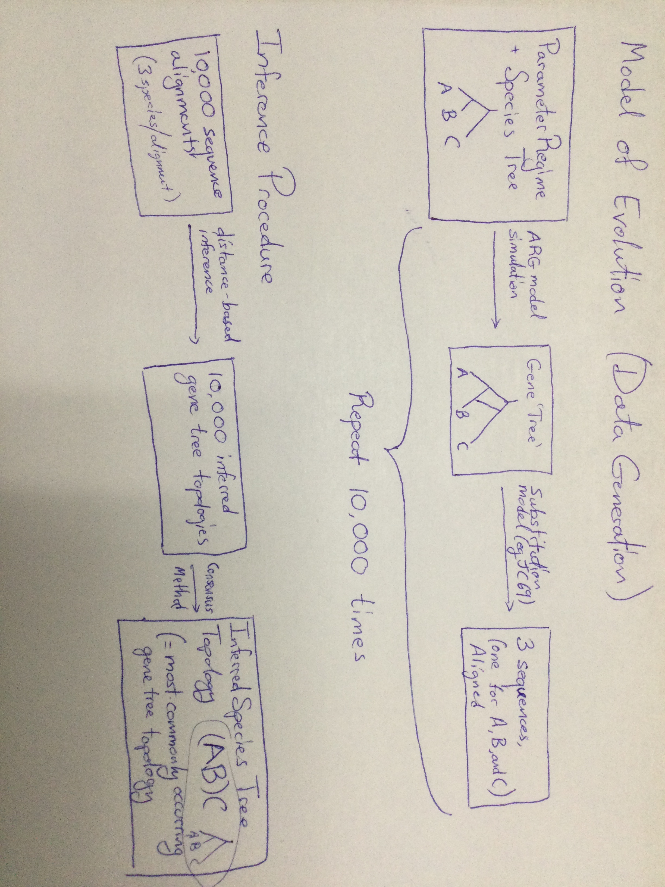

Slide 12
Anomaly zone

