Slide 1
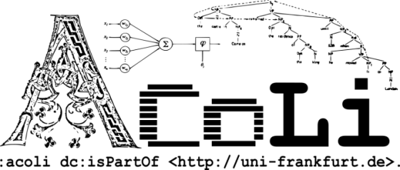




Datathon Miniproject Linking XML corpora
Tutors: Maxim Ionov, Christian Chiarcos
Participants: Sabine Tittel, ...

Slide 2
Corpora and edited works in the Humanities
TEI/XML as a de facto standard
Linked Data in Digital Philology
prosopography ([social] network analysis)
managing cross references
Little to no application of LOD for resource modeling
the lack of convincing prototypes
in this field, XML is likely to stay
Notes:
15 minutes, then hands-on-tasks

Slide 3
TEI and LOD
the relevance of LOD has also been recognized in the TEI community
yet, there is no convenient formalization of semantically typed URI references in the TEI
beyond special-purpose applications (prosopography)
here, experiment with using RDFa for the purpose
preserve TEI spirit and formalization
add LOD

Slide 4
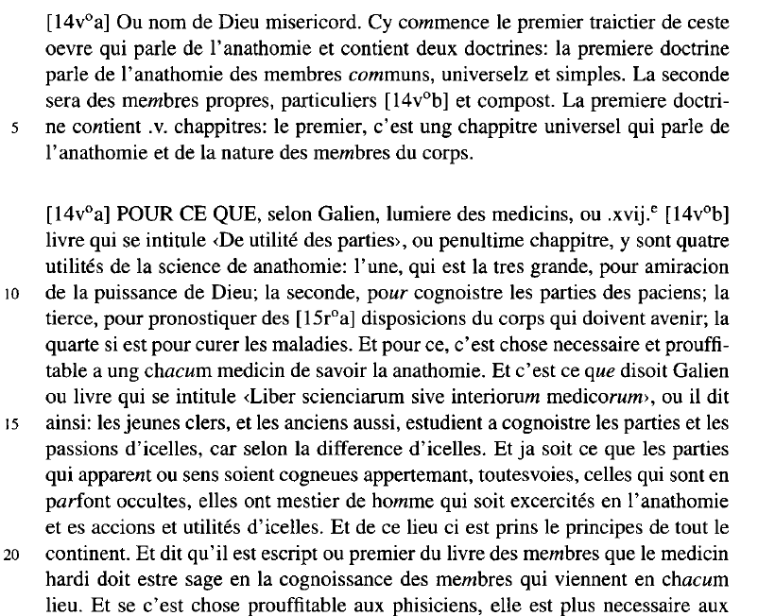
Sample Data: Edition (printed book)

Slide 5
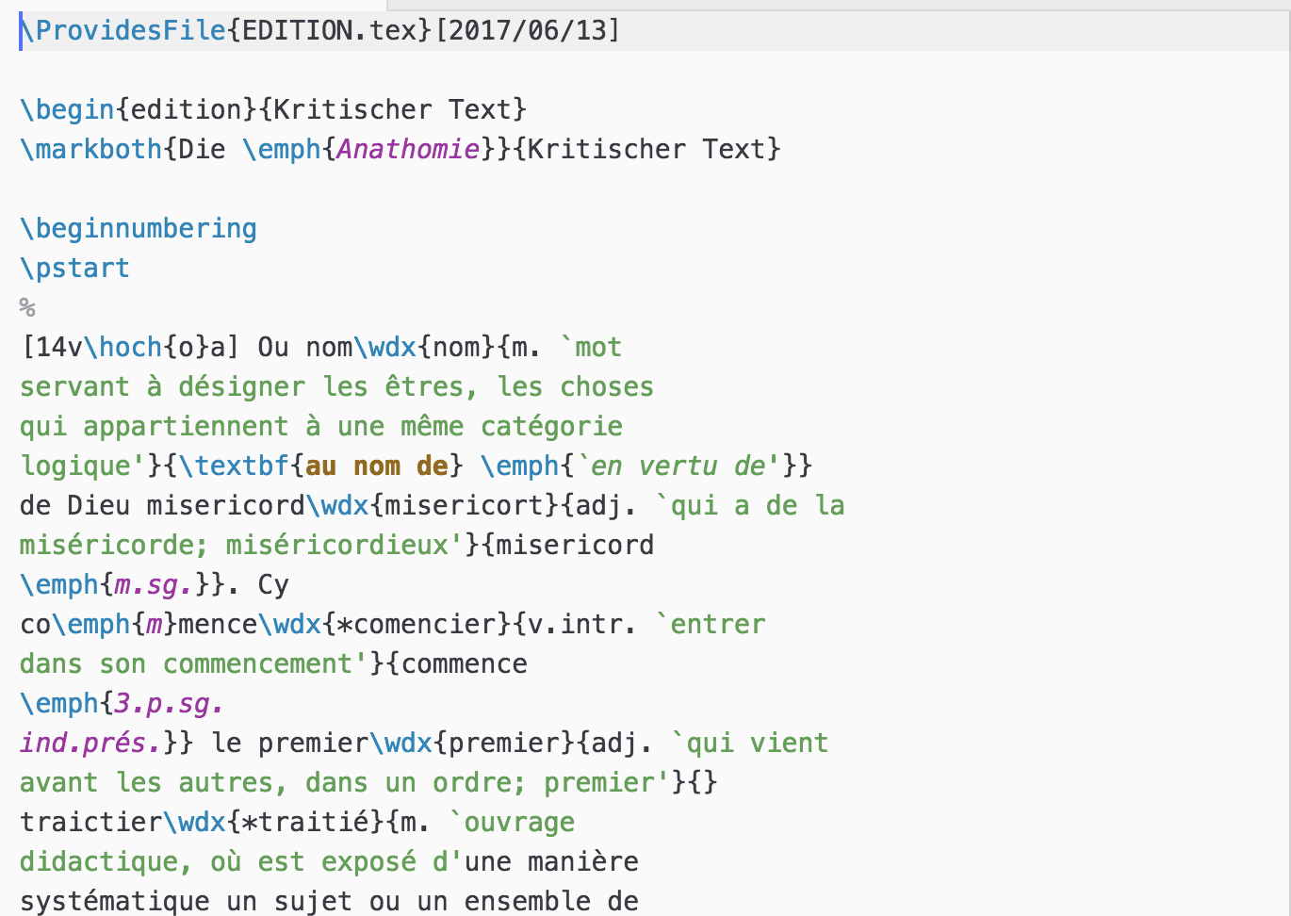
Sample Data: Edition (LaTeX source)

Slide 6
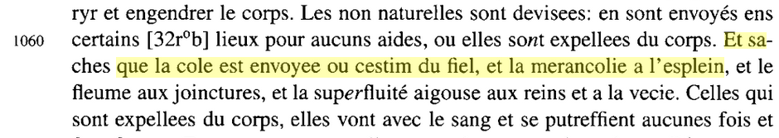
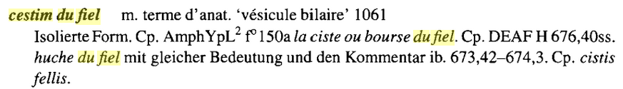
Sample Data: Edition
(snippet of the) edition of the Middle French Grande Chirurgie by Gui de Chauliac (15th c.)
text with glossary (originally typeset in LaTeX)
edited text
sample gloss (\index)

Slide 7
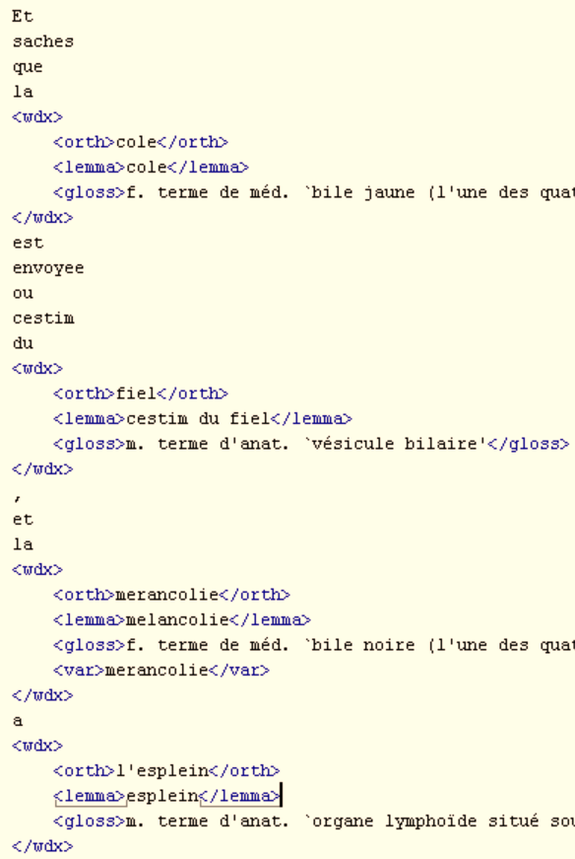
Text edition (Mid. French, 15th c.)
philological edition
primary text
plus in-line glossary
XML
converted from LaTeX sources
one-word-per-line formatting for viewing convenience only

Slide 8
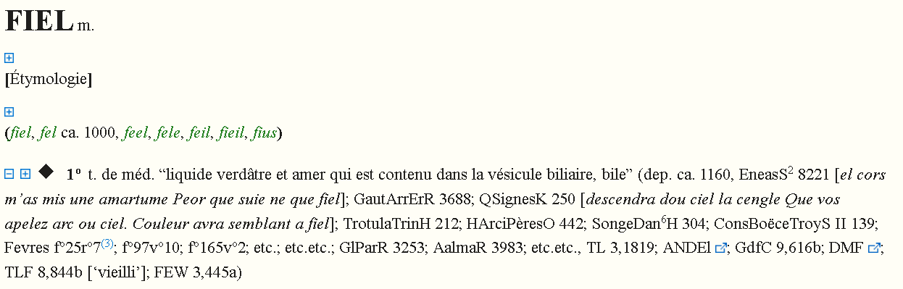
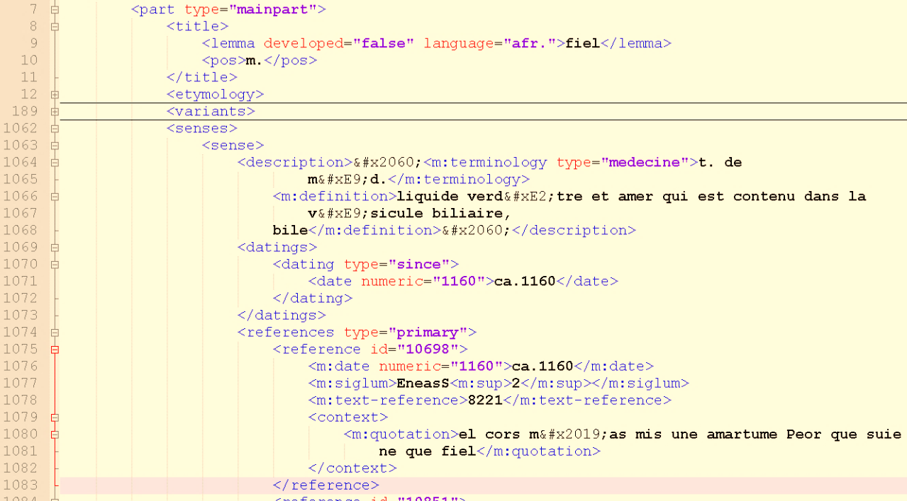
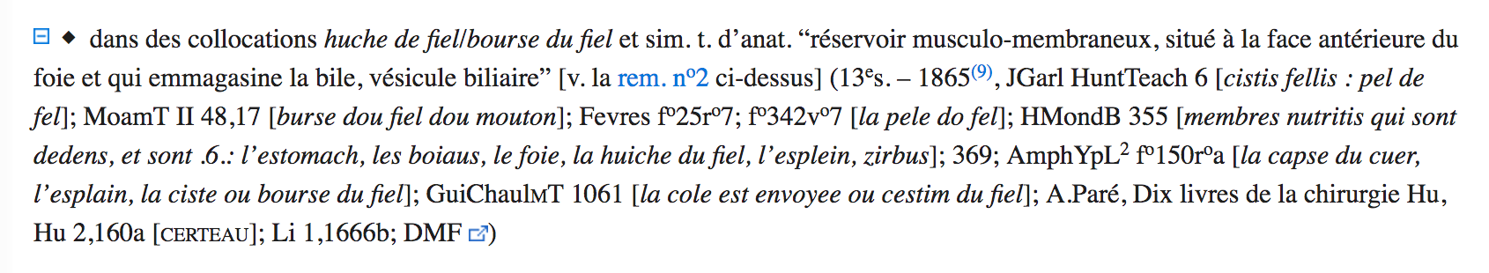
Sample Data: Dictionary
http://deaf-server.adw.uni-heidelberg.de/lemme/fiel

Slide 9
Miniproject
Data:
edition
text
glosses
dictionary
Ultimate goal:
dictionary and glossary as lemon
edited text as TEI/XML
cross-references between edited text (XML) and lemon dictionary
Here:
model for referencing lemon data from the edited text
RDFa+XML
for this and similar datasets
provided by participants

