Slide 1

Thomas SARBONI
DevOps Engineer @GreenCom Networks
For Meritis PACA
System/Cloud administrator and
Python developer since 10 years
https://github.com/max-k
https://www.linkedin.com/in/thomas-sarboni-2b282437/

Slide 3

Introducing Heron on Nomad

Slide 4
0. Why this presentation
We needed a Nomad Intro
Lack of real production usecases
Recent Jerry Peng blog article @Hashicorp
https://www.hashicorp.com/blog/introducing-heron-on-nomad

Slide 5
1. What is Nomad?
1.1 Key features
Cluster management/scheduling
Simplicity
Scalability
Extensibility
Docker support

Slide 6
1. What is Nomad?
1.2.1 VS Kubernetes
Much more simpler
Focused on scheduling
Not limited to Docker

Slide 7
1. What is Nomad?
1.2.2 VS Marathon/Aurora
Much more simpler
Doesn’t rely on external services
Optimistically concurrent scheduling
Multi data-center support

Slide 8
2. What is Heron?
2.1 Main information
Stream Processing Engine
Open sourced by Twitter in 2016
Now in incubation @Apache Software Foundation

Slide 9
2. What is Heron?
2.2 Key features
Simple workflow representation using topologies
Compatible with Apache Storm for easy migration
Compatible with a wide variety of schedulers
Support for main languages like Java and Python

Slide 10
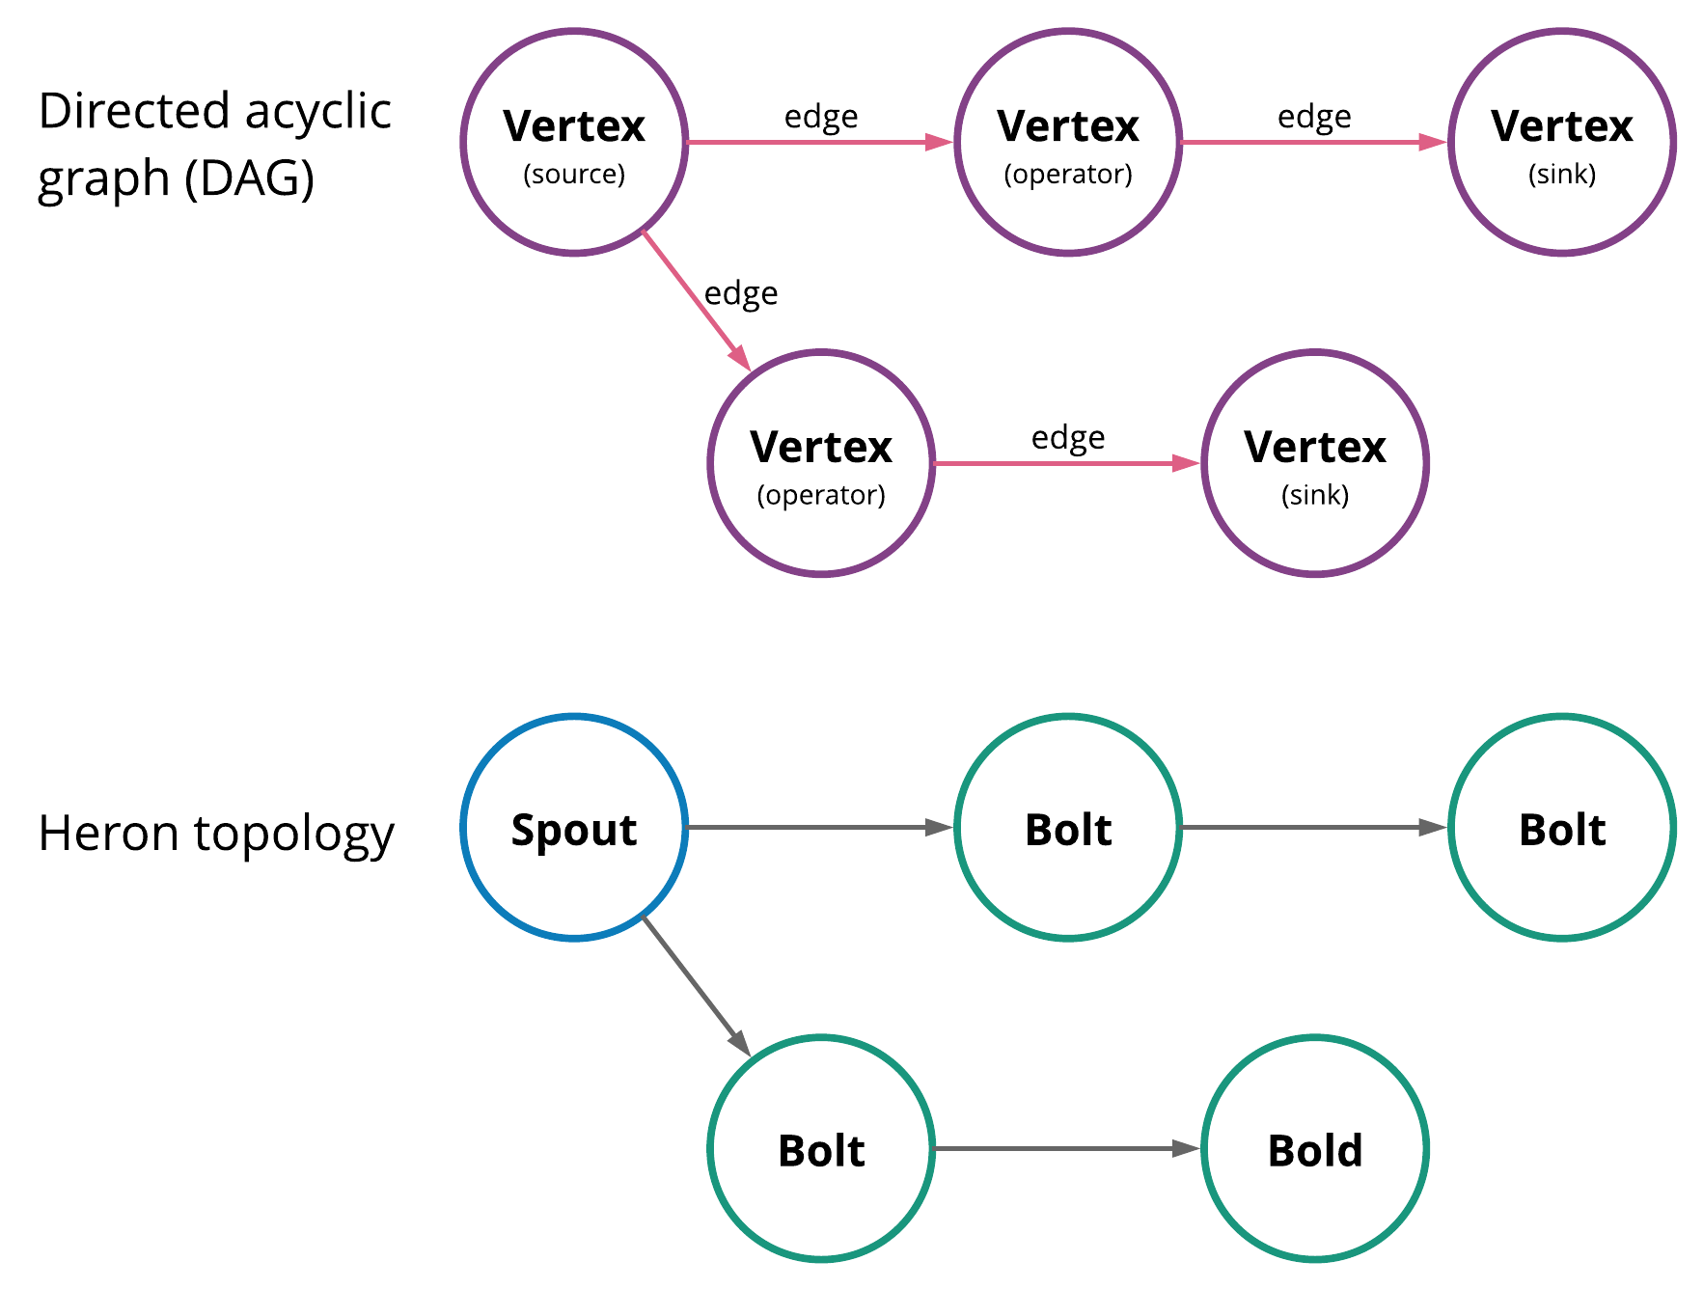
2. What is Heron?
2.3 Topologies

Slide 11
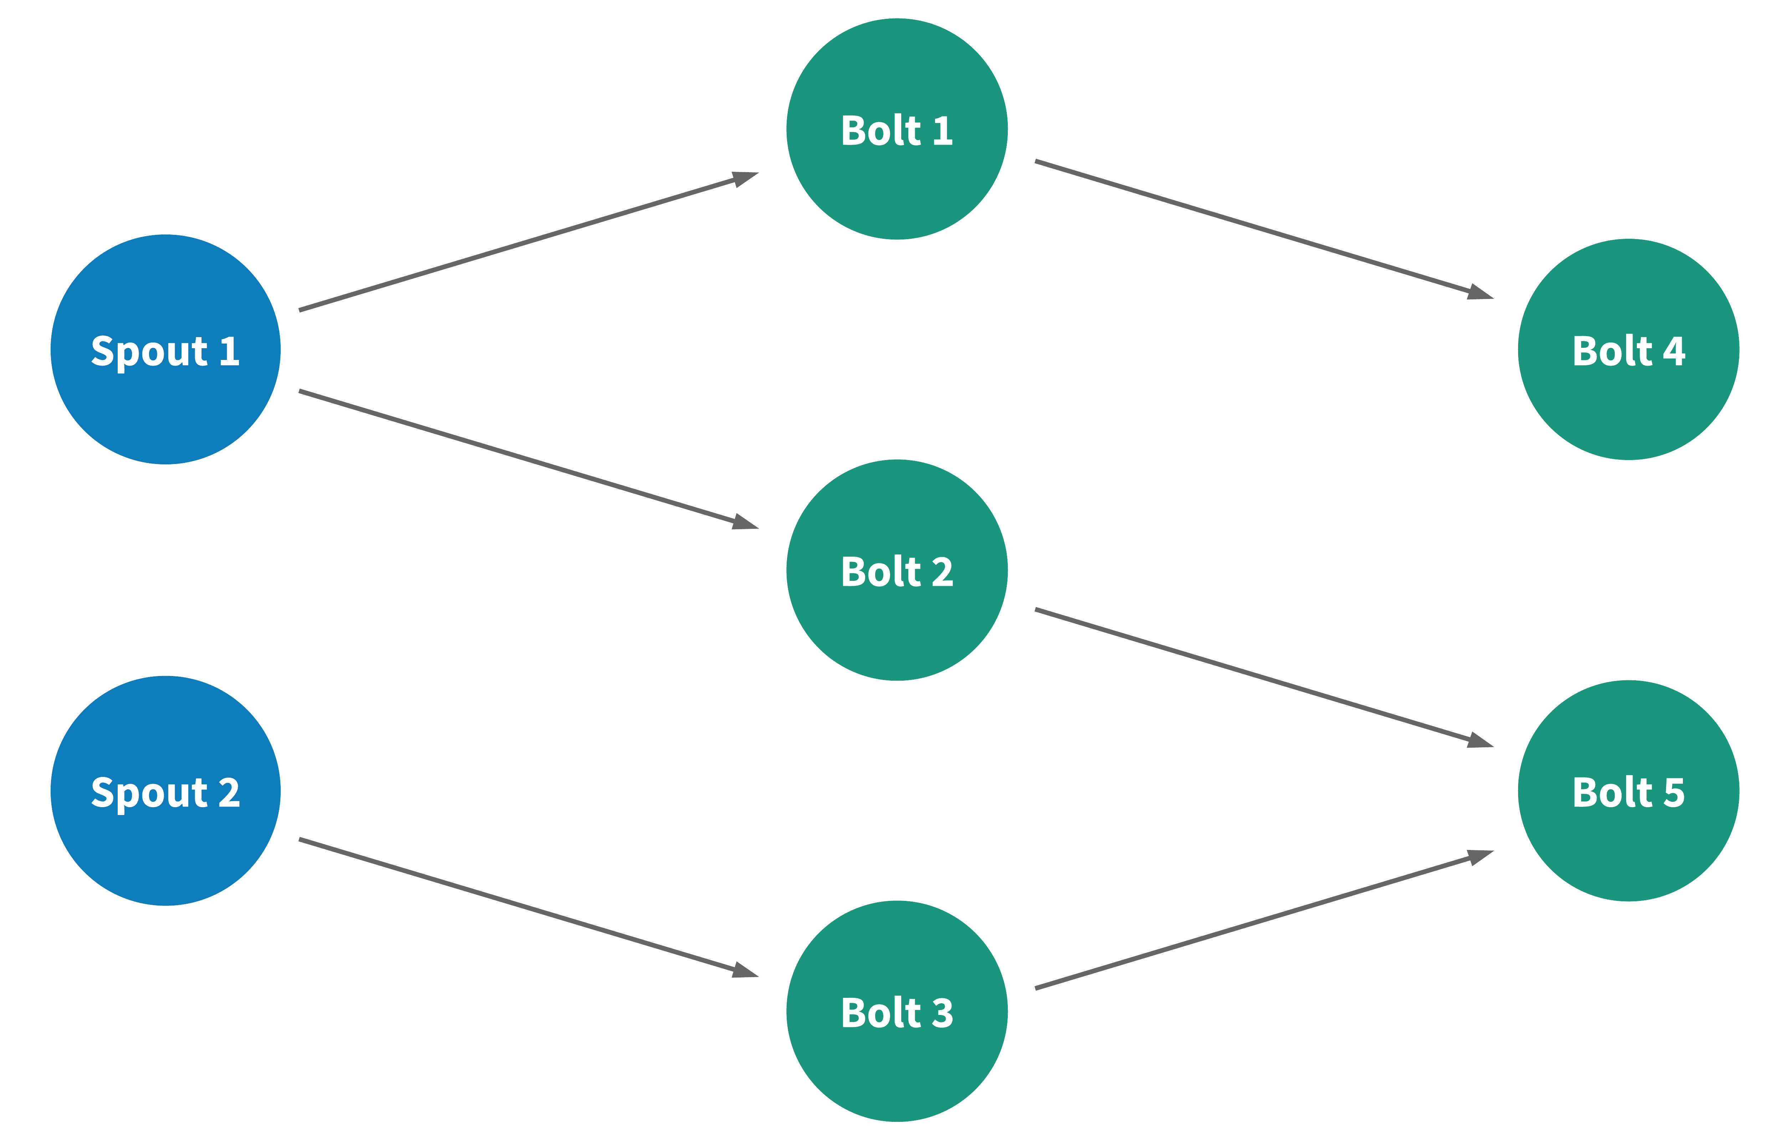
2. What is Heron?

Slide 12
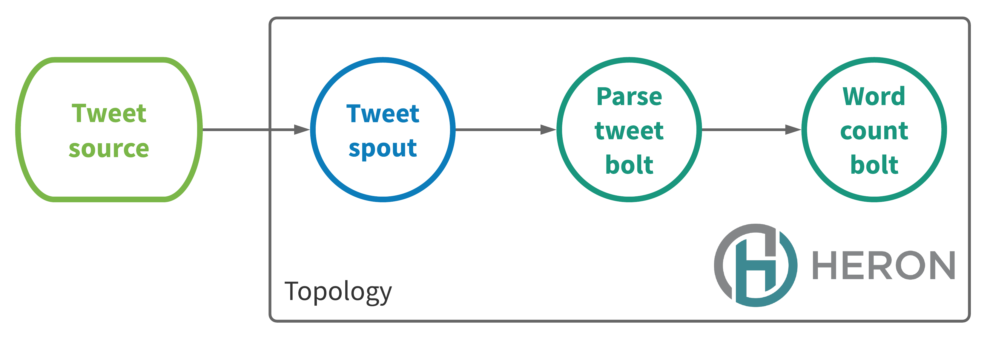
2. What is Heron?
2.4 Word count example

Slide 13
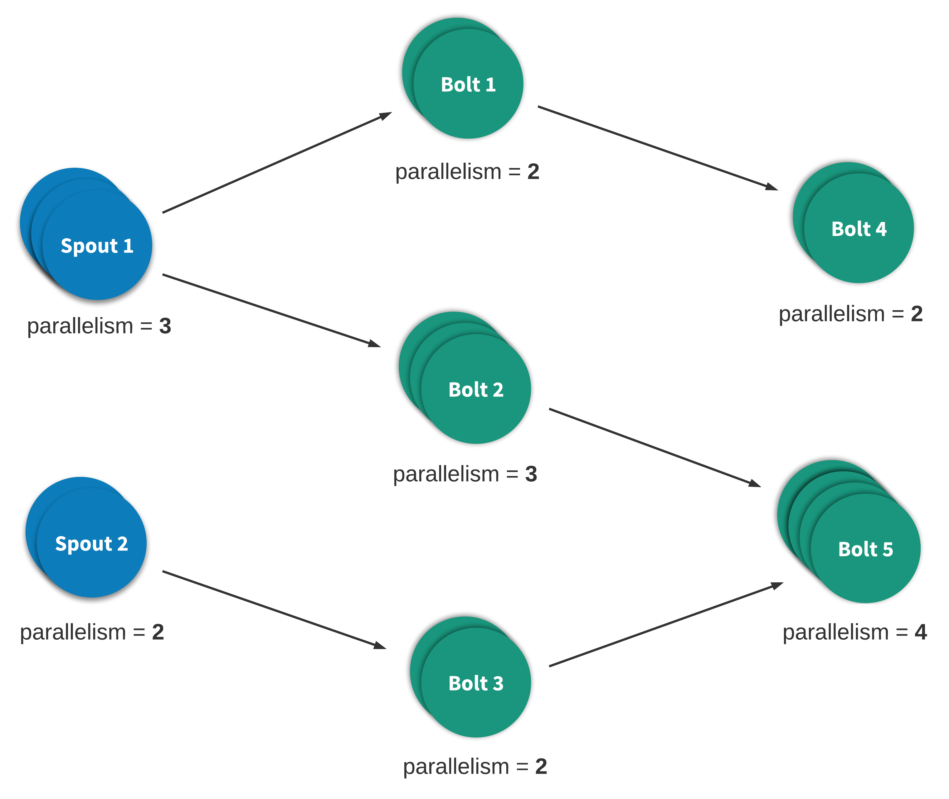
2. What is Heron?
2.5 Parallelism

Slide 14
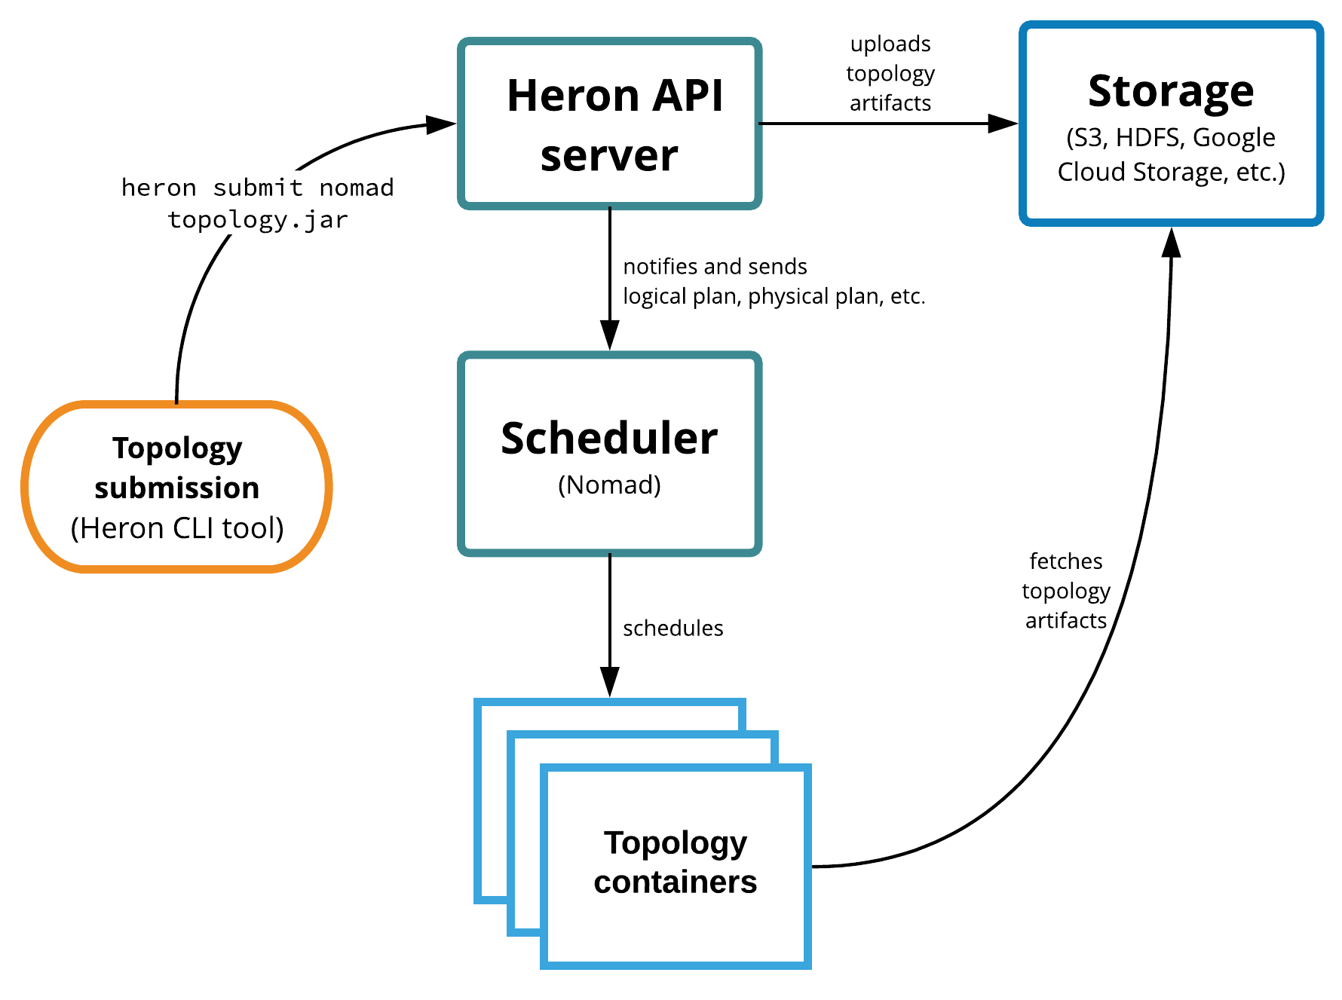
3. Heron on Nomad

Slide 15
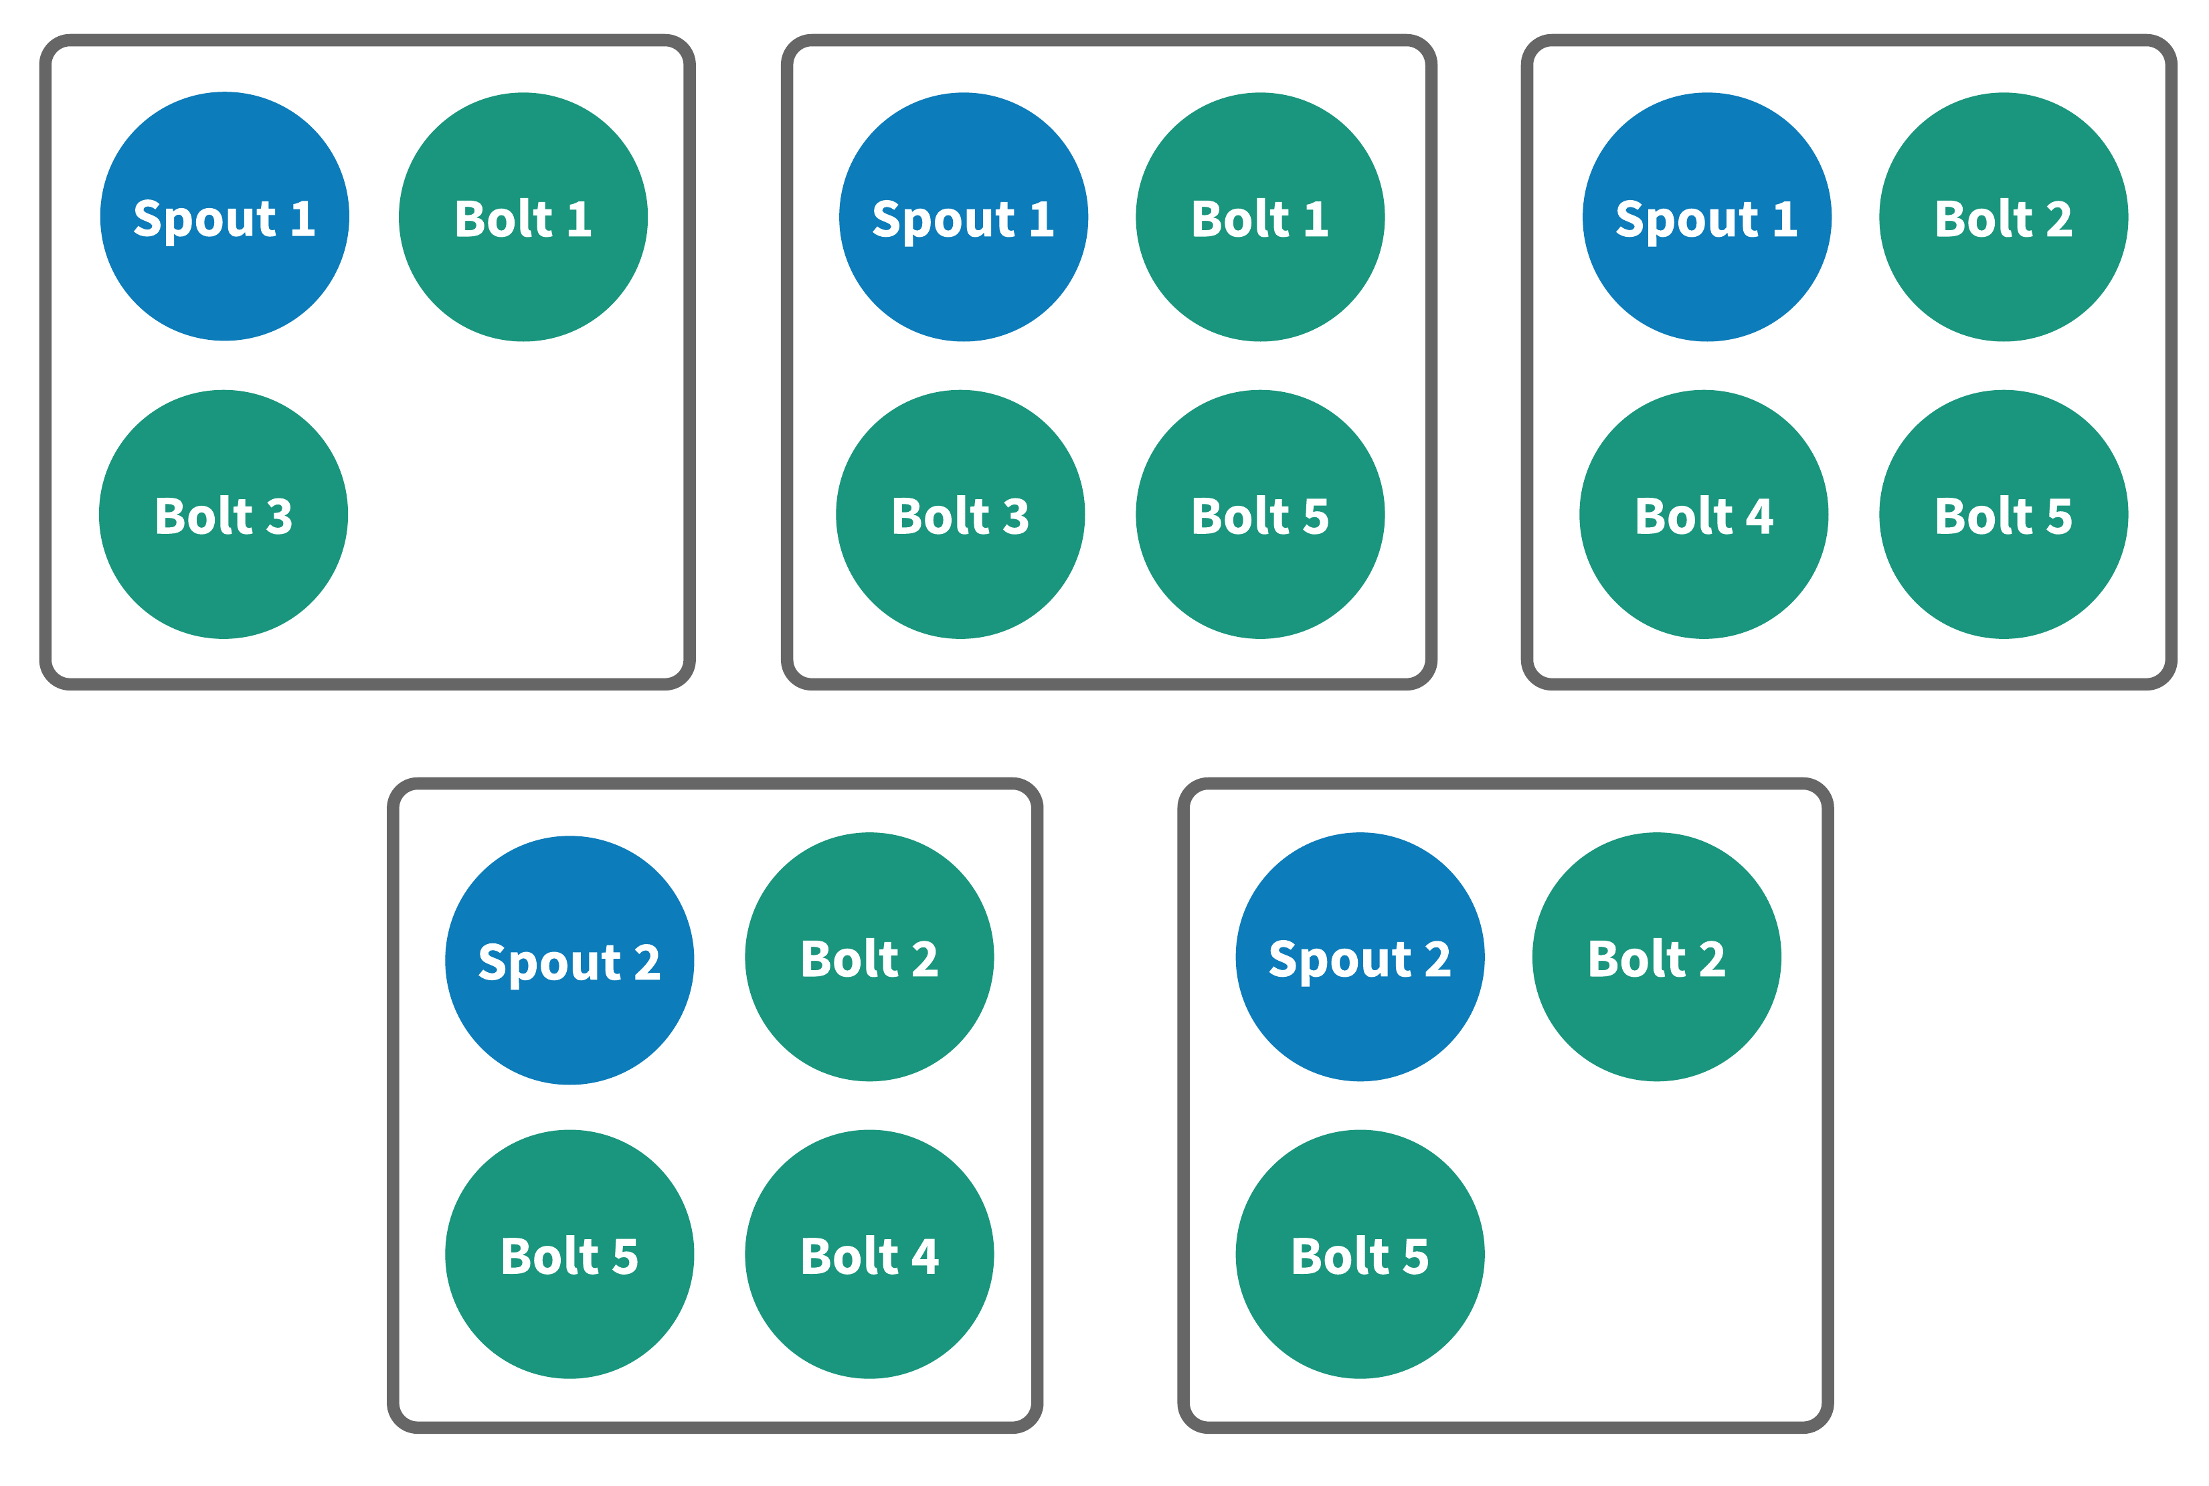
3. Heron on Nomad

Slide 16
3. Demo 0 : Installation
3.1 Global installation
$ mkdir ~/bin
$ export PATH="$PATH:~/bin"
$ cat >> ~/.bashrc < ‘EOF’
[[ -d ~/bin ]] && export PATH="$PATH:~/bin"
EOF

Slide 17
3. Demo 0 : Installation
3.1 Nomad installation
$ wget https://releases.hashicorp.com/nomad/0.8.4/nomad_0.8.4_linux_amd64.zip
$ unzip nomad_0.8.4_linux_amd64.zip
$ cp -a nomad ~/bin

Slide 18
3. Demo 0 : Installation
3.1 Heron installation
$ wget \ https://github.com/apache/incubator-heron/releases/download/0.17.8/heron-install-0.17.8-ubuntu.sh
$ chmod +x heron-install-0.17.8-ubuntu.sh
$ ./heron-install-0.17.8-ubuntu.sh --user
$ ln s ~/.heron/bin/heron-nomad ~/bin/

Slide 19
4. Demo 1 : Local Nomad
4.1 Startup
# Consul prerequisite
$ docker rm -f consul
$ docker run -tid --rm --net host --name=consul consul
# Nomad startup
$ sudo nomad agent -dev

Slide 20
4. Demo 1 : Local Nomad
4.2 First job
# Config file generation
$ nomad job init
# Job run
$ nomad job run example.nomad

Slide 21
4. Demo 1 : Local Nomad
4.3 Status
# Get job status
$ nomad job status example
# Get allocation status
$ nomad allow status -stats xxxxxxxx
$ nomad alloc logs xxxxxxxx redis
# Acces Web UI
$ firefox http://127.0.0.1:4646/ui/jobs

Slide 22
4. Demo 1 : Local Nomad
4.4 First migration
# Patch config file
$ sed -i "s/\(count =\) 1/\1 3/" example.nomad
# Plan migration
$ nomad job plan example.nomad
# Effective migration
$ nomad job run -check-index 13 example.nomad

Slide 23
4. Demo 1 : Local Nomad
4.5 First upgrade
# Patch config file
$ sed -i "s/\(redis\):3.2/\1:4.0/" example.nomad
# Plan migration
$ nomad job plan example.nomad
# Effective migration
$ nomad job run -check-index 37 example.nomad

Slide 24
4. Demo 1 : Local Nomad
4.6 Stop job
# Stop job
$ nomad job stop example

Slide 25
5. Demo 2 : Local Heron
5.2 Web interface startup
# Start web interface (run it in different terminal windows)
$ heron-tracker
$ heron-ui

Slide 26
5. Demo 2 : Local Heron
5.3 Kill topology (before burning you computer)
# Deactivate local topology
$ heron deactivate local test
# Delete local topology
$ heron kill local test

Slide 27
6. Demo 3 : Heron on Nomad
6.0 Start Zookeeper key-value store
# Run zookeeper dependency
$ docker rm -f zookeeper
$ docker run -tid --rm --net host --name zookeeper zookeeper

Slide 28
6. Demo 3 : Heron on Nomad
6.1 Patch configuration
# Patch topology upload configuration (remove S3)
$ cat > ~/.heron/conf/nomad/uploader.yaml < 'EOF'
# uploader class for transferring the topology jar/tar files to storage
heron.class.uploader: com.twitter.heron.uploader.http.HttpUploader
heron.uploader.http.uri: http://localhost:9000/api/v1/file/upload
EOF

Slide 29
6. Demo 3 : Heron on Nomad
6.2 API server deployment
# Run API server
$ heron-apiserver \
--cluster nomad \
--base-template nomad \
--download-hostname 127.0.0.1 \
--heron-core-package-path ~/.heron/dist/heron-core.tar.gz \
-D heron.statemgr.connection.string=127.0.0.1:2181 \
-D heron.nomad.scheduler.uri=127.0.0.1:4647 \
-D heron.class.uploader=com.twitter.heron.uploader.http.HttpUploader \
--verbose

Slide 30
6. Demo 3 : Heron on Nomad
6.3 Change core package download method
# Patch configuration
$ sed -i "s/#\(heron.package.core.*http:\/\/.*\)/\1/" ~/.heron/conf/nomad/client.yaml
$ sed -i "s/\(heron.package.core.*file:\/\/.*\)/#\1/" ~/.heron/conf/nomad/client.yaml

Slide 31
6. Demo 3 : Heron on Nomad
6.4 Topology submission
# Submit local topology
$ heron submit nomad ~/.heron/examples/heron-api-examples.jar \com.twitter.heron.examples.api.WindowedWordCountTopology test
# Kill nomad topology
$ heron submit nomad test

Slide 32
7. Demo 4 : Standalone Heron
7.1 Start cluster
# Run zookeeper dependency
$ docker rm -f zookeeper
$ docker run -tid --rm --net host --name zookeeper zookeeper
# Define cluster members
$ heron-admin standalone set
# Start cluster
$ heron-admin standalone cluster start

Slide 33
8. Cleanup
8.1 Cleanup
# Cleanup
$ rm -rf ~/.pex ~/.herondata ~/.heron ~/bin/heron*

Slide 34
9. What next?
Nomad cluster
Heron standalone cluster

