Slide 1
SCS16 CORE
Zorba Technologies LTD

Slide 2
Typical SoC Methodology
Embedded controller/processor
Partitioning – Into functional modules and sub modules
Local Scope – Implementing the Spec’s articles.
Embedded
micro-controller
Un-Structured
Random Logic
FSM based
Z RBA

Slide 3
Typical SoC Methodology (Cont.)
Designers’ “Tool Box” – FSM’s, data paths, arithmetic, memory
Bursty Nature – A few sub modules are called into action (for a short while) by the same event
Design Stages – Back-end flow after “code-freeze”
ECOs – Bugs discovered after sampling
Z RBA

Slide 4
Methodology Weaknesses (1)
REDUNDANCY
Logic Duplication – Between blocks
Bursts – Logic is idle between events
  Potential Area Loss
Z RBA

Slide 5
Methodology Weaknesses (2)
DESIGN CYCLE TIME
No Concurrency – Between front end design and the back end process
Late Bugs Set-Back – Redoing of the entire back end process
  Delay in Time to Market
Z RBA

Slide 6
Methodology Weaknesses (3)
ECO
Metal ECOs – Only a limited “bug fixing” capability
Changes – All metal layers, Timing closure
“All layers’ ECOs” are just that.
Back End Flow – Needs to be redone
  Time and Money Loss
Z RBA

Slide 7
“IDEAL” Solution
A Programmable Core
(Commercially available from ARM, ARC etc.)
Software Implementation
  Sequential Computation – 1 micro-code engine
  Concurrency – Software developed in parallel with back- end process
  No ECOs – Only Software Bugs (1 mask layer max.)
  However…..
Z RBA

Slide 8
Solution Weaknesses
A Programmable Core
(Commercially available from ARM, ARC etc.)
Responsiveness – speed of reaction to external events
Unpredictable Timing – Compiler and RTOS Dependencies
High cost of ownership
  Impractical Solution
Z RBA

Slide 9
Tread the Golden Mean
Un-Structured
Random Logic
FSM based
SCS16
Responsiveness
Embedded
micro-controllers
Programmability
Z RBA

Slide 10
The Area Gain
SCS16
SCS16
Embedded
micro-controller
SCS16
SCS16
Un-Structured
Random Logic
FSM based
Z RBA

Slide 11
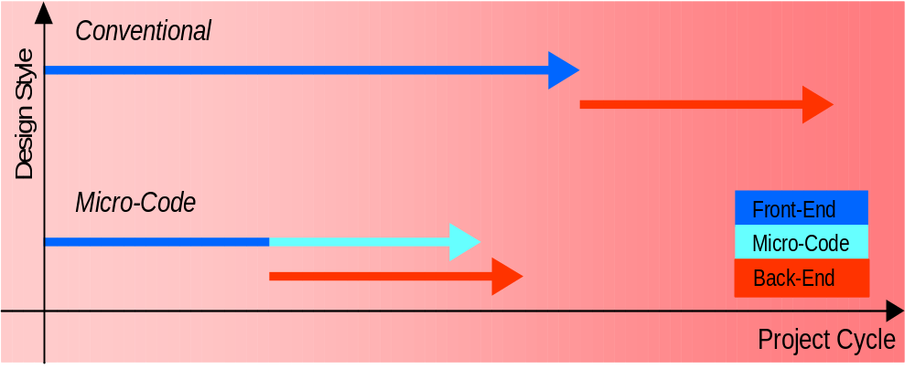
The Design Cycle Gain
Z RBA

Slide 12
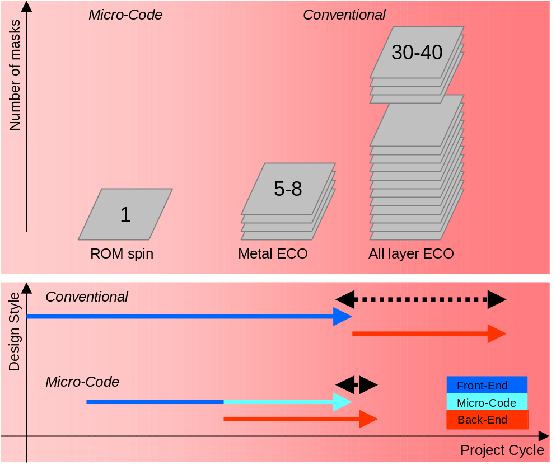
The ECO Cost Gain
Z RBA

Slide 13
Introducing the SCS16
A 16 bit Single Cycle Solution
A Nano Processor
Responsive – Targeted to replace Random Logic, easily triggered by external signals
Predictable Timing – 1 cycle per each code line – no pipe line
Low Cost of ownership
Z RBA

Slide 14
SCS16
SCS16 – An embedded nano controller designed to perform control & networking oriented tasks.
Harvard architecture
Single cycle for all commands, RISC – highly parallel execution.
16-bit ALU; up to 2K instruction and data memory.
2 sets of Eight 16-bit general-purpose registers.
Very low gate count, enables several instantiations on the chip.
Z RBA

Slide 15
SCS16 (Cont.)
SCS16 – Embedded nano controller designed to perform control & networking oriented tasks.
Highly flexible design - enables adding new commands.
ASIC/FPGA integration: vendor and technology independent
Fully synchronous and static design; No internal tri-state buses
C-like syntax.
Compiler and Debugger support.
Z RBA

Slide 16
SCS16 - I/O
Inputs:
c[15:0] – 16 fast sense and react lines for external events
s0, s1 [15:0] – 2 external source buses for data input
1 Interrupt signal
rst, clk
Outputs:
Up to 8x16 bit busses – Reflect registers to external world
p[15:0] – 16 one cycle pulse signals to qualify data output or handshaking
dev bus – 4 x 4bits level outputs to control external devices
c[15:0]
s0[15:0]
p[15:0]
s1[15:0]
dev[15:0]
Z RBA

Slide 17
Sizing & Orientation – 0.13u process
430u
ARM7
engine
IMEM
DMEM
IMEM
DMEM
IMEM
DMEM
331u
294u
264u
SCS16 Engine
SCS16 Engine
SCS16 Engine
Machine | IMEM Type | IMEM Length | DMEM Length | Total Area | Eq logic @80% util
SCS16 | Ram | 512 | 512 | 142Ku2 | 19.5K
SCS16 | Ram | 512 | 128 | 126Ku2 | 17.4K
SCS16 | Rom | 512 | 512 | 113Ku2 | 15.5K
ARM7 | Na | 0 | 0 | 254Ku2 | 35.0k
Naked ARM, no instruction/data memory
Z RBA

Slide 18
SCS16 Applications
MAC and Packet Processing implementations
  Where fast response yet flexibility is a must (standards not stable)
  Can be found in modern Packet Processor chips – Paves the road to the Programmable MAC …
low level control
  Where FSM’s are too much of a “fixed” solution and host software is too big and lazy
Application
Presentation
Session
Transport
Network
software
Data link
firmware
physical
hardware
Z RBA

Slide 19
802.3 Rx process – Architecture view
Data Flow
@(New_Packet(802.3))
To SDRAM IF
REQ Queue
MII
Eth MAC
Eth Framer
classifier/policer
Trash
576 cycles
Accumulate single Eth frame and forward it to next station
Supporting tables/CAMS
Provides services to other units as well
To Host IF
Z RBA

Slide 20
How does it connect to our design ? (1)
Example 1: getting data from fifo’s
Connect the SCS16 as per the following scheme
From within your code use :
  For a burst read :
  burst_store c[1] ram[R7++]=R1=s1 breakif !c[1] pulse-> p1
  For a single read :
  if (c[1]) {
  R1 = s1 pulse->p1
  }
fifo A
not_empty => c[1]
s1[15:0]
fifo B
not_empty => c[0]
s0[15:0]
next <= p[0]
next <= p[1]
Z RBA

Slide 21
How does it connect to our design ? (2)
Example 2: outputting/writing data to an external device
Connect the SCS16 as per the following scheme
From within your code your code use :
  For a burst write :
  loop L_wr L_wr 10
  L_wr, R2=ram[R7++] pulse-> p0
  For a single write :
  if (c[3]) {
  R2 = ram[R7] pulse->p0
  }
p[0] => wr
Optional!, depends upon protocol/device characteristic
device A
R2[15:0] => din[15:0]
c[3] <= ready
Z RBA

Slide 22
How does it connect to our design ? (3)
Example 3: outputting/writing data to multiple external devices
Connect the SCS16 as per the following scheme
From within your code use :
  For a burst write :
  loop L_wr L_wr 10
  device0=> 4’b0001
  L_wr, R2=ram[R7++] pulse-> p0
p[0] => wr
device A
R2[15:0] => din[15:0]
device B
dev0[0] => cs
dev1[0] => cs
Z RBA

Slide 23
How do two processing units communicate ??
Glue less connection
Packet Flow
Busy
D_valid
D_end
Data
100Mhz Clock
Clock
Busy
D_valid
DO Work
D_end
Data
Z RBA

Slide 24
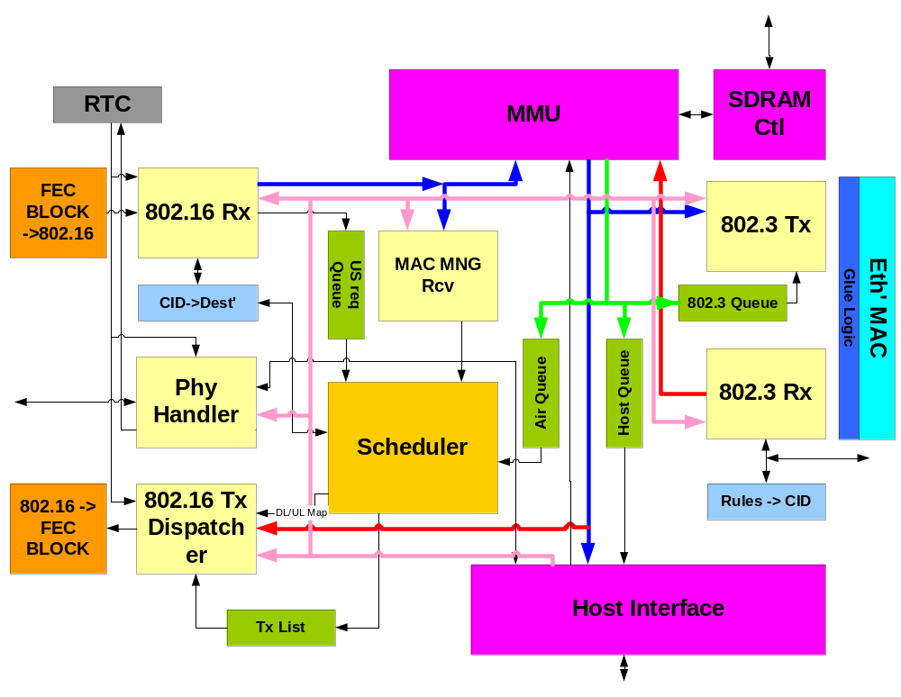
More complex architecture …
Write a DATA block to 802.16 Rx SCS16
In the Rx machine Micro-Code
…….
R3=R1+2
If (Host_cs)
gosub L_get_host_block
Goto L_new_packet
From the host program ….
If (Check_Asic_stat(`Write_Buffer,block_size))
Write_Asic(`RX_machine, block_pointer, 4);
Z RBA

Slide 25
Micro Scheduling
Frame Pulse
many cycles
Frame N
Some packet buffer
64
64
64
64
Control State
G
Process
O
IO
W
G
Process
O
IO
W
G
Process
O
IO
W
Some external Reg file/buffer
Frame Status N
Frame Status N+1
Packet buffer
Z RBA

Slide 26
SCS16 concept – Why SCS16 ???
Shorter Design Cycle – Micro-code development up to a week
before tapeout
Flexibility – either RAM based or single layer ECO for ROM
based
Dramatic area reduction
Manageability – large state machines are hard to manage. A
script in human language is much easier
Z RBA

Slide 27
SCS16 - Features
Speed - 100 to 200 MHz
Data and Instruction RAM/ROM hold up to 2K entries each.
16 bit architecture.
Single cycle – for all commands (branch incl.).
Highly parallel commands, including zero overhead burst.
8 General Purpose Registers (GPR).
2 contexts
Z RBA

Slide 28
SCS16 – Internal Capabilities
Sub routines, Interrupt.
One level of stack (PUSH and POP).
ALU/ALUI operations (+, -, <<, …)
Bit/Range Manipulation
Two Counters/Timers that can count a variety of events.
Dedicated hardware for CRC.
Zero overhead linear search command.
Zero overhead loop command.
FIFO Handling.
Z RBA

Slide 29
SCS16 Programming Language
C – Based
Each code line represents one clock cycle
Special Tokens – Reflect the core’s unique capabilities (pulse, wait_store, wait_load…)
Possible additions of special instructions
Z RBA

Slide 30



SCS16 – The Development Environment (1)
Developer script
A GUI System working in two modes:
1. Code Development and Debug:
    Revealing and fixing Compilation Bugs
    Code Coloring and Indentation
    Supports working with in a multi-window
    Environment
2. Simulation Review
    Traces each PC line in the source code file
    Supports all simulation related files
SCS16 Development environment
sniffer support
Micro Code
SCS16 sim model
HDL simulator
Other design models
scs16 log

Slide 31
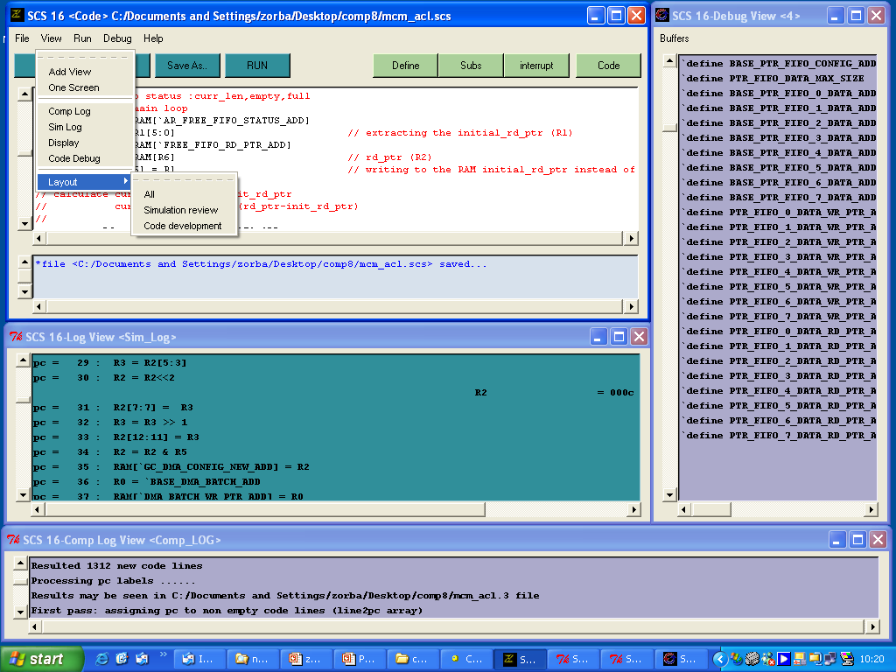
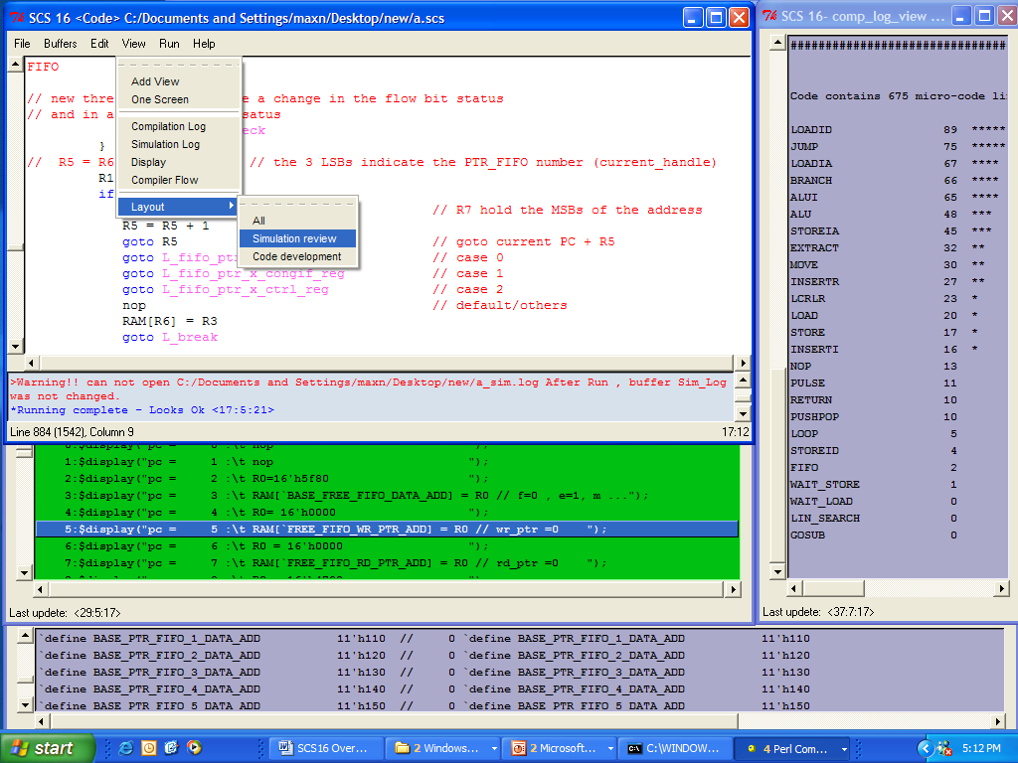
SCS16 – The Development Environment (2)

Slide 32
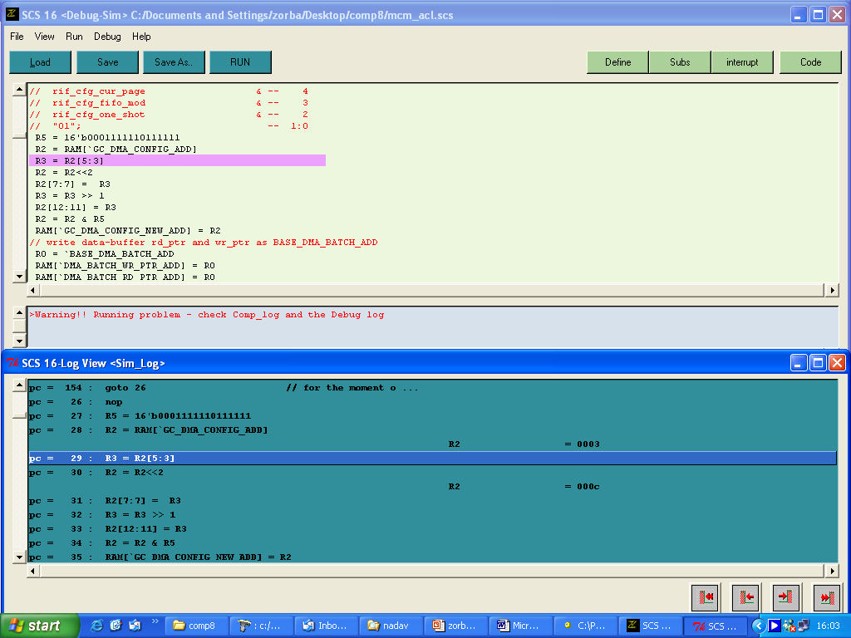
SCS16 – The Development Environment (3)

Slide 33
SCS16 concept – Why SCS16 ???
Shorter Design Cycle – Micro-code development up to a week
before tapeout
Flexibility – either RAM based or single layer ECO for ROM
based
Dramatic area reduction
Manageability – large state machines are hard to manage. A
script in human language is much easier
Z RBA

Slide 34
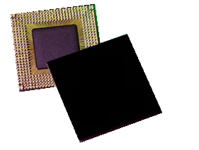
Zorb1 3202
Zorba Technologies LTD
zorba@zorba-tec.com

Slide 35
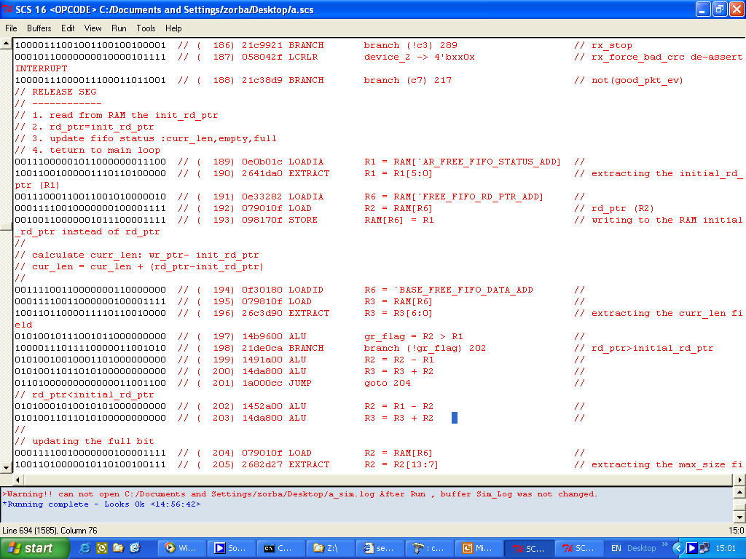

Slide 36
pc = 405 : gr_flag = R3 > R5
status = 010000
pc = 406 : branch (!gr_flag) 410
pc = 407 : device_2 -> 4'b1xxx // vr1_tx_flow OUTP ...
device = 8801
pc = 408 : R2[12:12] = 1 // setting the appr ...
pc = 409 : RAM[`AR_FREE_FIFO_STATUS_ADD] = R2
pc = 410 : goto 522
pc = 522 : pulse->p0 // output valid
pulse = 000000000000001
pc = 523 : device_1-> 4'bx0xx // data_out qualifi ...
pulse = 000000000000000
pc = 524 : pop device R0 R1 R2 R3 R4 R5 R6 R7
R0 = 0202
R2 = 0003
R3 = 0000
R4 = 0000
R5 = 1fbf
R6 = 0001
device = 0000
pc = 525 : rti // return from inte ...
pc = 30 : R2 = R2<<2
R2 = 000c
pc = 31 : R2[7:7] = R3
pc = 32 : R3 = R3 >> 1
pc = 33 : R2[12:11] = R3
pc = 34 : R2 = R2 & R5
pc = 35 : RAM[`GC_DMA_CONFIG_NEW_ADD] = R2
######################################################################### INTERUPT PENDING ######
pc = 36 : R0 = `BASE_DMA_BATCH_ADD
######################################################################### INTERUPT TAKEN ########
pc = 37 : RAM[`DMA_BATCH_WR_PTR_ADD] = R0
pc = 2047 : goto 360 // Interrupt pointe ...
pc = 360 : push device R0 R1 R2 R3 R4 R5 R6 R7
R2_b = 000c
pc = 361 : device_0-> 4'bxx00
pc = 362 : R6 = s1 // getting the add ...
R6 = 001d
pc = 363 : branch (!R6[11]) 368 // checking the rnw ...
pc = 368 : device_0-> 4'bxx01

Slide 37
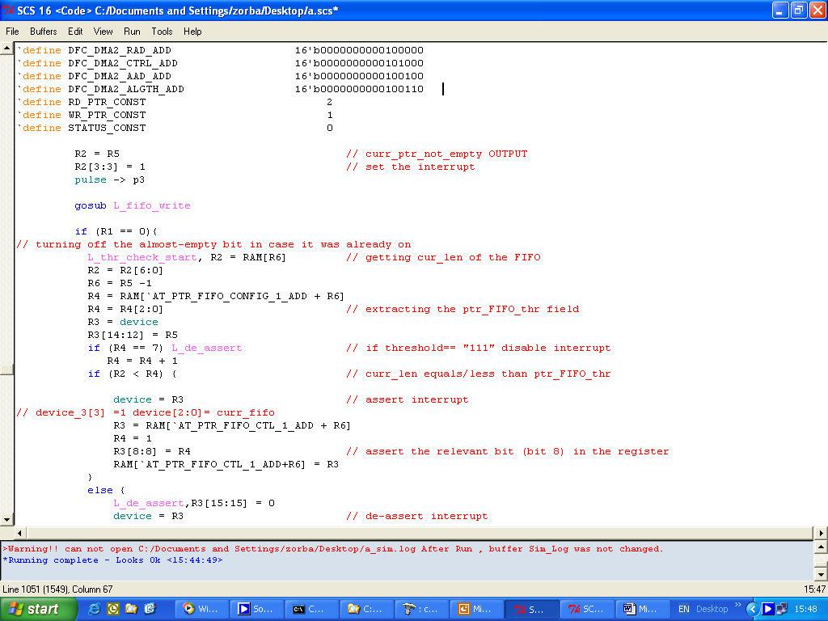

Slide 38
Example 1 – Flow Control
if (condition){
then
}
elsif(condition){
then
}
else{
then
}
gosub L_sub
return
goto L_label
wait (condition)

Slide 39
Example 2 - Memory
STORE
LOAD
RAM[R6]= 100
RAM[R7]= 16’h0af3
RAM[R7++] = R2
RAM[100] = R3
RAM[100+R7]= 16’h0021
R1=RAM[R6]
R0=RAM[R7++]
R4= RAM[11’b0001100111]
R5=RAM[10]
R3=RAM[20+R6]

Slide 40
Example 1 - ALU
R7 = R5 + R1
R4 = R1 + 300
R2 = R1 - R3
R5 = -100 - R2
R6 = R5 & R1
R0 = R2 & 10
R4 = R1 | R5
R5 = 100 | R2
R7 = R5 ^ R1
R4 = R1 ^ 300
R2 = R1 >> R3
R5 = R6 << R2
+ , - , & , ^ , | , > , < , != , == , >= ,<= , << , >>

Slide 41
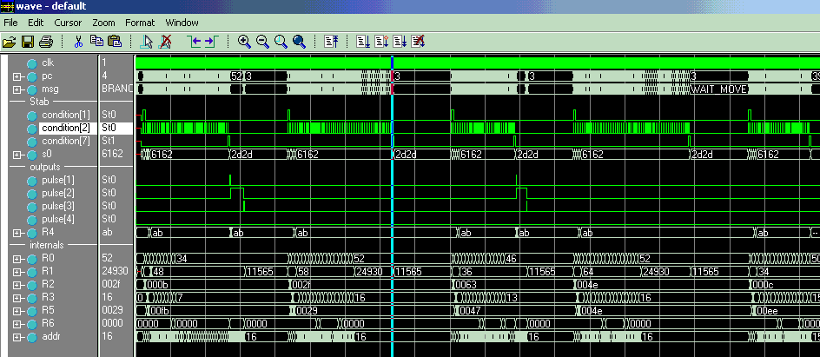
Packet Sorting – Simulation
Packet Received
Packet Extracted in burst
Packet ignored

