Slide 1
TITLE
J. Sampleperson
12th November 2025

Slide 2
Contents
Topic 1
Topic 2
Surprisingly topic 3

Slide 3
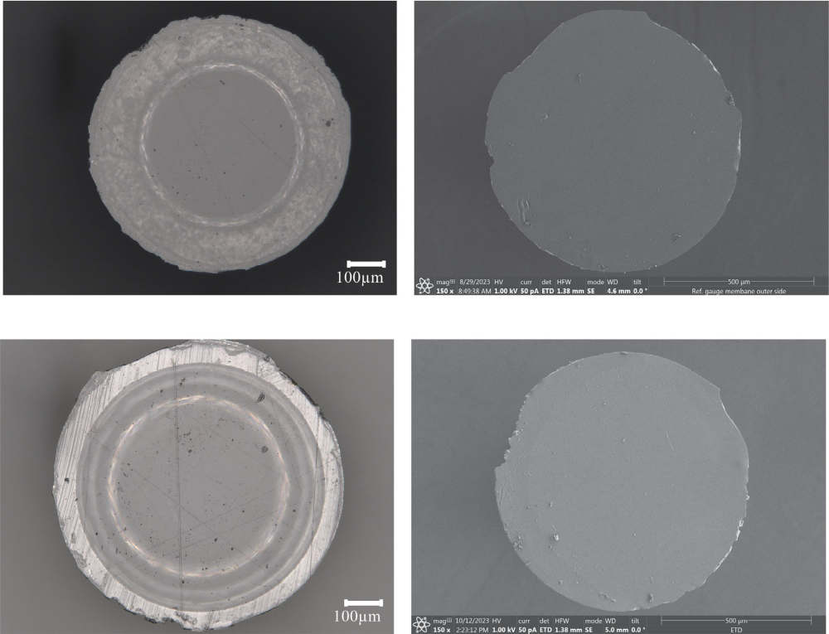
Topic 1
Sample text
More sample Text even highlighted
Images are also cool
Here look
▲ SEM images of unconditioned MDA pillars [1]

Slide 4
Thank You!

Slide 5
Bibliography
[1] Ziemer et al., 2025, "Impact of single and combined space environment factors on the performance of elastomer micropatterned dry adhesives"
[2] …

