Slide 1

The Effects of Primary and Secondary Education on Communities in Victorian Local Government Areas (LGAs)
Max Philip (836472)

Slide 2
Research Questions
How increased access to education affects the lives of people in local communities.
How does the number of schools in an LGA relative to its population, and the types of schools, change the impact made on surrounding communities?
How do changes to education availability in LGAs effect local community well-being and economic/physical quality of life?

Slide 3
Motivation
The results of this study could be used by policy makers or authorities such as the Victorian Government to benefit residents in each LGA by achieving goals pertaining to LGA communities through increased spending education, or changes to the education system.
This is because improvements to citizens’ quality of life, and by extension how close-knit local communities are, will always be an area of investment that garners government attention.
Families (particularly those with young children) could benefit from an improved understanding of how individual LGAs’ communities function. Prospective families as well.

Slide 4



Datasets
Local Government Area (LGA) profiles data 2015 for VIC
Social conditions of each LGA, as well as factors that influence quality of life, such as employment, transport and social engagement. Collected from AURIN and attributed to the Government of Victoria – Department of Health and Human Services.
ERP by LGA (ASGS 2016), 2001 to 2016
Contains the most recent Estimated Resident Population (ERP) by LGA, and is the official measure of the Australian population. Collected from the Australian Bureau of Statistics
School Locations – 2017
Details the information collected as part of the ongoing registration of schools in Victoria, which includes the name, school type, school sector, address, phone number, co-ordinates and local government area name. From the Victorian Government Data Directory.

Slide 5
Data Wrangling - 1
LGA Profiles required little cleaning – AURIN User Interface allowed for easy selection from the 402 available attributes
Restricted choices to relevant and complete data, since there are only a small number of total LGAs (79)
Used as basis for the final, clean dataset
ERP by LGA
Some LGA names were adjusted for easier integration later (e.g. “Latrobe (C) (Vic.)”)
Used for finding population to school ratios
School Locations
Data on different school types was taken to be integrated into the final clean dataset.
This was required to answer the first research question

Slide 6
Data Wrangling - 2
7 Community Indicators:
Total offences per 1000 (crime)
Homeless Rate (economy)
People with low English proficiency
People who help as volunteers
People who believe multiculturalism makes life better
People who rated their community as active
People who attended a local community event
Types of Schools:
Government Schools
Independent Schools
Catholic Schools
Primary, Secondary, Primary/Secondary Schools

Slide 7
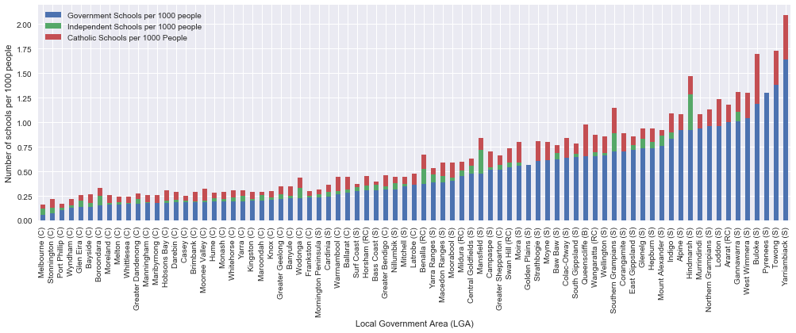
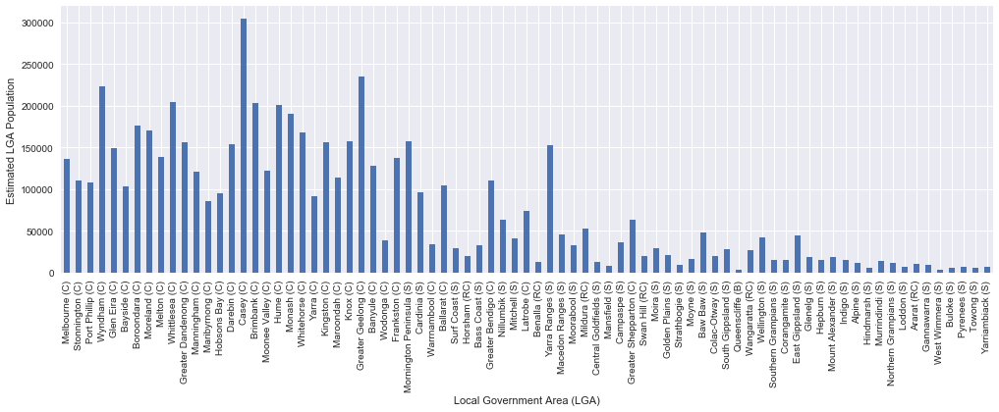
Investigation Conclusions
The figures have an almost inverse trend, in that LGAs with lower total populations tend to have more schools per 1000 people. This suggests closer-knit communities in low population areas, which allows us to progress to the analysis of community indicators and how they relate to this.

Slide 8
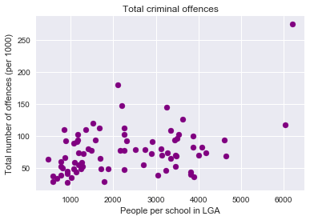
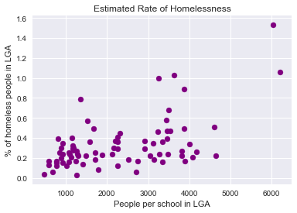
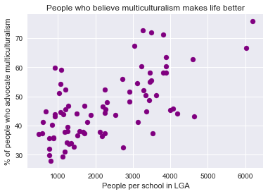
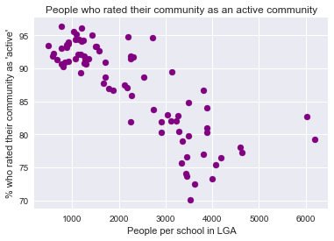
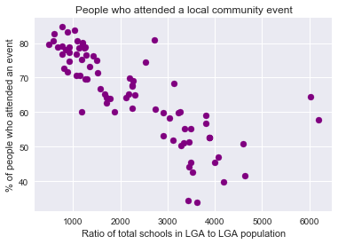
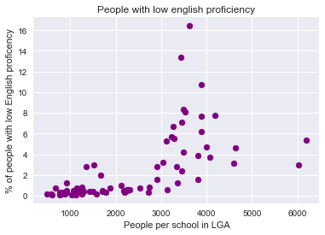
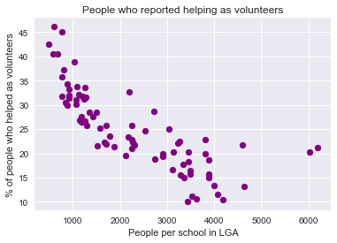

$$People per school in LGA=\frac{Estimated LGA Population}{Total Schools in LGA}$$
Number of people per school -> higher ratio = fewer schools
Pearson Correlations
Offences: 0.404212
Homelessness: 0.549287
Multiculturalism: 0.643019
Volunteers: -0.788744
Low English Proficiency: 0.643019
Rated Active Community: -0.811423
Attended Community Event: -0.79246

Slide 9
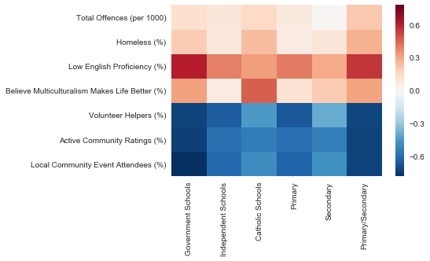
Using the scatter plots above as reference, this heatmap can be used to analyse the correlations between my selected community well-being indicators and different school types. Stronger Pearson Correlations indicate a closer similarity to the trend shown above for total schools in an LGA, for that specific school type.
Government and Primary/Secondary schools have higher correlations since they are the majority of schools in Victoria. Independent and Catholic schools can be seen to change the correlation, where Catholic schools have the largest departure from total school correlations, showing the impact of school type.

Slide 10
Challenges & Reflections
A significant challenge in this report was maintaining focus on answering the proposed research questions, since having an aggregation of various community-related attributes made it easy to broaden the scope of the investigation too much.
Not have enough space to include all my desired visualization methods, including boxplots to detect outliers and exploring clustering methods. (Mostly crime rate and homelessness)
I attempted to use VAT visualization to find clusters across combinations of my selected community indicators, however I struggled to produce any meaningful clusters.
The decision to analyse seven different community indicators may have prevented analysis as detailed as I would have liked

