Slide 1
Final Project Database Design
Group 5

Slide 2
Agenda
Explain dataset
Explain problems with dataset
Explain ETL pipeline developed

Slide 3

Final Project Dataset
Kaggel Movie Dataset

Slide 4
Kaggel Movie Dataset
Movie data from Module 8
MovieLens is a website run by the GroupLens research group at the University of Minnesota.
The dataset pulls from the MovieLens dataset of over 26 million reviews
The dataset contains a metadata file with details about the movies from The Movie Database (TMDb)
The dataset contains a file of Cast and Crew Information for all our movies.
Top 100 actors by revenue list

Slide 5
Problems with the data
When the data was processed for module 8 a number of problems were left in the data. The data was not ready for analysis
We removed the starring field
We removed the production companies field
We did the merge of the star ratings and the movie data wasn’t perfect
We left a lot of column which were of no use for analysis

Slide 6
Final Project ETL
Kaggel Movie Dataset

Slide 7
ETL Pipeline Developed
The ETL pipeline for our final project was developed based on the pipeline developed for module 8
The first concern was to remove to the wiki data from the process
The next concern to deal with was dealing with bad data
Cast
Crew
Production companies

Slide 8
Problems found in the data
There were a number of issues found in the movie data set
For our analysis we needed
Cast
Crew
Genre
Production company
In the original dataset all of these fields were strings containing JSON dictionary objects with the lists.
There is a large mismatch in number of reviews between the Kaggle dataset and the reviews datafile

Slide 9
Example JSON Object
Example from the cast field from the credits data file
[{'cast_id': 14, 'character': 'Woody (voice)', 'credit_id': '52fe4284c3a36847f8024f95', 'gender': 2, 'id': 31, 'name': 'Tom Hanks', 'order': 0, 'profile_path': '/pQFoyx7rp09CJTAb932F2g8Nlho.jpg'}, {'cast_id': 15, 'character': 'Buzz Lightyear (voice)', 'credit_id': '52fe4284c3a36847f8024f99', 'gender': 2, 'id': 12898, 'name': 'Tim Allen', 'order': 1, 'profile_path': '/uX2xVf6pMmPepxnvFWyBtjexzgY.jpg’}]
Example from the crew field from the credits data file
[{'credit_id': '52fe4284c3a36847f8024f49', 'department': 'Directing', 'gender': 2, 'id': 7879, 'job': 'Director', 'name': 'John Lasseter', 'profile_path': '/7EdqiNbr4FRjIhKHyPPdFfEEEFG.jpg'}, {'credit_id': '52fe4284c3a36847f8024f4f', 'department': 'Writing', 'gender': 2, 'id': 12891, 'job': 'Screenplay', 'name': 'Joss Whedon', 'profile_path': '/dTiVsuaTVTeGmvkhcyJvKp2A5kr.jpg'}]

Slide 10
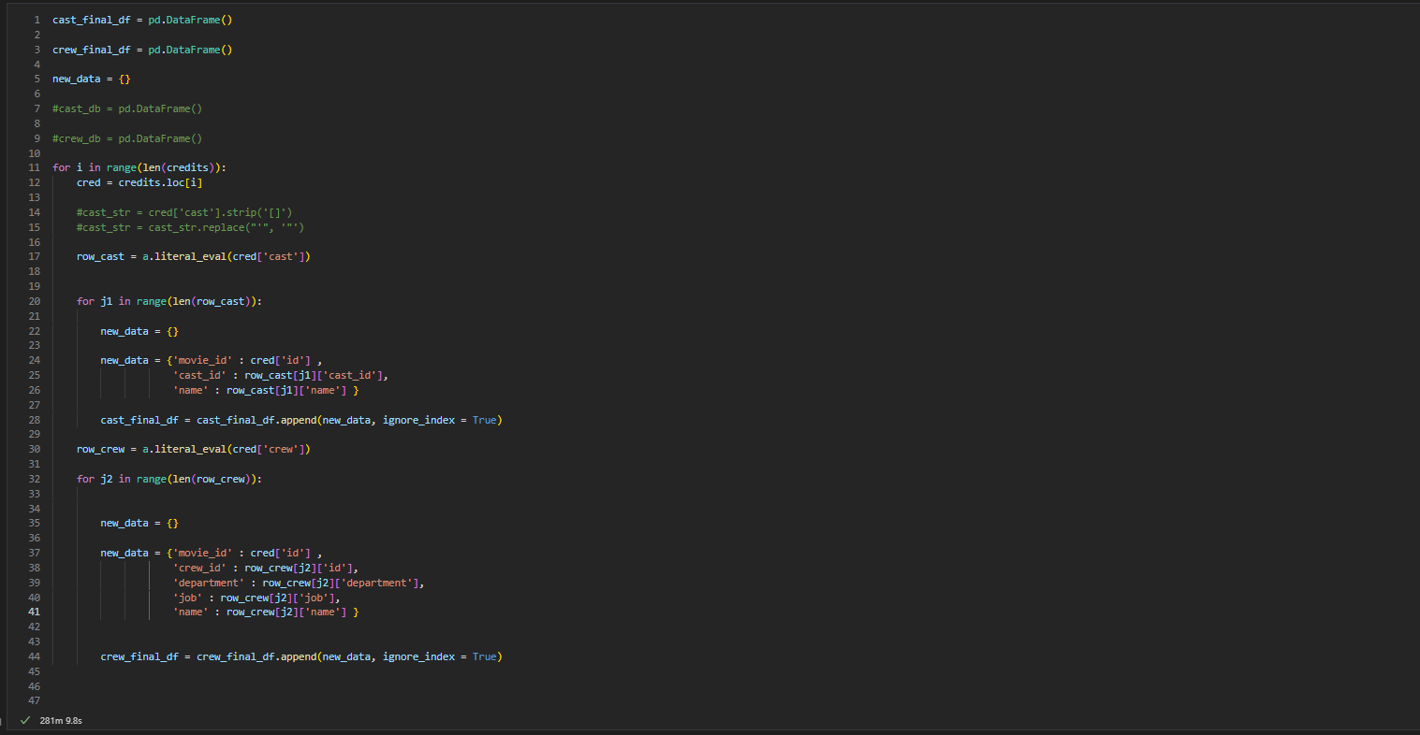
Processing Credit Data File
When the pipeline was developed, we first tried JSON.LOADS to process the strings in the files.
This command errored do the construction of the strings
We ended utilizing the literal_eval function from the AST module to process the strings into proper JSON

Slide 11
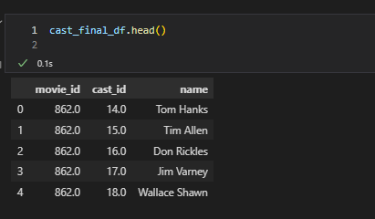
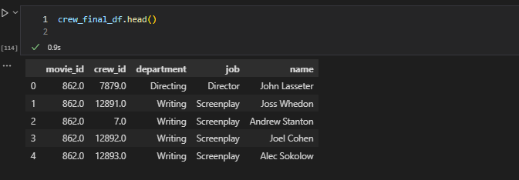
Problems found after processing
After processing the credits file to build a cast list and a crew list a major problem was identified
The unique ID for a record was movie_id and cast_id
There was no easy to identify all of the movies Tom Hanks was a cast member of
The problem is worse in the crew records. If a person does multiple things on a movie, like write and direct there is no way to easily identify that fact.

Slide 12
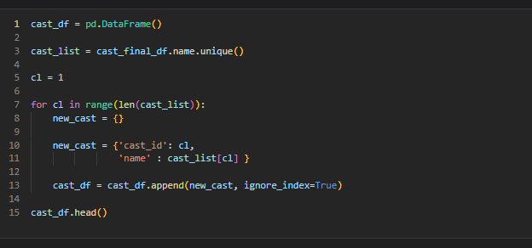
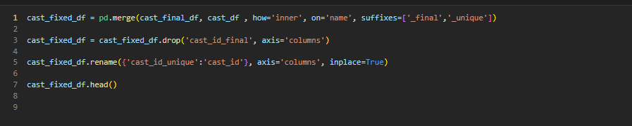
Resolving the cast and crew problems
The data needs to be read and the unique names need ot be identified
A unique ID needs to be assigned to each name
That unique ID and the movie id need to be built into a new table which makes each cast or crew members into discreet values

Slide 13
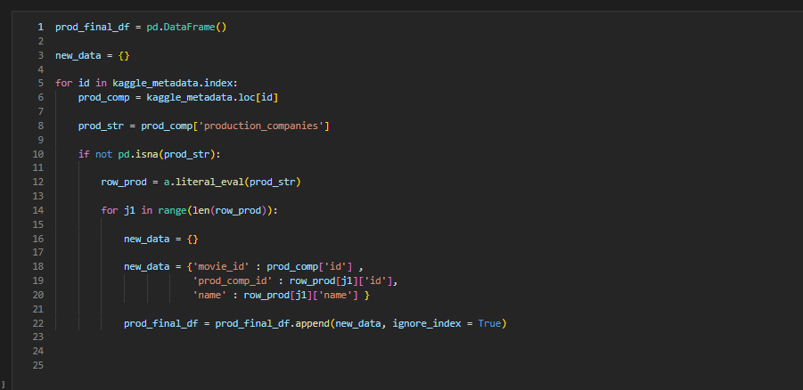
Problems found after processing
After processing the movies file a similar problem to what was found in the credits file was identified for the genres and the production companies fields
These fields were identified to contain a movie id and a unique id for either the genre or the production company
So the data was processed into a new table with discreet values for a movie id, a production company id, and company name

Slide 14
Problems found after processing
After the data was reviewed a large discrepancy was identified in the two review system in the dataset.
The ratings table contains ratings for 7,567 movies. We will provide two version of the movie table:
The original table with 45,454 movies with TMDB average scores and vote counts
The new table with 7,567 ratings based on a 5 star system from users of MovieLens

Slide 15
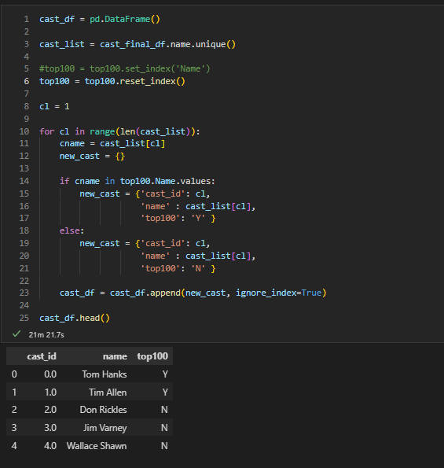
Calculated field
After reviewing the data, we found that the number of cast members was to large, and needed some filtering
We found the Top 100 actors by revenue list and decided to add it to our cast table
We added a field to the Cast table called Top100
We read in the list, and determined if the cast member of the movie was a part of the list
If so, we set Top100 to true
If not, we set Top100 to false

Slide 16
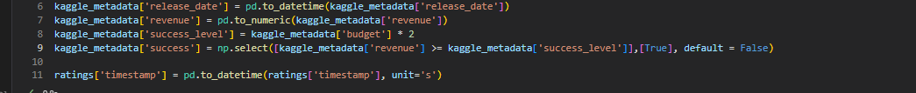
Calculated fields
We determined our question for this was revolving around revenue and success of the movie
We added a field to both movie tables, success_level, which is a calculated field of two times the movie’s budget
[success_level] = [budget] * 2
We added a field to both movie tables, success, which determine if revenues was higher than the calculated success level
[success] = ([revenue] >= [success_level])

Slide 17
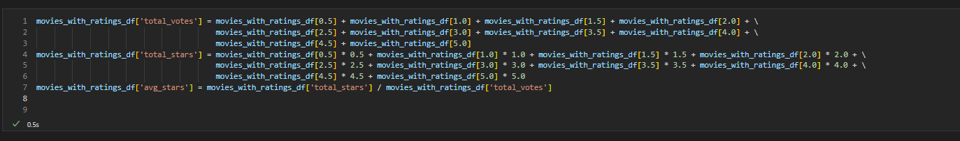
Calculated fields
To aid the analysis team, the ETL pipeline needed to add a field to calculate the total number of votes a movie got from MovieLens members
The next field we needed to add was a field for the total number of stars garnered by the movie
The final new field we calculated is field showing the average number of stars per vote

Slide 18
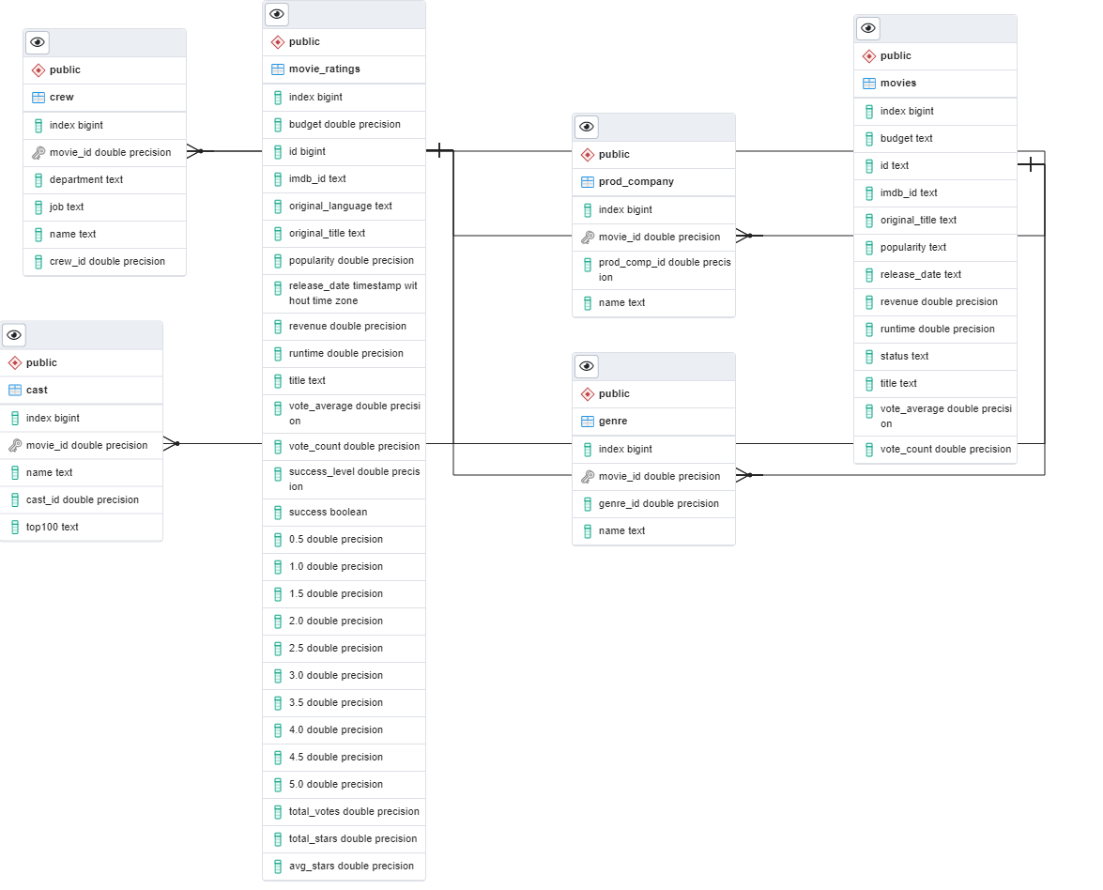
New Data Schema

