Slide 1
CS351 · AI ASSISTED SOFTWARE DEVELOPMENT· FINAL DEMO
From Git Basics to a
C++ Query Engine
max@yzu: ~/cs351
$ whoami
max-shen378
$ git log --semester
5 repositories
39 commits
6 pull requests
2 C++ projects
$ _
One semester of version control, CI/CD, documentation, AI-assisted development and C++ projects.
@max-shen378
max-shen378.github.io
Max Shen · 1123534
CS351 Final Demo · Max Shen · @max-shen378
01 / 15
Notes:
Good morning everyone. My name is Max Shen, student ID 1123534, GitHub account max-shen378. This is my final demo for CS351, Introduction to Software Engineering Tools. I called the talk 'From Git Basics to a C++ Query Engine' because that is literally the arc of my semester: we started with creating a GitHub account and writing Markdown, and I finished by building a small SQL-like database engine in C++ with tests and benchmarks. In the next 25 minutes I will walk through my website, my course repositories, both projects, my GitHub workflow, how I used AI tools responsibly, and finish with a live demo.

Slide 2
$ cat agenda.md
Agenda
01
Semester learning summary
05
Project B — CSV Mini Database
02
Personal website
06
GitHub workflow evidence
03
Course repository
07
AI-assisted development reflection
04
Project 0 — Two Sum
08
Final reflection
CS351 Final Demo · Max Shen · @max-shen378
02 / 15
Notes:
Here is the roadmap. I will keep the early parts brief — learning summary, website, course repo — and spend the most time on the two projects and the live demo. Projects get multiple slides each: the algorithm and testing story for Two Sum, and the architecture, data design, and performance trade-offs for the CSV database. Around minute 20 I will switch to the terminal and browser for the live demo, leaving time for questions.

Slide 3
SECTION 01
Semester Learning Summary
What I learned
Tools used this semester
▸ Automation: GitHub Actions CI building and testing on every push
▸ Jira: Tracking projects with Jira
▸ Working with AI tools and verifying everything they produce
Git
GitHub
GitHub Pages
GitHub Actions
VS Code
AI assistants
Markdown
C++17 / g++
HTML / CSS / JS
Most important growth
Tracking my projects and the workflow for a more organized setting, learning how to use Github actions and other features to the best alongside the assistance of AI for a more optimized development .
CS351 Final Demo · Max Shen · @max-shen378
03 / 15
Notes:
The single biggest change this semester is the last box. Before this course, finishing a program meant it ran once on my machine. Now finishing means: it is in version control with meaningful history, it has tests that prove it works, documentation that explains it, and CI that re-checks it on every push. The tool list looks long, but they all serve that one idea. I also learned to treat AI assistants as a tool in this chain — useful, but everything gets verified before it is committed.

Slide 4

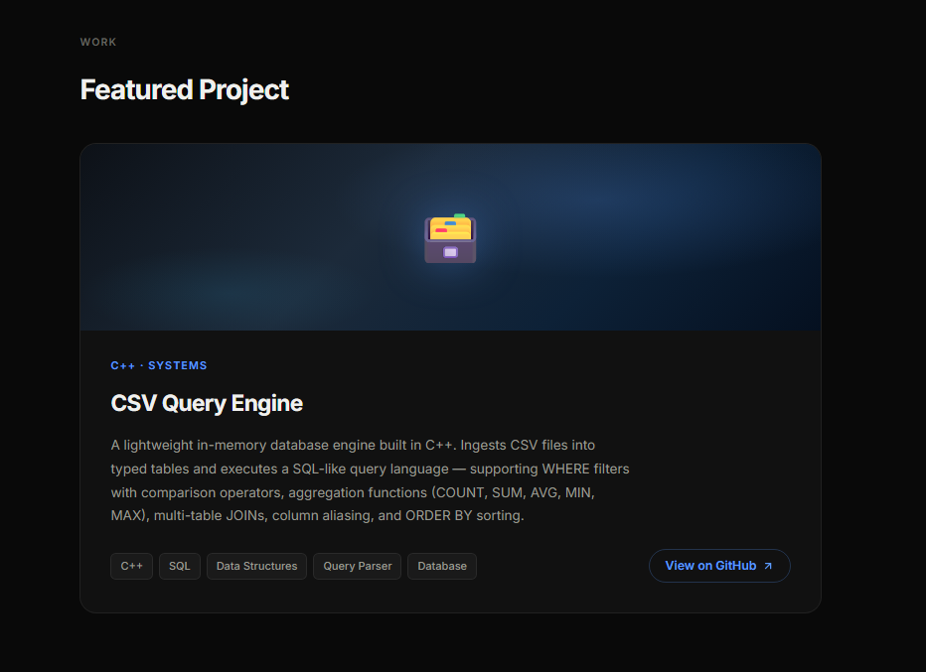
SECTION 02
Personal Website
URL: https://max-shen378.github.io
Technologies
HTML5
CSS3
vanilla JS
GitHub Pages
no frameworks
Design concept
▸ Dark portfolio theme, Inter typeface
▸ Pill navigation, home, About / Work / Skills / Repos
▸ Scroll-reveal animations
▸ Live clock in the top bar
Personal thoughts
▸ Separating style.css / main.js made changes safer
▸ The site is itself Git practice: every tweak is a commit
CS351 Final Demo · Max Shen · @max-shen378
04 / 15
Notes:
My personal site is at max-shen378.github.io, hosted on GitHub Pages. It is deliberately plain HTML, CSS and vanilla JavaScript — no frameworks — because the goal was to understand the platform: a repo named after my username, pushed to main, served as a static site. The design is a dark developer portfolio with a pill navigation, scroll-reveal animations done with IntersectionObserver, and a live Taiwan clock. The honest reflection: the commit history shows how it evolved — I started with a simple page, added sections, then did a full redesign and finally separated the CSS and JS into their own files. Each iteration was a commit, so the site doubled as Git practice. I'll open it live during the demo.

Slide 5
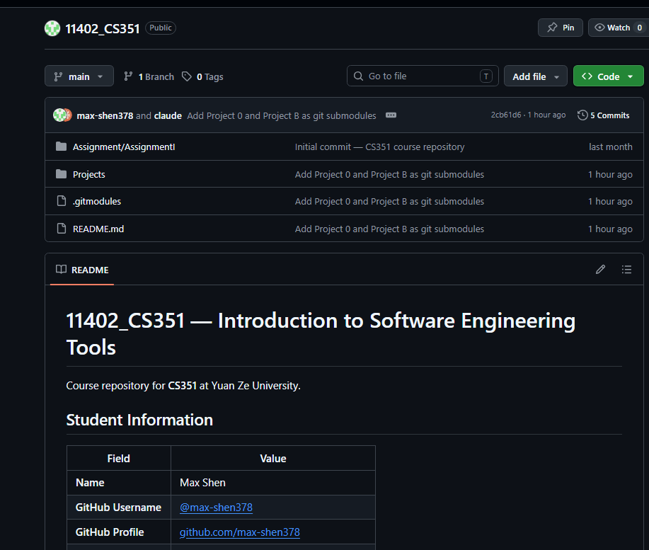
SECTION 03
Course Repository
URL: Course Repository
Learning progress & accomplishments
▸ Assignments GitHub account & profile, personal Pages site, course repo with structured Markdown
▸ Submission READMEs with tables, checklists and links
▸ A real merge conflict, resolved with a merge commit (91dad51)
What this repository demonstrates
▸ Git fundamentals: clone, add, commit, push, pull, merge
▸ Markdown as structured documentation (tables, task lists)
▸ Clean repository organization by assignment
▸ The hub that links profile, Pages site and projects together
CS351 Final Demo · Max Shen · @max-shen378
05 / 15
Notes:
The course repository 11402_CS351 is the administrative hub of the semester. Assignment I lived here: setting up the GitHub account and profile, publishing the Pages site, and writing structured Markdown — tables, checklists, links. One thing I want to highlight honestly: the top commit is a merge-conflict resolution. Early on my local and remote histories diverged and I had to actually understand pull, merge, and conflict markers instead of copy-pasting commands. That mistake taught me more about Git than the happy path did.

Slide 6
SECTION 04 · PROJECT 0
Two Sum — Goal & Algorithm
URL: Two-Sum Repository
Goal: given an array and a target, return the indices of two numbers that sum to the target implemented twice, to compare algorithmic trade-offs.
twoSumArray — brute force
twoSumHashTable — optimized
▸ Nested loops check every pair
▸ O(n²) time · O(1) space
▸ Simple; fine for small inputs
▸ Single pass with complement lookup
▸ O(n) time · O(n) space
▸ unordered_map<value, index>
src/twosum.cpp — the core idea
for (int i = 0; i < nums.size(); ++i) {
int complement = target - nums[i]; // what would complete the pair?
if (numMap.find(complement) != numMap.end()) return {numMap[complement], i};
numMap[nums[i]] = i; // remember and move on
CS351 Final Demo · Max Shen · @max-shen378
06 / 15
Notes:
Project 0 is the classic Two Sum problem, and the point of the assignment was not just to solve it but to solve it twice. The brute force version checks every pair — quadratic time, constant space. The optimized version makes a single pass: for each element it computes the complement, target minus the current value, and asks a hash map 'have I already seen this complement?' If yes, done; if no, store the current value and index. That trades O(n) memory for O(n) time. The four-line loop on screen is the whole trick — and interestingly, the same hash-lookup idea comes back later as the index in my Project B database engine.

Slide 7
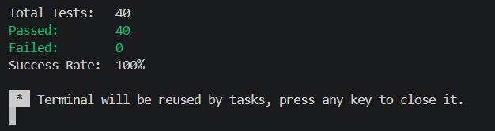
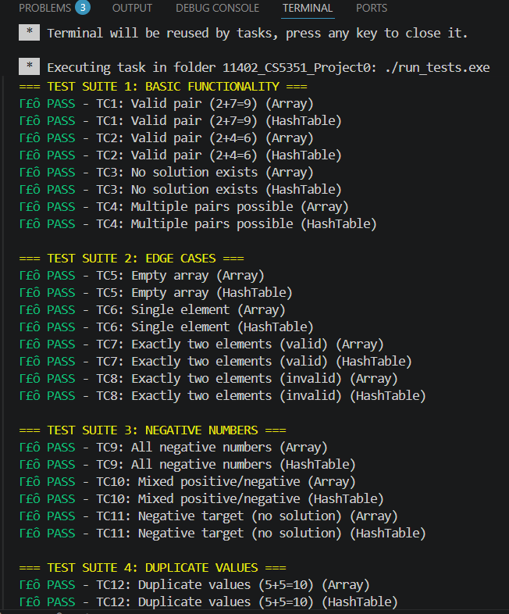
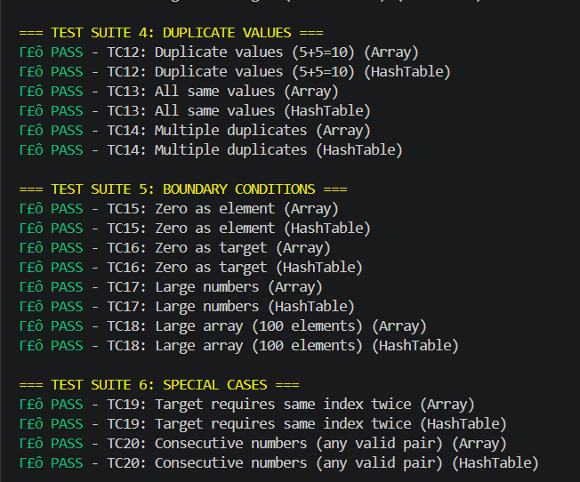
SECTION 04 · PROJECT 0
Two Sum — Testing & CI
40/40
6
100%
tests passing
test suites
of pushes & PRs auto-tested
Suite coverage
basic
edge
negatives
duplicates
bounds
special
07 / 15
Notes:
Testing is where this project got interesting. Forty tests across six suites — basic functionality, edge cases, negative numbers, duplicates, boundaries, special cases — and I re-ran them this week: 40 out of 40. But they didn't start at 40. Originally seven tests failed, and the lesson was that the tests were wrong, not the code: they asserted one specific index pair, while many inputs have several valid answers. The fix was to assert the property — the two returned values actually sum to the target — instead of hard-coded indices. That changed how I think about writing assertions. The CI side runs the same suite on Ubuntu, Windows and macOS plus cppcheck static analysis on every push, so a regression cannot sneak in silently.

Slide 8
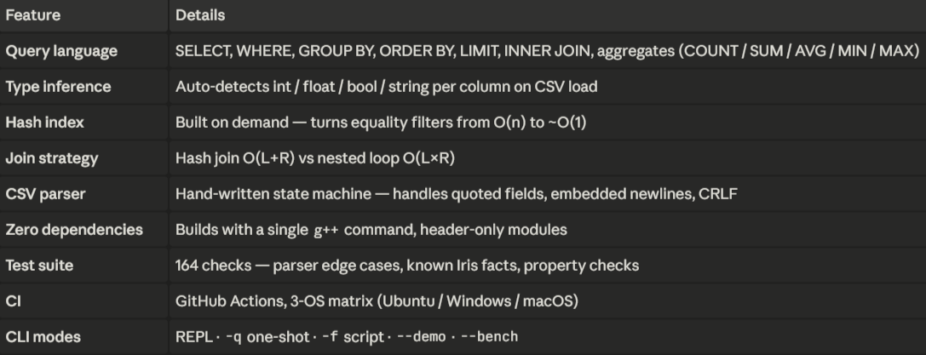
SECTION 05 · PROJECT B
CSV Mini Database
URL: CSV Mini Database Repository
Goal: a compact database engine: ingest CSV files into typed in-memory tables and run SQL-like queries filtering, projection, aggregation, GROUP BY, ORDER BY, JOIN.
CS351 Final Demo · Max Shen · @max-shen378
08 / 15
Notes:
Project B is the centerpiece: a miniature database engine in modern C++ with zero external dependencies — I wrote the CSV parser myself instead of pulling a library, which was one of the allowed options. The architecture is a classic database pipeline, and each stage is its own header-only module: the CSV parser turns raw text into records; the table layer infers a schema and stores typed values; the query layer tokenizes and parses a small SQL dialect into an AST; and the executor runs the pipeline — filter, join, group, sort — and even reports what plan it chose. Everything compiles with a single g++ command, which made it easy for anyone to build and grade. I test it against the classic Iris dataset from Kaggle.

Slide 9
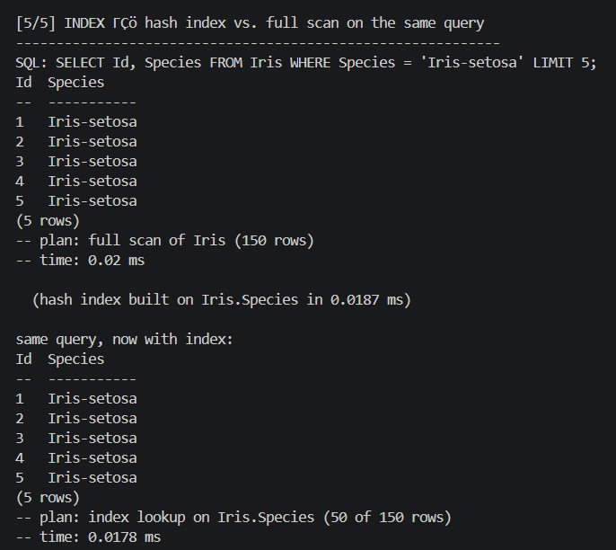
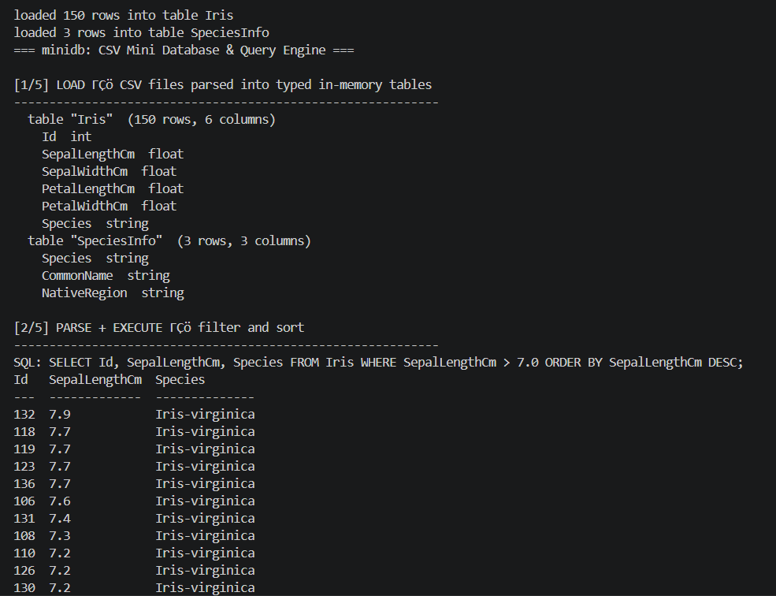
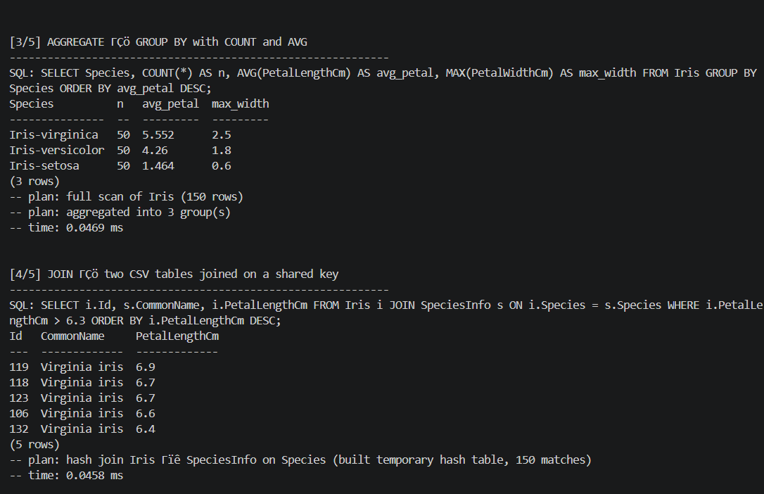
SECTION 05 · PROJECT B
The Query in Action
CS351 Final Demo · Max Shen · @max-shen378
09 / 15
Notes:
Here is what using it feels like. The first query is the one I always show: group the 150 iris flowers by species, count them, and average the petal length — three species, fifty rows each, and you can see virginica has by far the longest petals. The second query joins the measurement table against a small species-info lookup table — and notice the engine prints its plan: it chose a hash join. The grammar supports filtering with boolean logic, the five standard aggregates, grouping, sorting, limits, joins and aliases, with SQL-style NULL handling. The REPL also has meta-commands for schema inspection, building indexes, and timing. All of this I will run live in the demo.

Slide 10
SECTION 05 · PROJECT B
Data Design
Typed values
Schema inference
▸ Value = tagged variant: null · bool · int64 · double · string
▸ SQL-style comparisons; NULL never matches
▸ Scan all values: int > float > bool > string
▸ Iris → Id:int, 4 measures:float, Species:string
Row storage
Hash index
▸ Row-major vector<vector<Value>>
▸ Simple & cache-friendly for SELECT *; columns would be better for single-column aggregates
▸ value → list of row ids (built on demand)
▸ Powers fast equality WHERE filters and joins
The hand-written CSV parser (the robust option)
Single-pass character state machine — handles quoted fields, "" escapes, embedded newlines, CRLF, blank lines, and reports malformed input with record numbers instead of crashing.
CS351 Final Demo · Max Shen · @max-shen378
10 / 15
Notes:
Four design decisions define the engine. First, every cell is a tagged variant — null, bool, integer, double, or string — with SQL comparison semantics. Second, types are inferred by scanning the whole column with a precedence order, so the Iris measurements really are doubles and comparisons are numeric, not string-based. Third, storage is row-major, which is the simple, honest choice — I note in the README that a columnar layout would be faster for single-column aggregation; knowing the trade-off matters more than premature optimization. Fourth, the hash index maps a value to its row ids and accelerates both WHERE equality filters and joins. And underneath it all is the part I'm proudest of: a hand-written, single-pass CSV state machine that survives quoted commas, escaped quotes, and even newlines inside fields.

Slide 11
SECTION 05 · PROJECT B
Development History & Quality
PR #1 merged
PR #2 merged
engine complete
repository created, README initialized
full project spec via feature/SG11402_CS5351
parser · executor · tests · benchmark · docs (725fcdc)
Testing (164 checks, 0 failures)
Error handling by design
▸ Parser: quoting, escapes, embedded newlines, CRLF, malformed input must throw
▸ Engine vs known Iris facts: AVG(SepalLengthCm) = 5.8433, 50 rows per species, max sepal 7.9
▸ Property checks: |A| = |A∧B| + |A∧¬B|; indexed ≡ non-indexed results
▸ CSV errors: unterminated quotes, wrong field counts → clear messages with record numbers
▸ Query errors: unknown/ambiguous columns, type mismatches, non-numeric SUM → rejected loudly
▸ The REPL reports and keeps running
CS351 Final Demo · Max Shen · @max-shen378
11 / 15
Notes:
Project B also followed the branch-and-PR workflow: the repo and spec went in through two pull requests in April, and the engine itself landed in June. Quality has two halves. The test suite has 164 checks and they are not toy assertions: the parser is tested against hostile CSV — embedded newlines, escaped quotes, malformed rows that must throw — and the engine is validated against facts about Iris that I can verify independently, like the famous 5.8433 average sepal length. My favorite tests are the property checks: a predicate and its negation must partition the table, and an indexed query must return exactly the same rows as a full scan. Error handling is deliberate too — bad input gets a clear message, never a crash.

Slide 12
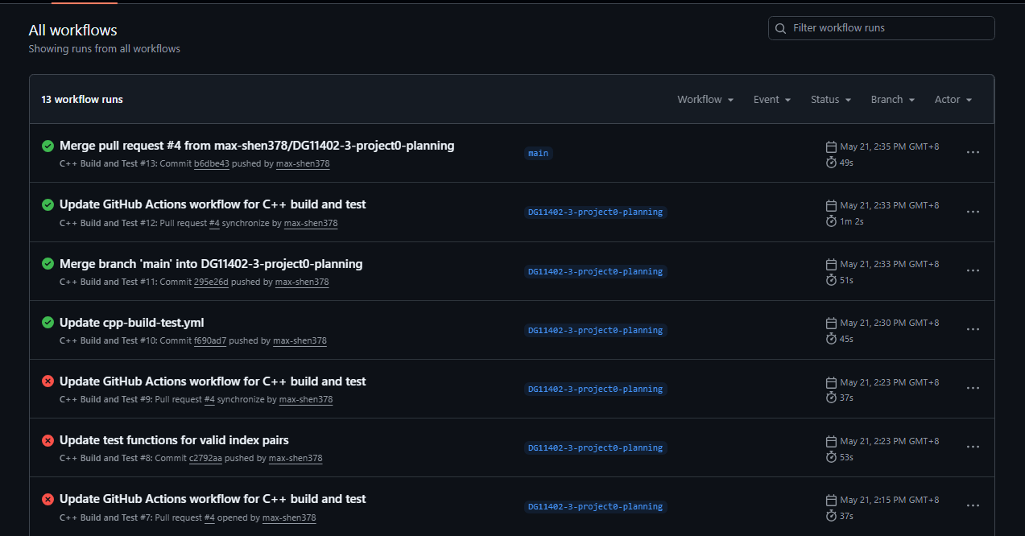
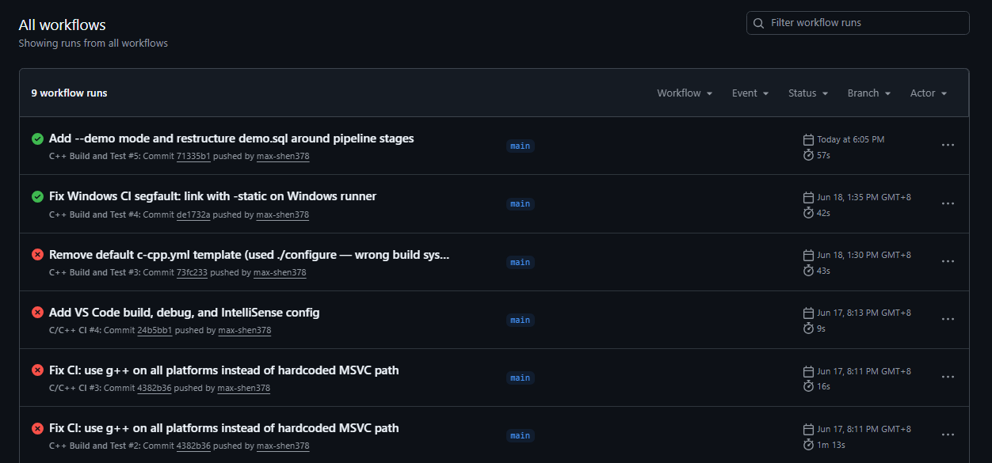
SECTION 06
GitHub Workflow Evidence
repository
commits
branches
PRs merged
highlights
11402_CS5351_Project0
17
2
4
docs-first, CI, task-coded commits
11402_CS5351_ProjectB
7
2
2
feature branch → PR → merge
max-shen378.github.io
10
1
—
iterative redesign history
11402_CS351
4
1
—
merge-conflict resolution
CS351 Final Demo · Max Shen · @max-shen378
12 / 15
Notes:
This is the evidence slide — the numbers behind the workflow story, all checkable on my GitHub profile. Across the four course repositories: 38 commits, six merged pull requests, and feature branches with real names you can still see in the repos. Two details I want to point out. First, commit messages carry task codes like SG11402-3, so you can trace a requirement to the exact commits that implemented it — that is the traceability idea from the documentation applied to version control. Second, even working solo, everything merged to main through a pull request, because the PR is where CI runs and where the change gets a second look — even if the second look is me, the next morning.

Slide 13
SECTION 07
AI-Assisted Development Reflection
How AI accelerated my work
AI quality and limits
▸ Speed: boilerplate, test scaffolding, doc drafts
▸ Coverage: suggesting edge cases I'd have missed
▸ Explanation: Git concepts, error messages, C++ idioms
▸ Environment bugs: needing real debugging
▸ Context it didn't have: wrong test expectations (assumed unique Two Sum answers)
▸ Judgment: what the assignment actually required
Validating every AI output
AI in Workflow
▸ Run the full suites: 40 checks (P0) + 164 checks (PB)
▸ Cross-check reality: known Iris statistics, CI
▸ Read every line before committing it
▸ AI is an accelerator, not an autopilot
▸ Never commit code I can't explain
▸ Be transparent about where AI was used
CS351 Final Demo · Max Shen · @max-shen378
13 / 15
Notes:
I used AI assistants throughout the semester, so this reflection is from real experience. Where AI genuinely helped: speed on boilerplate and test scaffolding, and breadth — it suggested edge cases like CRLF line endings and newlines inside quoted CSV fields that I would not have thought to test. Where it failed: anything it could not see. The best example is a segfault in Project B that turned out to be mismatched MinGW runtime DLLs on my machine — no AI could know my PATH; I had to run ldd and diagnose it myself. My verification routine became: compile with all warnings, run the full test suites, cross-check against facts I know independently, and read every line before committing. The rule I keep: never commit code I cannot explain. If I can't explain it, I don't own it — and on demo day, I have to own all of it.

Slide 14
SECTION 09
Final Reflection
What I learned
What I would improve
How this helps my future
▸ A professional workflow: branch, commit, PR, review, merge
▸ Tests and docs are what make code trustworthy
▸ CI catches what I forget
▸ Performance is about measured trade-offs, not guesses
▸ AI is powerful only when paired with verification
▸ Smaller, more frequent commits with sharper messages
▸ Set up CI on day one, not after the code works
▸ Finish the Docker packaging for Project 0
▸ Add range (sorted) indexes and LEFT JOIN to Project B
▸ Practice code review with classmates, not just solo PRs
▸ These are the exact tools used in internships and industry
▸ A public GitHub portfolio that shows process, not just results
▸ Confidence to build non-trivial systems (database) from scratch
▸ A verification habit that transfers to every AI-era workflow
CS351 Final Demo · Max Shen · @max-shen378
14 / 15
Notes:
Three honest lists. What I learned is really one thing wearing five hats: a workflow that makes software trustworthy — version control, tests, documentation, automation, and verified use of AI. What I would improve: my commit hygiene got better over the semester but the early history shows messages like 'update'; I would also set up CI before writing code, not after, and there are concrete features left on both projects' roadmaps. How it helps my future: this is the exact toolchain I will meet in any internship, and the projects are public — anyone can read not just my code but how I got there, which I think is the real portfolio.

Slide 15
CS351 Final Demo · Max Shen · @max-shen378
Thank you!
links
profile github.com/max-shen378
website max-shen378.github.io
course github.com/max-shen378/11402_CS351
project 0 github.com/max-shen378/11402_CS5351_Project0
project B github.com/max-shen378/11402_CS5351_ProjectB
CS351 · AI ASSISTED SOFTWARE DEVELOPMENT· Yuan Ze University · Max Shen · 1123534
15 / 15
Notes:
That's my semester: from a first Markdown README to a working database engine, with every step versioned, tested and documented. All five repositories are public at github.com/max-shen378 — the links are on screen, and the deck plus a full demo script are in the repos too. Thank you for the course, and I'm happy to take questions: about the projects, the workflow, the AI reflection, or anything you'd like me to run live.

