Slide 1
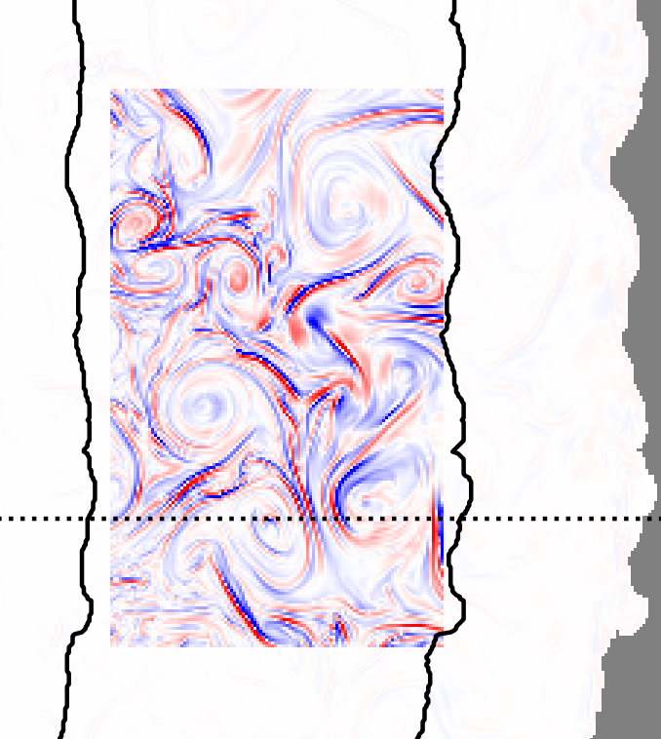
On the Impact of Submesoscale Fronts on Mesoscale Eddies and Biological Productivity in the California Current System
Masterthesis by Max Simon at Environmental Physics Group, ETH Zurich

Slide 2
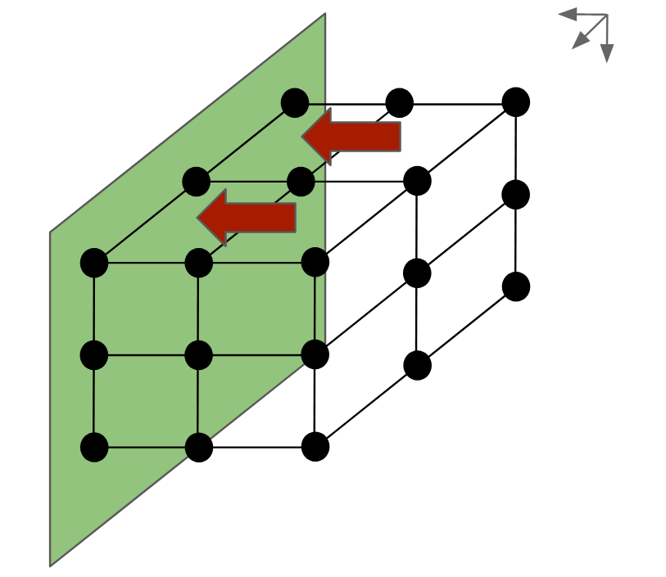
Computational Model Approach
Atmospheric Forcing
Boundary Conditions
Physics: Primitive Equations, Equation of State for u, p, S, T, ρ using ROMS
Biology: Biogeo-chemical tracers (e.g. NO3) and dynamics (NPP, carbon sinking) using ROMS-BEC (coupled to physics)
O(10km)

Slide 3

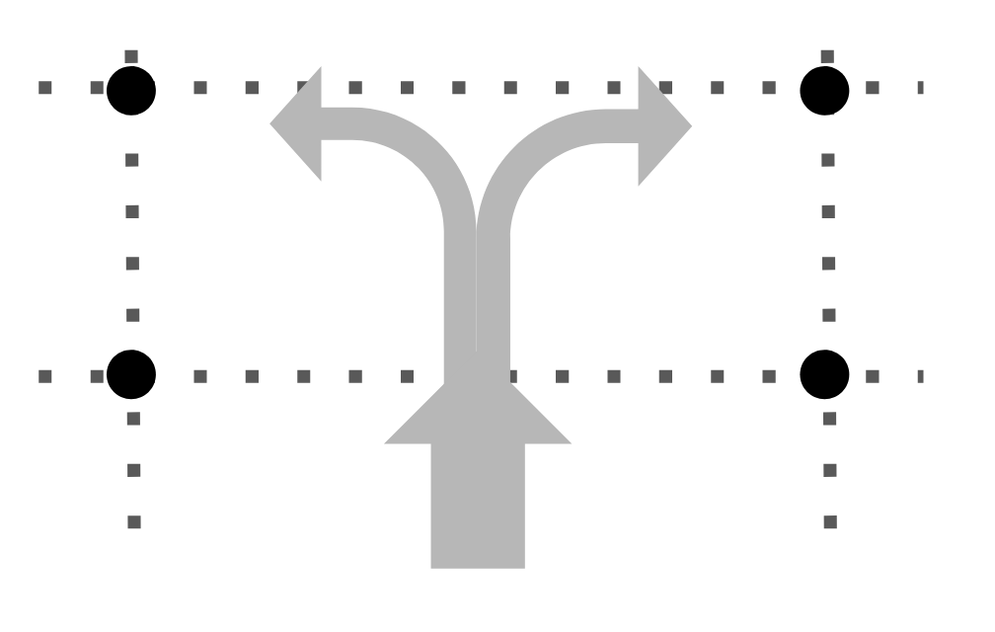
Computational Model Approach
Atmospheric Forcing
Discretization
Boundary Conditions
Physics: Primitive Equations, Equation of State for u, p, S, T, ρ using ROMS
Observations: all processes contribute to observations
Biology: Biogeo-chemical tracers (e.g. NO3) and dynamics (NPP, carbon sinking) using ROMS-BEC (coupled to physics)
O(10km)
Model: only resolved processes can contribute

Slide 4
What is the difference between a model that resolves submeso-scale fronts and a model that does not?

Slide 5
Structure
Domain & Model Data
Submesoscale Fronts
Impact on Mesoscale Eddies
Biological Productivity
Summary

Slide 6
Domain & Model Data

Slide 7
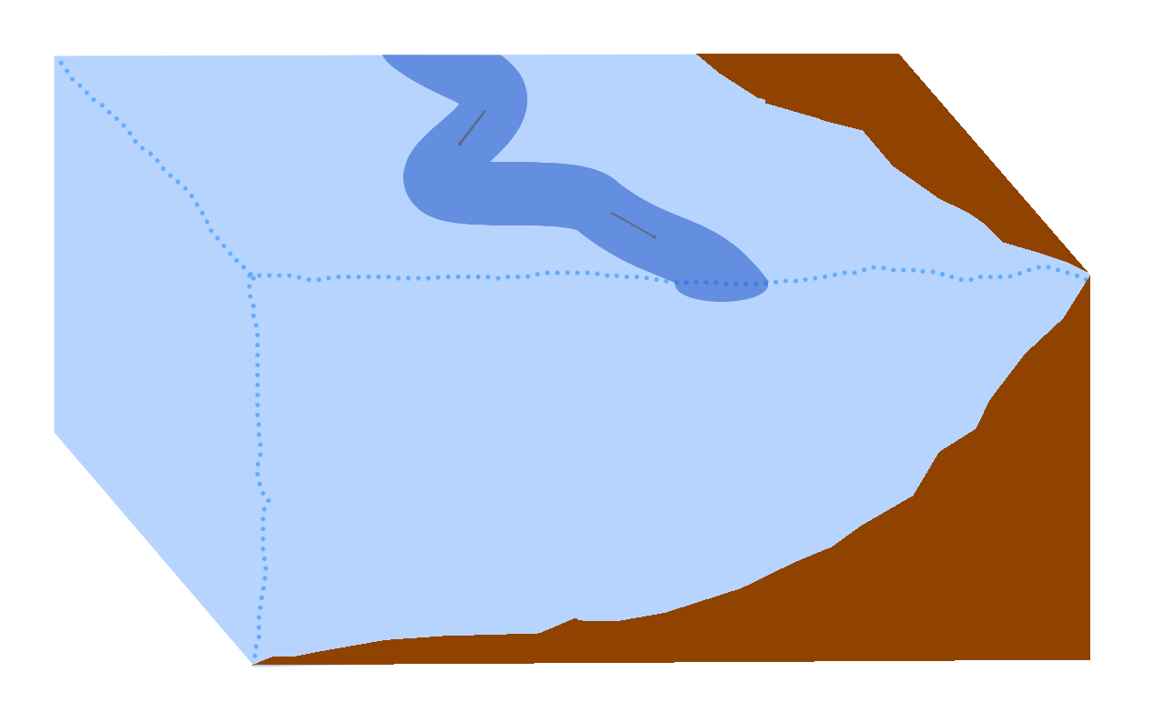
Domain: Eastern Boundary Upwelling System
Domain & Model Data
Submesoscale Fronts
Impact on Mesoscale Eddies
Biological Productivity
Summary
(based on Nagai et al., 2015)

Slide 8
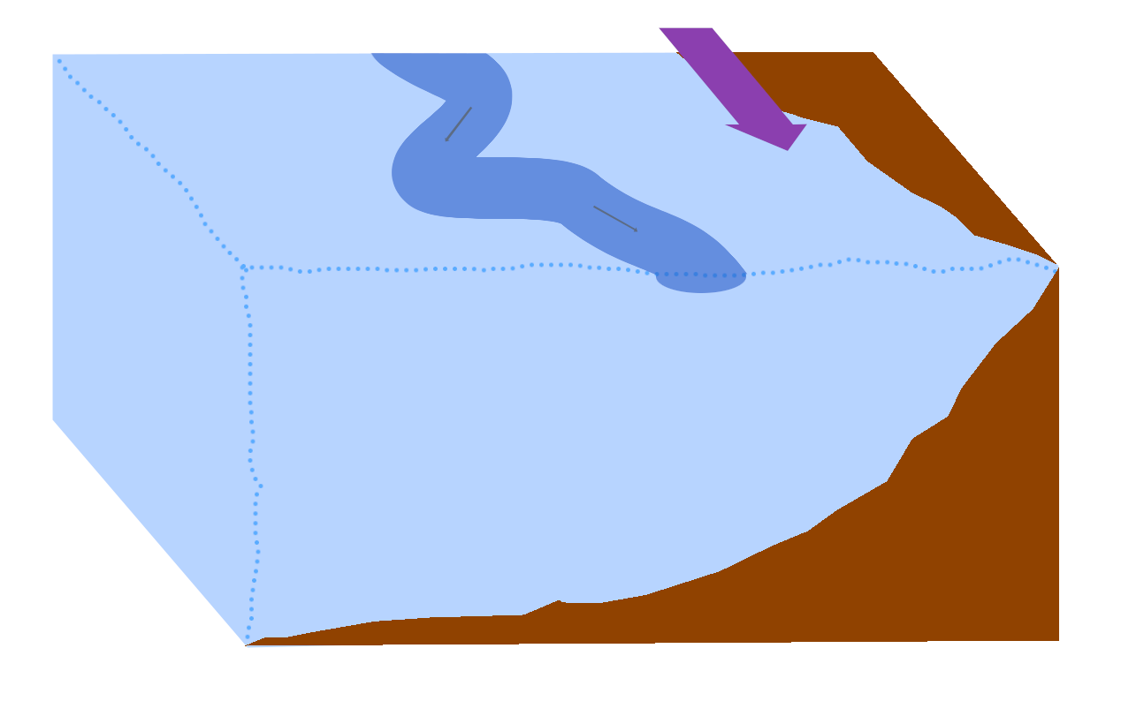
Domain: Eastern Boundary Upwelling System
Domain & Model Data
Submesoscale Fronts
Impact on Mesoscale Eddies
Biological Productivity
Summary
(based on Nagai et al., 2015)

Slide 9
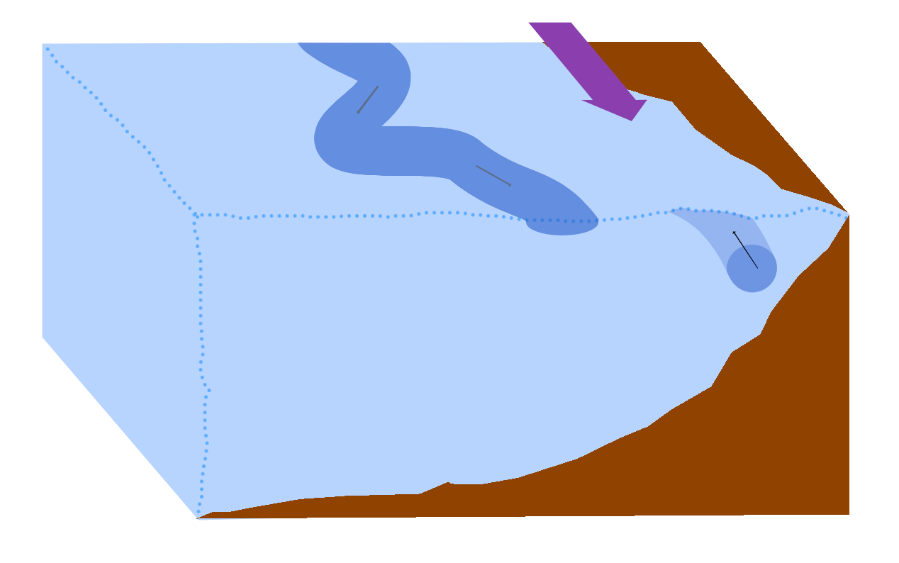
Domain: Eastern Boundary Upwelling System
Domain & Model Data
Submesoscale Fronts
Impact on Mesoscale Eddies
Biological Productivity
Summary
(based on Nagai et al., 2015)

Slide 10
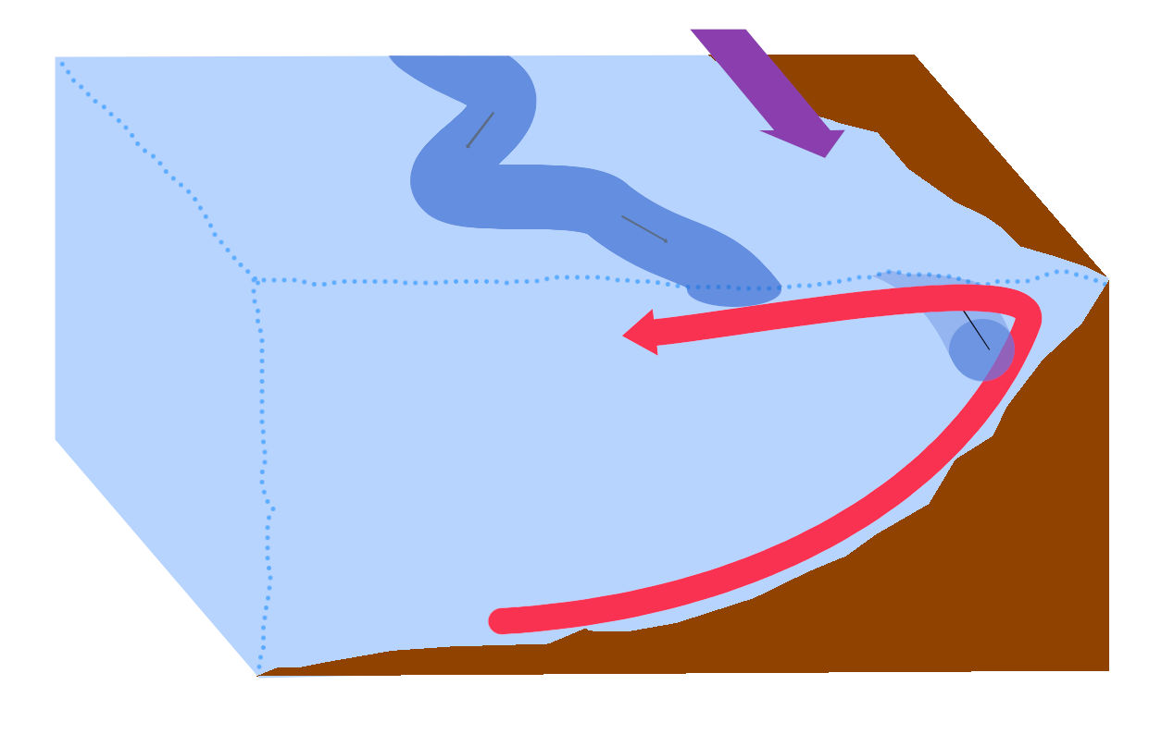
Domain: Eastern Boundary Upwelling System
Domain & Model Data
Submesoscale Fronts
Impact on Mesoscale Eddies
Biological Productivity
Summary
(based on Nagai et al., 2015)

Slide 11
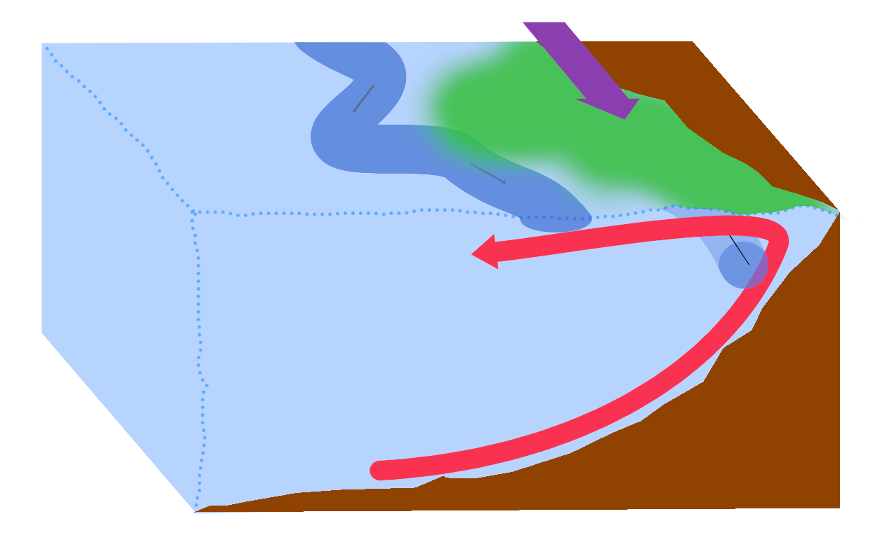
Domain: Eastern Boundary Upwelling System
Domain & Model Data
Submesoscale Fronts
Impact on Mesoscale Eddies
Biological Productivity
Summary
(based on Nagai et al., 2015)

Slide 12
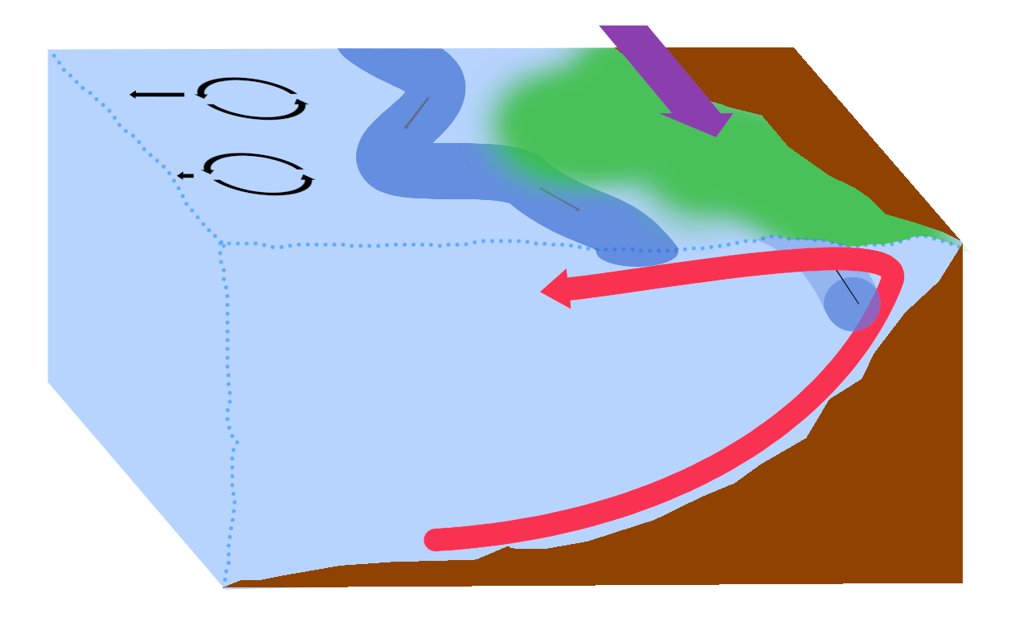
Domain: Eastern Boundary Upwelling System
Domain & Model Data
Submesoscale Fronts
Impact on Mesoscale Eddies
Biological Productivity
Summary
(based on Nagai et al., 2015)

Slide 13
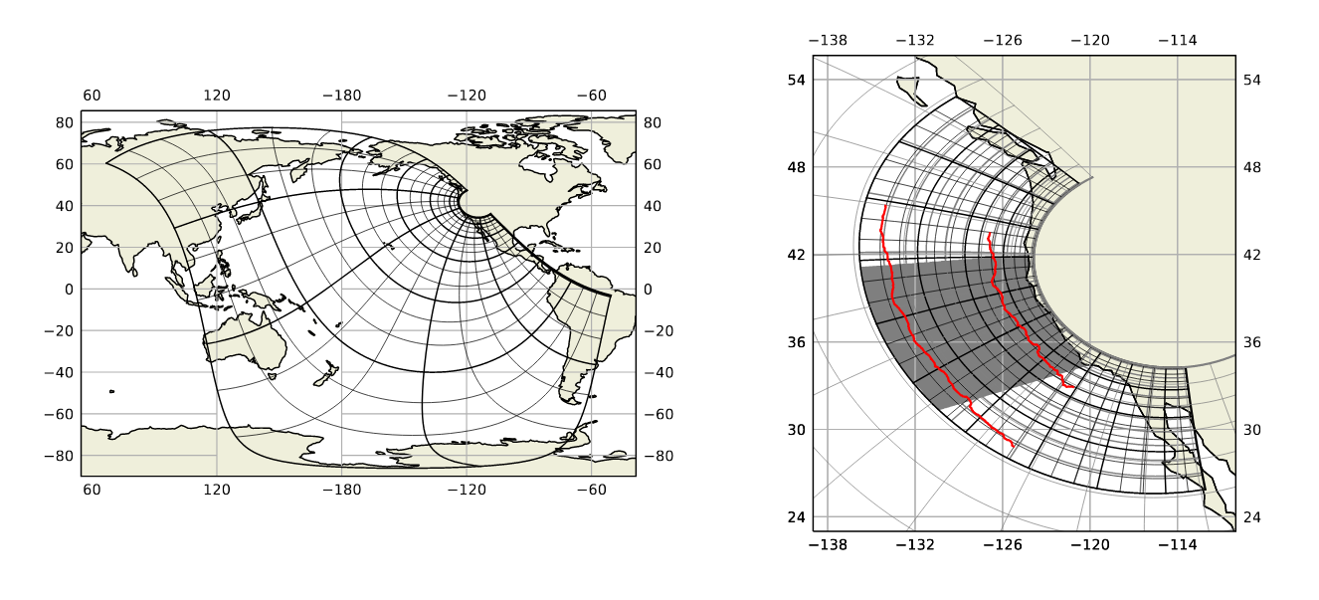
Model data
Domain & Model Data
Submesoscale Fronts
Impact on Mesoscale Eddies
Biological Productivity
Summary
High resolution (2.8 km) uswtcs
Mid resolution (7.0 km)
pactcs30
climatological forcing (normal year, ERA5)
MR integrated on full domain, used as boundary condition for HR
five years integration time, last three years used for analysis
data saved as bidaily averages

Slide 14
Submesoscale Fronts

Slide 15
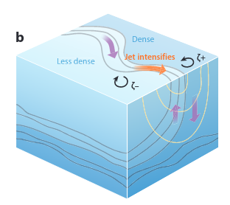
Submesoscale Fronts: Frontogenesis
Domain & Model Data
Submesoscale Fronts
Impact on Mesoscale Eddies
Biological Productivity
Summary
emerge at horizontal density fronts, driven by mesoscale eddy strain or atmospheric forcing
(Mahadevan, 2016)
(Thomas et al., 2008; Mahadevan, 2016)

Slide 16
Submesoscale Fronts: Frontogenesis
Domain & Model Data
Submesoscale Fronts
Impact on Mesoscale Eddies
Biological Productivity
Summary
emerge at horizontal density fronts, driven by mesoscale eddy strain or atmospheric forcing
ageostrophic secondary circulation to restore geostrophic balance of jet
(Mahadevan, 2016)
(Thomas et al., 2008; Mahadevan, 2016)

Slide 17

Submesoscale Fronts: Frontogenesis
Domain & Model Data
Submesoscale Fronts
Impact on Mesoscale Eddies
Biological Productivity
Summary
emerge at horizontal density fronts, driven by mesoscale eddy strain or atmospheric forcing
ageostrophic secondary circulation to restore geostrophic balance of jet
upwelling at less dense side, downwelling at dense side ( O(m/day) )
(Mahadevan, 2016)
(Thomas et al., 2008; Mahadevan, 2016)

Slide 18
Submesoscale Fronts: Frontogenesis
Domain & Model Data
Submesoscale Fronts
Impact on Mesoscale Eddies
Biological Productivity
Summary
emerge at horizontal density fronts, driven by mesoscale eddy strain or atmospheric forcing
ageostrophic secondary circulation to restore geostrophic balance of jet
upwelling at less dense side, downwelling at dense side ( O(m/day) )
modulated by mixed layer depth
(Mahadevan, 2016)
(Thomas et al., 2008; Mahadevan, 2016)

Slide 19
Submesoscale Fronts: Characteristics
Domain & Model Data
Submesoscale Fronts
Impact on Mesoscale Eddies
Biological Productivity
Summary
Vertical velocity field at 25m depth
800 km 200 km coast

Slide 20
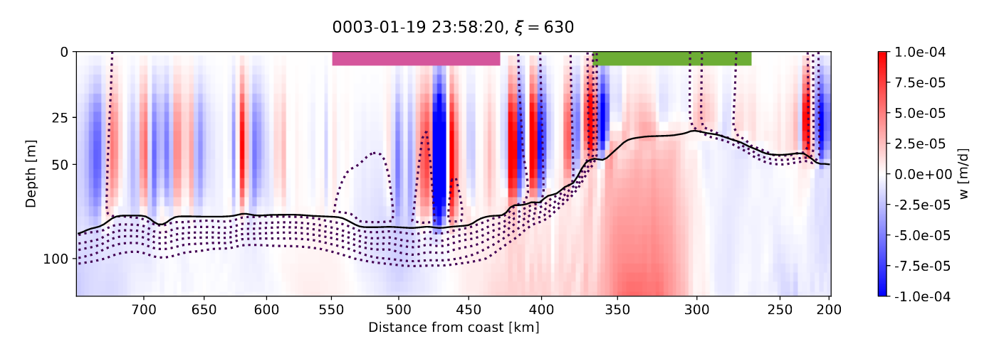
Submesoscale Fronts: Characteristics
Domain & Model Data
Submesoscale Fronts
Impact on Mesoscale Eddies
Biological Productivity
Summary
Vertical velocity field at 25m depth
Vertical velocity field as vertical section
800 km 200 km coast

Slide 21
Submesoscale Fronts: Characteristics
Domain & Model Data
Submesoscale Fronts
Impact on Mesoscale Eddies
Biological Productivity
Summary
Vertical velocity field at 25m depth
Vertical velocity field as vertical section
800 km 200 km coast
Submesoscale fronts shape vertical velocities in the mixed layer

Slide 22
Submesoscale Fronts: Characteristics
Domain & Model Data
Submesoscale Fronts
Impact on Mesoscale Eddies
Biological Productivity
Summary
Vertical velocity field at 25m depth
Vertical velocity field as vertical section
Characteristics:
strong vertical velocities
elongated features
horizontally & vertically coherent
800 km 200 km coast
Submesoscale fronts shape vertical velocities in the mixed layer

Slide 23
Submesoscale Fronts: Characteristics
Domain & Model Data
Submesoscale Fronts
Impact on Mesoscale Eddies
Biological Productivity
Summary
Vertical velocity field at 25m depth
Vertical velocity field as vertical section
Characteristics:
strong vertical velocities
elongated features
horizontally & vertically coherent
Detection:
thresholding vertical velocity field
connected components
800 km 200 km coast
Submesoscale fronts shape vertical velocities in the mixed layer

Slide 24
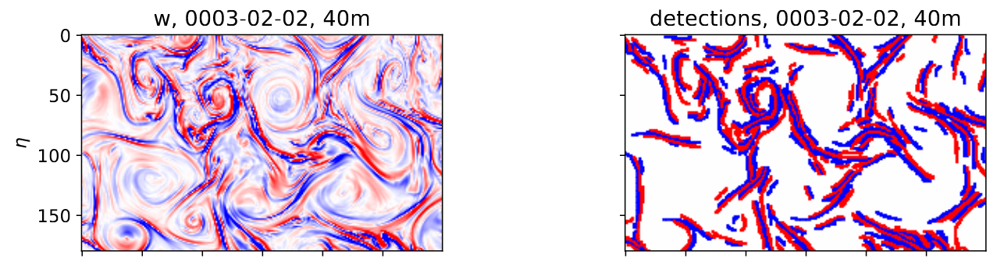
Submesoscale Fronts: Characteristics
Domain & Model Data
Submesoscale Fronts
Impact on Mesoscale Eddies
Biological Productivity
Summary
Vertical velocity field at 25m depth
Vertical velocity field as vertical section
Characteristics:
strong vertical velocities
elongated features
horizontally & vertically coherent
Detection:
thresholding vertical velocity field
connected components
800 km 200 km coast
Continuous values of vertical velocity
Boolean map of submeso-scale fronts
Submesoscale fronts shape vertical velocities in the mixed layer

Slide 25
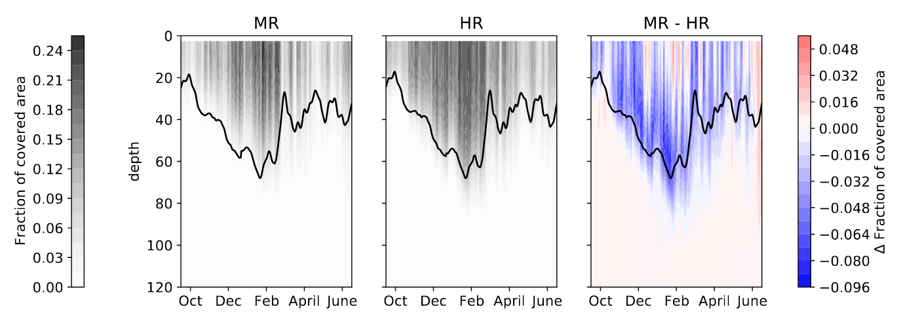
Submesoscale Fronts: Detection Algorithm
Domain & Model Data
Submesoscale Fronts
Impact on Mesoscale Eddies
Biological Productivity
Summary

Slide 26
Submesoscale Fronts: Detection Algorithm
Domain & Model Data
Submesoscale Fronts
Impact on Mesoscale Eddies
Biological Productivity
Summary
reproduce modulation by MLD
reproduce seasonality (given by MLD, deepest in winter)

Slide 27
Submesoscale Fronts: Detection Algorithm
Domain & Model Data
Submesoscale Fronts
Impact on Mesoscale Eddies
Biological Productivity
Summary
reproduce modulation by MLD
reproduce seasonality (given by MLD, deepest in winter)
reproduce asymmetry between upwelling and downwelling

Slide 28
Submesoscale Fronts: Detection Algorithm
Domain & Model Data
Submesoscale Fronts
Impact on Mesoscale Eddies
Biological Productivity
Summary
reproduce modulation by MLD
reproduce seasonality (given by MLD, deepest in winter)
reproduce asymmetry between upwelling and downwelling
visual inspection
Does its job in both, MR and HR ✓

Slide 29
Submesoscale Fronts: Detection Algorithm
Domain & Model Data
Submesoscale Fronts
Impact on Mesoscale Eddies
Biological Productivity
Summary
fronts cover larger fraction of domain in HR than in MR
reproduce modulation by MLD
reproduce seasonality (given by MLD, deepest in winter)
reproduce asymmetry between upwelling and downwelling
visual inspection
Does its job in both, MR and HR ✓

Slide 30
Impact on Mesoscale Eddies

Slide 31
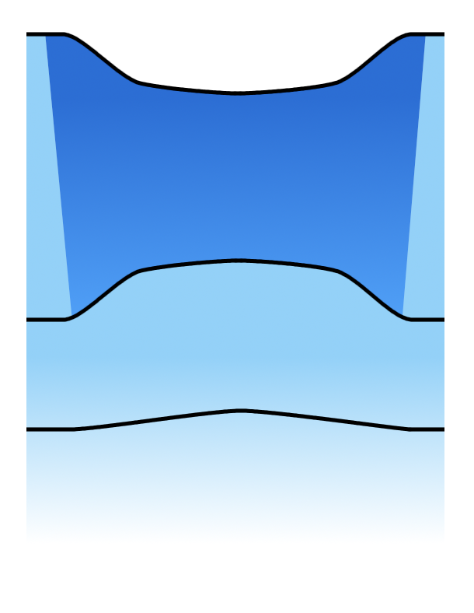
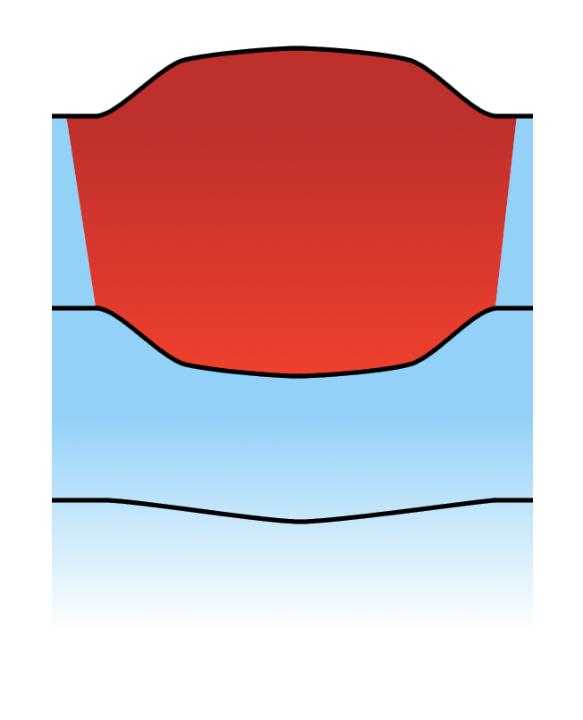

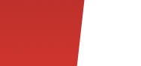
Mesoscale Eddies
Domain & Model Data
Submesoscale Fronts
Impact on Mesoscale Eddies
Biological Productivity
Summary
Cyclones
Anticyclones
radius 20 km - 200 km, several months lifetime
Positive ρ, negative T anomaly
Negative ρ, positive T anomaly
few hundred metres
eddy length scale, tenth of kilometres
(based on Frenger et al., 2015)
(McWilliams, 2008; Kurian et al., 2011; Freilich & Mahadevan, 2019)

Slide 32
Mesoscale Eddies
Domain & Model Data
Submesoscale Fronts
Impact on Mesoscale Eddies
Biological Productivity
Summary
Cyclones
Anticyclones
radius 20 km - 200 km, several months lifetime
tracking by SSH anomaly
Positive ρ, negative T anomaly
Negative ρ, positive T anomaly
few hundred metres
eddy length scale, tenth of kilometres
(based on Frenger et al., 2015)
(McWilliams, 2008; Kurian et al., 2011; Freilich & Mahadevan, 2019)

Slide 33
Mesoscale Eddies
Domain & Model Data
Submesoscale Fronts
Impact on Mesoscale Eddies
Biological Productivity
Summary
Cyclones
Anticyclones
radius 20 km - 200 km, several months lifetime
tracking by SSH anomaly
trap fluids and transport biogeochemical tracers
negative SSH anomaly
positive SSH anomaly
Positive ρ, negative T anomaly
Negative ρ, positive T anomaly
few hundred metres
eddy length scale, tenth of kilometres
(based on Frenger et al., 2015)
(McWilliams, 2008; Kurian et al., 2011; Freilich & Mahadevan, 2019)

Slide 34
Mesoscale Eddies
Domain & Model Data
Submesoscale Fronts
Impact on Mesoscale Eddies
Biological Productivity
Summary
Cyclones
Anticyclones
radius 20 km - 200 km, several months lifetime
tracking by SSH anomaly
trap fluids and transport biogeochemical tracers
interactions with wind stress or other eddies can induce strong vertical velocities
negative SSH anomaly
positive SSH anomaly
Positive ρ, negative T anomaly
Negative ρ, positive T anomaly
few hundred metres
eddy length scale, tenth of kilometres
(based on Frenger et al., 2015)
(McWilliams, 2008; Kurian et al., 2011; Freilich & Mahadevan, 2019)

Slide 35
Mesoscale Eddies
Domain & Model Data
Submesoscale Fronts
Impact on Mesoscale Eddies
Biological Productivity
Summary
Cyclones
Anticyclones
radius 20 km - 200 km, several months lifetime
tracking by SSH anomaly
trap fluids and transport biogeochemical tracers
interactions with wind stress or other eddies can induce strong vertical velocities
displacement of isopycnals allows for fluxes into/out of euphotic zone and alters mixed layer depth
negative SSH anomaly
positive SSH anomaly
Positive ρ, negative T anomaly
Negative ρ, positive T anomaly
few hundred metres
eddy length scale, tenth of kilometres
(based on Frenger et al., 2015)
(McWilliams, 2008; Kurian et al., 2011; Freilich & Mahadevan, 2019)

Slide 36
Mesoscale Eddies: Energy Cascade
Domain & Model Data
Submesoscale Fronts
Impact on Mesoscale Eddies
Biological Productivity
Summary
Mesoscale Eddies
Inverse energy cascade by eddy merging
(McWilliams, 2016; Schubert et al., 2020)

Slide 37
Mesoscale Eddies: Energy Cascade
Domain & Model Data
Submesoscale Fronts
Impact on Mesoscale Eddies
Biological Productivity
Summary
Mesoscale Eddies
Submesoscale Fronts
Forward Energy Cascade
Inverse energy cascade by eddy merging
(McWilliams, 2016; Schubert et al., 2020)

Slide 38
Mesoscale Eddies: Energy Cascade
Domain & Model Data
Submesoscale Fronts
Impact on Mesoscale Eddies
Biological Productivity
Summary
Mesoscale Eddies
Submesoscale Fronts
Forward Energy Cascade
Mixed Layer Eddies
Inverse energy cascade by eddy merging
(McWilliams, 2016; Schubert et al., 2020)

Slide 39
Energy Cascade: Submesoscale Contribution
Domain & Model Data
Submesoscale Fronts
Impact on Mesoscale Eddies
Biological Productivity
Summary
Schubert et al., 2020
inverse energy cascade is fueled by eddies with radius down to 17 km
Our work
eddies < 20 km much better resolved in HR model

Slide 40
Energy Cascade: Submesoscale Contribution
Domain & Model Data
Submesoscale Fronts
Impact on Mesoscale Eddies
Biological Productivity
Summary
Schubert et al., 2020
inverse energy cascade is fueled by eddies with radius down to 17 km
energy reaches mesoscale in late spring/early summer (seasonality of submesoscale fronts)
Our work
eddies < 20 km much better resolved in HR model
strongest increase in EKE in early summer by ~50 %

Slide 41
Energy Cascade: Submesoscale Contribution
Domain & Model Data
Submesoscale Fronts
Impact on Mesoscale Eddies
Biological Productivity
Summary
Schubert et al., 2020
inverse energy cascade is fueled by eddies with radius down to 17 km
energy reaches mesoscale in late spring/early summer (seasonality of submesoscale fronts)
kinetic energy at mesoscale is reduced by 20 % when submesoscale motions are not resolved
Our work
eddies < 20 km much better resolved in HR model
strongest increase in EKE in early summer by ~50 %
overall EKE increases by ~10 % in HR

Slide 42
Energy Cascade: Submesoscale Contribution
Domain & Model Data
Submesoscale Fronts
Impact on Mesoscale Eddies
Biological Productivity
Summary
Schubert et al., 2020
inverse energy cascade is fueled by eddies with radius down to 17 km
energy reaches mesoscale in late spring/early summer (seasonality of submesoscale fronts)
kinetic energy at mesoscale is reduced by 20 % when submesoscale motions are not resolved
Our work
eddies < 20 km much better resolved in HR model
strongest increase in EKE in early summer by ~50 %
overall EKE increases by ~10 % in HR
Submesoscale fronts energize mesoscale eddies

Slide 43
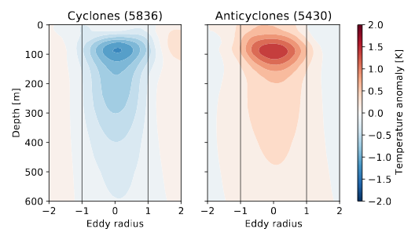
Mesoscale Eddies: Impact on Density Anomaly
Domain & Model Data
Submesoscale Fronts
Impact on Mesoscale Eddies
Biological Productivity
Summary

Slide 44
Mesoscale Eddies: Impact on Density Anomaly
Domain & Model Data
Submesoscale Fronts
Impact on Mesoscale Eddies
Biological Productivity
Summary
Mean bet-ween 80 m and 120 m

Slide 45
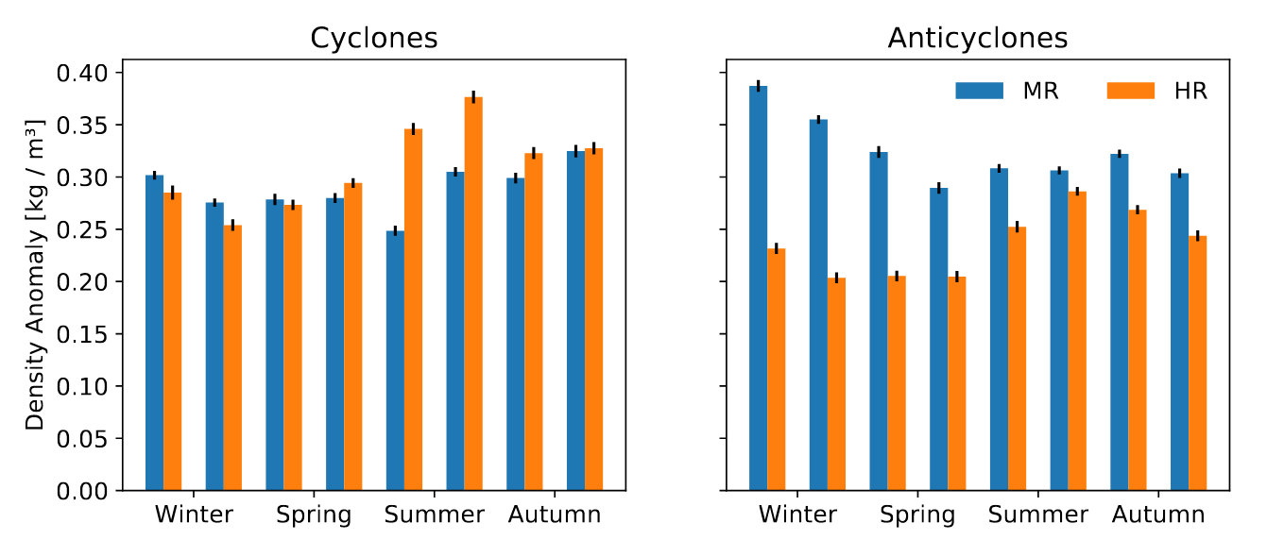
Mesoscale Eddies: Impact on Density Anomaly
Domain & Model Data
Submesoscale Fronts
Impact on Mesoscale Eddies
Biological Productivity
Summary
Mean bet-ween 80 m and 120 m

Slide 46
Mesoscale Eddies: Impact on Density Anomaly
Domain & Model Data
Submesoscale Fronts
Impact on Mesoscale Eddies
Biological Productivity
Summary
Mean bet-ween 80 m and 120 m
cyclones are only little affected

Slide 47
Mesoscale Eddies: Impact on Density Anomaly
Domain & Model Data
Submesoscale Fronts
Impact on Mesoscale Eddies
Biological Productivity
Summary
Mean bet-ween 80 m and 120 m
cyclones are only little affected
anticyclones are strongly damped during winter and spring by ~40 %

Slide 48
Mesoscale Eddies: Intersection with Fronts
Domain & Model Data
Submesoscale Fronts
Impact on Mesoscale Eddies
Biological Productivity
Summary
Coverage of mesoscale eddies by submesoscale fronts at 25 m depth from January to March
(Thomas et al., 2013; Brannigan et al., 2017; Su et al., 2018; Klein et al., 2019)

Slide 49
Mesoscale Eddies: Intersection with Fronts
Domain & Model Data
Submesoscale Fronts
Impact on Mesoscale Eddies
Biological Productivity
Summary
Coverage of mesoscale eddies by submesoscale fronts at 25 m depth from January to March
 | Cyclones | Anticyclones
MR | 7.0 % | 11.7 %
HR | 8.3 % | 20.0 %
(Thomas et al., 2013; Brannigan et al., 2017; Su et al., 2018; Klein et al., 2019)

Slide 50
Mesoscale Eddies: Intersection with Fronts
Domain & Model Data
Submesoscale Fronts
Impact on Mesoscale Eddies
Biological Productivity
Summary
Coverage of mesoscale eddies by submesoscale fronts at 25 m depth from January to March
 | Cyclones | Anticyclones
MR | 7.0 % | 11.7 %
HR | 8.3 % | 20.0 %
submesoscale fronts cover larger parts of anticyclones, especially in HR
(Thomas et al., 2013; Brannigan et al., 2017; Su et al., 2018; Klein et al., 2019)

Slide 51
Mesoscale Eddies: Intersection with Fronts
Domain & Model Data
Submesoscale Fronts
Impact on Mesoscale Eddies
Biological Productivity
Summary
Coverage of mesoscale eddies by submesoscale fronts at 25 m depth from January to March
 | Cyclones | Anticyclones
MR | 7.0 % | 11.7 %
HR | 8.3 % | 20.0 %
submesoscale fronts cover larger parts of anticyclones, especially in HR
also observed by Brannigan et al., 2017
(Thomas et al., 2013; Brannigan et al., 2017; Su et al., 2018; Klein et al., 2019)

Slide 52
Mesoscale Eddies: Intersection with Fronts
Domain & Model Data
Submesoscale Fronts
Impact on Mesoscale Eddies
Biological Productivity
Summary
Coverage of mesoscale eddies by submesoscale fronts at 25 m depth from January to March
 | Cyclones | Anticyclones
MR | 7.0 % | 11.7 %
HR | 8.3 % | 20.0 %
submesoscale fronts cover larger parts of anticyclones, especially in HR
also observed by Brannigan et al., 2017
anticyclonic vorticity and deeper MLD
(Thomas et al., 2013; Brannigan et al., 2017; Su et al., 2018; Klein et al., 2019)

Slide 53
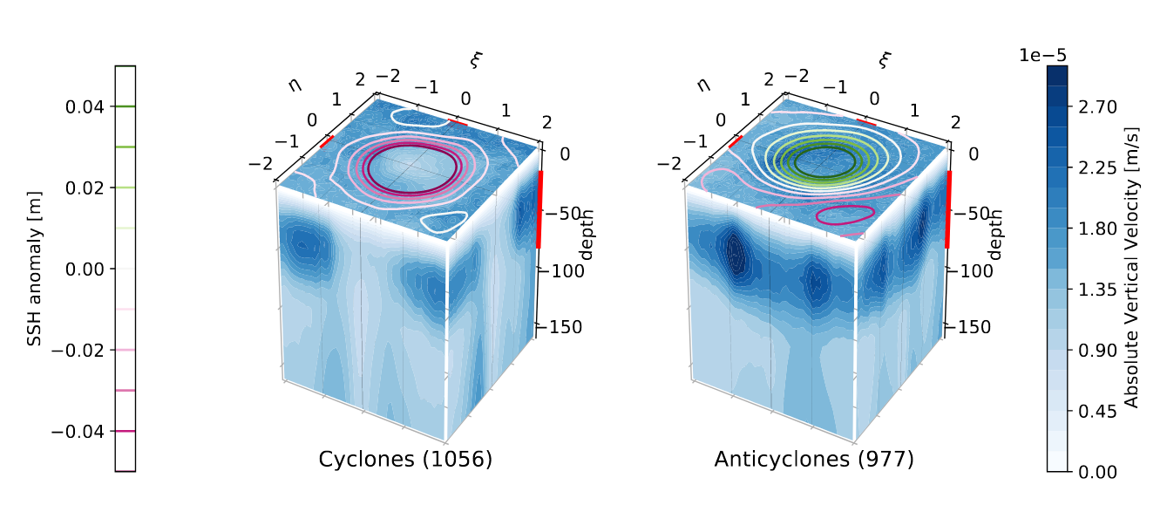
Mesoscale Eddies: Intersection with Fronts
Domain & Model Data
Submesoscale Fronts
Impact on Mesoscale Eddies
Biological Productivity
Summary
Coverage of mesoscale eddies by submesoscale fronts at 25 m depth from January to March
 | Cyclones | Anticyclones
MR | 7.0 % | 11.7 %
HR | 8.3 % | 20.0 %
Eddy composites of absolute vertical velocity in HR, January to March
submesoscale fronts cover larger parts of anticyclones, especially in HR
also observed by Brannigan et al., 2017
anticyclonic vorticity and deeper MLD
fronts lead to strong vertical velocities inside eddy core in anticyclones
(Thomas et al., 2013; Brannigan et al., 2017; Su et al., 2018; Klein et al., 2019)

Slide 54
Mesoscale Eddies: Intersection with Fronts
Domain & Model Data
Submesoscale Fronts
Impact on Mesoscale Eddies
Biological Productivity
Summary
Coverage of mesoscale eddies by submesoscale fronts at 25 m depth from January to March
 | Cyclones | Anticyclones
MR | 7.0 % | 11.7 %
HR | 8.3 % | 20.0 %
Eddy composites of absolute vertical velocity in HR, January to March
submesoscale fronts cover larger parts of anticyclones, especially in HR
also observed by Brannigan et al., 2017
anticyclonic vorticity and deeper MLD
fronts lead to strong vertical velocities inside eddy core in anticyclones
fronts induce a positive vertical heat flux which could undermine positive temperature anomaly of anticyclones
(Thomas et al., 2013; Brannigan et al., 2017; Su et al., 2018; Klein et al., 2019)

Slide 55
Mesoscale Eddies: Intersection with Fronts
Domain & Model Data
Submesoscale Fronts
Impact on Mesoscale Eddies
Biological Productivity
Summary
Coverage of mesoscale eddies by submesoscale fronts at 25 m depth from January to March
 | Cyclones | Anticyclones
MR | 7.0 % | 11.7 %
HR | 8.3 % | 20.0 %
Eddy composites of absolute vertical velocity in HR, January to March
submesoscale fronts cover larger parts of anticyclones, especially in HR
also observed by Brannigan et al., 2017
anticyclonic vorticity and deeper MLD
fronts lead to strong vertical velocities inside eddy core in anticyclones
fronts induce a positive vertical heat flux which could undermine positive temperature anomaly of anticyclones
Submesoscale fronts damp the density anomaly of mesoscale anticyclones
(Thomas et al., 2013; Brannigan et al., 2017; Su et al., 2018; Klein et al., 2019)

Slide 56
Biological Productivity

Slide 57
Submesoscale Impacts on Biological Productivity
Domain & Model Data
Submesoscale Fronts
Impact on Mesoscale Eddies
Biological Productivity
Summary
vertical exchange of nutrients and organic matter by strong vertical velocities
but: bound to mixed layer, depth is out of phase with biological productivity.
(Mahadevan et al., 2012; Levy et al., 2018; Kessouri et al., 2020)

Slide 58
Submesoscale Impacts on Biological Productivity
Domain & Model Data
Submesoscale Fronts
Impact on Mesoscale Eddies
Biological Productivity
Summary
vertical exchange of nutrients and organic matter by strong vertical velocities
enhancing light exposure time by restratification of mixed layer
but: bound to mixed layer, depth is out of phase with biological productivity.
important when productivity is light limited (spring bloom)
(Mahadevan et al., 2012; Levy et al., 2018; Kessouri et al., 2020)

Slide 59
Submesoscale Impacts on Biological Productivity
Domain & Model Data
Submesoscale Fronts
Impact on Mesoscale Eddies
Biological Productivity
Summary
vertical exchange of nutrients and organic matter by strong vertical velocities
enhancing light exposure time by restratification of mixed layer
impact on larger scale transport processes
but: bound to mixed layer, depth is out of phase with biological productivity.
important when productivity is light limited (spring bloom)
e.g. eddy quenching
(Mahadevan et al., 2012; Levy et al., 2018; Kessouri et al., 2020)

Slide 60
Eddy Quenching
Domain & Model Data
Submesoscale Fronts
Impact on Mesoscale Eddies
Biological Productivity
Summary
(Lathuilière et al., 2010; Gruber et al., 2011; Nagai et al., 2015)

Slide 61
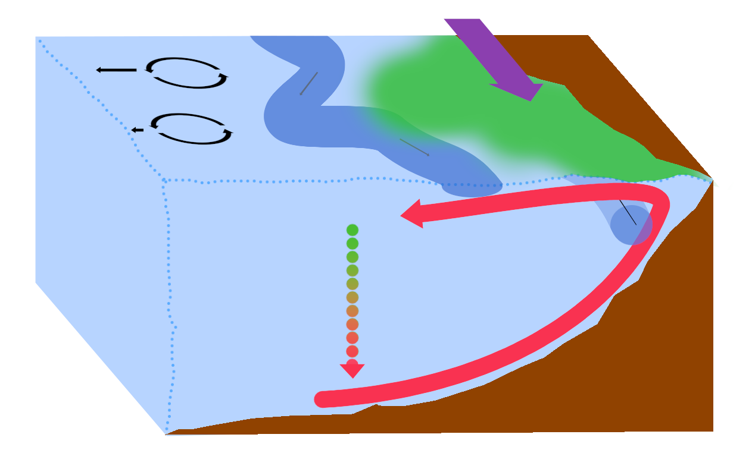
Eddy Quenching
Domain & Model Data
Submesoscale Fronts
Impact on Mesoscale Eddies
Biological Productivity
Summary
(Lathuilière et al., 2010; Gruber et al., 2011; Nagai et al., 2015)

Slide 62
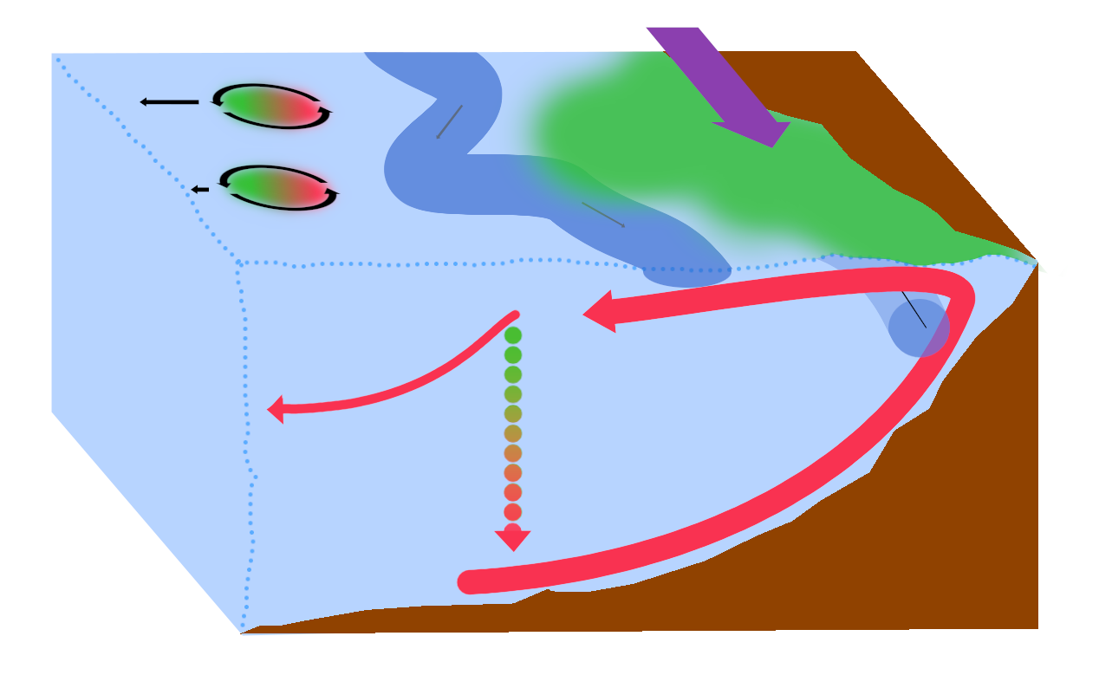
Eddy Quenching
Domain & Model Data
Submesoscale Fronts
Impact on Mesoscale Eddies
Biological Productivity
Summary
(Lathuilière et al., 2010; Gruber et al., 2011; Nagai et al., 2015)

Slide 63
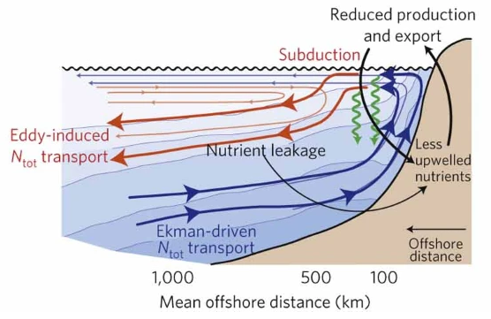
Eddy Quenching
Domain & Model Data
Submesoscale Fronts
Impact on Mesoscale Eddies
Biological Productivity
Summary
(Gruber et al., 2011)
(Lathuilière et al., 2010; Gruber et al., 2011; Nagai et al., 2015)

Slide 64
Submesoscale Impacts on Biological Productivity
Domain & Model Data
Submesoscale Fronts
Impact on Mesoscale Eddies
Biological Productivity
Summary
vertical exchange of nutrients and organic matter by strong vertical velocities
enhancing light exposure time by restratification of mixed layer
impact on larger scale transport processes
but: bound to mixed layer, depth is out of phase with biological productivity.
important when productivity is light limited (spring bloom)
e.g. eddy quenching
(Mahadevan et al., 2012; Levy et al., 2018; Kessouri et al., 2020)

Slide 65
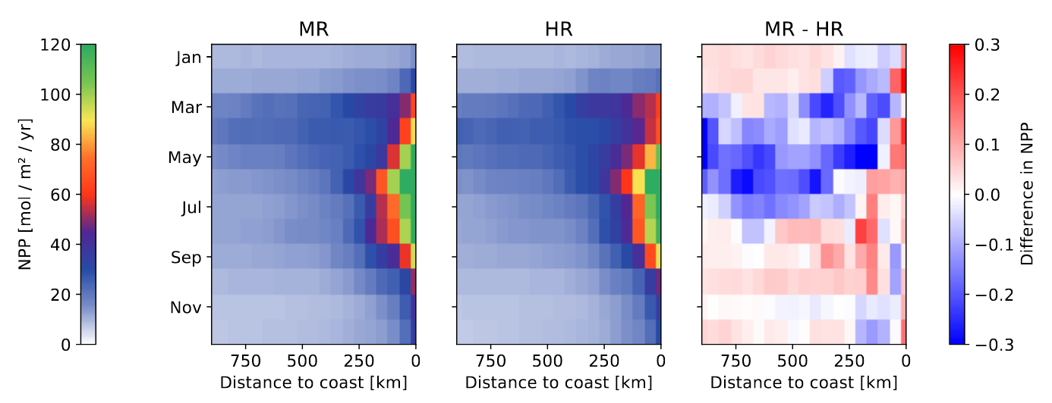
Net Primary Production
Domain & Model Data
Submesoscale Fronts
Impact on Mesoscale Eddies
Biological Productivity
Summary

Slide 66
Net Primary Production
Domain & Model Data
Submesoscale Fronts
Impact on Mesoscale Eddies
Biological Productivity
Summary
Light Exposure

Slide 67
Net Primary Production
Domain & Model Data
Submesoscale Fronts
Impact on Mesoscale Eddies
Biological Productivity
Summary
Light Exposure
Transport Processes

Slide 68
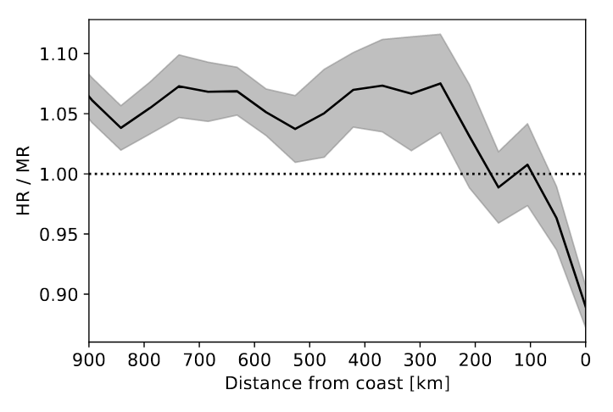
Net Primary Production
Domain & Model Data
Submesoscale Fronts
Impact on Mesoscale Eddies
Biological Productivity
Summary
Light Exposure
Transport Processes
+6.0 %
-3.8 %

Slide 69
Net Primary Production
Domain & Model Data
Submesoscale Fronts
Impact on Mesoscale Eddies
Biological Productivity
Summary
Light Exposure
Transport Processes
+6.0 %
-3.8 %
productivity decreases at coast and increases offshore

Slide 70
Net Primary Production
Domain & Model Data
Submesoscale Fronts
Impact on Mesoscale Eddies
Biological Productivity
Summary
Light Exposure
Transport Processes
+6.0 %
-3.8 %
productivity decreases at coast and increases offshore
transport processes require more time to take effect

Slide 71
Net Primary Production
Domain & Model Data
Submesoscale Fronts
Impact on Mesoscale Eddies
Biological Productivity
Summary
Light Exposure
Transport Processes
+6.0 %
-3.8 %
productivity decreases at coast and increases offshore
transport processes require more time to take effect
not all effects are captured due to short integration time

Slide 72
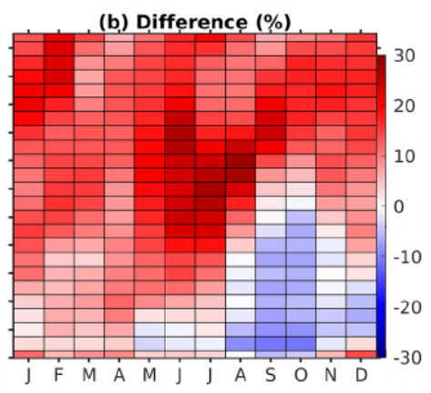

Net Primary Production
Domain & Model Data
Submesoscale Fronts
Impact on Mesoscale Eddies
Biological Productivity
Summary
Light Exposure
Transport Processes
+6.0 %
-3.8 %
productivity decreases at coast and increases offshore
transport processes require more time to take effect
not all effects are captured due to short integration time
Kessouri et al., 2020: longer integration time, better tuning of model
(Kessouri et al., 2020)

Slide 73
Net Primary Production
Domain & Model Data
Submesoscale Fronts
Impact on Mesoscale Eddies
Biological Productivity
Summary
Light Exposure
Transport Processes
+6.0 %
-3.8 %
productivity decreases at coast and increases offshore
transport processes require more time to take effect
not all effects are captured due to short integration time
Kessouri et al., 2020: longer integration time, better tuning of model
(Kessouri et al., 2020)
Resolving submesoscale motions broadens the productive band

Slide 74
Summary
Domain & Model Data
Submesoscale Fronts
Impact on Mesoscale Eddies
Biological Productivity
Summary
Submesoscale fronts shape vertical velocities in the mixed layer

Slide 75
Summary
Domain & Model Data
Submesoscale Fronts
Impact on Mesoscale Eddies
Biological Productivity
Summary
Submesoscale fronts shape vertical velocities in the mixed layer
Submesoscale fronts energize mesoscale eddies

Slide 76
Summary
Domain & Model Data
Submesoscale Fronts
Impact on Mesoscale Eddies
Biological Productivity
Summary
Submesoscale fronts shape vertical velocities in the mixed layer
Submesoscale fronts energize mesoscale eddies
Submesoscale fronts damp the density anomaly of mesoscale anticyclones

Slide 77
Summary
Domain & Model Data
Submesoscale Fronts
Impact on Mesoscale Eddies
Biological Productivity
Summary
Submesoscale fronts shape vertical velocities in the mixed layer
Submesoscale fronts energize mesoscale eddies
Submesoscale fronts damp the density anomaly of mesoscale anticyclones
Resolving submesoscale motions broadens the productive band

Slide 78

Summary
Domain & Model Data
Submesoscale Fronts
Impact on Mesoscale Eddies
Biological Productivity
Summary
Submesoscale fronts shape vertical velocities in the mixed layer
Submesoscale fronts energize mesoscale eddies
Submesoscale fronts damp the density anomaly of mesoscale anticyclones
Resolving submesoscale motions broadens the productive band
Thesis and source code:
https://github.com/max-simon/master-thesis

Slide 79
Outlook
Domain & Model Data
Submesoscale Fronts
Impact on Mesoscale Eddies
Biological Productivity
Summary
fix shortcomings: longer integration time, better tuning of model

Slide 80
Outlook
Domain & Model Data
Submesoscale Fronts
Impact on Mesoscale Eddies
Biological Productivity
Summary
fix shortcomings: longer integration time, better tuning of model
reason for increased presence of submesoscale fronts and for reduced density anomaly in anticyclones

Slide 81
Outlook
Domain & Model Data
Submesoscale Fronts
Impact on Mesoscale Eddies
Biological Productivity
Summary
fix shortcomings: longer integration time, better tuning of model
reason for increased presence of submesoscale fronts and for reduced density anomaly in anticyclones
interaction with other processes, e.g. coastal filaments, submesoscale coherent vortices or inertial gravity waves

Slide 82
Outlook
Domain & Model Data
Submesoscale Fronts
Impact on Mesoscale Eddies
Biological Productivity
Summary
fix shortcomings: longer integration time, better tuning of model
reason for increased presence of submesoscale fronts and for reduced density anomaly in anticyclones
interaction with other processes, e.g. coastal filaments, submesoscale coherent vortices or inertial gravity waves
confirm impact on biological productivity with Lagrangian experiments

Slide 83
Outlook
Domain & Model Data
Submesoscale Fronts
Impact on Mesoscale Eddies
Biological Productivity
Summary
fix shortcomings: longer integration time, better tuning of model
reason for increased presence of submesoscale fronts and for reduced density anomaly in anticyclones
interaction with other processes, e.g. coastal filaments, submesoscale coherent vortices or inertial gravity waves
confirm impact on biological productivity with Lagrangian experiments
impact on carbon export and biodiversity

Slide 84
References
Brannigan, L., Marshall, D. P., Garabato, A. C., Nurser, A. J., & Kaiser, J. (2017). Submesoscale instabilities in mesoscale eddies. Journal of Physical Oceanography, 47(12), 3061–3085. https://doi.org/10.1175/JPO-D-16-0178.1
Freilich, M. A., & Mahadevan, A. (2019). Decomposition of vertical velocity for nutrient transport in the upper ocean. Journal of Physical Oceanography, 49(6), 1561–1575. https://doi.org/10.1175/JPO-D-19-0002.1
Frenger, I., Münnich, M., Gruber, N., & Knutti, R. (2015). Southern Ocean eddy phenomenology. Journal of Geophysical Research: Oceans, 120(11), 7413–7449. https://doi.org/10.1002/2015JC011047
Kessouri, F., Bianchi, D., Renault, L., McWilliams, J. C., Frenzel, H., & Deutsch, C. (2020). Submesoscale currents modulate the seasonal cycle of nutrients and productivity in the California Current System. Global Biogeochemical Cycles, 34(10). https://doi.org/10.1029/2020gb006578
Klein, P., Lapeyre, G., Siegelman, L., Qiu, B., Fu, L.-L., Torres, H., Su, Z., Menemen-lis, D., & Le Gentil, S. (2019). Ocean‐Scale Interactions From Space. Earth and Space Science, 6(5), 795–817. https://doi.org/10.1029/2018EA000492
Kurian, J., Colas, F., Capet, X., McWilliams, J. C., & Chelton, D. B. (2011). Eddyproperties in the California Current System. Journal of Geophysical Research: Oceans, 116(8). https://doi.org/10.1029/2010JC006895
Lathuilière, C., Echevin, V., Lévy, M., & Madec, G. (2010). On the role of the mesoscale circulation on an idealized coastal upwelling ecosystem. Journal of Geophysical Research, 115(C9), C09018. https://doi.org/10.1029/2009JC005827
Lévy, M., Franks, P. J., & Smith, K. S. (2018). The role of submesoscale currents in structuring marine ecosystems. Nature Communications, 9(1), 1–16. https://doi.org/10.1038/s41467-018-07059-3
Mahadevan, A. (2016). The Impact of Submesoscale Physics on Primary Productivity of Plankton. Annual Review of Marine Science, 8(1), 161–184. https://doi.org/10.1146/annurev-marine-010814-015912
Mahadevan, A., D’Asaro, E., Lee, C., & Perry, M. J. (2012). Eddy-driven stratification initiates North Atlantic spring phytoplankton blooms. Science, 336(6090), 54–58. https://doi.org/10.1126/science.1218740
McWilliams, J. C. (2008). The nature and consequences of oceanic eddies. Geophysical monograph series (pp. 5–15). Blackwell Publishing Ltd. https://doi.org/10.1029/177GM03
McWilliams, J. C. (2016). Submesoscale currents in the ocean. Proceedings of the Royal Society A: Mathematical, Physical and Engineering Sciences, 472(2189), 20160117. https://doi.org/10.1098/rspa.2016.0117
Nagai, T., Gruber, N., Frenzel, H., Lachkar, Z., McWilliams, J. C., & Plattner, G.-K. (2015). Dominant role of eddies and filaments in the offshore transport of carbon and nutrients in the California Current System. Journal of Geophysical Research: Oceans, 120(8), 5318–5341. https://doi.org/10.1002/2015JC010889
Schubert, R., Gula, J., Greatbatch, R. J., Baschek, B., & Biastoch, A. (2020). The submesoscale kinetic energy cascade: Mesoscale absorption of submesoscale mixed layer eddies and frontal downscale fluxes. Journal of Physical Oceanography, 50(9), 2573–2589. https://doi.org/10.1175/JPO-D-19-0311.1
Su, Z., Wang, J., Klein, P. et al. Ocean submesoscales as a key component of the global heat budget. Nat Commun 9, 775 (2018). https://doi.org/10.1038/s41467-018-02983-w
Thomas, L. N., Tandon, A., & Mahadevan, A. (2008). Submesoscale processes and dynamics. Geophysical monograph series (pp. 17–38). Blackwell Publishing Ltd. https://doi.org/10.1029/177GM04
Thomas, L. N., Taylor, J. R., Ferrari, R., & Joyce, T. M. (2013). Symmetric instability in the Gulf Stream. Deep-Sea Research Part II: Topical Studies in Oceanography, 91, 96–110. https://doi.org/10.1016/j.dsr2.2013.02.025

Slide 85
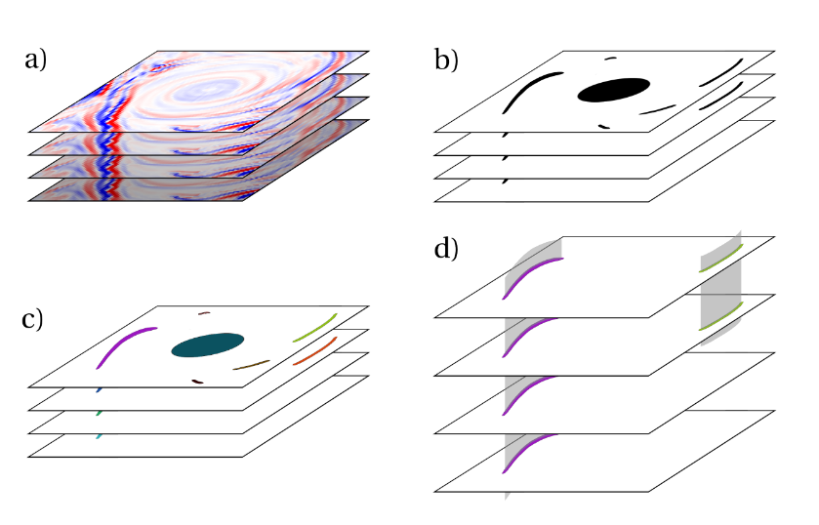
Submesoscale Fronts: Detection Algorithm
Domain & Model Data
Submesoscale Fronts
Impact on Mesoscale Eddies
Biological Productivity
Summary
Calculate an adaptive threshold for every depth level (Gaussian filter, average). Threshold vertical velocities.
Perform 2D connected component on every depth level, filter out noise and too circular structures.
Perform 3D connected component, filter out too shallow fronts.

