Slide 1
Гараж
легковых и грузовых машин

Slide 2
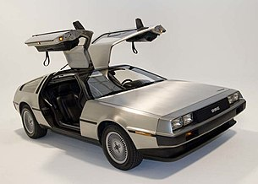
Car
fullTime: true
model: DMC-12
numDoors: 2
firm: Delorean
maxSpeed: 250

Slide 3
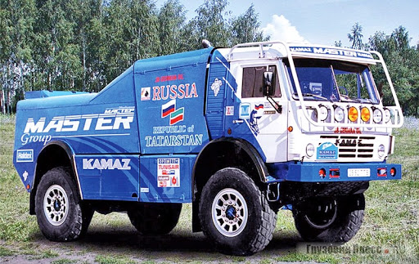
Truck
model: Master
power: 500
trailer: true
firm: Kamaz
maxSpeed: 200

