Slide 1
LIF_V3
Biologically realistic output spike and membrane potential

Slide 2
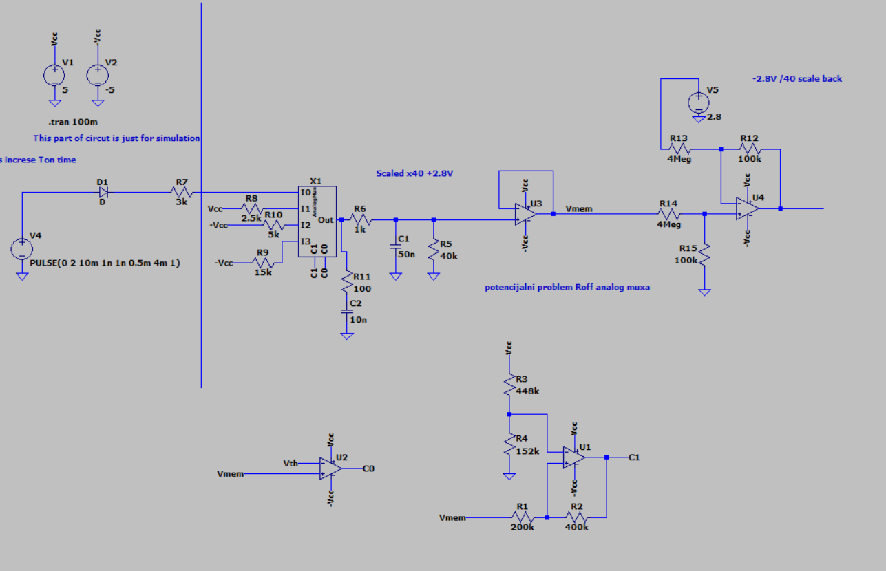
Circuit

Slide 3
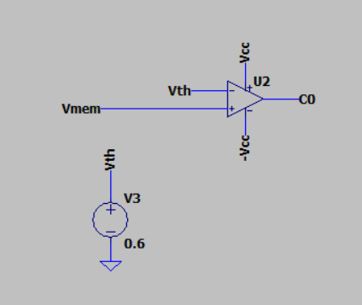
Threshold detection

Slide 4
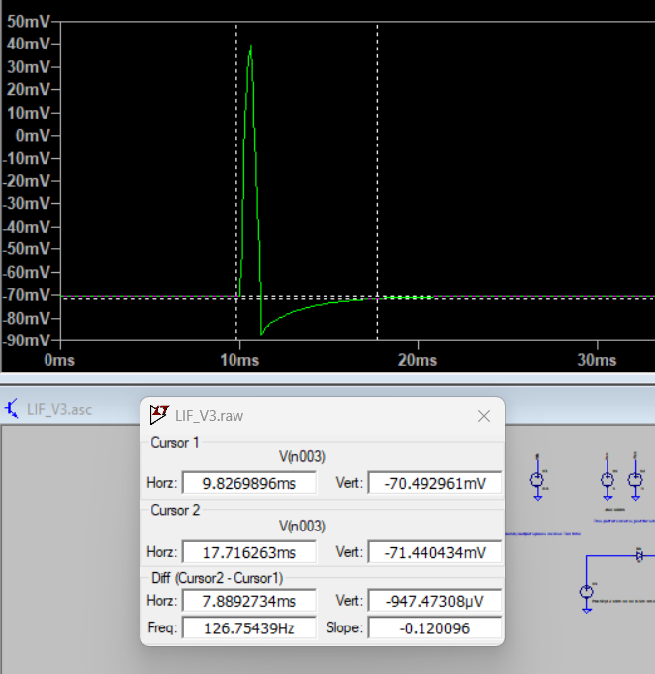
Output spike

Slide 5
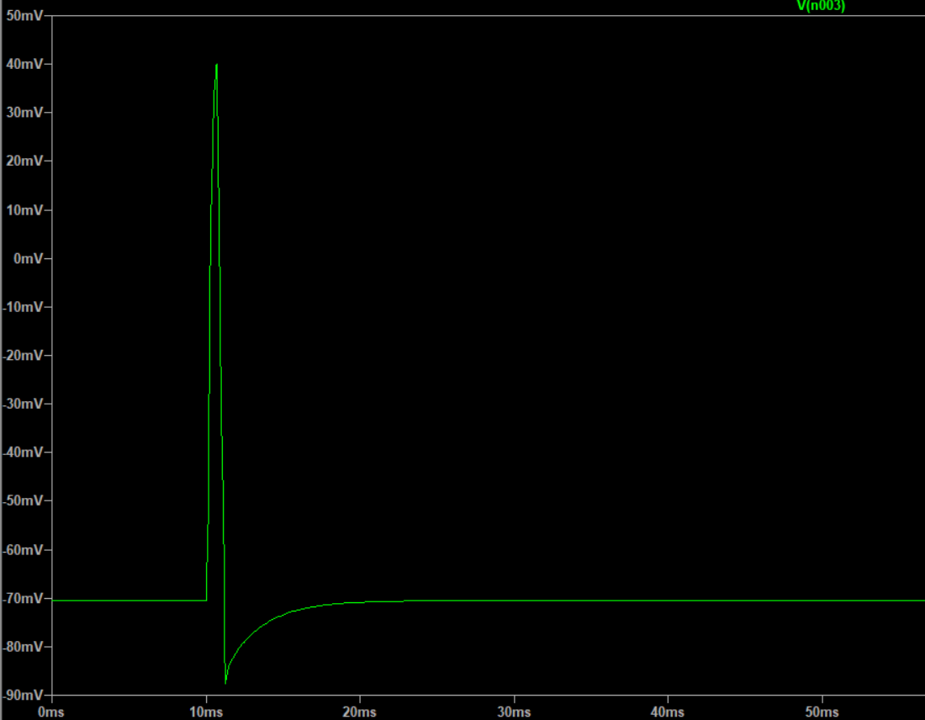

Slide 6
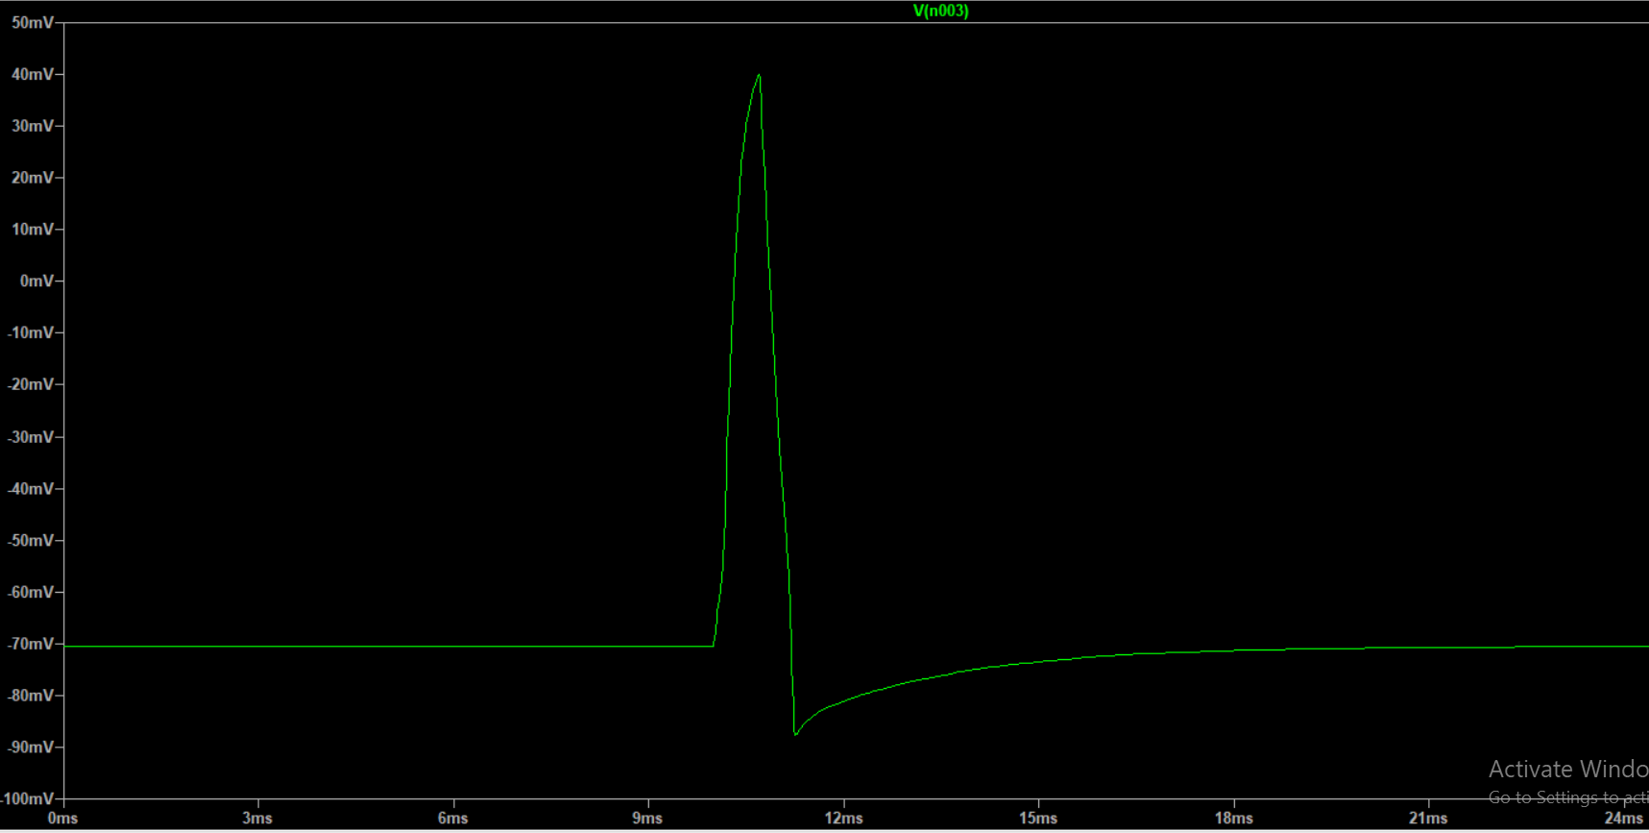

Slide 7
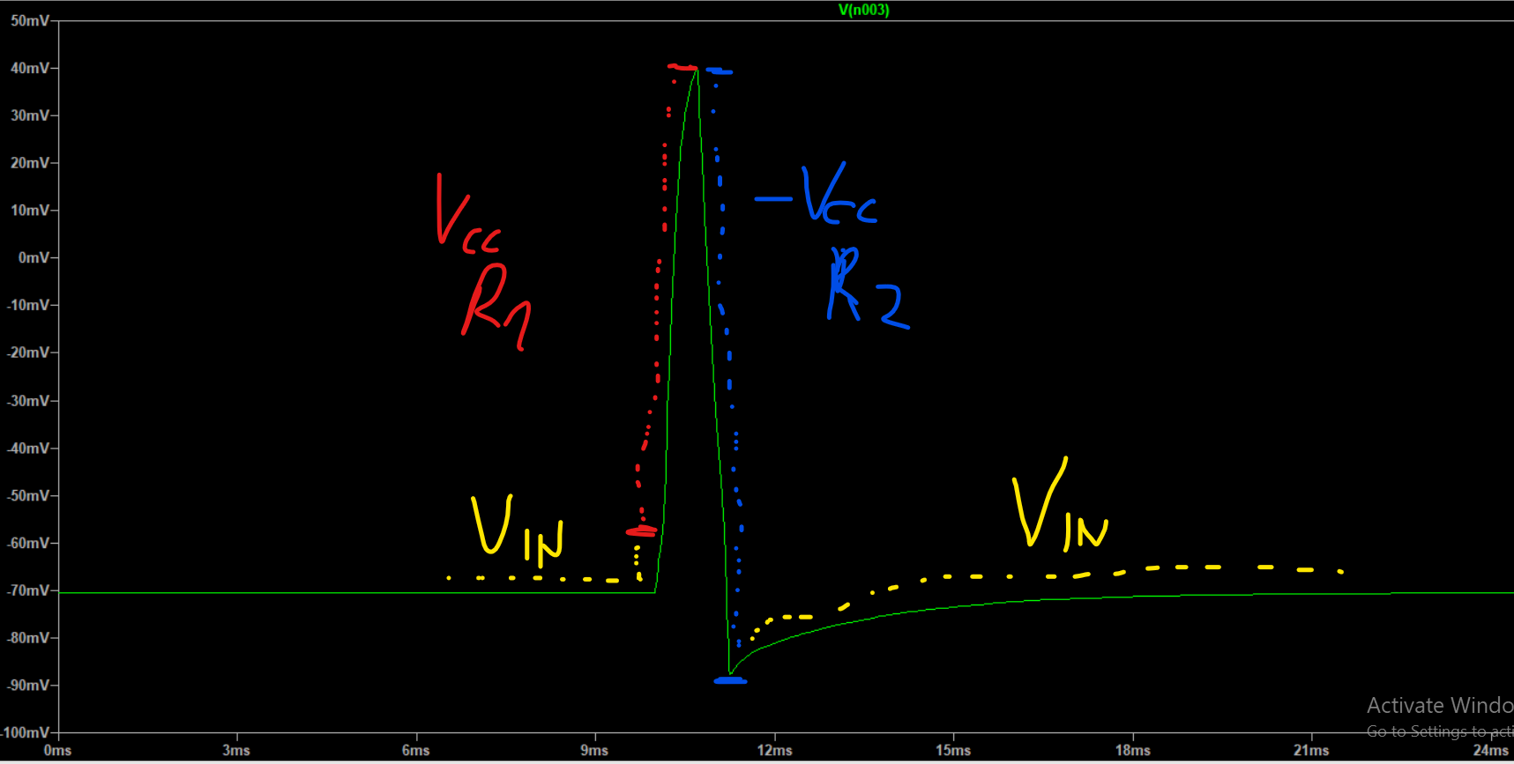

Slide 8
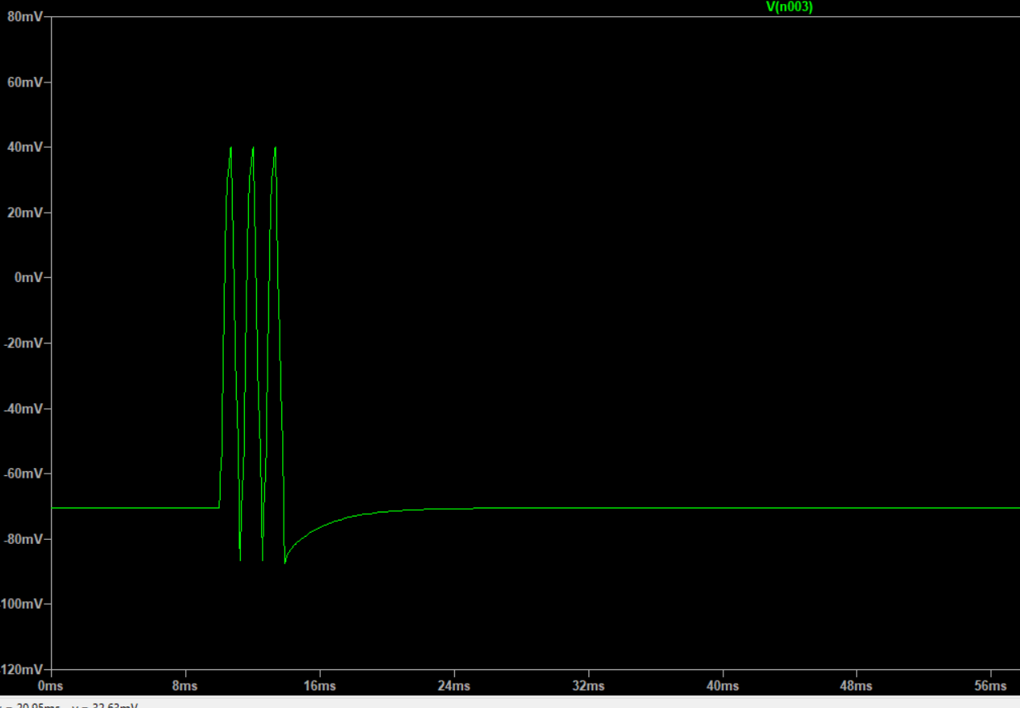
Output spike – membrane potential constantly charged

