Slide 1
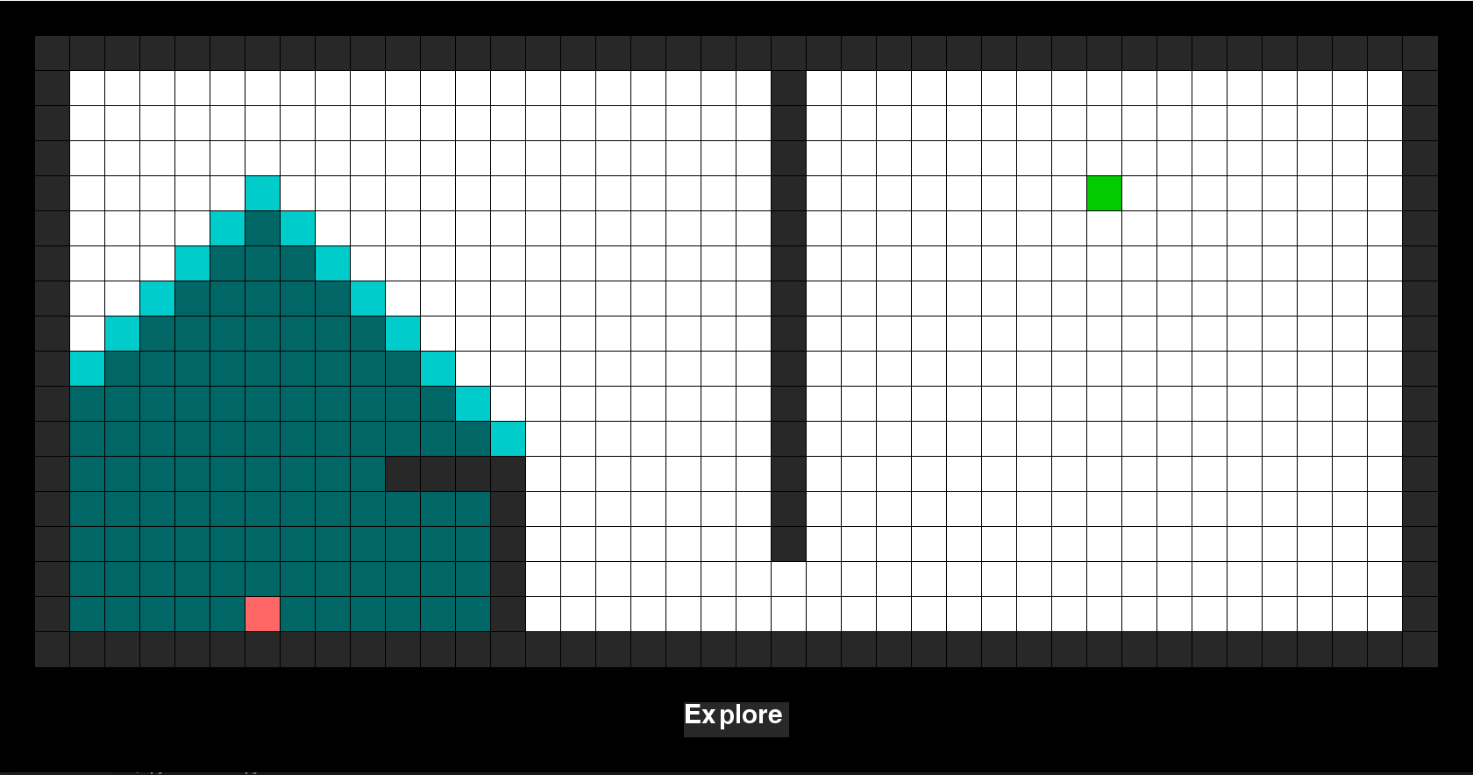
Visited
(have already been searched)
Open
(also called Frontier)
(one of these will be searched next)
Goal
Start

