Slide 1





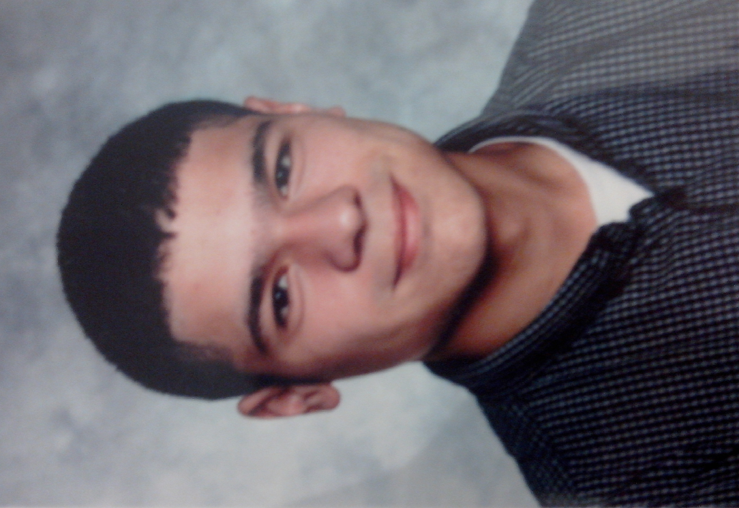











2016
CV site project:
-Created a web site in HTML 5, CCS 3 et JavaScript
Team project :
-Developed an application in Java
-Elaborated of UML design
-Developed the user and technical documentations
-Managed a team
Projet Othello :
-Elaborated an Othello game in Java
-Designed a graphic interface in Java Swing
2017 (Currently)
Team project :
-Develop a live view interface of scientfics data in Python, WebGL and MQTT
-Learn agile method
-Learn the communication with a client
-Make a project in professional condition
2016
Graduate in Scientific studies, IT option, Lycée international Victor Hugo, Colomiers (31)
2016-2018
Studying two years technician University degree in IT IUT Blagnac, University of Toulouse 2 Jean Jaurès
Basketball (club of Colomiers since 5 years), Reading, Music, Drawing, Mathematics
Internship
In IT
Education :
Experience :
Hobbies :
IT projects :
19 years old
5 boulevard de Pibrac (apartment 322),
Colomiers 31770
Maxencedeliot@gmail.com
Driving license
French
Programming languages : Java, Python, C
Development Web : HTML 5, CSS 3, JavaScript
Tools for slide presentation : Microsoft PowerPoint
Maxence
DELIOT
Project management : Apache SVN, GitLab
Databases management : Oracle SQL, PL/SQL
Analysis-design : UML
English : Good skills
Sense of team work
Good listening skills
Communication :
Computing :
Languages :
Skills :

