Slide 1
PICK N PAY STORES LIMITED · FY2022 – FY2026
Financing Strategy
How Pick n Pay chose to fund its operations, growth and recovery over five years
R11.4bn → R0.2bn
R(0.3)bn → R10.7bn
R4.0bn
Interest-bearing debt, FY2024 to FY2026
Total equity, FY2024 to FY2026
Rights offer raised in FY2025
Group Presentation · DEMM9X2 · Financing Strategy Section

Slide 2
Capital Structure: A Five-Year Turnaround
Total equity vs. total debt (borrowings + IFRS 16 lease liabilities), Rm
Key Observations
1
FY2024 equity turned negative (R(293)m) as debt peaked at R11.4bn - the low point of the turnaround.
2
FY2025 rights offer flipped the structure: debt fell to R1.15bn, equity rebounded to R11.0bn.
3
By FY2026 debt is almost fully cleared (R200m) with equity holding above R10.7bn — a decisive shift toward equity funding.
Financing Strategy — Capital Structure
2

Slide 3
Sources of Finance
Where Pick n Pay's funding actually comes from, FY2022 → FY2026 (Rm)
EQUITY FINANCING
DEBT & OTHER FINANCING
Rm | 2022 | 2023 | 2024 | 2025 | 2026
Share Capital | 6 | 6 | 6 | 3883 | 3883
Retained Earnings | 4,717.3 | 4,685.2 | 646 | 7,301 | 6,588
Rm | 2022 | 2023 | 2024 | 2025 | 2026
Borrowings | 6,803.2 | 5,669.4 | 11,445 | 1,150 | 200
Lease Liabilities (IFRS 16) | 16,087.9 | 17,604 | 19,706 | 19,120 | 18,535
Trade & Other Payables | 12,976.4 | 14,661 | 15,354 | 15,036 | 15,326
Rights Offer (FY2025): R3,877m raised in net proceeds - the single largest equity event in the period, done specifically to repair the balance sheet.
Borrowing mix: short-term facilities dominated during the FY2024 crisis; by FY2026 conventional borrowings are almost eliminated.
Dividends: suspended from FY2024 onward, so profits are retained rather than distributed - internally financing the recovery.
Lease liabilities (store leases under IFRS 16) are now the dominant form of “debt” — structurally tied to the store network rather than discretionary borrowing.
No new ordinary shares were issued outside the FY2025 rights offer.
Trade payables have stayed broadly stable — not a lever management used to manage financing risk.
Financing Strategy — Sources of Finance
3

Slide 4
Financing Activities — Cash Flow Statement
Cash flows from financing activities, Rm
DIVIDEND POLICY
R959.6m → R1,112.8m → R0
Dividends paid, FY2022 and FY2023, then suspended through FY2026 (0 cents/share) to preserve cash for the turnaround.
NET FINANCING CASH FLOW
Net financing cash flows fluctuated throughout the period, moving between outflows of R1,502m in FY22 and R3,495m in FY26, with net inflows of R877m in FY24 and R3,744m in FY25.dividends outweighed new funding.
Note: FY2025 also includes R3,877m in net proceeds from the rights offer (equity, not shown above).
Financing Strategy — Financing Activities & Dividends
4

Slide 5
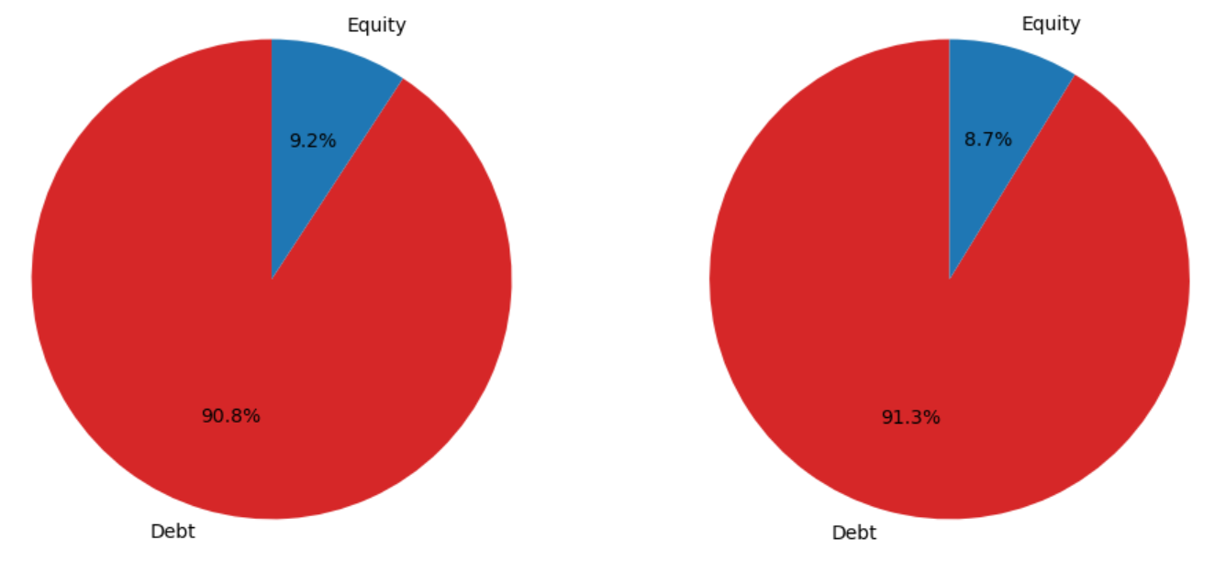
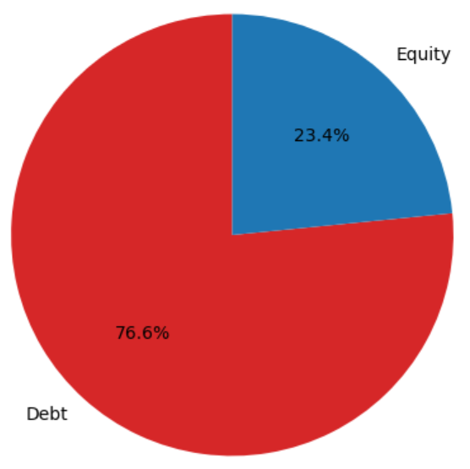
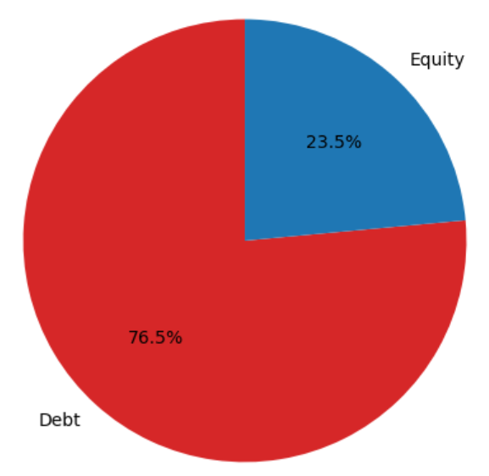
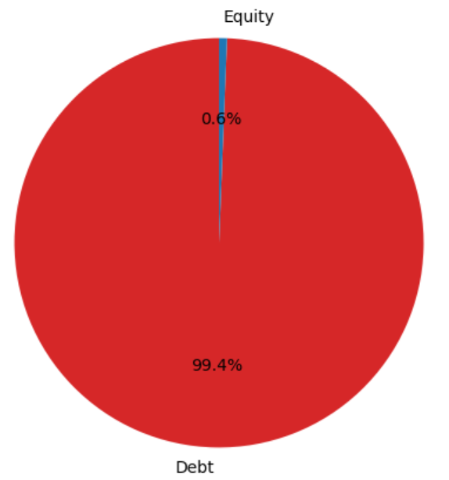
Key Financing Decisions, FY2022–FY2026
What management did, and why
FY22–23
FY24
FY25
FY26
Debt-funded operations
Crisis point
Recapitalisation
Turnaround discipline
High reliance on borrowings and overdrafts; lease liabilities significant under IFRS 16; no equity issuance.
Dividends suspended after losses; equity turns negative (R(293)m); debt peaks at R11.4bn; restructuring discussions begin.
R4.0bn rights issue; debt cut from R11.4bn to R1.15bn; swings from R6.1bn net debt to R4.2bn net cash.
Debt reduced further to R200m; strong net cash (~R3.1bn); dividends still suspended.
WHY: Inflation and lingering COVID pressure squeezed cash generation.
WHY: Weak profitability and liquidity pressure forced defensive action.
WHY: Deliberate equity-led plan to restore solvency and reduce leverage.
WHY: Boxer-led growth funded conservatively to protect covenants.
Financing Strategy — Key Financing Decisions
5

Slide 6
Conclusion: Pick n Pay's Financing Strategy
A five-year shift from debt-strained operations to a deliberately equity-led, deleveraged balance sheet
1
Grew reliant on debt and lease financing through FY2022–FY2024 to sustain operations under pressure, pushing equity into negative territory.
2
Executed a R4.0bn rights issue in FY2025 — a decisive shift to equity financing to repair the balance sheet and restore solvency.
3
Preserved liquidity by suspending dividends from FY2024 onward, retaining earnings to self-fund the recovery.
4
Aggressively repaid borrowings (R11.4bn → R200m by FY2026), prioritising a strong, low-leverage balance sheet over cheap debt.
5
Now finances growth (Boxer expansion) conservatively — minimal external debt, cash-generative operations, and covenant discipline.
Net effect: Pick n Pay moved from a debt-dependent, loss-making capital structure to an equity-strengthened, self-funded turnaround.

