Slide 1
How to differentiate a differential equation? (and why)
By Maximus Smith

Slide 2
A Problem
Linear ODEs are solved easily with Spectral Methods
Applying the same techniques to a Non-Linear ODE has problems

Slide 3
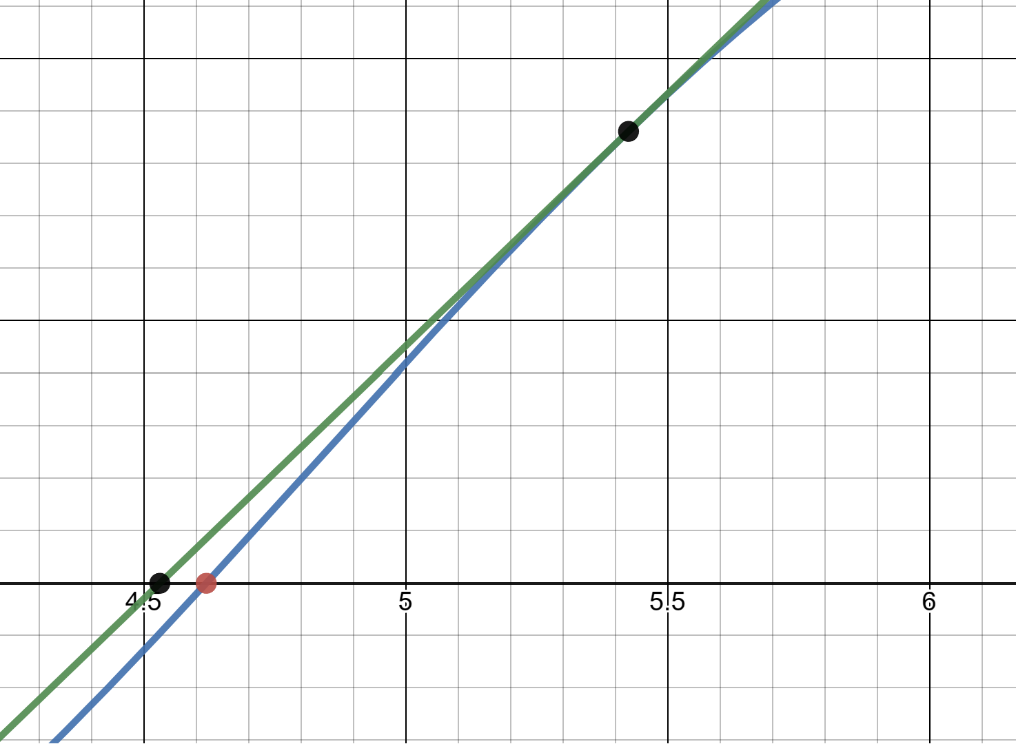

Motivation for Solution
For Non-Linear Equations one of the best methods is the Newton-Raphson:
Rearrange equation as f(x)=0
Approximate f(x) using 1st order taylor about some point $x_{i}$
Solving the resulting linear equation gives $x_{i+1}$
Repeating gives quadratic convergence to a root

Slide 4

How can we do this on a Non-Linear ODE? -Quasilinearization Method
Rewrite ODE as $L(y(x))=f\left(y\left(x\right)\right)$ with: L – Linear, f – Non-Linear
Approximate using a first order functional taylor of $f(y(x))$about the point $y_{i}(x)$
Solving the resulting ODE leads to $y_{i+1}(x)$
We choose $y_{0}(x)$ to be as similar to the final solution as possible with our current knowledge of the ODE.

Slide 5

Functional Taylor Series
Same as multivariate Taylor series except our “variables” are: $y\left(x\right),y^{′}\left(x\right),y^{′′} \left(x\right)…$ ext.
Example – Expand to first order about $y_{i}(x)$: $\cos\left(y(x)\right)y′(x)$
$⇒$ $\cos\left(y_{i}\left(x\right)\right)y_{i}′\left(x\right)+(−sin⁡(y_{i}\left(x\right){)y}_{i}′\left(x\right))(y\left(x\right)−$ $y_{i}\left(x\right))+(cos⁡(y_{i}\left(x\right))(y^{′}\left(x\right)−y_{i}′\left(x\right))$
Remark: Multivariate Taylor Series -
$$f\left(x,y\right)=f\left(x_{i},y_{i}\right)+\frac{∂f\left(x_{i},y_{i}\right)}{∂x}\left(x−x_{i}\right)+\frac{∂f\left(x_{i},y_{i}\right)}{∂y}\left(y−y_{i}\right)$$

Slide 6

Practical Example: Lane Emden Equation
$$y^{′′}+\frac{2}{x}y^{′}+y^{n}=0, y\left(0\right)=1 and y^{′}\left(0\right)=0$$
1) $y^{′′}+\frac{2}{x}y^{′}={−y}^{n}$
2) ${y_{i+1}}^{′′}+\frac{2}{x}{y_{i+1}}^{′}={{(−y_{i}}^{n})+(−ny_{i}}^{n−1}$)($y_{i+1}−y_{i})$
$⇒{(y_{i+1}}^{′′})+\frac{2}{x}{{(y}_{i+1}}^{′})+{ny_{i}}^{n−1}{(y}_{i+1})=(n−1)$ ${y_{i}}^{n}$
3) The starting point $y_{0}=1$ satisfies the initial conditions

Slide 7
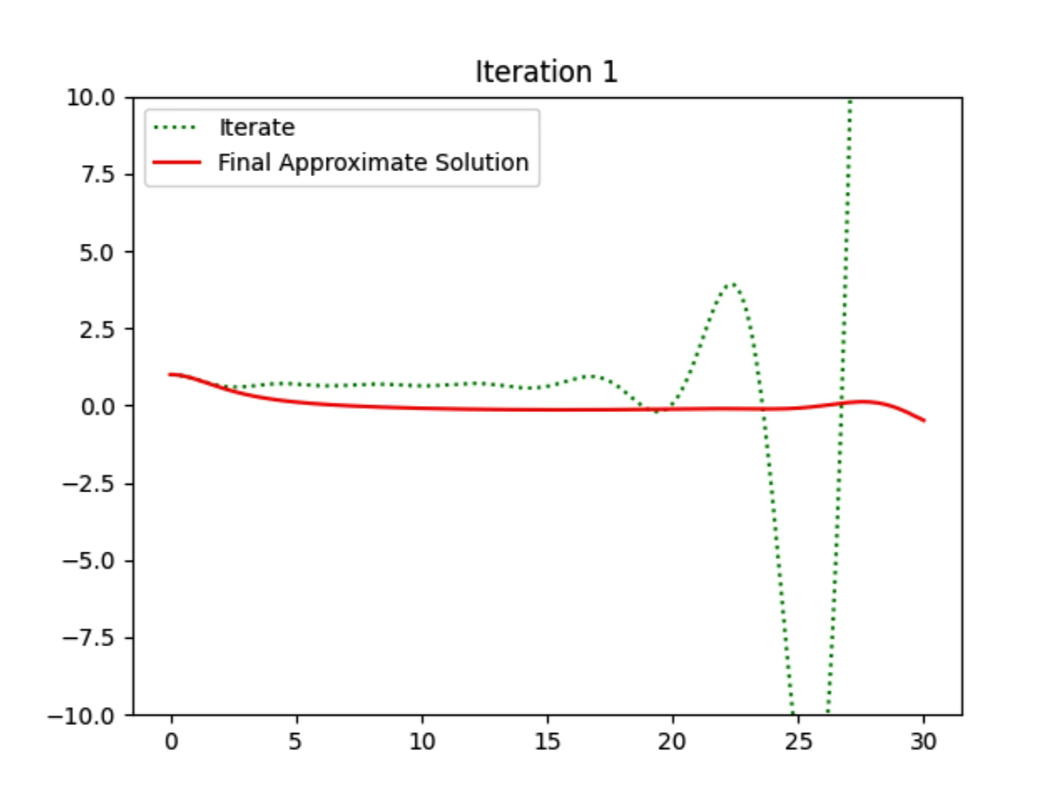
Using Laguerre polynomials (Lane-Emden n=3)

Slide 8
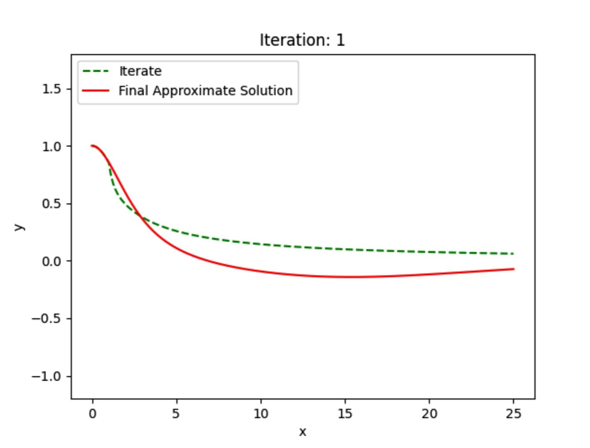
Using Rational Chebyshev Functions (Lane-Emden n=3)

Slide 9
Pros and Cons
Pros:
Quadratic Convergence for most cases
We have a method to pick our starting point
Easy to implement
Cons:
Not always easy to pick the start point
Resulting Linear ODEs can be hard to solve to high precision
Can be very unstable

Slide 10
Future Research
Completing the proof of quadratic convergence for a wide set of functions
Finding an efficient method for expanding the domain on which a solution is known for the Lane-Emden equation
The usefulness of different substitutions into ODEs on semi-infinite intervals

