Slide 1
How to Differentiate a Differential Operator and Why
By Maximus Smith

Slide 2
A Problem
Not all ODEs can be solved and solution expressed in terms of nice functions
(ie. sinx, cosx, lnx ext.)
Nevertheless, finding a solution is generally possible for Linear ODEs (Greens Function, Frobenius’s Method ext.)
However, this will usually be an analytic expression which we will have a limited number of terms of
Extending this expression can be very difficult and usually this serves as a bad approximation
So, we’d like a faster method.

Slide 3

Collocation
Assume an approximate solution to an nth order ODE:
$y_{N}=\sum_{k=1}^{N}{a_{k}φ_{k}(x)}$
Where $φ_{k}(x)$ are basis functions of a chosen basis (for instance Chebyshev or $1,x,x^{2}…)$
Then our job is to find the $a_{k}$ (Note we have N of these unknowns)
In order to do this, we hence need N equations. (which can be solved efficiently using Gauss Jordan)
n of these will come from forcing our solution to satisfy the Initial/Boundary Conditions
The remaining N-n will come from making our $y_{N}$satisfy the ODE at N-n points

Slide 4
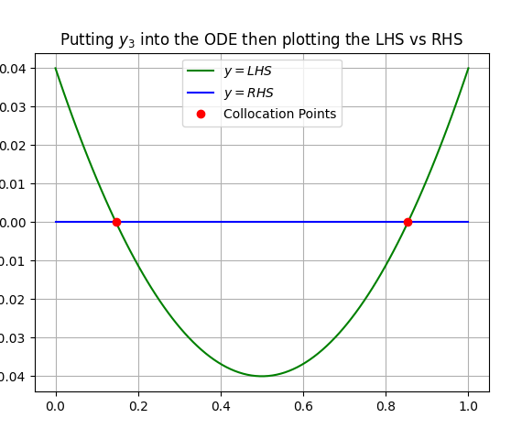
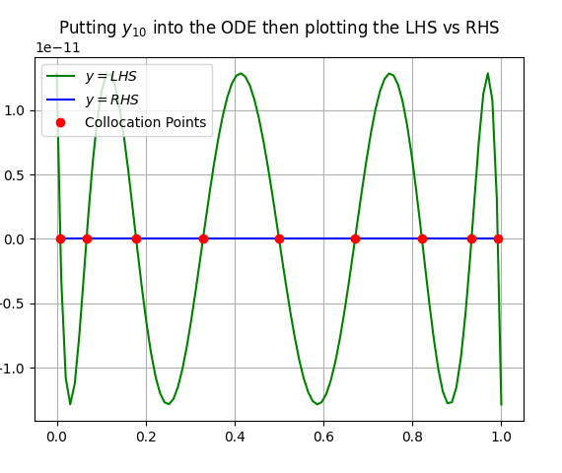
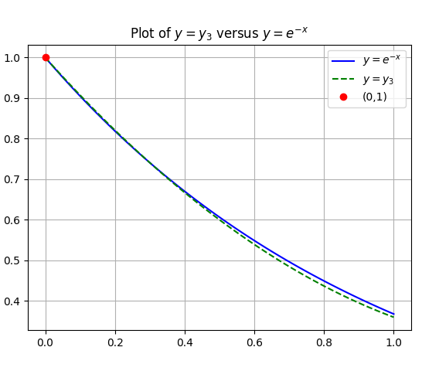
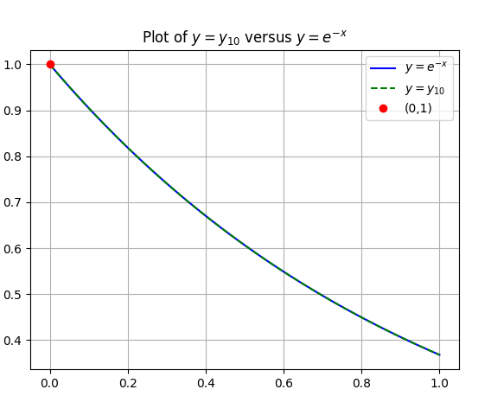

Example: $\frac{dy}{dx}+y=0, y\left(0\right)=1 on [0,1]$

Slide 5
Some things to note:
The choice of basis functions and collocation points has an impact on the rate of convergence
For now, we will stick to using Chebyshev Polynomials with Chebyshev Nodes.
In general, this will get us exponential convergence (highest order of convergence possible)

Slide 6
But what about Non-Linear?
Doing the same procedure creates N non-linear equations.
Generally, these will need to be solved numerically using the Newton-Raphson Method.
A general problem unless we have more info about the ODE is choosing a starting point.
This could be solved using trial and error but as we increase N the number of possible starting points will increase exponentially.
Remark: We may get multiple solutions that satisfy the equations but only one will be the solution we are after, which increases the difficulty in picking the starting point.

Slide 7
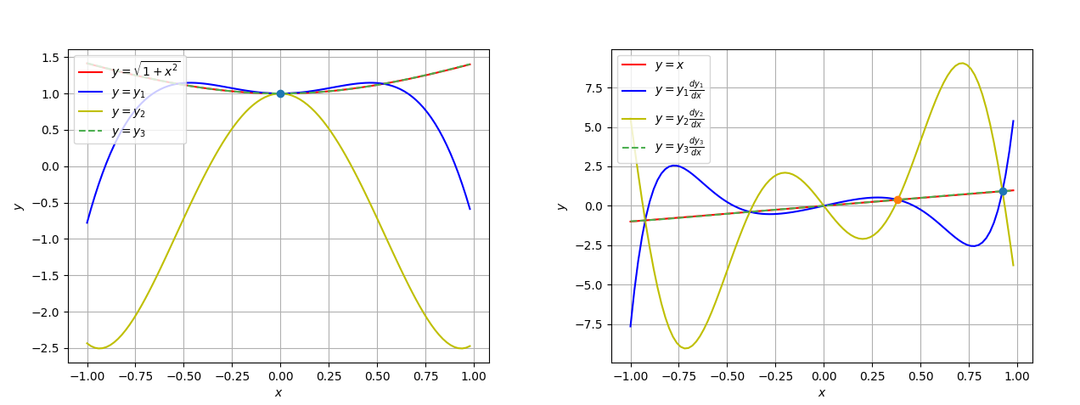
Example:

Slide 8
Quasilinearization Method
Instead, we do Newton-Raphson on the actual Differential Equation
Like before we may get convergence to multiple different solutions.
BUT in this method simply by choosing an initial starting solution to satisfy the initial conditions it should converge to final solution
“Should” is used here because there are some cases where this doesn’t work, and we need to fine tune our approach, we’ll discuss this later.

Slide 9

How does it work?
Step 1) Split the ODE as $L\left(y_{i+1}\right)=f\left(y_{i+1}\right).$ Where L is a linear operator and f is a non-linear Operator.
Step 2) Expand $f(y_{i+1})$ about $y_{i}$ using the Functional Taylor Expansion up to it’s Linear Term. This is a Linear Approximation of $f(y_{i+1})$.
The resulting expression is a Linear ODE in $y_{i+1}$. Which we can solve (if we know $y_{i}$)
Step 3) Choose a starting point $y_{0}$ that satisfies the initial conditions
Step 4) Use the iteration we found in Step 2 to find $y_{1},y_{2},y_{3}$ext.
This method achieves quadratic convergence and usually after 5 or 6 iterations we get very good accuracy. Each step we use Collocation.

Slide 10

Example – Lane Emden Equation
$$y^{′′}+\frac{2}{x}y^{′}+y^{n}=0, y\left(0\right)=1 and y^{′}\left(0\right)=0$$
$y^{′′}+\frac{2}{x}y^{′}={−y}^{n}$
${y_{i+1}}^{′′}+\frac{2}{x}{y_{i+1}}^{′}={{(−y_{i}}^{n})+(−ny_{i}}^{n−1}$)($y_{i+1}−y_{i})$
$⇒{(y_{i+1}}^{′′})+\frac{2}{x}{{(y}_{i+1}}^{′})+{ny_{i}}^{n−1}{(y}_{i+1})=(n−1)$ ${y_{i}}^{n}$
3) The starting point $y_{0}=1$ satisfies the initial conditions and for a small domain such as $\left[0,10\right]$ we get our quadratic convergence

Slide 11
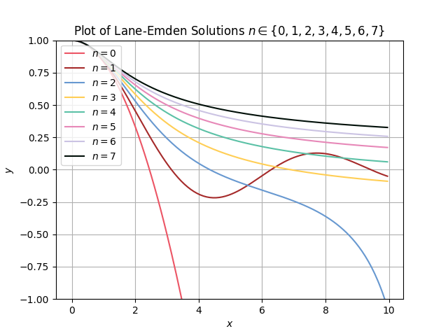
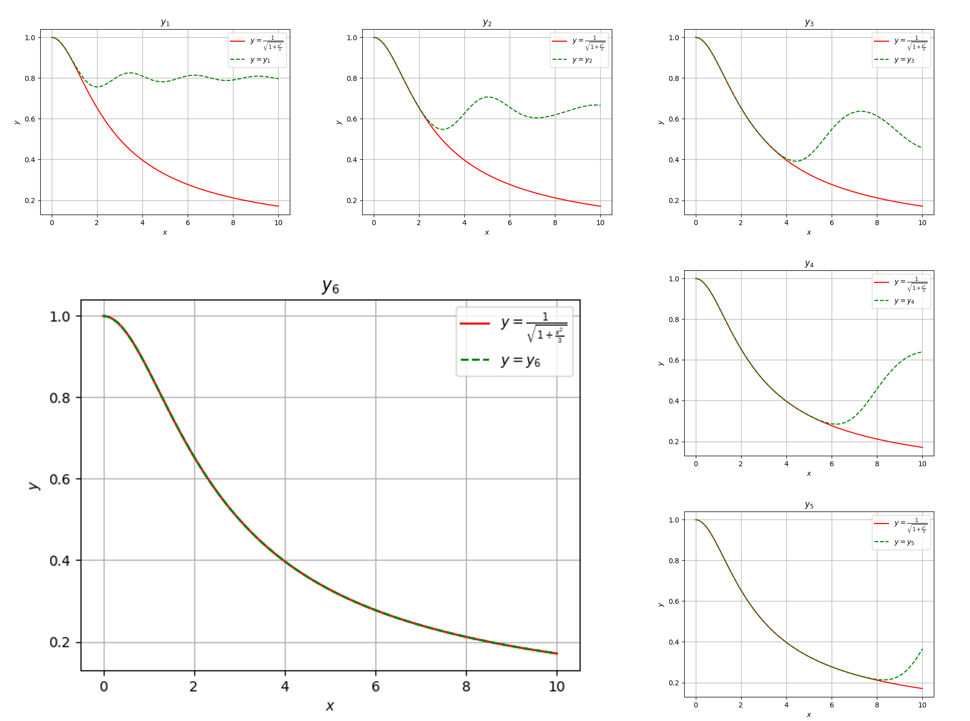

The Results
Plot of the $y_{i}$ for n=5

Slide 12
The Problem
Now as we have seen generally speaking this has pretty fast convergence which is good.
We have a method to pick our starting point.
It’s easy to implement.
The Problem: Not always is the starting point just a function that satisfies the initial conditions, we require the starting point to be sufficiently close to the exact solution in functional space.

Slide 13

Observation of the Problem:
In the case of the Lane-Emden equation choosing $y_{0}=1$ is good for small domains because the exact solution is very close to this.
HOWEVER for $n>1$ the solutions to the Lane-Emden equation tend towards 0 as $x→∞$.
The consequence: Although our starting point $y_{0}=1$ is close to the solution for small $x$ as $x$ gets big the error is going to be close to 1 and as the error in functional space is some sort of summed error across a domain (depending on which norm) then this is going to be very large.

Slide 14
The Discovery
To combat this we can use the Simple Domain Extending Algorithm (SDEA).
In simple terms SDEA does the following:
Chooses a suitably small domain about the initial conditions such that a guess satisfying the initial conditions will converge.
Then we find the best approximation on that domain.
Following this we extend the domain and repeat except our starting point is the solution found in the last step.

Slide 15
How to Calculate Error:
We will calculate the average residual error:
[Insert formula]
Remark: This represents the total error divided by the width of the domain. We divide by the width so that we can compare our solution for different domain sizes)

Slide 16
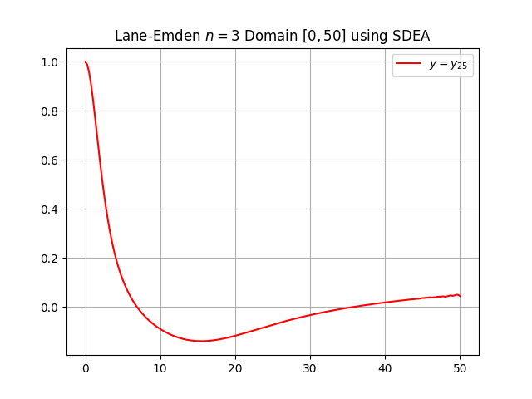

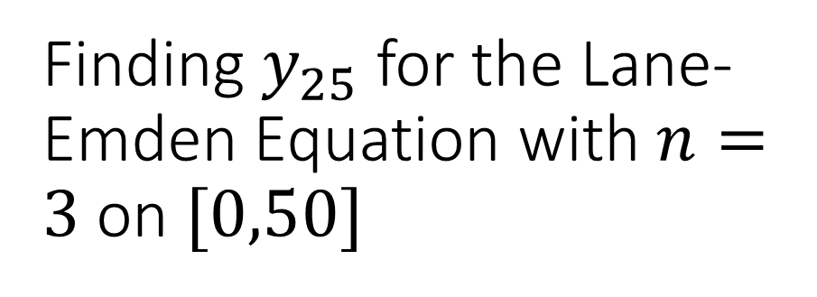
Finding $y_{25}$ for the Lane-Emden Equation with $n=3$ on $[0,50]$
Using the SDEA starting with the domain $[0,10]$ and increasing to $\left[0,14\right],\left[0,18\right]…\left[0,50\right]:$
Mean Log Residual Error:
[ Find this ]

Slide 17
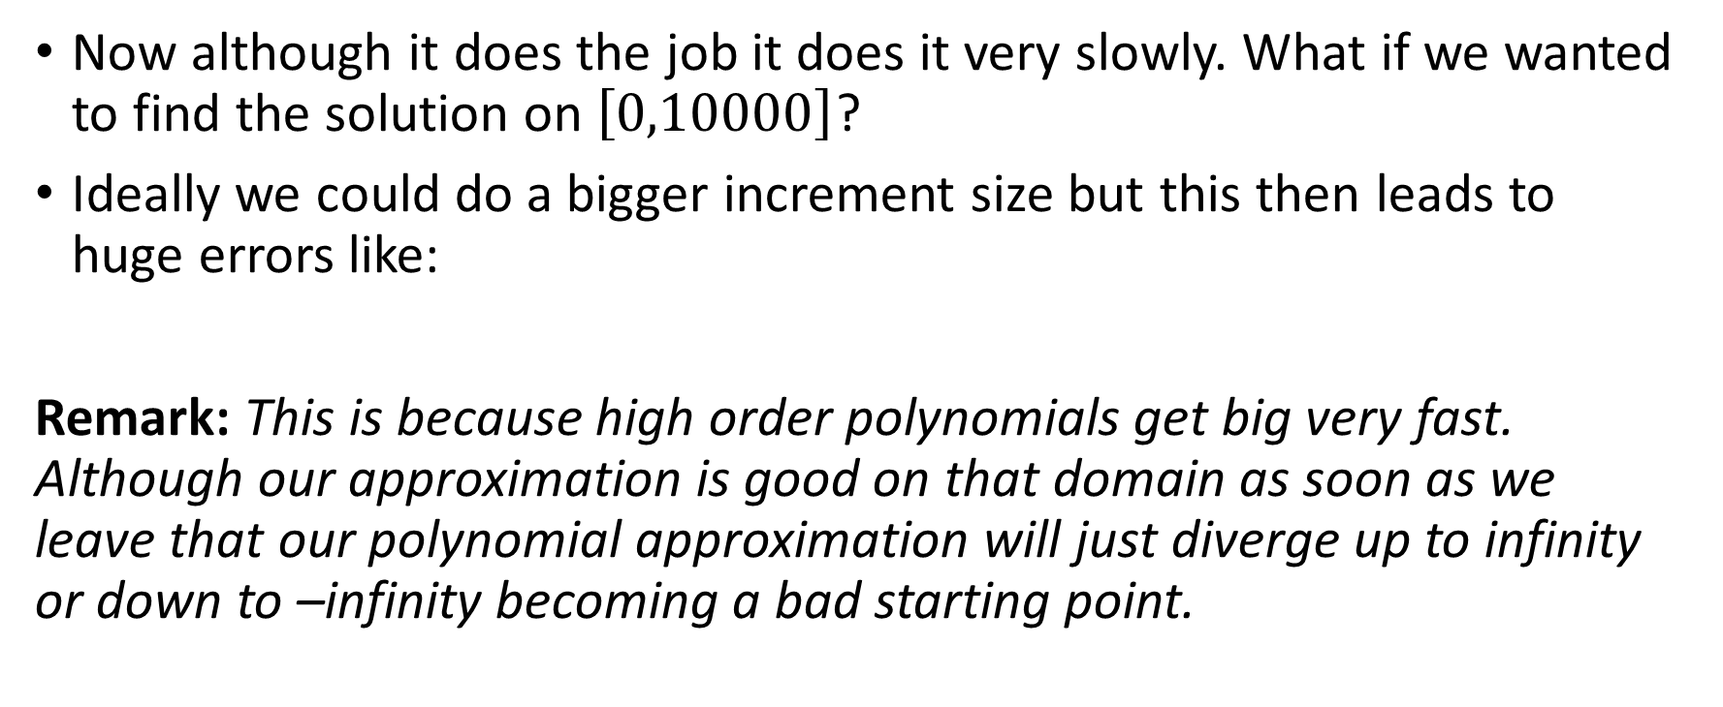
Evaluation: SDEA
Now although it does the job it does it very slowly. What if we wanted to find the solution on $\left[0,10000\right]$?
Ideally we could do a bigger increment size but this then leads to huge errors like:
Remark: This is because high order polynomials get big very fast. Although our approximation is good on that domain as soon as we leave that our polynomial approximation will just diverge up to infinity or down to –infinity becoming a bad starting point.

Slide 18
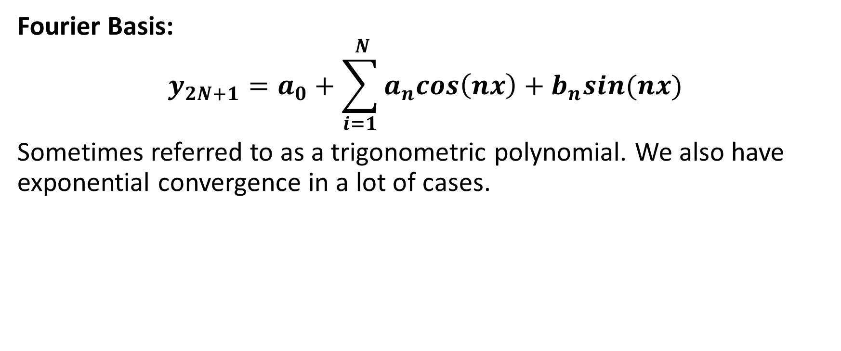
The Fix: Alternative Basis Function
Fourier Basis:
$$y_{2N+1}=a_{0}+\sum_{i=1}^{ N}{a_{n}cos\left(nx\right)+b_{n}sin(nx)}$$
Sometimes referred to as a trigonometric polynomial. We also have exponential convergence in a lot of cases.

Slide 19

Lane-Emden with $n=3$ on $\left[0,50\right]$ using Trigonometric Basis

