Slide 1

Identification of the class of English text among Several Classes

Slide 2
Identification of the class of English text among Several Classes
ID | Name
4142001 | Islam Samir Sayed
4142009 | Ahmed Nagy Radwan
4141066 | Mohamed Rashad
4141069 | Mohamed El Kesay
4141179 | Ahmed Abboud Hanafy
4141126 | Gehad Khaled
Under the supervision of
Dr.Ahmed Diaa

Slide 3
Presentation Outline
Introduction
Theoretical explanation
Presenting the application
Results
Conclusion

Slide 4
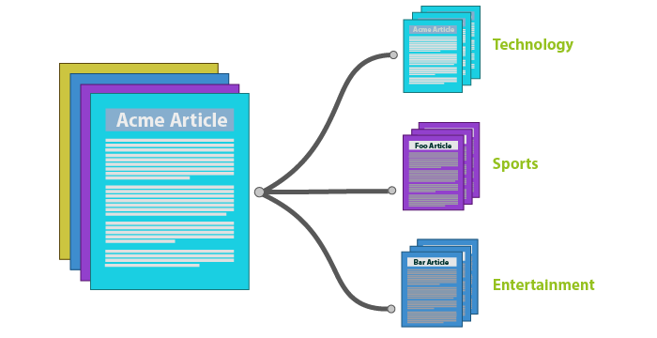
Text Classification problem
(1)

Slide 5
Text Classification problem
(2)
Problem Components
Input : d, text description
Predefined set of classes : C
Output : C_{j} C

Slide 6
Text Classification: Common uses
Spam detection
Information retrieval
Text mining (Text analytics)
Sentiment Analysis
Social media monitoring

Slide 7
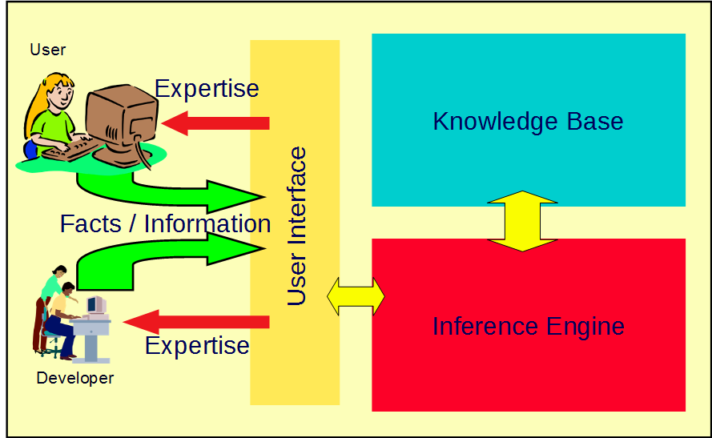
How it can be implemented
(Expert Systems)

Slide 8
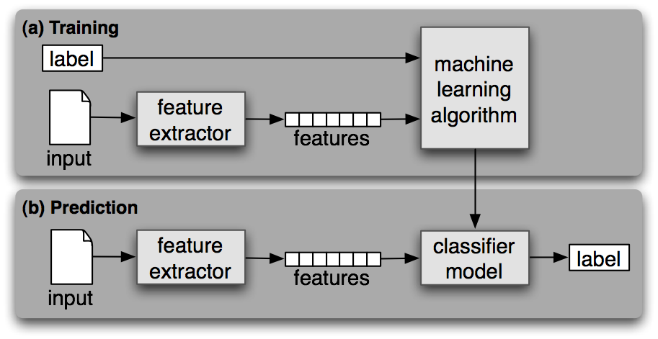
How it can be implemented
(Machine learning techniques)

Slide 9
Project description and objectives
The project is a Research-based one
Focuses on machine learning techniques to solve the problem
Make a valuable comparison between different text classification approaches
Getting the best classification model in terms of accuracy

Slide 10
Characteristics of the required Dataset
Balanced distribution of classes
Exhibits patterns for classes
clean documents descriptions
Prefered to be multinomial

Slide 11
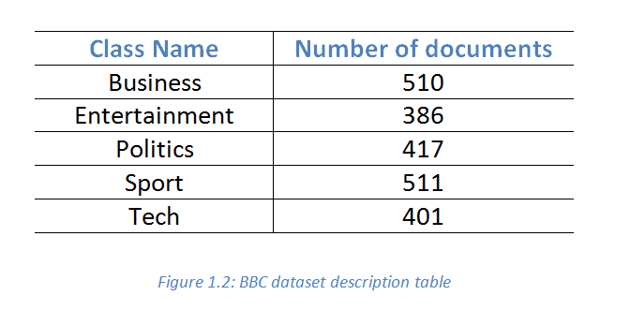
BBC Dataset
(1)

Slide 12
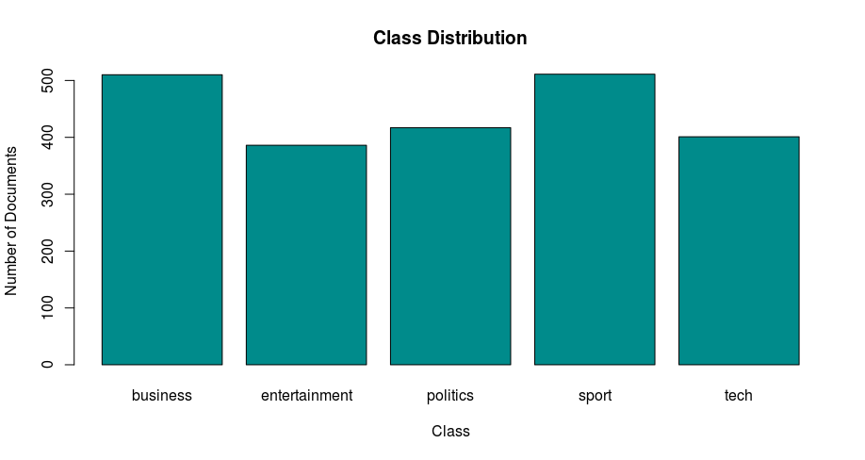
BBC Dataset
(2)

Slide 13
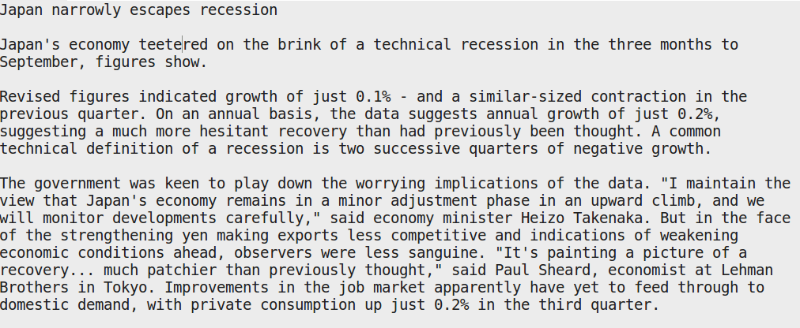
BBC Dataset
(3)

Slide 14
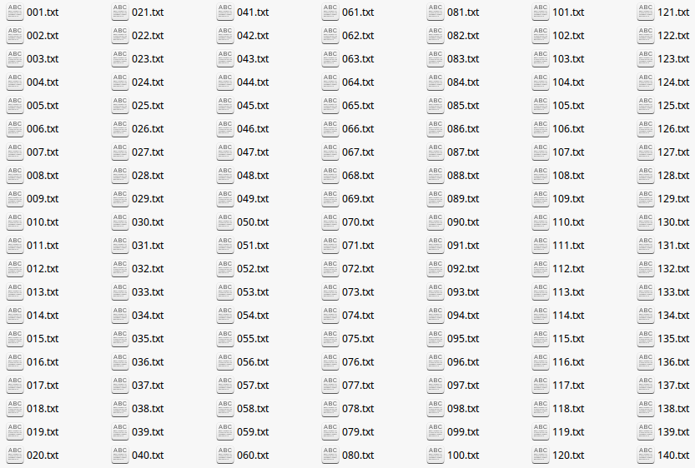
BBC Dataset
(4)

Slide 15
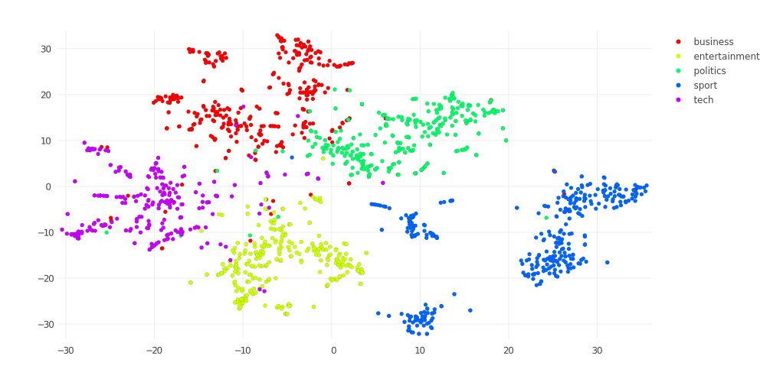
BBC Dataset
(5)

Slide 16
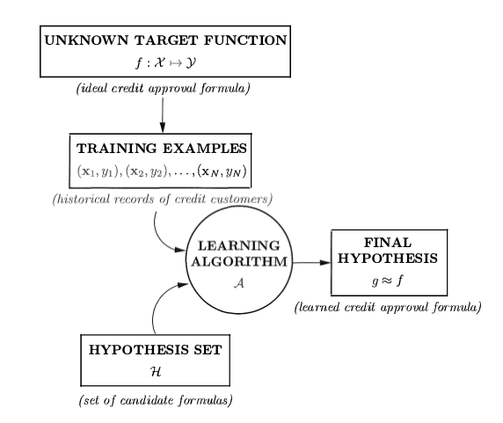
Basic procedure of learning process

Slide 17
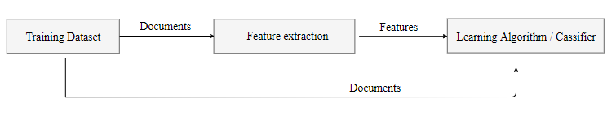
Basic procedure of text classification process

Slide 18
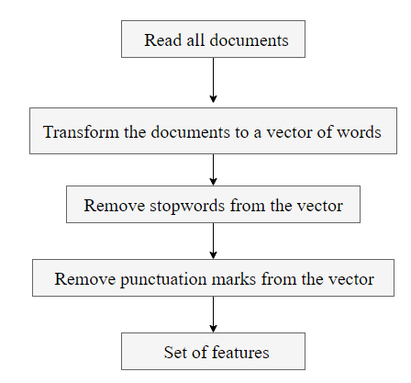
Feature extraction Procedure

Slide 19
Important terms and concepts
The extracted features set is called vocabulary
Bag of word Model
Document Term matrix

Slide 20
Text representation techniques
Binary weighting
Term frequency weighting
TF-IDF weighting
N-gram as an extension of BOW

Slide 21
Document Term matrix with TF weighting
example
(1)
Given a vocabulary V = { good, country, cat, feeling }.
Given a document d₁ : Egypt is a good country with good places.
Given a document d₂ : the cat had a good feeling.

Slide 22

Document Term matrix with TF weighting
example
(2)

Slide 23
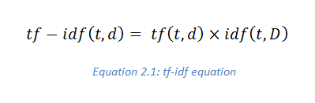
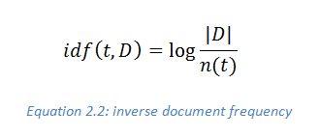
TF-IDF weighting

Slide 24
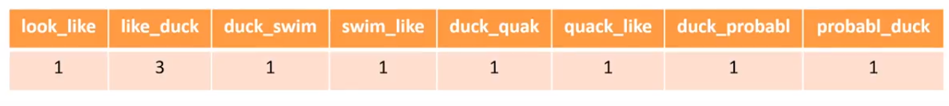
Bigram Where N = 2
example
Given a sentence : look like duck swim like duck quack like duck probably duck

Slide 25
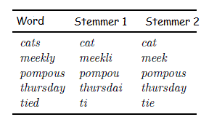
Stemming and Lemmatization

Slide 26
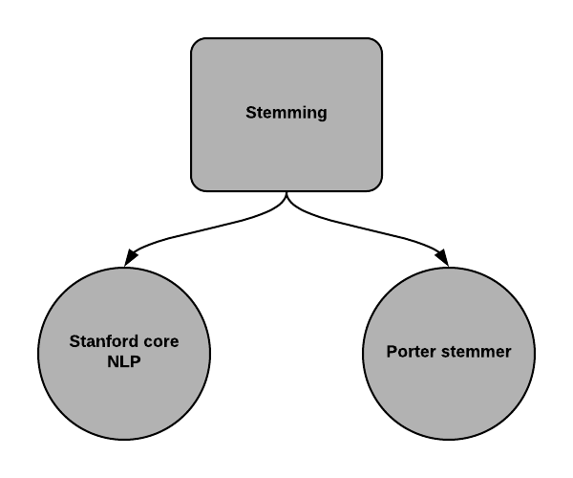
Stemming tools

Slide 27
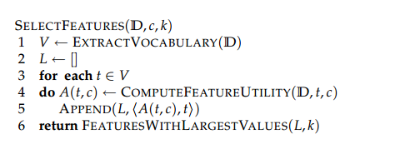
Feature Selection

Slide 28
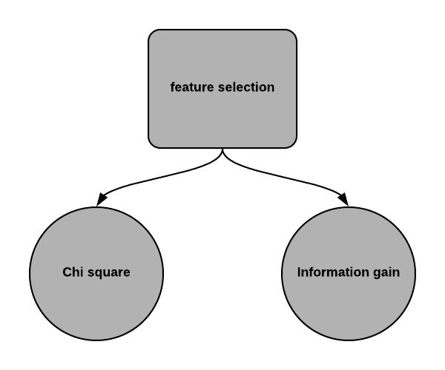
Feature Selection Techniques

Slide 29
Chi-square
example
(1)
D = {d₁,d₂,d₃};
t = t₁;
C = {c₁,c₂};
chi-square(D,t,C) = ?

Slide 30
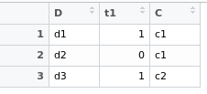
Chi-square
example
(2)

Slide 31
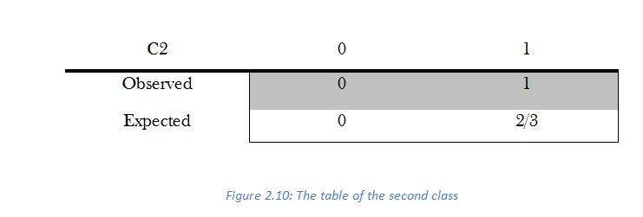
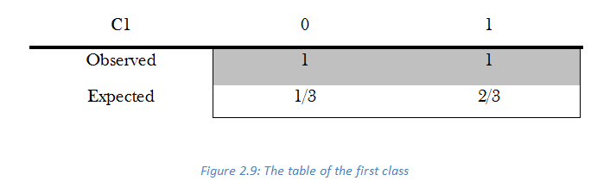
Chi-square
example
(3)

Slide 32
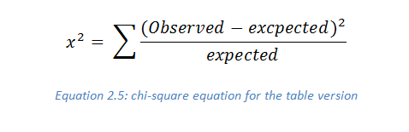
Chi-square
example
(4)

Slide 33
Chi-square
example
(4)

Slide 34
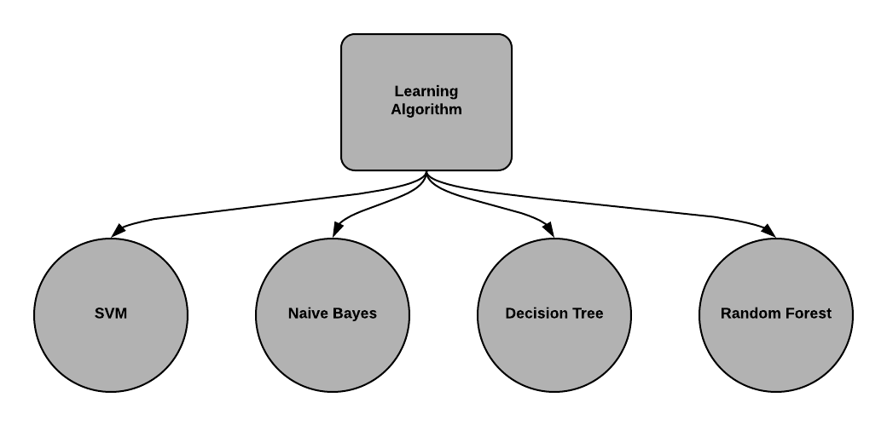
Classification algorithms

Slide 35
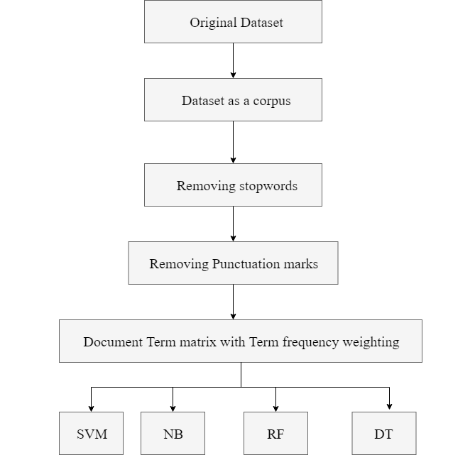
Approach A

Slide 36
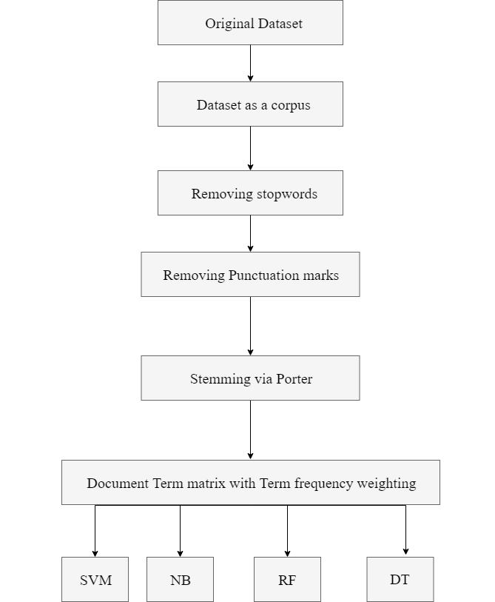
Approach B

Slide 37
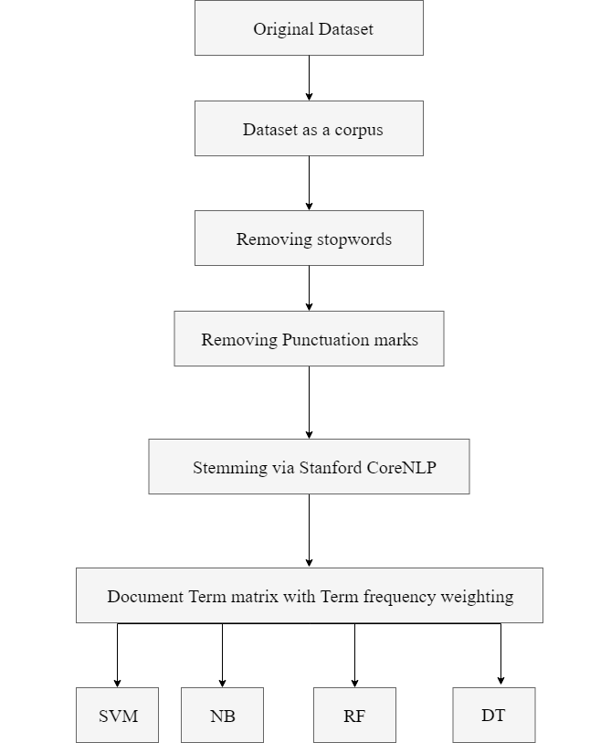
Approach C

Slide 38
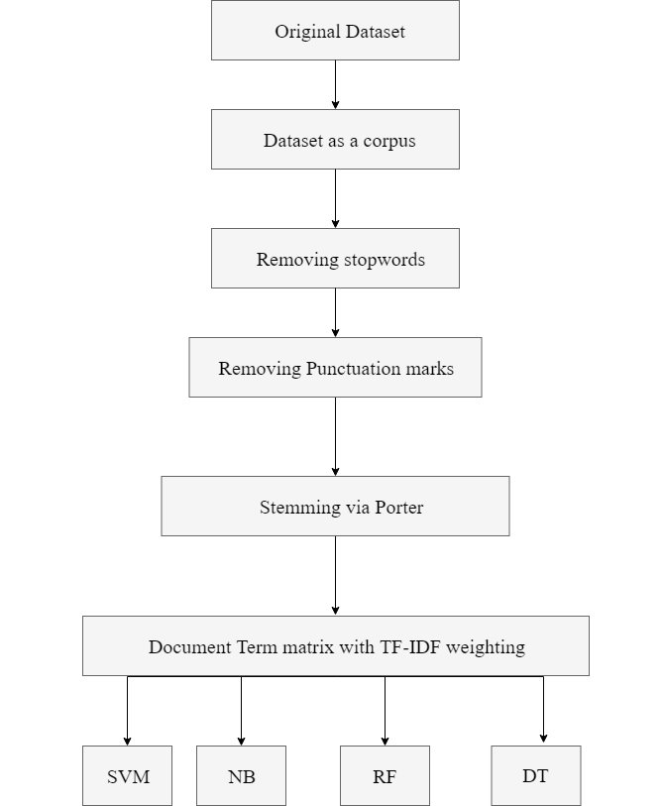
Approach D

Slide 39
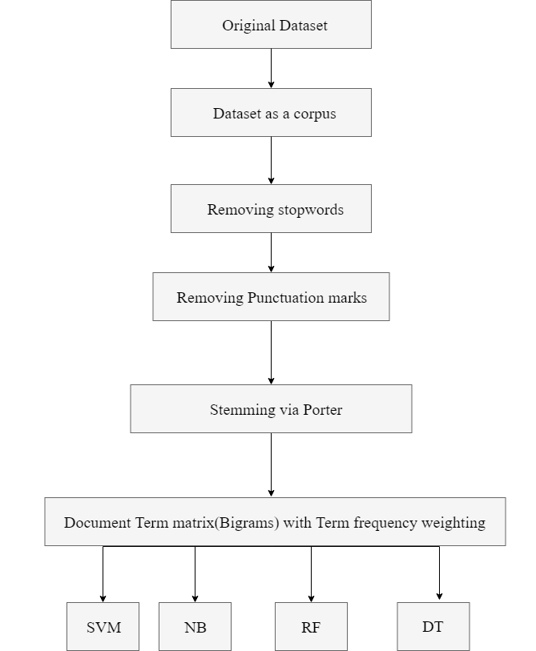
Approach E

Slide 40
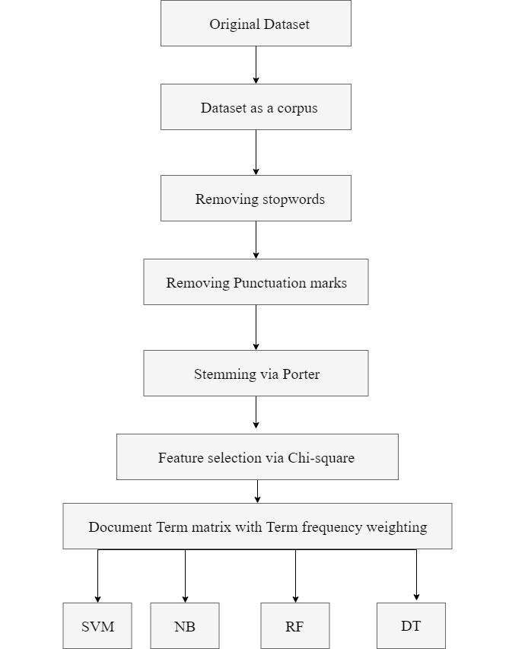
Approach F

Slide 41
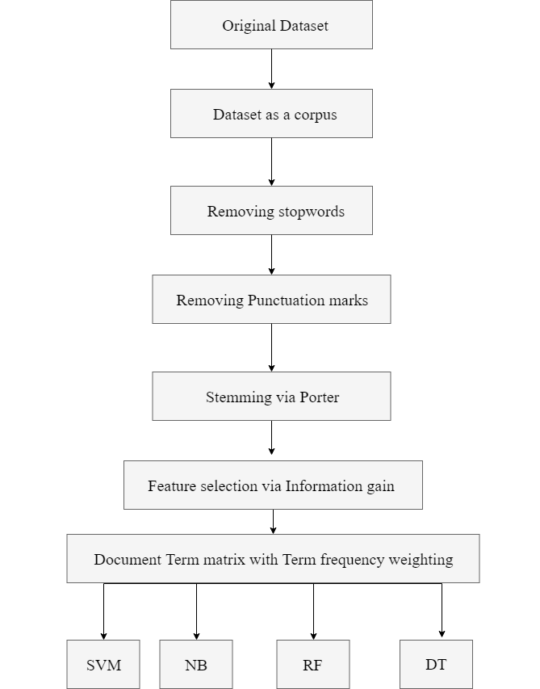
Approach G

Slide 42
Best Approach with SVM ( Approach D )

Slide 43
Application Presentation

Slide 44
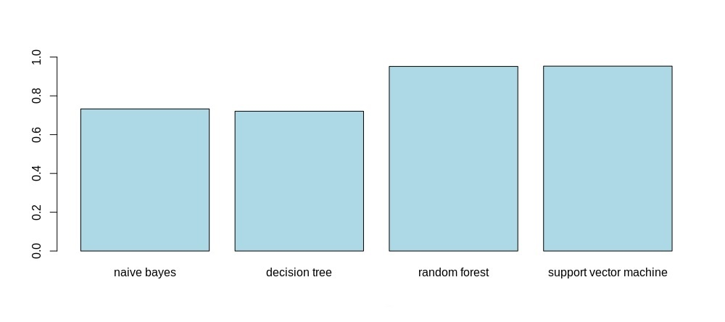
Results of Approach A

Slide 45
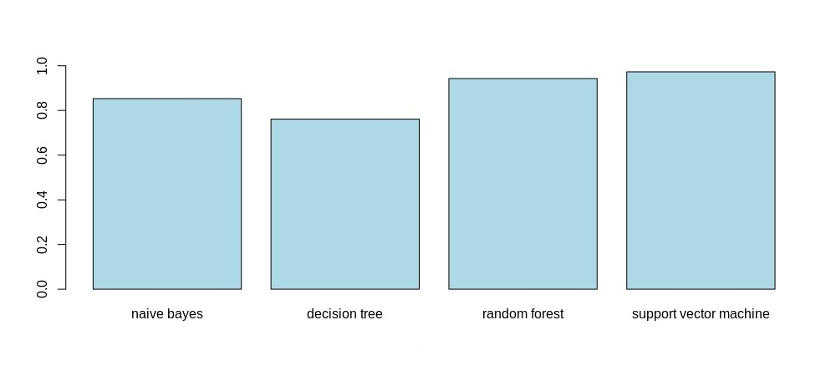
Results of Approach B

Slide 46

Results of Approach C

Slide 47
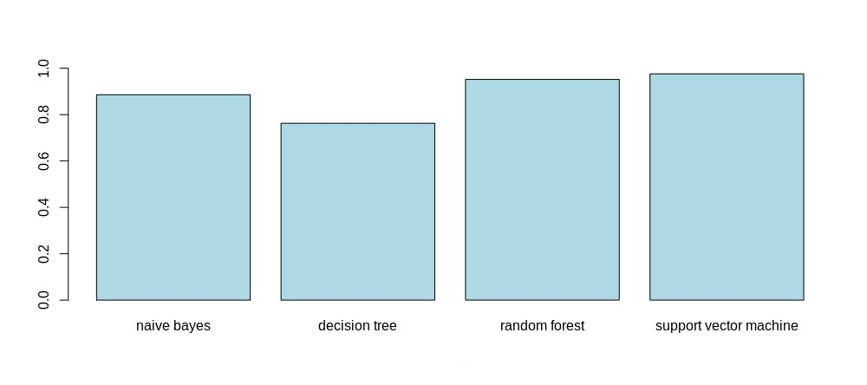
Results of Approach D

Slide 48
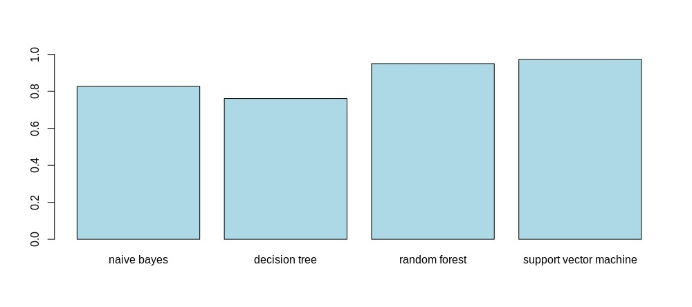
Results of Approach E

Slide 49

Results of Approach F

Slide 50

Results of Approach G

Slide 51
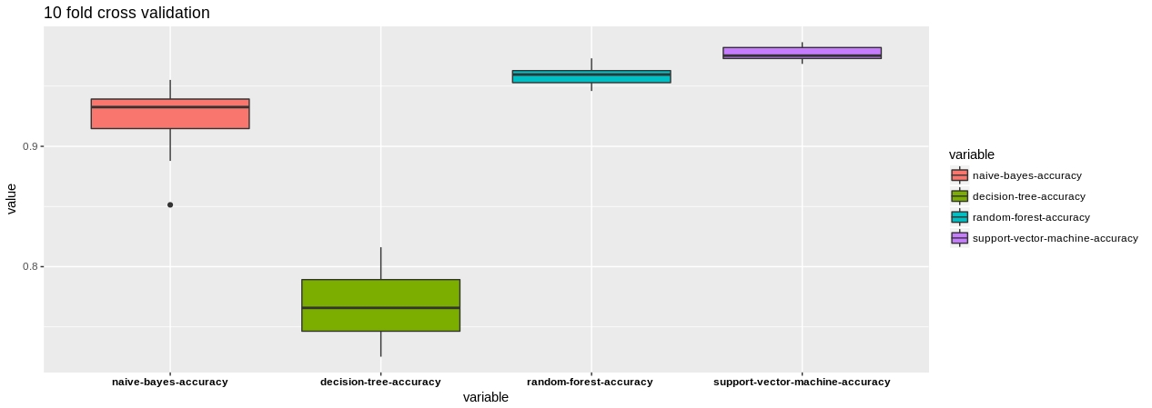
Cross-validation validation technique

Slide 52
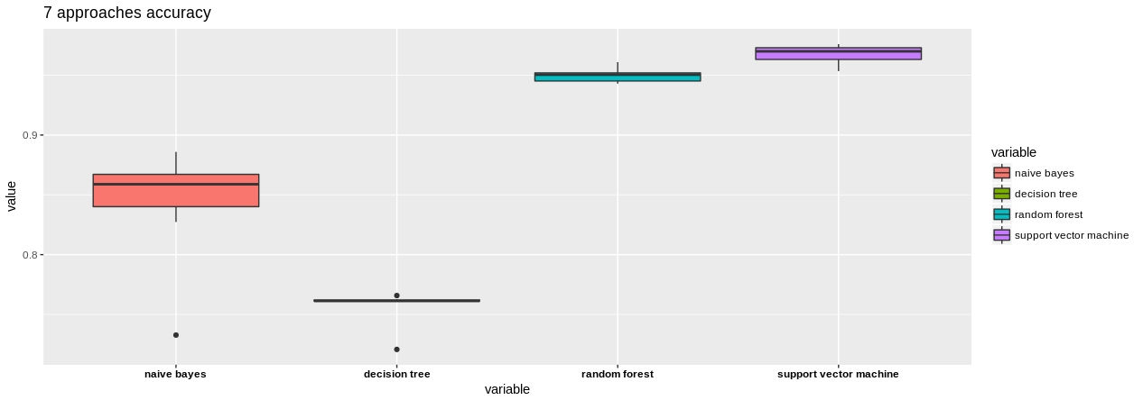
Box Plots of classification models accuray through the seven approaches

Slide 53
Conclusion
Random forest is better with high-dimensional spaces
Stanford CoreNLP lemmatization could make a big leap if it lemmatize with high performance
Naïve Bayes had a big leap with stemming
CoreNLP with moderate performance approximately is similar to Porter
SVM is the most classification model among others
Decision Tree isn’t a good choice for text classification purpose
N-gram could be useful for another text classification problems but not with news/articles classification

