Slide 1
CMMI What do you know about it?
Celestial 14BIT1
Notes:
Presentation slide for courses, classes, lectures et al.

Slide 2
Group Information
Lê Đức Anh
Phạm Xuân Bách
Nguyễn Nguyên Hoàng
Lê Hoàng Huy
Phạm Thiên Ân
Notes:
Beginning course details and/or books/materials needed for a class/project.

Slide 3
CMMI Introduction
CMMI
What
Who
When
Where
How
Why
Notes:
Introductory notes.

Slide 4
What?
Capability Maturity Model Integration
Notes:
Objectives for instruction and expected results and/or skills developed from learning.

Slide 5
Who?
Founder
SEI
Notes:
Relative vocabulary list.

Slide 6
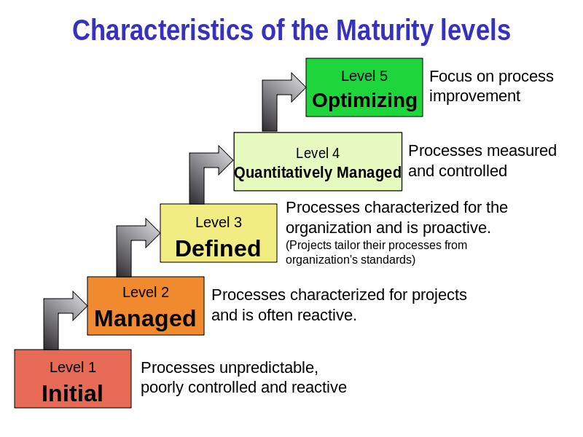
When?
5 Level
Initial
Managed
Defined
Quantitatively Managed
Optimizing
Notes:
A list of procedures and steps, or a lecture slide with media.

Slide 7
Where?
System Engineering (SE)
Software Engineering (SW)
Integrated Product and Process Development (IPPD)
Supplier Sourcing (SS)
Notes:
Example graph/chart.

Slide 8
How?
8 Steps
Cost
Notes:
Example graph/chart.

Slide 9
Why?
Enterprise
Manager & Performer
Senior Manager
Worker
CMMI
Notes:
Conclusion to course, lecture, et al.

Slide 10

Questions/Discussions
Notes:
An opportunity for questions and discussions.

