Slide 1
Seminar project What do you know about CMMi?
Celestial 14BIT1
Notes:
Presentation slide for courses, classes, lectures et al.

Slide 2
Group Information
Lê Đức Anh
Phạm Xuân Bách
Nguyễn Nguyên Hoàng
Lê Hoàng Huy
Phạm Thiên Ân
Notes:
Beginning course details and/or books/materials needed for a class/project.

Slide 3
Analyze
Plan
Report
Analyze request

Slide 4
Build
CMMI
What
Who
When
Where
How
Why
Notes:
Introductory notes.

Slide 5
Report
Edit information
Build PowerPoint
Check PowerPoint

Slide 6
What?
Capability Maturity Model Integration
Notes:
Objectives for instruction and expected results and/or skills developed from learning.

Slide 7
Who?
Founder
SEI
Notes:
Relative vocabulary list.

Slide 8
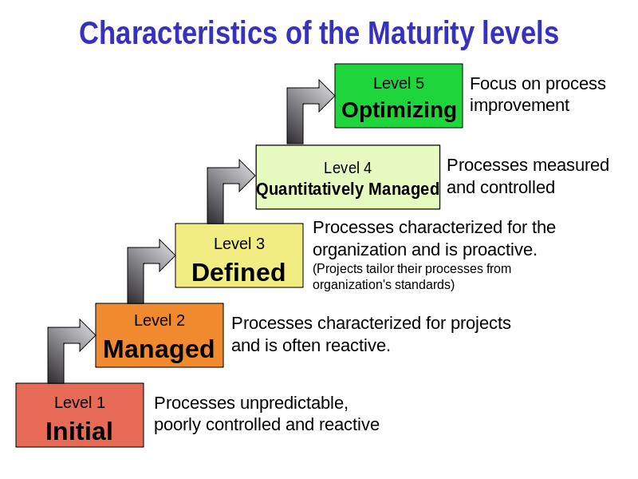
When?
5 Level
Initial
Managed
Defined
Quantitatively Managed
Optimizing
Notes:
A list of procedures and steps, or a lecture slide with media.

Slide 9
Where?
System Engineering (SE)
Software Engineering (SW)
Integrated Product and Process Development (IPPD)
Supplier Sourcing (SS)
Notes:
Example graph/chart.

Slide 10
How?
8 Steps
Cost
Notes:
Example graph/chart.

Slide 11
Why?
Enterprise
Manager & Performer
Senior Manager
Worker
CMMI
Notes:
Conclusion to course, lecture, et al.

Slide 12
Issue
Big
Health problem
Website problem
Medium
AUT program
Main project
Small
Rework report
Remake PPT

Slide 13
Conclusions
Rate
Lê Đức Anh: Well Done
Phạm Xuân Bách: Well Done
Phạm Thiên Ân: Well Done
Nguyễn Nguyên Hoàng: Well Done
Lê Hoàng Huy: Well Done

Slide 14


Questions/Discussions
Notes:
An opportunity for questions and discussions.

