Slide 1

2
19
Mtest
---- CPP DT test framework
reporter：Max time：2019/2/25

Slide 2
01 / Introduction
CONTENTS
02 / Why Mtest
03 / Mtest architecture
04 / Q&A

Slide 3
1
PART ONE
Introduction

Slide 4
About Mtest
Multi-threads/Multi-usage/Multi-parts
What is Mtest
C++ test
Mtest is write for C++ language.
Mtest is a test framework to C++ DT test, it support C++ sync/async API.
Sync/async API
Mtest supports both sync API and async API
Where is Mtest
https://github.com/maxcong001/CPP_test_env
Parallel testing
Mtest run test cases parallel.
N x Faster
Boost develop time and run n times faster.
Re-useable
Every test body is re-useable by cases.

Slide 5
2
PART TWO
WHY Mtest

Slide 6
Why Mtest
Support async API/Multi-threads/Multi-parts
A
Support async API
P
Parallel test
R
Reusable
Notes:
Support Async test: Nowadays, more and more C++ function is async function, which means the function returns immediately, but the result comes back later. There is no test frame work support this kind of test.
Parallel test: Mtest starts several threads(according to how many cores of the test server) to run test cases parallel.
Flexible test case: Every test case has different parts, every part is re-useable. You can build up cases using different combination of parts.

Slide 7
3
PART THREE
Mtest architecture

Slide 8
Mtest architecture
Mtest basic component
Test case
Test suit
Include all the info of a test
test cases of same scope
Test project
Test body
The project to test
The code logic to test
Mtest concepts

Slide 9
Mtest test case
What are in Mtest test case
Case name
Prepare function
Test case
Project name
body
Suit name
Destroy function

Slide 10
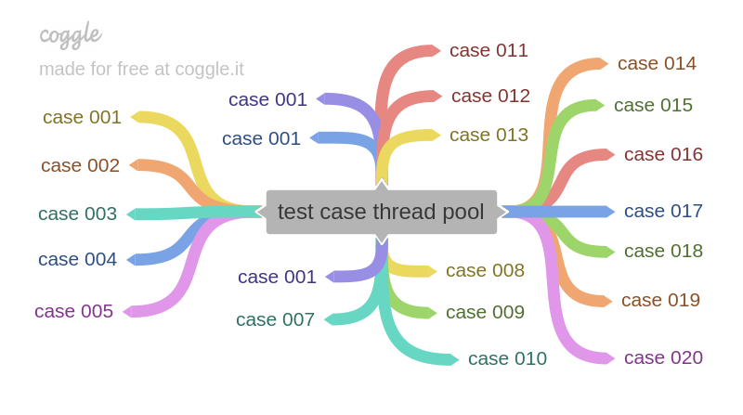
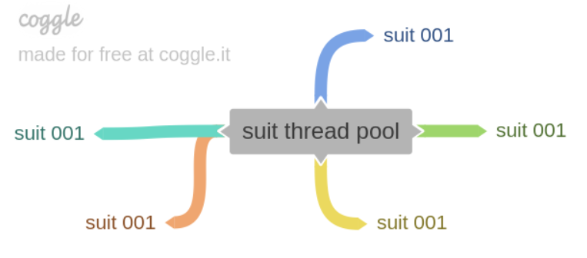
Mtest thread pool
Mtest thread pool
Case thread 002
Suit thread 003
Case thread 003
Suit thread 001
Case thread 001
Suit thread 002

Slide 11
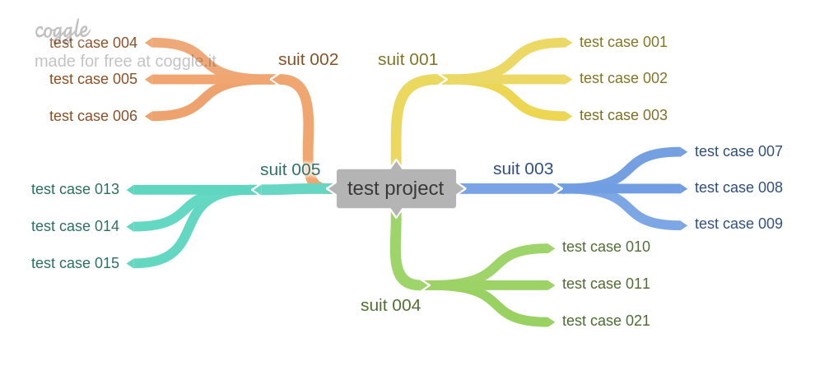
Mtest test run
Mtest test run

Slide 12
4
PART FOUR
Q&A

Slide 13
2
19
Thanks

