Slide 1

2
19
Mtest
---- CPP DT test framework
reporter：Max time：2019/2/25

Slide 2


1. 运行时间长
2. 没有async支持
3. Case组织混乱

Slide 3
About Mtest
Multi-threads/Multi-usage/Multi-parts
What is Mtest
C++ test
Mtest is write for C++ language.
Mtest is a test framework to C++ UT/DT test, it support C++ sync/async API.
Sync/async API
Mtest supports both sync API and async API
Where is Mtest
https://github.com/maxcong001/CPP_test_env
Parallel testing
Mtest run test cases parallel.
N x Faster
Boost develop time and run n times faster.
Re-useable
Every test body is re-useable by cases.

Slide 4
Mtest architecture
Mtest basic component
Test case
Test suit
Include all the info of a test
test cases of same scope
Test project
Test body
The project to test
The code logic to test
Mtest concepts

Slide 5
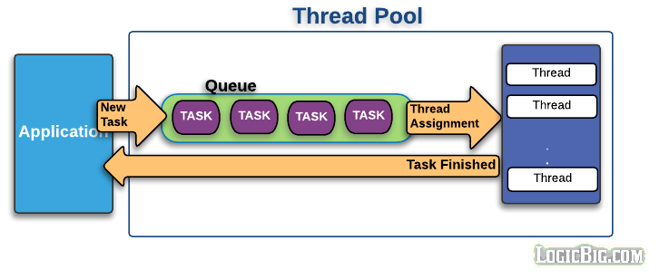
Mtest architecture
Mtest basic component

Slide 6




Why Mtest
Support async API/Multi-threads/Multi-parts
800%
200%
Mtest execute speed
Mtest develop speed
Notes:
Support Async test: Nowadays, more and more C++ function is async function, which means the function returns immediately, but the result comes back later. There is no test frame work support this kind of test.
Parallel test: Mtest starts several threads(according to how many cores of the test server) to run test cases parallel.
Flexible test case: Every test case has different parts, every part is re-useable. You can build up cases using different combination of parts.

Slide 7
Mtest example

Slide 8
4
PART FOUR
Q&A

Slide 9
2
19
Thanks

Slide 10
1
PART ONE
Introduction

Slide 11
01 / Introduction
CONTENTS
02 / Why Mtest
03 / Mtest architecture
04 / Q&A

Slide 12
Mtest vs Google test
Support async API/Multi-threads/Multi-parts
Mtest
google test
A
Support async API
not support
P
parrallel test
VS
not support
R
Reusable
not support
Notes:
Support Async test: Nowadays, more and more C++ function is async function, which means the function returns immediately, but the result comes back later. There is no test frame work support this kind of test.
Parallel test: Mtest starts several threads(according to how many cores of the test server) to run test cases parallel.
Flexible test case: Every test case has different parts, every part is re-useable. You can build up cases using different combination of parts.

Slide 13
2
PART THREE
Mtest architecture

Slide 14
Mtest architecture
Mtest basic component
Test case
Test suit
Include all the info of a test
test cases of same scope
Test project
Test body
The project to test
The code logic to test
Mtest concepts

Slide 15
3
PART TWO
WHY Mtest

