Slide 1
Systems architecture & Benefit assessment of new requirement
Business group: Business group name
Project name: New requirement name

Slide 2
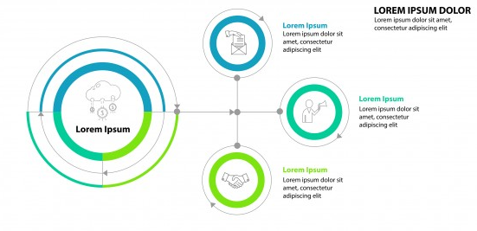
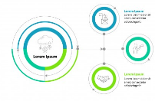

Base brief: Projects material management
Current status:
PDL items for each project around 500, materials re-use(leverage) xx rate %(~ xx items) in 15G
Each project took hours/week average during developing cycle in project
It caused dedicate xx to collect, back and forth discussion with function team, come out waterfall which must be finished within xx weeks for each phase. Heavy overtime on fn team during this period.
Estimate now will be xxxx efforts compared with past.
Target:
Kickoff by Jan 1th 2020
Effective by Jan. 2021
Reduce xx% working hour by automation
Past process diagram
Now process diagram

Slide 3
Process Comparison
As-Is (by manually)
xxx
xxx
xxx
xxx
xxx
xxx
xxx
PM
PM/PCC
PM/PCC
Function Team
PM/Function Team
PCC
PCC
Check xxx
Maintain xxx
Compare xxx
To-Be (by automation)
xxx
xxx
xxx
xxx
xxx
PM
Function Team
PCC
PDL System
PCC

Slide 4



System Blueprint
fn
Input xxx
fn
Input xxxx
fn
Input xxxx
Xxx plan
OxO system
output
xxxx
Compare
Upload
Download

Slide 5
Project’s investment and ROI
Estimate working hours on xxx project without system support: xhours * 52 weeks * y projects = result hours/year
Estimate working hours on xxx project plan with system support: y hours
Estimate manpower on process discussion and system developing: z hours
Other benefit:
Improve materials plan efficiency and reduce human error
Enhance customer satisfaction with accuracy plan & report
(Unit hour/week)
Job Description | PIC | past x1 efforts | Now project x3 efforts
 |  | Was | As-Is | To-Be
Collect function team demand | Fn | 1 | 2 | 0
Check inventory | Fn | 1 | 2 | 0
Check material version | Fn | 1 | 2 | 0
Check shortage Q’ty | Fn | 1 | 2 | 0
Maintain RYG table | Fn | 1 | 2 | 1
Compare PDL change history | Fn | 1 | 2 | 0
Cross check different project team test schedule | Fn | 1 | 2 | 1
Create Waterfall Plan by Excel | fn | 1 | 2 | 0
 | Sub-Total | 8 | 16 | 2
 | PM | PCC | DQMS | Function Team
Phase | hrs/wk | hrs/wk | hrs/wk | hrs/wk | x duration | Total hours
Define |  |  |  |  | x12 weeks | X
Design |  |  |  |  | x12 weeks | Y
Pilot run |  |  |  |  | x3 weeks | Z
 |  |  |  |  |  | x+y+z

Slide 6
Project’s Summary
問題陳述
Server產品所搭配的測試樣品多樣化且單價高，因此不管是在內部或客戶的要求上，測試樣品需要做到跨專案的高度Leverage，使得fn在與測試team調查測試需求量、測試時間與庫存比對花費許多時間與人力，並由人工計算排出Waterfall plan。因此希望在樣品的統計與計算上導入系統自動化，目的是減少fn與測試team溝通時間並加速與樣品需求統計流程。
目標設定
Item | 預計改善前 | 預計改善後
關鍵指標/project | x hours/week | y hours/week
預計年度效益/year | (x-y) * x * 3=z hours/year z * $568 = result M/year
專案成員
Role | Name | Function
Leader | name | fn
Member | name | fn
Member | name | fn
專案時程
Phase | Start Date | End Date | Remark
Define | 2020/1/1 | 2020/1/1 | On-going
Design | 2020/2/1 | 2020/2/1
Polit run | 2020/3/1 | 2020/3/1
Effective | 2020/4/1 | 2020/4/1

Slide 7
Backup

