Slide 1

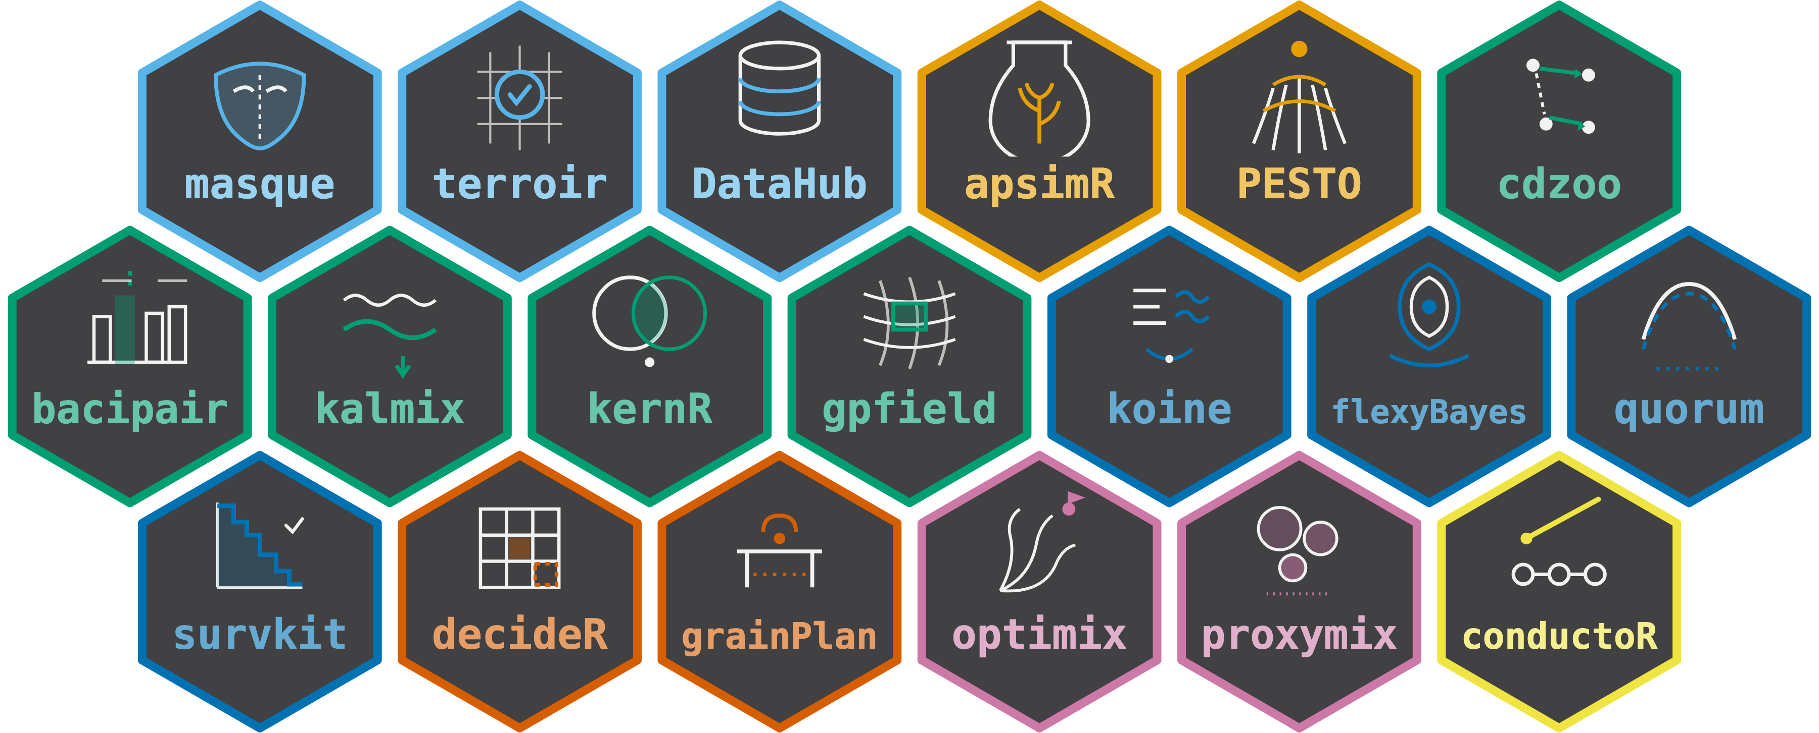

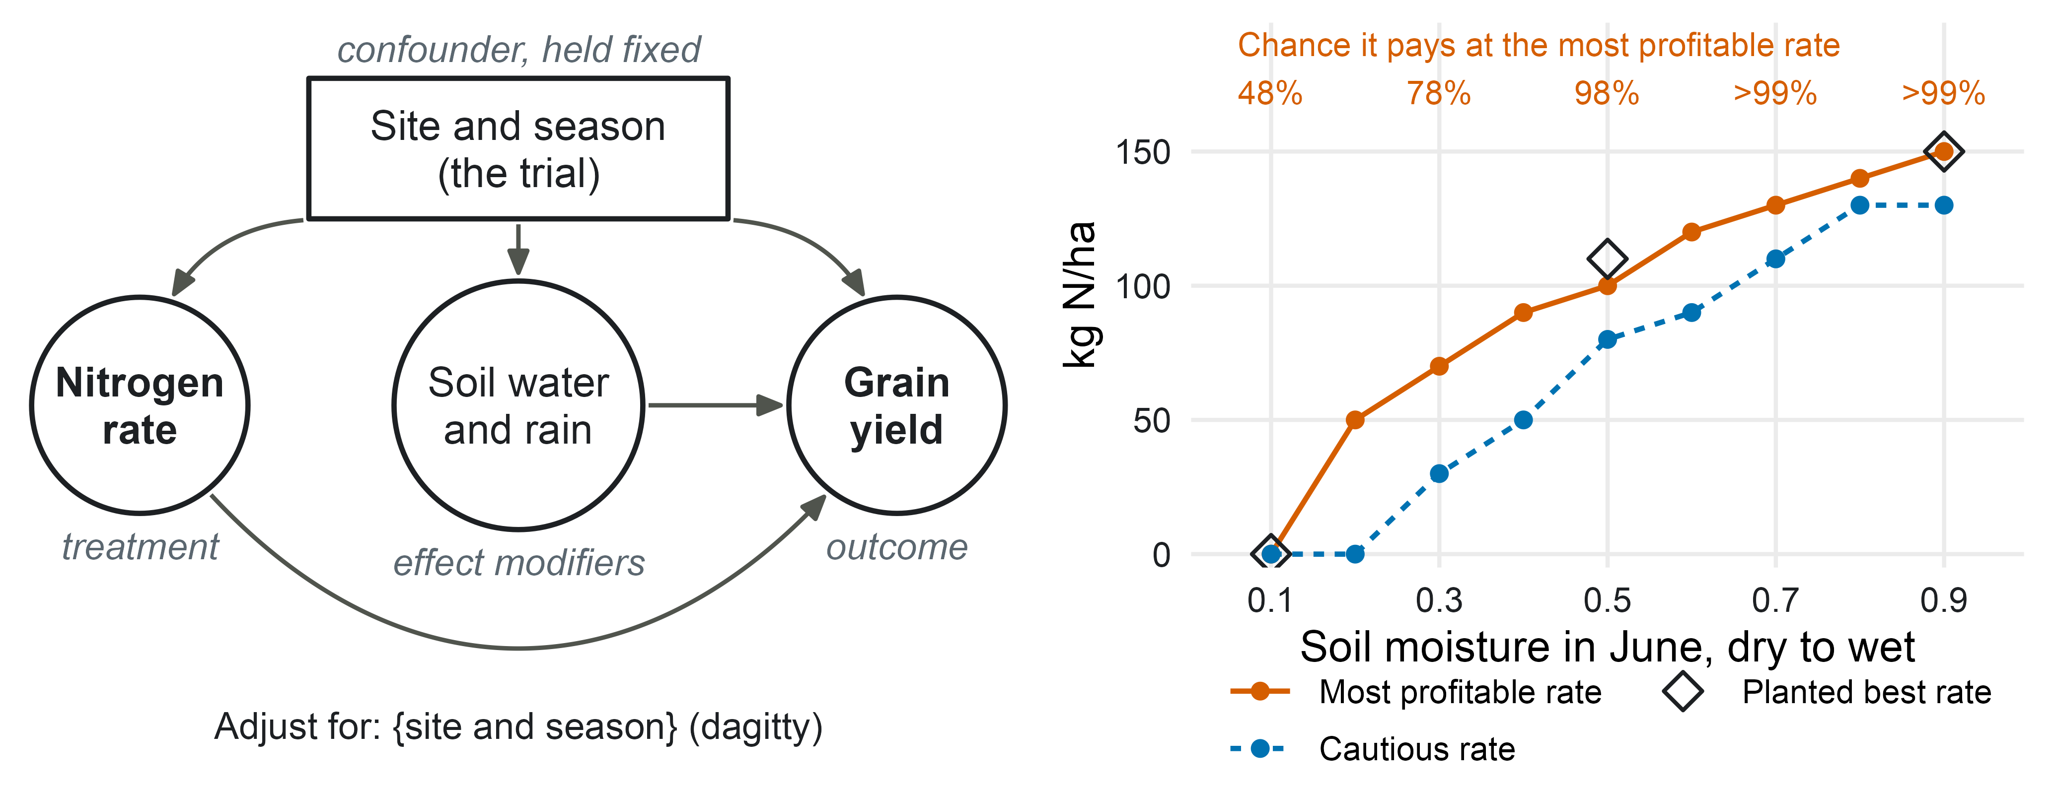
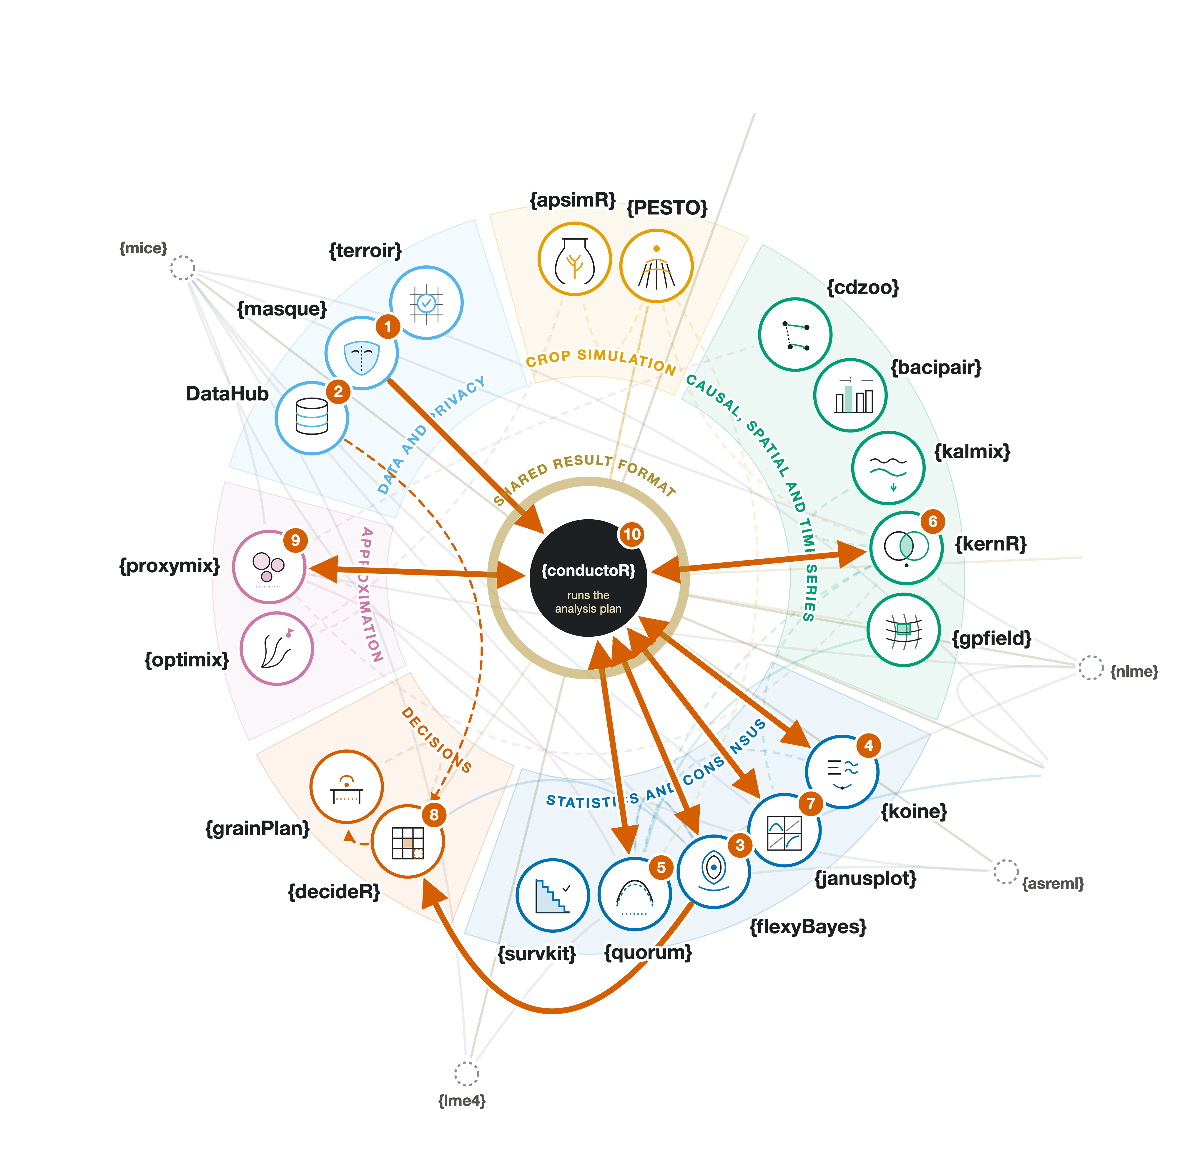
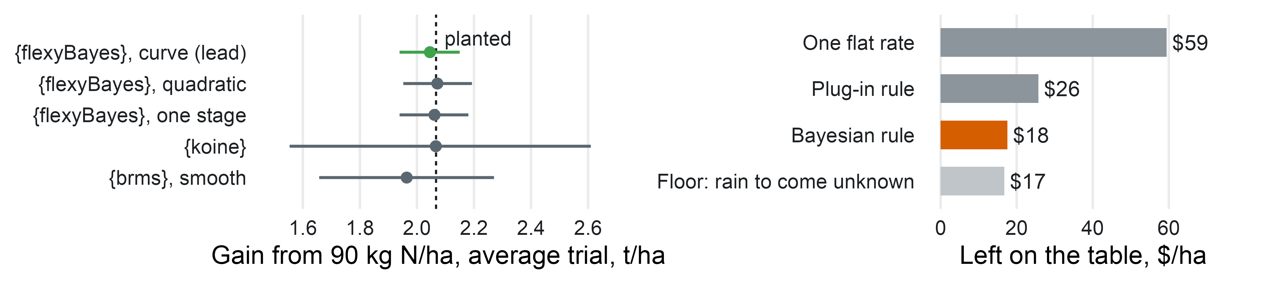


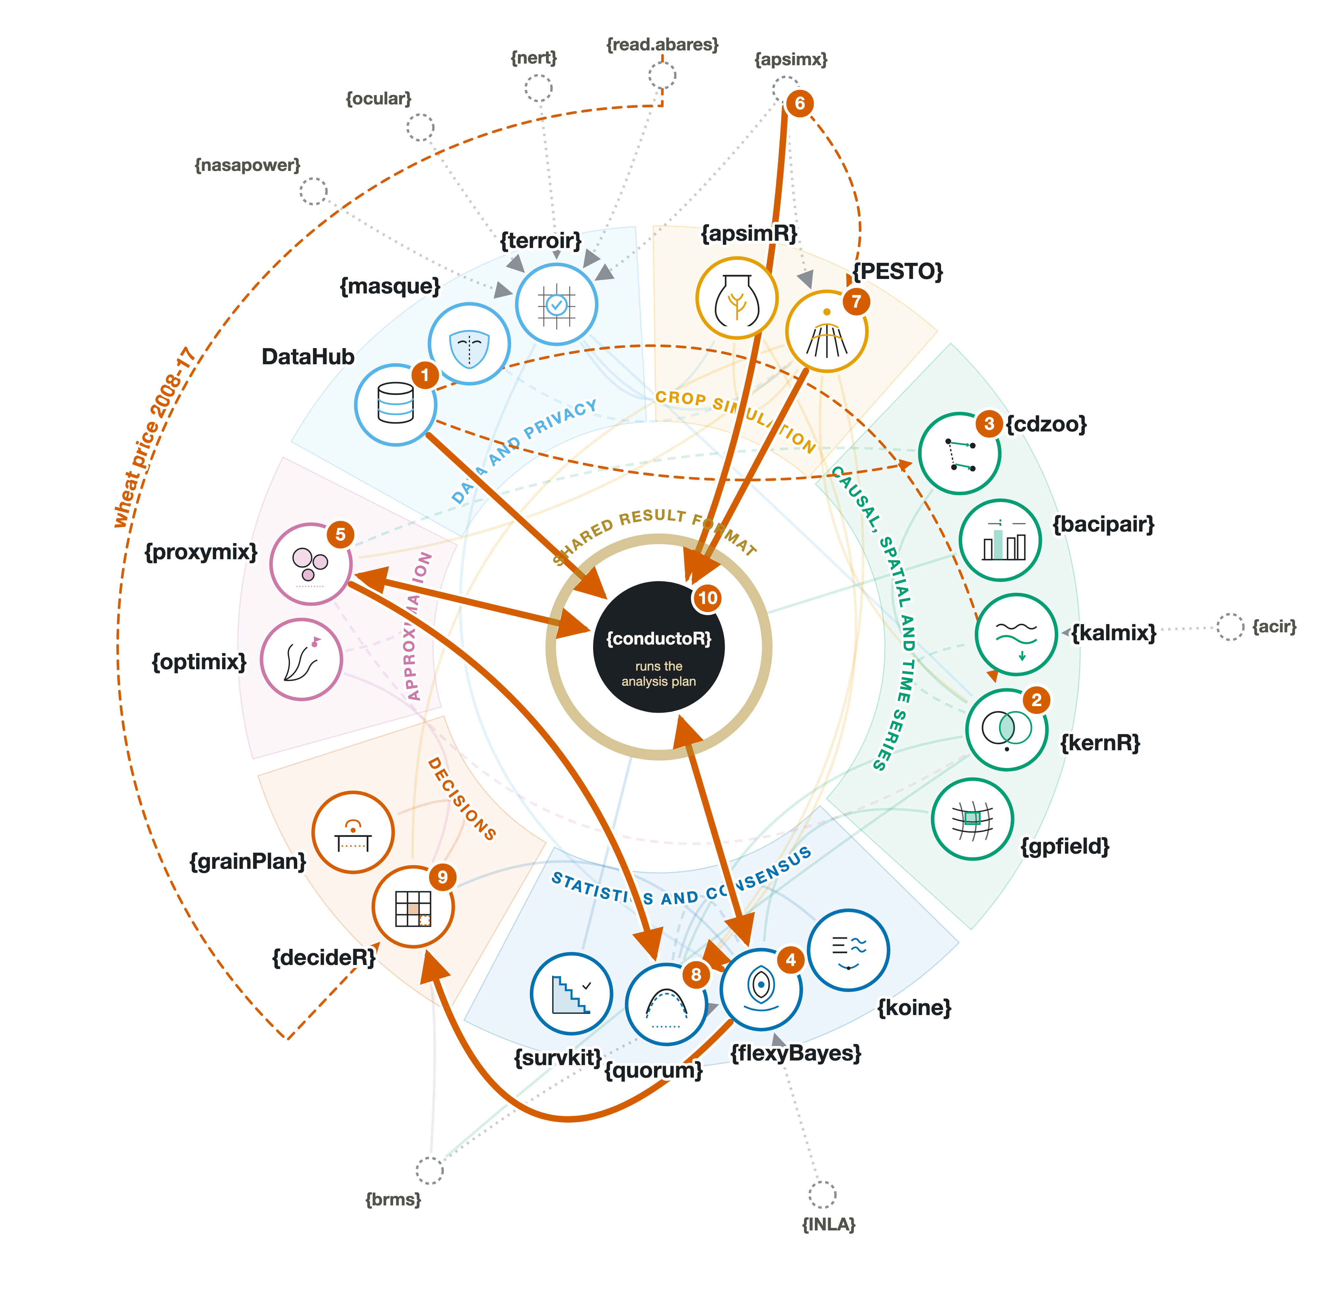
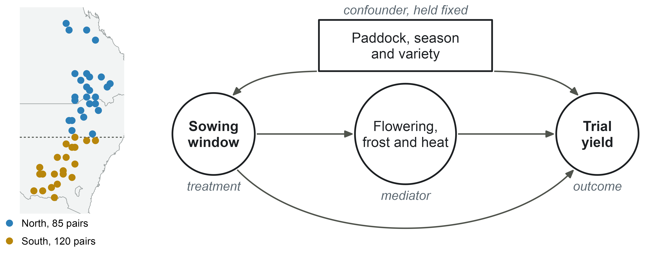
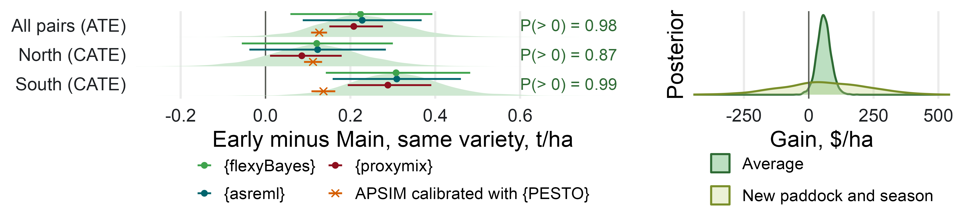
Crop Analytics Orchestra
A coordinated, flexible constellation of R packages for crop analytics
Max Moldovan · Biometry Hub, Adelaide University · max.moldovan@adelaide.edu.au
Abstract
DataHub: the data layer
This work has been done towards GRDC-funded AAGI Research and Development project AAGI-AU-RD-CSL, Causal learning for optimising industry relevant traits in Australian grain production systems, with an intention to introduce a broader analytical paradigm to the grain industry, with a potential of AI integration. In particular, crop analytics mostly treat analytical methods either in isolation (e.g. linear modelling) or in small constellations (e.g. descriptives + modelling + economic evaluation). The Crop Analytics Orchestra is a larger constellation of 18 R packages and an interactive open-data catalogue called DataHub – all built to work together, also covering a wider open-ended range of methods. {conductoR} is a central analytical task dispatcher and outcome collector, and it is currently a pure R package, provisioned to be AI integrated. The Orchestra is practically illustrated with a study of nitrogen topdressing in barley, rehearsed on a synthetic copy of the GRDC Barley Synthesis trials with a known answer planted in it. Each package, except {conductoR}, can function stand-alone, and each aims either to be entirely novel (e.g. {proxymix}, already on CRAN) or to perform among the best in its class.
101
27
55
8
open datasets held
of them Australian
more listed, awaiting access
kinds of question it can match
Each dataset is stored with its source and license, formatted, and its columns and coverage are recorded at the time of enrolment. We can ask, for example, which datasets compare several nitrogen rates, and DataHub would present candidates. The study on this poster takes its barley price from DataHub's ABARES tables. Its trials are private GRDC data, so {masque} made a synthetic copy to build the analysis on, and the real rows stayed with their holder.
The orchestra
How much nitrogen to topdress in June?
The GRDC Barley Synthesis trials tested nitrogen rates from 0 to 150 kg N/ha, topdressed as urea 4 to 6 weeks after sowing, at 48 sites and seasons from 2010 to 2016. At topdressing a grower knows the soil moisture, the rain so far and the soil's water-holding capacity, but not the rain to come.
1. Copy and rehearse. {masque} made a synthetic copy of the trials. The plan was written and rehearsed on it, with a known nitrogen response planted in the copy, then sealed before the real trials were touched.
2. Two stages. Each trial is analysed on its own layout first. {flexyBayes} then fits one Bayesian response curve across the 48 trials, whose ceiling moves with soil water and rain.
3. Decide. {decideR} turns the posterior into the most profitable rate for each soil moisture reading, the chance it pays, and a cautious rate that protects the worst fifth of seasons.
4. Check. {koine} gives an independent second analysis and {quorum} checks that the analyses agree. Each rule is then scored on locations left out of the fit.
max578.github.io
/orchestra
Each hexagon is one package, except DataHub. Its border colour shows its role, as listed below.
Data and privacy. {terroir}: climate, soil and farm data with their sources · {masque}: synthetic copies of private data · DataHub: open-data catalogue
Crop simulation. {apsimR}: runs APSIM from R · {PESTO}: fits a crop simulator to field data
Causal, spatial and time series. {kernR}: tests whole distributions · {cdzoo}: causal discovery · {bacipair}: before and after comparisons · {gpfield}: maps a field · {kalmix}: series over time
Statistics and consensus. {flexyBayes}: Bayesian models for field trials · {koine}: an independent second analysis · {quorum}: combines estimates · {survkit}: time to an event
Approximation and optimisation. {proxymix}: simplifies distributions · {optimix}: chooses an optimiser
Decisions. {decideR}: decisions under uncertainty · {grainPlan}: plans for growers
At the centre. {conductoR}: runs an analysis plan
One study through the orchestra
Left: the causal graph (Hernán and Robins, 2020). Within a trial the nitrogen rates were randomised to plots, so only the site and season affect both the rate and the yield; holding the trial fixed is enough, as {dagitty} confirms (Textor et al., 2017). Soil water and rain change how much nitrogen pays, and do not confound it. Right: the rule for a new paddock, with barley at $314/t (ABARES, 2026-27 forecast) and nitrogen at its recorded cost, beside the planted best rate at three readings.
1. {masque} makes a synthetic copy of the private trials; the plan is written and rehearsed on it.
2. DataHub supplies the barley price (ABARES).
3. {flexyBayes} analyses each trial, then fits the Bayesian response curve the decision uses.
4. {koine} gives an independent second analysis.
5. {quorum} checks that the analyses agree.
6. {kernR} tests whether soil water and rain change the response.
7. {janusplot} checks what the curve leaves unexplained.
8. {decideR} turns the posterior into a rate for each soil moisture reading; {grainPlan} checks it in a grower's terms.
9. {proxymix} checks that the decision has one best region, not two.
10. {conductoR} runs the sealed plan, and logs each dispatch and collect.
In the rehearsal, with a known answer planted in the synthetic copy, the orchestra found it. Topdressing 90 kg N/ha added 2.05 t/ha (1.94 to 2.15) on the average trial, against the planted 2.07. The rule followed soil moisture as planted: no nitrogen on a dry reading, 100 kg N/ha on a middling one (planted best 110) and 150 kg on a wet one (planted 150). Where no response was planted, it said not to topdress, in 4 runs of 4.
These are rehearsal numbers: they show that the orchestra recovers a known answer, not what the real trials say.
Lines are 90% intervals. Right: the return lost against the planted best rate, mean of four rehearsal runs.
Colours are as declared in the list above. Dotted circles are packages from outside the Orchestra, used by Orchestra members. Bold arrows are the handoffs {conductoR} recorded in the rehearsal run, and dashed arrows ran beside it. {dagitty} computes the adjustment set and is not drawn.
What the Bayesian rule adds. Against the planted truth it left $18/ha on the table, against $26 for the usual plug-in rule and $59 for one flat rate; about $17 is lost whatever the rule, because the rain to come is unknown. Scored on locations left out of the fit, it was not clearly better than the plug-in rule, and the plan reports that as it stands.
When the shape is wrong. With a sharp plateau at 50 kg planted, the rule chose 77 kg on average, and the plan flagged the plateau in 4 runs of 4.
The real trials. The same sealed plan runs on the real trials at the data holder; its results follow consultation with GRDC.
How the packages work together
One shared philosophy. The Orchestra works together to take a grain-production question from open data to a decision a grower can act on.
One plan. In its present form, {conductoR} runs an analysis algorithmically, reading from a YAML file, dispatching analytical tasks and re-distributing results. The study on this poster ran this way.
One data and result format. Each dataset is accepted by {conductoR} and dispatched further in a unified format. Each result contains its estimate, its uncertainty range and its data source, so the next package can check it and use it either directly or through {conductoR}.
One install. The sixteen public packages install with one call:
Get it and explore
Sixteen packages are open source (MIT) on max578.r-universe.dev; {flexyBayes} and {quorum} are in development. Every package, with its role and links: max578.github.io/orchestra/members.
References
ABARES (2026). Agricultural commodities: September quarter 2026, statistical tables, Table 6. Australian Bureau of Agricultural and Resource Economics and Sciences.
Bürkner, P.-C. (2017). brms: An R package for Bayesian multilevel models using Stan. Journal of Statistical Software, 80(1). https://doi.org/10.18637/jss.v080.i01
Hernán, M. A., & Robins, J. M. (2020). Causal inference: What if. Chapman & Hall/CRC.
Textor, J., van der Zander, B., Gilthorpe, M. S., Liśkiewicz, M., & Ellison, G. T. H. (2017). Robust causal inference using directed acyclic graphs: The R package 'dagitty'. International Journal of Epidemiology. https://doi.org/10.1093/ije/dyw341
install.packages(c("apsimR", "bacipair", "cdzoo", "conductoR",
"decideR", "gpfield", "grainPlan", "kalmix", "kernR", "koine",
"masque", "optimix", "PESTO", "proxymix", "survkit", "terroir"),
repos = c("https://max578.r-universe.dev",
"https://cloud.r-project.org"))
This work was done under AAGI project AAGI-AU-RD-CSL, Causal learning for optimising industry relevant traits in Australian grain production systems. The support of the Grains Research and Development Corporation (GRDC) provided through the Analytics for the Australian Grains Industry (AAGI) project is acknowledged.

