Slide 1


Privacy-preserving data analysis with non-local AI agents
Max Moldovan
AAGI-AU, Biometry Hub, School of Agriculture, Food and Wine, Adelaide University

Slide 2
An AI agent can now run the whole analysis, but only if it is given the data
The data owner
An AI agent
→
To do the AI-assisted analysis, the data must be passed to AI
A breeding programme, a trial network, a grower group. The data are held under licence or a confidentiality agreement.
Loads the data, chooses the methods, runs them and writes the report, from a prompt or a few.
1 Not reproducible
2 Not traceable
3 Data leave the owner
Ask twice with the same data and the same request: different methods, different answers.
You cannot tell whether a number came from the calculation or from the AI.
Your records go to an AI service run by another company.
Moldovan: privacy-preserving data analysis with non-local AI agents
2

Slide 3
The AI needs the layout of the data, not the data itself
The masked copy (the clone)
Rehearse on the copy
Columns, their types, levels and missing values | same as the real data
Trial design: sites, blocks, rates | kept
Covariates, e.g. rainfall, soil pH | re-made: same spread and links to other columns, no real value
Site coordinates | each site moved 5 to 20 km, still on land
Yield and other outcomes | synthetic, checked for leaks before hand-over
Add a known yield gain to the copy: the plan must find it.
Add none: the plan must find none.
Run as often as needed. No real record is touched.
Handed over once, with a project brief: the question, what each column means, and the background a consultant would be given.
Moldovan: privacy-preserving data analysis with non-local AI agents
3

Slide 4
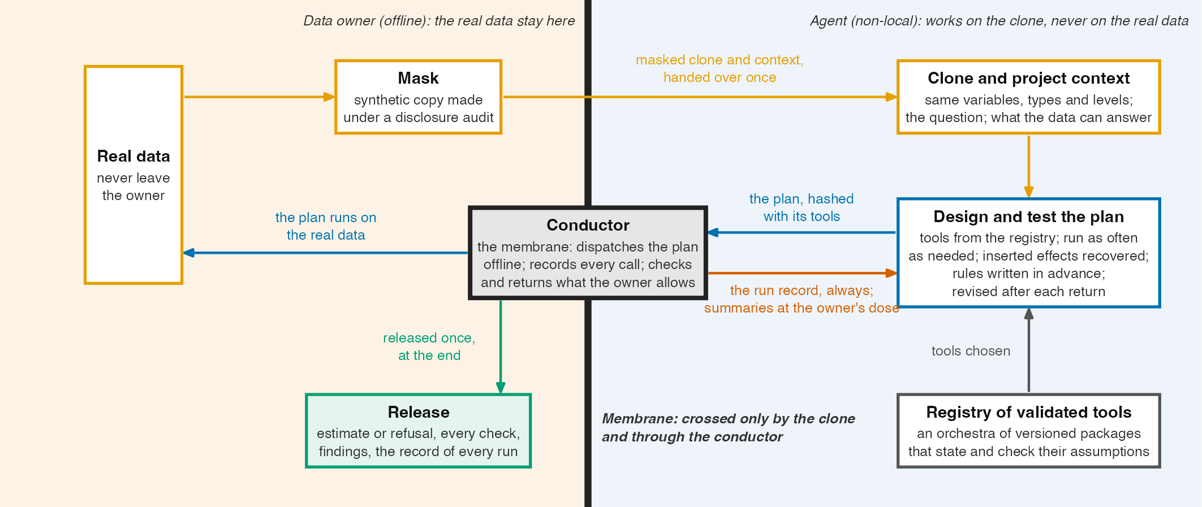
The conductor is the only crossing between the agent and the data
Moldovan: the conductor as a membrane between the agent and the data
4

Slide 5
The agent writes a plan, and the conductor keeps the record
1 Compose
2 Seal
3 Run
4 Loop/return
The AI writes a plan: a list of steps, each calling a tested function from an approved R package.
All rules and settings are fixed before the real data are touched. A person can check the plan.
conductoR reads the plan and calls those functions on the real data. No new code. Every call is logged.
The results are either released or certain summaries returned back to the AI agent.
Run the same plan on the same data again, and you get the same numbers.
Every number in the report can be traced to the step that produced it. Anomalies are flagged.
Built and running: conductoR and the Crop Analytics Orchestra, open-source R packages at github.com/max578
Moldovan: privacy-preserving data analysis with non-local AI agents
5

Slide 6
The data owner decides how much comes back to the AI, in doses
Dose | What comes back to the AI | When the owner allows it
0 | A log of the run: which steps ran, which stopped and why, which checks passed | Always. It holds no data values
1 | Model results: estimates, their uncertainty and how well the model fits | When the owner would publish the answer anyway
2 | Summaries by group: counts, averages, spread. Small groups, and groups one farm dominates, are held back | When the plan must adjust to how the real trial was laid out, or how its yields vary
3 | Detailed checks of the model fit, group by group, each reviewed by the owner | When the plan failed on something the copy did not show, with the owner's analyst
4 | Checks of cause and effect, and of the shape of the data | When those assumptions must be checked on the real data, with the owner's analyst
5 | The data themselves | Only for public data, or when the AI runs on the owner's own computers
Each dose includes everything below it. Doses 1 to 4 are checked for privacy before they go back. What comes back only helps the AI fix its plan. The published result is a separate, checked release at the end.
Moldovan: what returns to the agent through the conductor
6

Slide 7
One loop on a nitrogen-rate trial: the AI never sees a real yield
1 Fix the question
2 Make the copy
3 Design on the copy
How much yield each extra unit of nitrogen adds, and the most profitable rate at given grain and nitrogen prices.
Keep the sites, blocks and published rates. Replace every yield with a synthetic one.
Curve shape picked by a rule set in advance. Add a known gain: the plan finds it. Add none: it finds none.
4 Review and lock
5 Run at the owner
6 Fix or publish
An analyst at the owner approves the plan without seeing the data.
Dose 0: only whether the run finished, and which warning flags were raised. Dose 1: the estimate and its range.
If a step stops, the AI fixes the plan and it runs again. At the end, the owner publishes the rate, every check and every run log.
Data: a public multi-site nitrogen trial (agridat, hernandez.nitrogen), treated as confidential to illustrate the steps. No result is reported.
Moldovan: one loop, step by step
7

Slide 8
Privacy is enforced by the conductor (pure R), not by asking the AI to behave
What the conductor enforces
What it does not guarantee
■ The AI gets only the checked copy, the project brief, and what the owner allows back.
■ Anything beyond the run log must be asked for in the plan in advance, and is checked before it goes back: no small groups, no figures one farm dominates, no working out a hidden value by comparing two answers.
■ The owner sets a limit on how much can come back in total.
□ Zero risk. The dataset can leak due to poor real dataset isolation, for example.
□ The copy, the brief and the published result can also give something away, so they get the same checks.
□ Analysis and inference integrity. An AI may already have seen the data, or reports on them, in its training.
Moldovan: privacy-preserving data analysis with non-local AI agents
8

Slide 9
Thank you
Max Moldovan, max.moldovan@adelaide.edu.au
github.com/max578
The support of the Grains Research and Development Corporation (GRDC), provided through the Analytics for the Australian Grains Industry (AAGI) project AAGI-AU-RD-CSL, Causal learning for optimising industry relevant traits in Australian grain production systems, is acknowledged.

