Slide 1
Byte Academy
Career Outcomes

Slide 2
Topics
The different application processes
How to write your resume
How to set up your LinkedIn profile
What to do for networking
What to do for interviews

Slide 3
Types of Applications
Online / Recruiter / Referral

Slide 4
Disadvantages
Applying For Jobs On-The-Line
advantages
You can apply to MANY jobs quickly
You can apply at your convenience.
You will not stand out from the other applications
It’s hard to track your progress for that application
It’s hard to follow up
Should be doing some research for each company you are applying to
FOLLOW UP
Follow up in 3-5 business days
Follow up via email
Only once!

Slide 5
Disadvantages
Applying For Jobs Through Recruiter
advantages
You will not have any control over the application for this position
You will not get proper feedback
Who will be paying the recruiter fee?
Is there another candidate the recruiter has for that position?
More Inside Info
A Recruiter will be selling you
Easier to follow up with a recruiter
Cover Letters aren’t required as much
FOLLOW UP
Wait 1-2 business days to follow up
Follow up with Recruiter via call
Follow up with Recruiter via email after call if needed

Slide 6
Disadvantages
Applying For Jobs Through Referral
advantages
Not too many disadvantages.
Approach with caution as to not insult your referral or yourself
Access to reliable insider information
If you are referred through an employee, their opinion has more weight
More likely to get in the door, even without a resume or cover letter
FOLLOW UP
Follow up in 2-4 business days
Follow up with the person you were put into contact with.
Ideally only one follow up, use own judgment if more

Slide 7
Resume / Linkedin / online presence

Slide 8
Resume Writing & Cover Letter

Slide 9
Cover Letters
Keep it short
Give a detailed account of why you are qualified
Talk about your skills, previous experiences, relatable soft skills
Show your interest in that position and the company

Slide 10
Your Highlight Reel
Employers take SEVEN seconds to look at your resume
Your Resume is meant to get you in the door, in front of a human being
You will have multiple versions of your resume
Keep your resume to one page.
Send your resume in pdf format
Text editors like MS Word may change the format
Your name should be in the name of the file.
Jason_Ng_Resume.pdf

Slide 11
Organization and consistency
Organization
Consistency
Position best content at the top
Use common words in job description
Name and contact information at the top
Email, Phone, Address, Github, Portfolio
Education/Skills on the side or the bottom
RELEVANT experiences
Position, Company, Dates of employment, Location
Related Responsibilities / accomplishments
The proportion of page taken should represent the importance in the experience or the amount of time spent at a job
Most relevant skills for position at top of section
Fonts
Use the same font for the same tasks
One font for headers / titles
One font for bullets / descriptions
Keep the font size the same
All wording of same type should be the same.
If one job title is underlined, all job titles are underlined
Use the same bullets throughout the whole resume
Decide whether you are using periods or not
Keep all tenses the same (IN THE PAST)

Slide 12
Describing Your Byte experience
How can we appeal to a broad range of readers? It could be a:
HR administrator, technical recruiter, or a developer
You’ll want to keep your bullets short and to the point
Action Verb → What You Did → How You Did It
“Developed a RESTful whiskey api using Express.js, and SQLite3”
“Built a chat application using Socket.io, Django, Html, CSS, jQuery”

Slide 13
Describing Your non-technical experience
Keep bullets short
Use numbers wherever possible
Describe your experience using an action tense. Do not describe them based on your “duties” or “responsibilities”
DO NOT! → “Responsible for building the api for a Django application about cars”
Action Verb → What You Did → How You Did It
“Implemented a CMS workflow that targeted At Risk Students within one month of the semester”
“Developed advisement survey system that increased retention of first year students by 30%”

Slide 14
LinkedIn

Slide 15
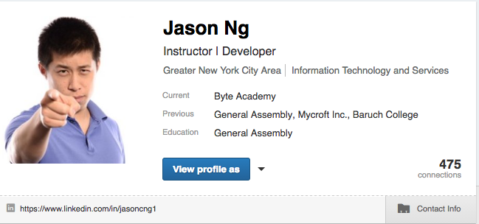
Your First Impression
Headshot
Name
Headline
City
Industry
Contact Information
Personal URL

Slide 16
Your Headshot
Your headline
Your profile picture is the first thing that appears on searches.
It is the first thing people will look at when they visit your profile
Get an image that just shows your head and shoulders
If it’s a more creative image feel free to use that
Make sure to wear nice clothing
Clean clothing
Ironed clothing
No deep v-necks
Fix your collars
Be Creative
Do NOT write “Student”
Show what you’re interested in
This should definitely include something about programming
Can also including something not about programming

Slide 17
City and Industry
Where are you looking for a job?
Put the city or state where you want to get a job
If you are open to moving around then you can leave it blank
What industry are you looking for?
Include all industries that are related to your field

Slide 18
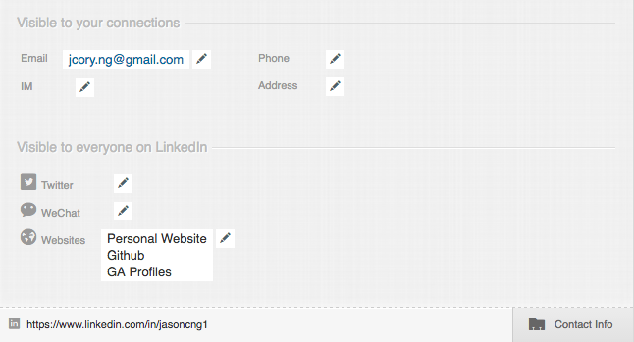
Your Personal URL
Your Contact Information
SET YOUR URL!!!
Do not use the default one LinkedIn URL
Make it as close to your name as possible
This will be the URL you share to employers and recruiters
Use a professional email address.
Make your email public
Put up your Github link
Any other sites, such as a personal portfolio include
Do NOT use any social media accounts unless they are relevant to work, or the industry you hope to join

Slide 19
Your Summary
Who are you?
What did you use to do?
What are you currently doing?
Where do you want to go? What are you looking for?
Write this in first person
Keep it short, creative, funny?
Emphasize important aspects of your experience

Slide 20
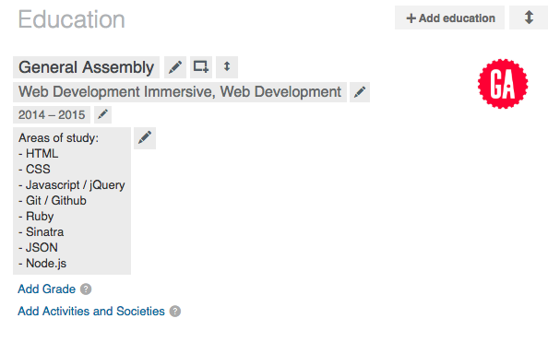
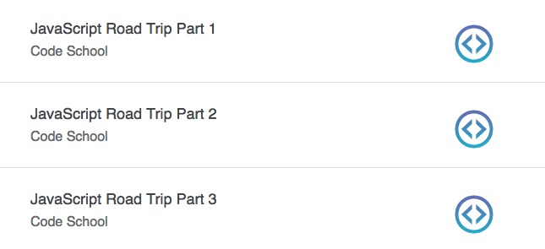
Your Byte Education
Include Byte in the education section
Write a paragraph about your Byte experience.
What languages you used, what projects you worked on, pair programming, and the like
You can also just list this out.
However, a paragraph is more descriptive, and since LinkedIn gives you the room for it you might as well use it
Education should also include other schooling and/or certificate courses.
Example: Code School allows you to put completed courses on LinkedIn

Slide 21
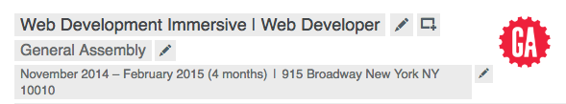
Your Byte Experience
You can include “Student” in the title
Write a summary of your experience
Write bullets for your projects and languages used
“Developed a political web application using Express, AJAX, and APIs to pull information regarding donations to legislators and the bills they sponsored.”
Upload images and projects using the square box with a plus sign at the top right
Include Other Experiences
Full Time / Part Time / Volunteer
Emphasize soft skills
Collaboration, taking initiative, and the like.
Emphasize accomplishments,
If possible try to tailor them to the industry you want to move towards

Slide 22
Skills / connections / Following
Skills
Connections
Following
Put down all the skills!
Move the most relevant skills to the top
Endorse your classmates for everything
The more endorsements you have for a particular language the higher priority you will have for people searching for that skill
Do not feel the need to accept people you don’t know
If you want to connect with somebody do not use a default message
Write a personalized note
Accept a connection within one business day
Follow groups that you like and/or are relevant to your industry
Follow companies that you like
Follow leaders in your industry

Slide 23
Application Work Flow

Slide 24
Trello Board
Make a Trello Board for your application process
Columns for each of the following
Profiles, Places to Consider, Position to Apply, Applied, Interview, Offers, Rejections / Did Not Want
Use Trello’s Cards
Make a checklist (resume sent / cover letter sent / thank you email / etc.)
Save a link to the job posting
Make a due date

Slide 25
Networking Interviewing

Slide 26
Networking
Go to networking events by yourself or with your classmates
Is this in your industry? Is this about a language or framework you’re interested in?
It is not hard to be the most approachable person in a room of programmers… Just smile?
Practice talking about your experience.
What have you done? / What are you currently doing? / Where do you want to go?
Projects you built? Working as a team? Building an MVP?
Passionate about “industry”. Really enjoy working with “Language” / NO “I hate xyz”
Do not bring business cards, take business cards.
Practice Your Elevator Pitch
Write something that will take 30 seconds. Practice saying it
Cut the fluff, make it 20 seconds. Practice saying it
Trim the fat, make it 10 seconds, Practice saying it
Tongue twister warm up: “Unique New York”

Slide 27
Follow Up
Do not hand out business cards, take them. (mentioned in previous slides)
Follow up with them in 1-2 business days
In the email mentioned how you met them, and ask them if they would like to meet for coffee/tea.
Give them TWO times on DIFFERENT days.
Now the ball is in their court and they will respond with:
Yes lets me at X time / I’m not available at those times how about this / It was great meeting you, we are not hiring right now.

Slide 28
Interview
If it is a meeting at a coffee or tea shop treat it AS AN INTERVIEW
Dress appropriately.
(no hats, beanies, sports jerseys, etc. )
Dress to impress without going overboard. (You’re entering an industry where people wear t-shirts and shorts to work)
Carry copies of your resume
Have questions prepared for them
“What does the average day look like in this position?”
“What qualities does your ideal candidate have?”
Finish your interview with room to expand on short comings.
Example: “Those are all my questions, are there any concerns about my experience / fit that I can address for you?”

Slide 29
Interview Part 2 Discussion Topics
Past Experience
Your Projects
What do you like about programming?
Why do you want to program?
Conceptual Questions.
Explain REST / OOP / Inheritance
White Board Questions
They don’t care about syntax or the answer, just to see your thought process of how you plan to get the answer
Do not be afraid to say you do not know something

Slide 30
Thank You Notes
Follow up quickly. 1-2 business days
Address anything that you felt you did poorly on during the interview
Mention something you did great on during the interview
Make sure to actually write thank you

Slide 31
Resources

Slide 32
Job Sites
Dice
Angel.co
Glassdoor
CyberCoders
Misc Resources
Creddle.io
Trello

Slide 33
Alumni Schedule

Slide 34
Before 8:30 AM
Prepare cover letters for job postings
8:30 – 11:30
Send out job applications
Afternoon
Practice programming
Send out follow ups to previously applied jobs
Send out thank you emails to previous interviews
Evening
Go to meetups
Look for positions you want to apply for the next morning
Update your Trello board
Misc
Do not send out items on Friday

