Slide 1

Predicting Term Deposit Subscription
Using Machine Learning
Prepared by: Maximillian Abraham

Slide 2
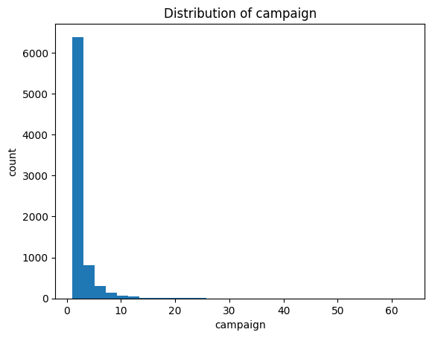
Business Problem
Banks conduct marketing campaigns to sell term deposits.
Problem:
• Low campaign efficiency
• High operational cost
Goal:
• Predict customers likely to subscribe

Slide 3
Stakeholder & Objective
Stakeholder:
• Marketing Team & Management
Objective:
• Build ML model to predict subscription probability
• Improve targeting accuracy

Slide 4
Dataset Overview
Dataset: Bank Marketing Campaign
Rows: 7,813 customers
Features: Demographics, campaign info, previous contact
Target: Deposit Subscription (Yes/No)

Slide 5
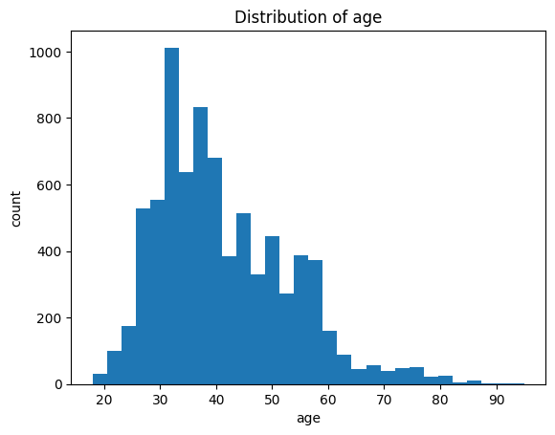
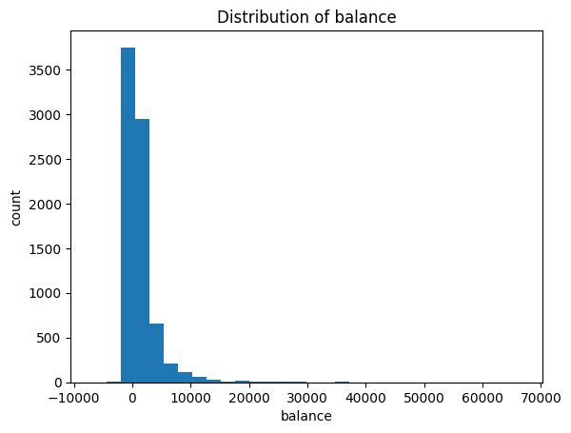
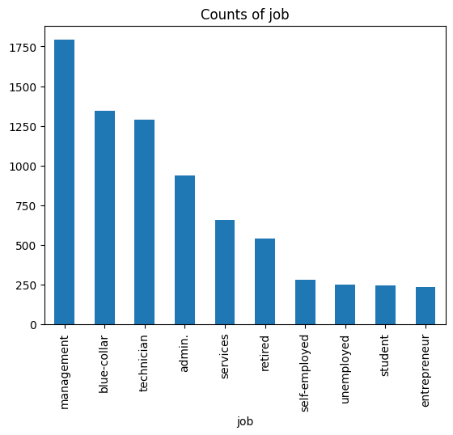
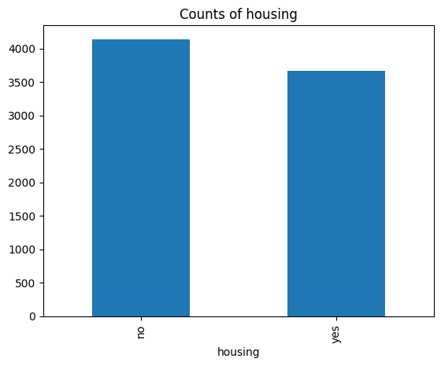
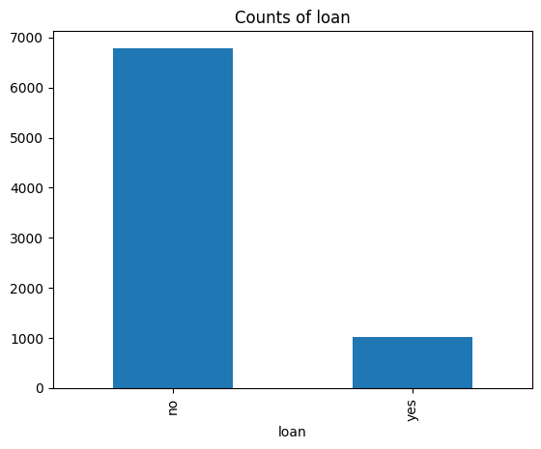
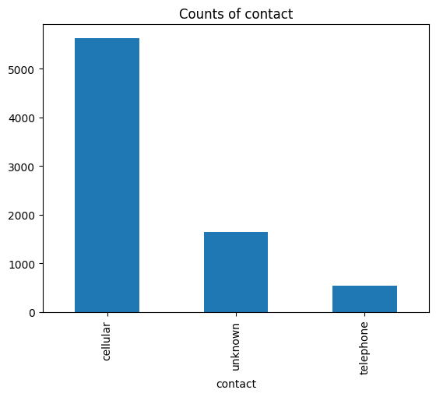

Slide 6
Analytical Approach
Problem Type: Classification
Models Tested:
• Logistic Regression
• Random Forest
Evaluation Metrics:
• Precision
• Recall
• F1-score
• Accuracy

Slide 7

Data Preprocessing
• Removed duplicates
• Numerical imputation (median)
• Categorical encoding (One-Hot Encoding)
• Feature scaling for Logistic Regression

Slide 8
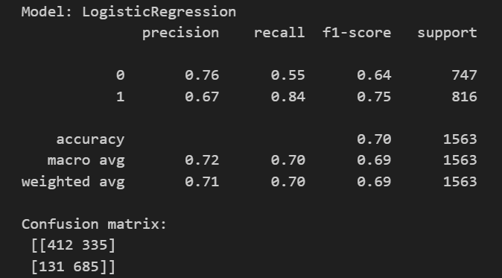
Model Performance – Logistic Regression
Accuracy: 70%
Recall (Subscribed): 84%
Strength:
• High recall – fewer missed subscribers
• Interpretable coefficients

Slide 9
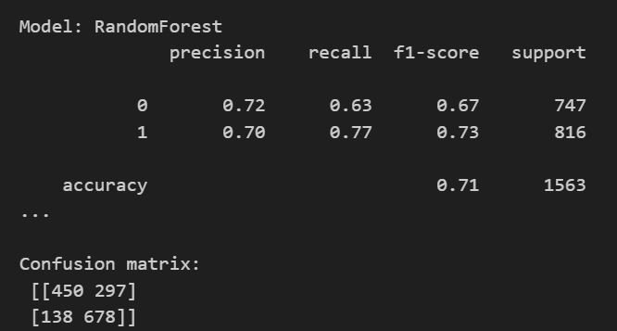
Model Performance – Random Forest
Accuracy: 71%
Recall (Subscribed): 77%
Strength:
• Slightly higher accuracy
• Captures non-linear patterns

Slide 10
Model Selection
Final Model Chosen: Logistic Regression
Reason:
• Higher recall on subscribers
• Lower risk of missing potential customers
• Better interpretability

Slide 11
Post-Modeling Insights
• Certain contact methods increase subscription likelihood
• Previous campaign outcome strongly impacts response
• Missed subscribers identified via false negative analysis

Slide 12
Business Impact
• Improved campaign targeting
• Reduced marketing cost
• Higher conversion rate
• Data-driven decision making

Slide 13
Limitations
• Dataset size is limited
• No customer income information
• Model depends on historical behavior

Slide 14
Recommendations
• Use model for campaign targeting
• Prioritize high-probability customers
• Tune probability threshold for business needs
• Retrain model regularly

Slide 15
Future Improvements
• Add more customer behavioral data
• Test Gradient Boosting models
• Implement SHAP for explainability
• Deploy model into CRM system

Slide 16
Conclusion
Machine learning significantly improves bank marketing efficiency.
Logistic Regression provides interpretable and business-aligned predictions.

Slide 17
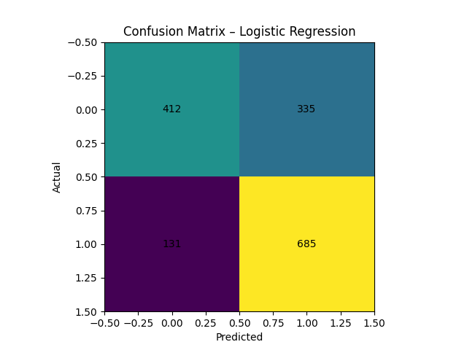
Confusion Matrix – Logistic Regression

Slide 18
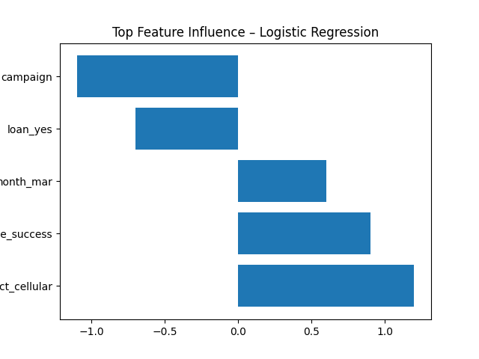
Feature Importance (Model Interpretation)

