Slide 1

Slugs With Attitude SlugSports Will Herrera Sean Medenhall Max Kerscher-Santelli Rahul Patel Daniel Roberts
CMPS115 – Project Presentation
December 3, 2015

Slide 2
Problem:
Difficult to play sports
Solution?
Slug Sports

Slide 3
Challenges
1. Learning Android Studio
2. Utilizing Google API
3. Integrating Parse and enhancing UI

Slide 4
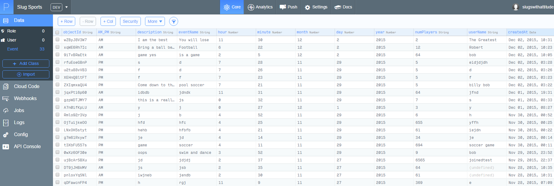
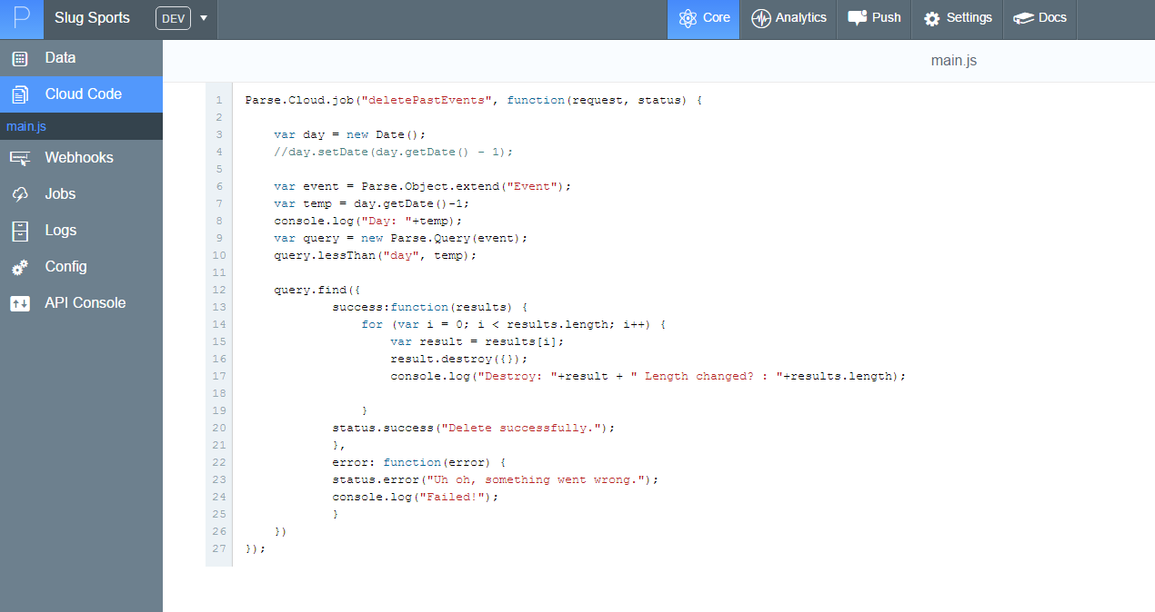
Parse

Slide 5
Acceptance Test
Sign in
Joining a game
Leaving a game
Creating a game
List of your games
OPERS Events
Maps

Slide 6
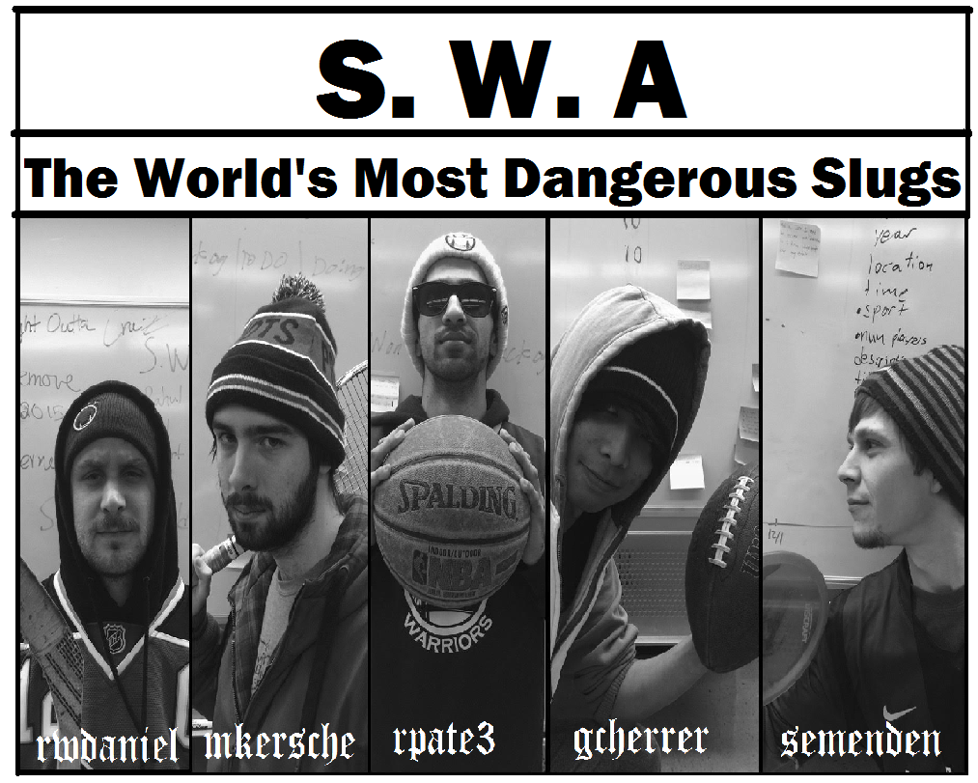
Thank You

