Slide 1
<TODO name of conference>
Global Data Consistency in Microservice Architechtures
Copyright 2015 (c) Ant Kutschera

Slide 2
Agenda
The Problem
Traditional Solutions
An Open Source Solution based on JTA
  Introduction to 2PC
  Contracts
  Eventual Consistency
  Patterns

Slide 3

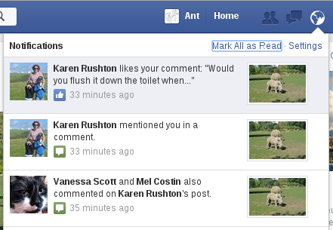
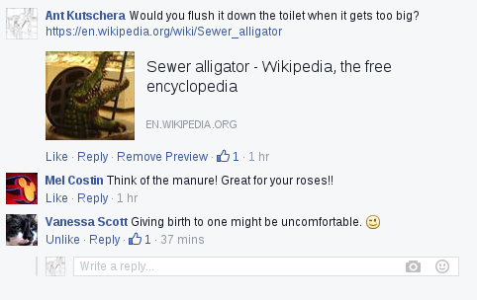
Facebook bug?
Middle link shows Karens comment at the bottom. Other link does not. Inconsistent data between nodes => increased scalability but only eventually consistent. Who wants to build their own framework code to ensure this consistency? It comes for free in NoSQL DBs. Why not in Microservice environments?
???

Slide 4
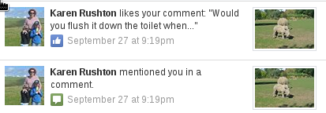
Facebook bug?
Two days later its consolidated.
This is a good example of data being sharded and later consolidated, just as Apache Cassandra and other NoSQL stores do it.
With Cassandra you can choose the isolation level when you send a query – first node, quorum, all nodes, etc.

Slide 5
Selling Tickets
TODO talk about how we integrated fremdsysteme and how you dont want to purchase something on their side but not have it noted on your side and be financially responsible without reselling it to the end customer.
You cannot dictate the signature of the service you are integrating
Complex solution involving async batches
Getting it wrong costs 3m CHF in a month!

Slide 6
Adding a contract to a sale
TODO build up on last example
Abo Management done in SAP
SAP is a “microservice” (http://martinfowler.com/articles/microservices.html)
  It does one thing well (contract management)
  Language Agnostic – SOAP + ABAP
  Decentralised gonvernance
  Decentralised data management
  Product (contract management)
  Split around Business Capability? (contracts department/CRM)
  Evolutionary design (in this case because it was custom)

Slide 7
Adding a contract to a sale
TODO Services:
  Customer DB – allows compensation only
  SAP – execute/commit/rollback (contract managment)
  SAP – compensation only (financials, which run async)
  Ticket Backend – reserve/complete purchase/freigabe
  Order Management – standard JTA/JDBC, but XA since multiple DB connections
Solution
  Custom made asynchronous framework consisting of orchestrated commands
  No BPEL because no centralised support for product :-(
  Cost: up to 1 Man Year

Slide 8
Case Management
TODO talk about workflow where each claims case is also added into the workflow management product.
Because of wrong design, claim “container” is saved, WF case is created, and then validation logic is run. => invalid claim causes an error – schadenfall not saved, but webservice to WF already called.
One Solution
  Fix design
Better Solution
  Still need to consider compensation if something else goes wrong. If the schaden DB fails, you will get lots of created cases in WF which all need cleaning up manually!

Slide 9
Membership in Wiki
Small system built for an assocation
Membership Applications are made
When approved, application leads to:
  Member creation in Wiki (REST, membership management done there)
    Consists of lots of seperate calls! (create user, update properties)
    No control over interface
  Create account in Billing System (local DB or separate microservice)
What happens if first call to Wiki works, but subsequent calls fail due to validation?
  Don't want to duplicate validation rules in front end!
What happens if there is a failure down the line, after the wiki account is created?

Slide 10
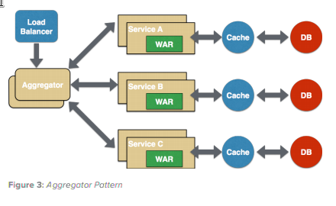
Common Problem
Composite Service
(see https://dzone.com/servlet/storage/?file=293353)
TODO when is it used? Entry point
of Client – Application Service
How do we make data consistent?
  Either make data initially only visible to transaction (isolation level; via e.g. states)
  Or compensate if something goes wrong
  Eventually Consistent is OK here
    Two Phase Commit / XA are only eventually consistent!

Slide 11
Possible Asynchronous Solutions
Write Job to DB in XA Transaction
Use JMS
=> Async means no instant feedback :-(

Slide 12
Possible One-Shot Solutions
CDI Events
  Context, but no Recovery
Enlist XA Resource into JTA Transaction
  Ctx.lookup(“java:comp/UserTransaction”).enlistResource(XAResource);
  No Recovery
Register Transaction Callbacks
  No Context, No Recovery
=> Synchronous, but only one shot :-(

Slide 13
Possible Other Solutions
Custom Solution
  Expensive; likely to be buggy; everyone on project will hate it
WS-AT
  Do you have control over Interfaces?; locking?
Business Process Engine
  Not a microservice, but yeah, why not?
Remote EJB
  Old School; Locking
Write a JCA adapter… ;o)

Slide 14
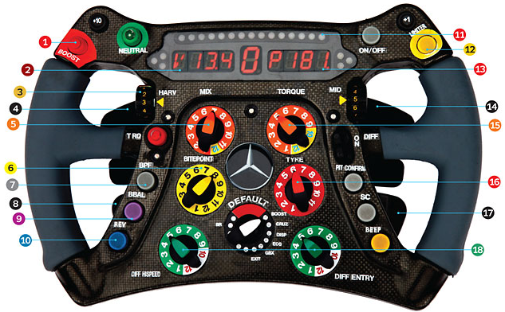
Best Choices
Anything that uses an existing transaction manager
  Don't reinvent that very complex wheel!
JTA 1.1 => Ability to manage transaction over multiple resources

Slide 15
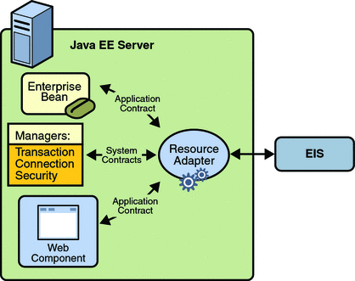
Why not write a JCA Adapter?
The Java EE 5 Tutorial
https://docs.oracle.com/javaee/5/tutorial/doc/bncjy.html
Figure 35-1
The Connector architecture enables Java EE components to interact with enterprise information systems (EISs) ... EIS software includes various types of systems... Connector architecture simplifies the integration of diverse EISs. ...Because an implementation adheres to the Connector specification, it is portable across all compliant Java EE servers.

Slide 16
Has anyone already used JCA?
Yes, anyone who has written JDBC code which runs in a Java EE server has. JDBC and JMS are implemented using JCA!

Slide 17
Refresher – Two Phase Commit
mysql> XA START 'someTxId';
mysql> insert into person values (null, 'ant');
mysql> XA END 'someTxId';
mysql> XA PREPARE 'someTxId';
mysql> XA COMMIT 'someTxId';
mysql> select * from person;
+-----+-------------------------------+
| id | name |
+-----+-------------------------------+
| 771 | ant |
+-----+-------------------------------+

Slide 18
Refresher – Two Phase Commit
mysql> XA RECOVER ;
+----------+--------------+--------------+----------+
| formatID | gtrid_length | bqual_length | data |
+----------+--------------+--------------+----------+
| 1 | 8 | 0 | someTxId |
+----------+--------------+--------------+----------+

Slide 19
Refresher – Two Phase Commit
Why is 2PC so bad?
  Relatively slow because it is synchronous
    All nodes in Oracle cluster are updated?
    Compare to Apache Cassandra (NoSQL) – only one node is updated
  No upper limit on how long to lock resources
    3 Phase Commit => timeout
  Databases tend to lock data
    But locking data might make sense from a business point of view – e.g. a seat in a plane

Slide 20
Important Stages of 2PC
Execution
  Make sure execution is bound into transaction
Commit
  Handled automatically
Rollback
  Handled automatically
Timeout
  Don't block resources forever (3PC)
Recovery
  Automatically retry commit/rollback until it works

Slide 21
“Contract” for Microservices that we can coordinate
Microservice should make three operations available: execution, commit and rollback (although commit is actually optional 1),
Microservice may let non-committed and non-rolledback executions timeout after which any reserved resources may be used in other transactions (à la 3PC),
A successful execution guarantees that the transaction manager is allowed to commit or rollback the reserved resources, as long as no timeout has occurred 2,
A call to commit or rollback the reservation can be done multiple times without side effects (think about idempotency here), so that the transaction manager may finish the transaction if an initial attempt failed.

Slide 22
//JDBC is JCA! We want to have an analagous API.
@Resource DataSource mysql;
@TransactionAttribute(REQUIRES_NEW)
public void doSomething(){
try(Connection connection = xamysql.getConnection()){
PreparedStatement stmt = connection.prepareStatement("insert into person(id, name)…");
stmt.setString(1, username);
stmt.executeUpdate();
}
}
Example Code

Slide 23
//How does it all work?
MysqlXADataSource mysql = new MysqlXADataSource();
mysql.setUser("root"); //url, password, etc...
JdbcTransactionalResource mysqlResource = new JdbcTransactionalResource("jdbc/mysql", mysql);
UserTransactionServiceImp utsi = new UserTransactionServiceImp();
utsi.registerResource(mysqlResource); //registered for recovery purposes
UserTransactionManager utm = new UserTransactionManager();
utm.begin();
Transaction tx = utm.getTransaction();
XAConnection xamysql = mysql.getXAConnection();
XAResource db = xamysql.getXAResource();
tx.enlistResource(db);
try(Connection connection = xamysql.getConnaection()){
PreparedStatement stmt = connection.prepareStatement("insert into person(id, name)…");
stmt.setString(1, username);
stmt.executeUpdate();
}
tx.delistResource(db, XAResource.TMSUCCESS);
utm.commit();
Example Code

Slide 24
JCA Example in Java EE Container
@Resource(lookup = "java:/maxant/BookingSystem")
TransactionAssistanceFactory bookingFactory; //like a DataSource
//web service client (REST, SOAP, whatever)
BookingSystem bookingSystem = new BookingSystemWebServiceService().getBookingSystemPort();
@TransactionAttribute(REQUIRES_NEW)
public void doSomething(){
try(TransactionAssistant bookingTransactionAssistant = bookingFactory.getTransactionAssistant()){
String bookingResponse = bookingTransactionAssistant.executeInActiveTransaction(txid -> {
return bookingSystem.reserveTickets(txid, refNumber);
});
} catch (...) {...}
}

Slide 25
JCA Example in Java EE Container
@Startup @Singleton
public class TransactionAssistanceSetup {
@Resource(lookup = "java:/maxant/BookingSystem") TransactionAssistanceFactory bookingFactory;
@PostConstruct public void init() {
bookingFactory
.registerCommitRollbackRecovery(new Builder()
.withCommit( txid -> {
new BookingSystemWebServiceService().getBookingSystemPort().bookTickets(txid);
})
.withRollback( txid -> {
new BookingSystemWebServiceService().getBookingSystemPort().cancelTickets(txid);
})
.build()
);
}

Slide 26
Spring Boot Example
@Service
@Transactional
public class AppService {
@Autowired BaseicTransactionAssistanceFactory microserviceFactory;
public String doSomethingWithAGlobalTransactionAndARemoteMicroservice(String username) ... {
String msResponse = null;
try(TransactionAssistant transactionAssistant = microserviceFactory.getTransactionAssistant()){
msResponse = transactionAssistant.executeInActiveTransaction(txid->{
final LetterWriter service = new LetterWebServiceService().getLetterWriterPort();
return service.writeLetter(txid, username);
});
}
return msResponse;
}

Slide 27
Spring Boot Example
final LetterWriter service = new LetterWebServiceService().getLetterWriterPort();
CommitRollbackHandler commitRollbackCallback = new CommitRollbackHandler() {
@Override
public void rollback(String txid) throws Exception {
//compensate by cancelling the letter
service.cancelLetter(txid);
}
@Override
public void commit(String txid) throws Exception {
//nothing to do, this service autocommits.
}
};
BitronixTransactionConfigurator.setup("xa/ms1", commitRollbackCallback, 30000L, new File("."));

Slide 28
Supported Stacks
Standalone Java
  Bitronix or Atomikos
Tomcat / Jetty
  Plain Java + Bitronix or Atomikos
  Spring + Bitronix or Atomikos
Spring Boot + Bitronix or Atomikos
Java EE
  JBoss EAP + Wildfly
  Websphere – not yet – need support please!
  Other App Servers – not yet – need support please!

Slide 29
Contextual Information for Commit/Rollback
Look back at other code. The transaction ID – a String – is the key which you can use to lookup data from the execution stage.
  Execution Stage MUST write data in an inner transaction before calling the microservice, to ensure it is available during commit / rollback.
  Use File, DB or persistent key/value storage like MemCached or any NoSQL storage
  No solution provided by library, because there are so many options!

Slide 30
(Non-)Issues
I'm integrating a service which doesn't have a “commit” method
  No Problem. The data in that system might look consumed, altho a rollback / compensation is pending. But it's still eventually consistent
It takes a long time for a service to come back online after a crash
  And Facebook has never lost a photo temporarily? Eventually, everything will be consistent.

Slide 31
(Non-)Issues
Isn't WS-AT better
  If you are integrating SOAP services which support it and your systems are compatible, give it a try
TODO?

Slide 32
More Info
TODO
  Links to blog articles
    Original
    Integrating non-tx
    Spring boot
  https://github.com/maxant/genericconnector
    Lots of demo code
  Create Forum?
  Contacting Ant:
    ant@maxant.co.uk @maxant_ch

