Slide 1
Cyber-Attacks
On Power Grids

Slide 2
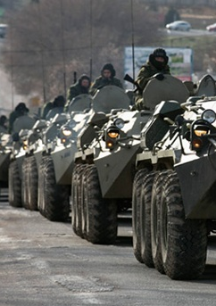
December 2015 in Ukraine
Lead to Power Outages
Protest against annexation of the Crimea by Russia

Slide 3
The Attack
Intruders sent malicious mail attachments
Human failure
Centrally controlled networks allow this kind of attacks easy

Slide 4
Minimize the effects
Decentralized power grids
Work like small islands

Slide 5
Thanks for your attention
Any Questions?

