Slide 1
Ethereum
The Programmable Blockchain

Slide 2
Bitcoin Blockchain (simplified)
Block Header
Block Header
Block Header
Prev Hash
Nonce
Prev Hash
Nonce
Prev Hash
Nonce
Merkle Root
Merkle Root
H(E || F)
Merkle Root
Merkle Tree
Merkle Tree
Merkle Tree
E
H(A || B)
F
H(C || D)
A
H(TX1)
B
H(TX2)
C
H(TX3)
D
H(TX4)
TX1 (COINBASE)
TX2
TX3
TX4

Slide 3
Bitcoin Blocks
Block Size (4 bytes): Size of the Block in bytes
Version
Previous Block Id (hash)
Merkle Root
Time
Bits (target)
Nonce
Transaction Counter (VarInt, 1-9 bytes): Num Transactions that follow
BLOCK BODY (variable size)
= Transactions (Merkle Tree)

Slide 4
Bitcoin Transactions
Input 0
txid (hash)
VOUT
ScriptSig Size
ScriptSig
Sequence
Version
Input Count
Inputs
Output Count
Outputs
Locktime
Output 0
Value
ScriptPubKey Size
ScriptPubKey
Input 1
Output 1
Input n
Output m

Slide 5
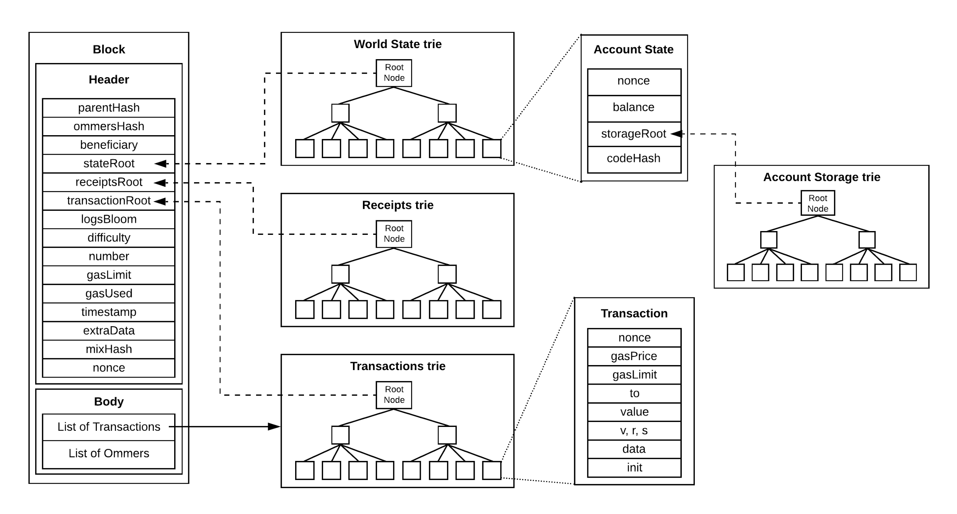
Ethereum (simplified)

Slide 6
Bitcoin Summary
State Transition System
append-only ledger, UTXO model
current state: current ownership status of all BTC
state transition: state + transaction = new state
Verification mechanism
digital signatures & valid hashes
PoW
effective consensus, allowing nodes to agree on state changes
anyone can join, but sybil attacks prevented
barrier to participation: computing power
Bitcoin Script
weak version of a “smart contract” (e.g. m-of-n transactions)

Slide 7
Bitcoin Script Limitations
Not Turing-Complete
no loops
benefit: no infinite loops (avoids halting problem, DDOS)
quasi-loops possible with enough “if” statements, but not space efficient
Value-blind
no way for UTXO script to provide fine-grained control over amount withdrawn
Stateless
UTXO can either be spent or unspent
no multi-stage scripts or any other internal state (e.g. vote counts)
Blockchain-blind
UTXO has no access to block data (timestamp, nonce, previous block hash, etc.)

Slide 8
Ethereum
Fully decentralized platform to run smart contracts
Turing-complete
Account-based
State machine
Transactions lead to state changes
Trustless Distributed Computer
Ethereum Virtual Machine (EVM)
Native cryptocurrency: Ether
Smart Contracts: cryptographic "boxes" that contain value and state, and only unlock it if certain conditions are met

Slide 9
Accounts
Ethereum world state made up of objects called “accounts”, each of which has:
address (20 bytes)
nonce: counter that ensures each transaction processed only once
balance: current amount of ether
contract code, if present
storage, empty by default
Two account types
externally owned accounts: controlled by private keys
contract accounts: controlled by contract code
State Transition: direct transfers of value and information between accounts

Slide 10
Externally Owned Accounts (EOAs)
Has balance
Does not have code, state
Associated with private key
owned by person, corporation, entity, etc.
Send messages from EOAs through transactions
Send messages to other EOAs
value transfer
Contract Accounts
activate contract code
Signs messages with private key

Slide 11
Contract Accounts
Has code, state, balance
Receives messages from EOAs or other contracts
Message from EOA activates code
read/write internal storage/state
propagate messages to other CAs
Cannot self-initiate code or new transactions
react when “poked”

Slide 12
EOA
EOA
TX
EOA
Contract
Contract
TX
Internal TX

Slide 13
Transactions
Transaction: data package that stores message
Sent from EOA
Fields
message recipient
sender signature
amount of ether to transfer, sender -> recipient
optional data field
STARTGAS : max # computational steps allowed in execution
GASPRICE : fee per computational step

Slide 14
Messages
Message: virtual object that exist in execution environment (not serialized)
Fields
sender (implicit)
recipient
amount of ether to transfer
data (optional)
STARTGAS
Sent from contracts to other contracts

Slide 15
Gas
Halting Problem: proven to be impossible to determine ahead of time whether code will terminate
in distributed network: leads to Denial of Service (DoS)
relevant in turing-complete execution contexts
Gas provides “fuel” for execution (and storage)
every EVM operation costs some amount of gas (fixed)
STARTGAS = GASLIMIT: max quantity of gas sender willing to consume
GASPRICE: fee, in ether, sender willing to pay per unit gas
measured in gwei: 1 gwei = 10^9 wei, 1 eth = 10^9 gwei
GASPRICE * STARTGAS = max amount sender willing to pay
Unused gas is returned
Used gas goes to miner as fee
Gas costs
Fee schedule: Yellowpaper, page 20, Appendix G

Slide 16
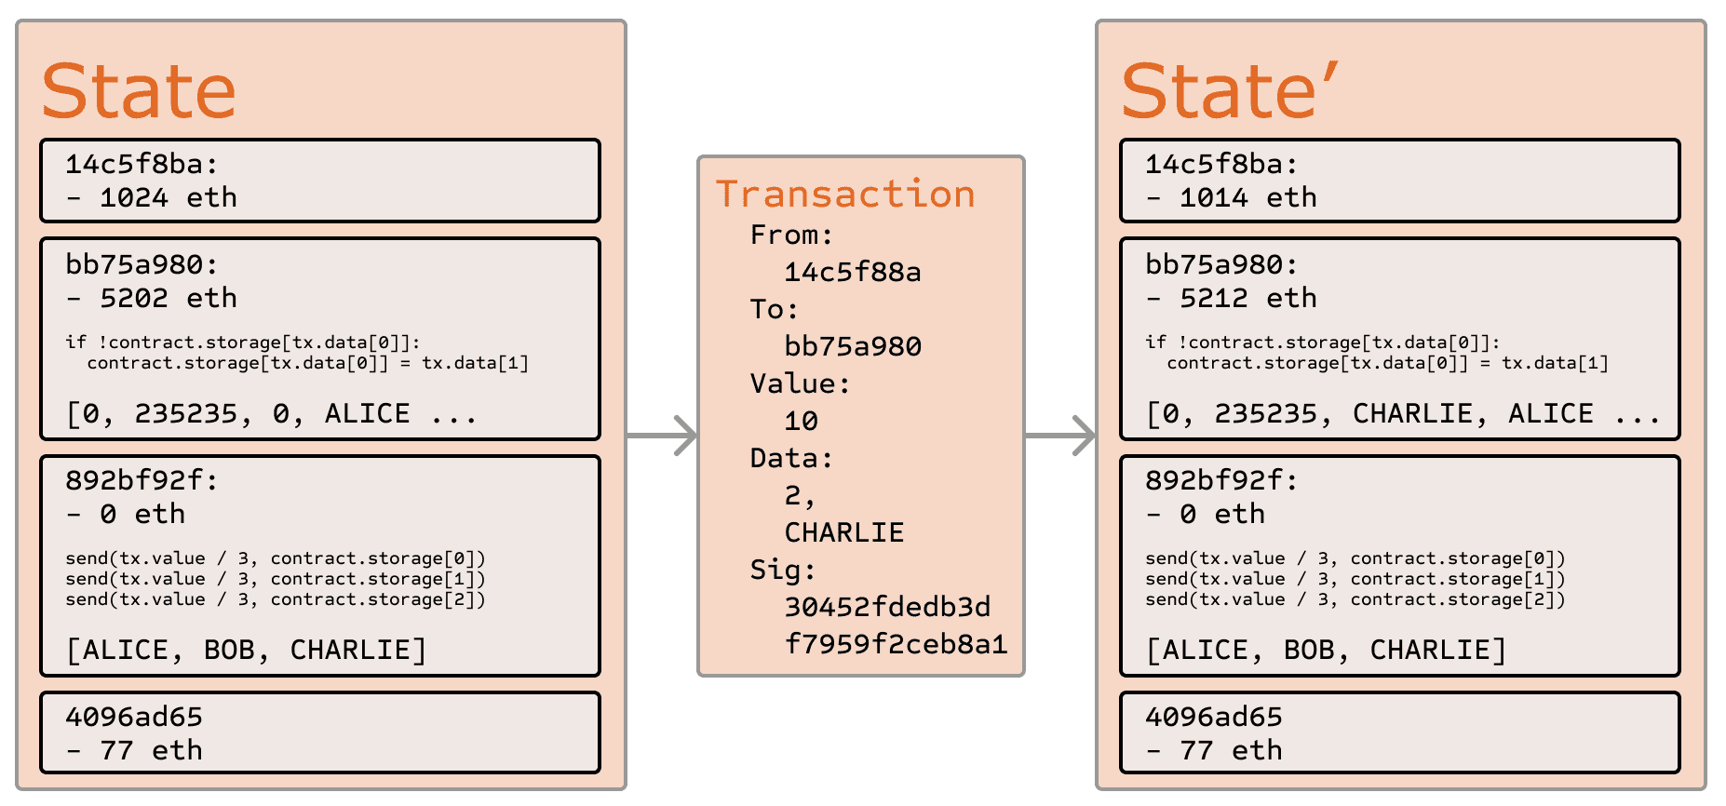
State Transition
validate Tx
Fee = STARTGAS * GASPRICE
subtract Fee from sender
increment sender nonce
GAS = STARTGAS
GAS -= size(data) * gas_per_byte
create recipient account if it does not exist
transfer tx value from sender to recipient
revert if failed
fee not returned
gas spent not returned

Slide 17
Code Execution
Contract code is low-level, stack-based bytecode: EVM code
each byte represents operation (opcode)
usually written in high-level language and compiled
Contracts have memory (expandable byte array) and storage (key/value store)
persists after computation
Code can access memory, storage, message details (value, sender, data), block header data
Code can return byte array as output

Slide 18
Code Compilation
Solidity Contract
pragma solidity 0.4.25;
contract MyContract {
…
}
Solidity Compiler
EVM Code
0000 60 PUSH1 0x80
0002 60 PUSH1 0x40
0004 52 MSTORE
0005 34 CALLVALUE
0006 80 DUP1
ABI
Bytecode
6080604052348015600f57600080fd5b5060878061001e996000396000f3fe608060…
Vyper Contract
@external
def __init__(...)
Vyper Compiler

Slide 19
Mining
Download entire Blockchain
Verify incoming transactions
run code
update state
Create block from transactions
Find valid nonce
Broadcast block to network

Slide 20
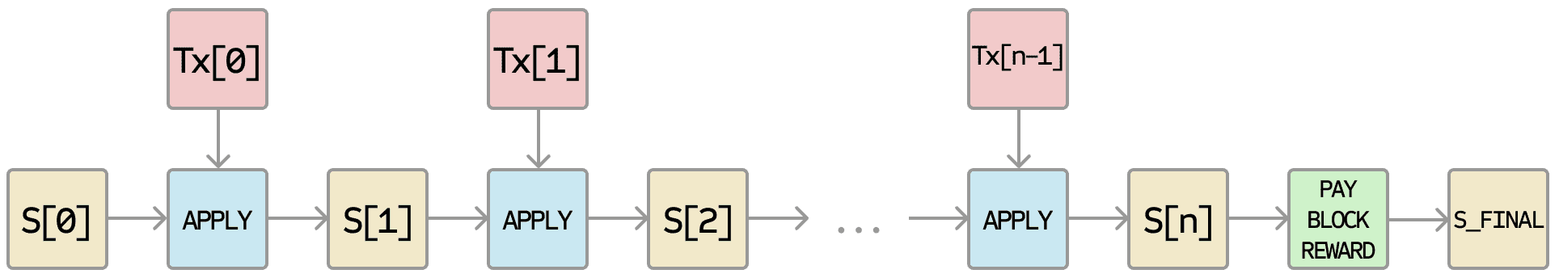
Block Validation
Validate block header
For each transaction in block:
calculate intermediate state: apply transaction’s state transition function
Results transaction list’s final state
Pay block reward
Results in block’s final state
All state stored in Patricia-Merkle Tree
All validating nodes run computation

Slide 21
EVM
Maximally redundant: all nodes reproduce current state by performing computation on all transactions
replicated state machine
computation performed by nodes in parallel
inefficient: expensive, slow, memory-intensive
vital for consensus in trustless distributed network
Incentive to push computation to only a portion of the network
sharding (active research area)

Slide 22
DAPPs
DAPP: Decentralized Application
Implemented via Smart Contracts (contract code)
Decentralized (peer-to-peer)
Immutable (blockchain as database)
Open source code (public blockchain)

Slide 23
Resources
Ethereum Whitepaper
Ethereum Yellowpaper
How does Ethereum work, anyway?
Ethereum Gas
Ethereum Denominations

Slide 24
Ether Denominations
1 ETHER = 1,000,000,000,000,000,000 WEI = 1 (EXA)WEI
1 (MILLI)ETHER = 0.001 ETHER = 1,000,000,000,000,000 WEI = 1 (PETA)WEI
1 (MICRO)ETHER = 0.000001 ETHER = 1,000,000,000,000 WEI = 1 (TERA)WEI
1 (Nano)ETHER = 0.000000001 ETHER = 1,000,000,000 WEI = 1 (GIGA)WEI
1 (PICO)ETHER = 0.000000000001 ETHER = 1,000,000 WEI = 1 (MEGA)WEI
1 (FEMTO)ETHER = 0.000000000000001 ETHER = 1,000 WEI = 1 (KILO)WEI
1 (ATTO)ETHER = 0.000000000000000001 ETHER = 1 WEI
gwei -> Shannon (denomination of GAS)
pwei -> Finney
ether -> Buterin
1 eth = 1,000,000,000,000,000,000 wei = 50 pwei = 20 gwei

