Slide 1
CUDA Performance Optimization
GPU Programming with CUDA
Jiri Kraus (NVIDIA) based on work by Andrew V. Adinetz

Slide 2
What you will learn:
What is memory coalescing
What is branch divergence
Exposing enough parallelism
Expressing data locality
What you will not learn (in this session):

Slide 3
Motivating Example: Matrix Transpose
CPU VERSION:
void transpose(
Integer* a_trans,
Integer* a,
Integer n ) {
for ( Integer row = 0; row < n; ++row ){
for ( Integer col = 0; col < n; ++col )
{
a_trans[col][row] = a[row][col];
}
}
}
CUDA VERSION:
__global__ void transpose(
Integer* a_trans,
Integer* a,
Integer n ) {
Integer row = bIdx.y*bDim.y+tIdx.y;
Integer col = bIdx.x*bDim.x+tIdx.x;
if ( row < n && col < n )
a_trans[col][row] = a[row][col];
}

Slide 4
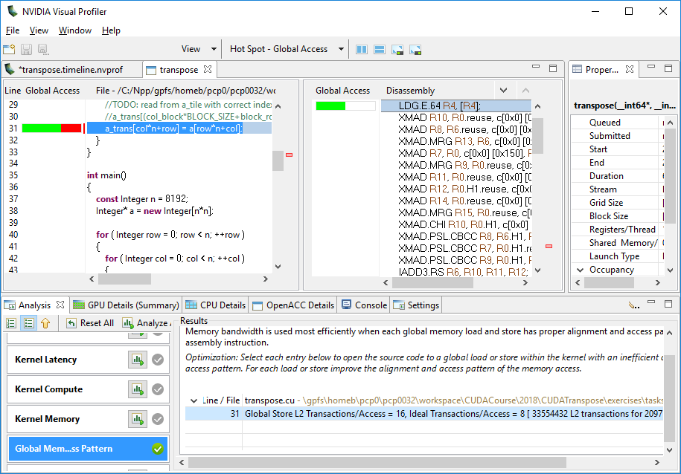
Motivating Example: Matrix Transpose (demo)

Slide 5
Memory Transactions and Coalescing
Access to global memory triggers transactions
size of 32 or 128 bytes
Transaction are aligned to its size
Transaction are always R/W fully
Coalescing
adjacent threads can share transactions
more memory read than used => performance penalty
#bytes requested
degree of coalescing =
#bytes read

Slide 6
Coalescing Details
Details in CUDA Programming Guide
L1-cached access
128-byte transactions
L2-cached access
32-byte transactions
Used for global memory

Slide 7
L2-Cached Thread Index Access
32 adjacent threads requesting 32 aligned or permuted 4 byte words
All addresses fall within 4 segments
Bus utilization: 100%
Transactions: 4
a[tid]
Addresses from warp
0 128 256 384
Addresses from warp
0 128 256 384

Slide 8
L2-Cached Shifted Access
32 adjacent threads requesting 32 aligned 4 byte words
All addresses fall within 5 segments
160 bytes move across bus while 128 bytes are required
Bus utilization: 80%
Transactions: 5
a[tid - 1]
Addresses from warp
0 128 256 384

Slide 9
L2-Cached Single Access
32 adjacent threads requesting the same 4 byte word
Addresses fall in 1 segment
Warp requires 4 bytes but 32 bytes transferred
Bus utilization is only 12.5%
a[42]
Addresses from warp
0 128 256 384

Slide 10
L2-Cached Strided Access
32 adjacent threads requesting 32 4-byte words with stride 3
All addresses fall in 12 segments
Bus utilization: 33%
Transactions: 12
a[3 * tid]
Addresses from warp
0 128 256 384
struct {float x,y,z;} a; ... a[tid].x
use structure-of-arrays (SoA)
float a[M][N]; ... a[tid][42]
multi-dimensional arrays: pay attention to coalescing

Slide 11
L2-Cached Fully Random Access
32 adjacent threads requesting 32 4-byte random words
All addresses fall in 32 segments
Bus utilization: only 12.5%
Transactions: 32
a[b[tid]]
0 128 256 384
pointer chasing: lists, trees etc.

Slide 12
Matrix Transpose Access Pattern
col
Stride-1 column access (thread view)
is actually stride-N access in memory
row
Linear Memory Address
Source: GTC 2015 - Memory Bandwidth Bootcamp: Best Practices by Tony Scudiero (NVIDIA)

Slide 13
Matrix Transpose using shared memory
col
Row is loaded fully coalesced
row
Global Memory
Shared Memory
Source: GTC 2015 - Memory Bandwidth Bootcamp: Best Practices by Tony Scudiero (NVIDIA)

Slide 14
Matrix Transpose using shared memory
col
Row is loaded fully coalesced
Indexing: location of block is flipped across the diagonal
row
Global Memory
Shared Memory
Source: GTC 2015 - Memory Bandwidth Bootcamp: Best Practices by Tony Scudiero (NVIDIA)

Slide 15
Matrix Transpose using shared memory
col
Row is loaded fully coalesced
Indexing: location of block is flipped across the diagonal
Column of shared is written to a row of the matrix
Transposes the Block
Coalesced Write
row
Global Memory
Shared Memory
Source: GTC 2015 - Memory Bandwidth Bootcamp: Best Practices by Tony Scudiero (NVIDIA)

Slide 16
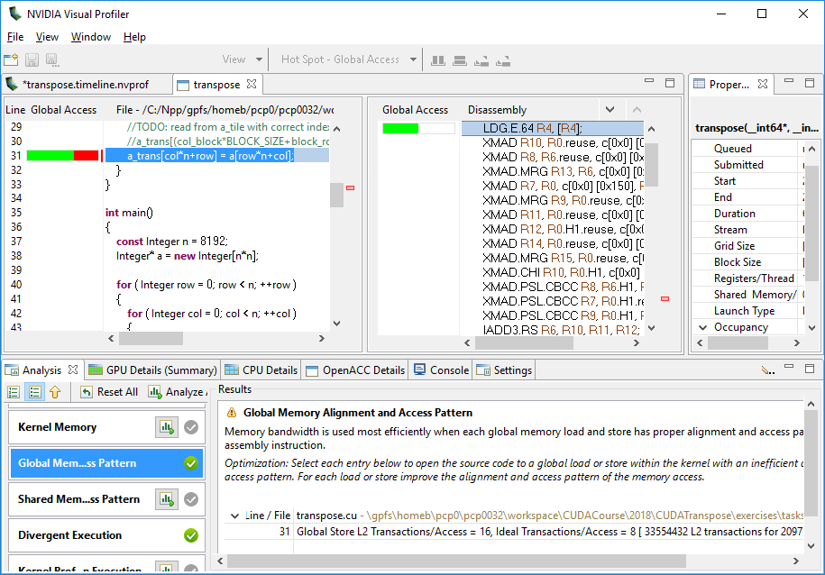
Using NVidia Visual Profiler
Experiments:
memory access pattern
divergent execution
Show in source code
nvcc -lineinfo ...

Slide 17
Task: Coalesced Matrix Transpose
Use shared memory to coalesed writes to a_trans
Follow TODOs in
CUDATranspose\exercises\tasks\transpose.cu
Check solution with “Memory Access Pattern” experiment
Solution is in
CUDATranspose\exercises\solutions\transpose.cu
Slides are in CUDATranspose\slides\CUDATranspose.pdf

Slide 18
Warps
GPUs use the Single Instruction Multiple Threads (SIMT) execution
functionally transparent to the programmer
but has performance implications
warp
group of synchronously executing threads
neighbor threads (mostly x dimension)
32 threads (NVIDIA), 64 threads (AMD, =wavefronts)
basic unit of scheduling

Slide 19
Branch Divergence Within Warp
// ...
if(condition) {
// do smth
// ...
} else {
// do smth else
// ...
}
// ...
all threads running
“else” threads masked
“if” threads masked
all threads running
divergence within warp => performance penalty
if(threadIdx.x % 2 == 0) ...

Slide 20
Branch Divergence Between Warps
// ...
if(condition) {
// do smth
// ...
} else {
// do smth else
// ...
}
// ...
divergence between warps => no penalty
if(blockIdx.x % 2 == 0) ...

Slide 21
Conclusion
To achieve coalesced global memory access
Try to use shared memory
Look for different way of storage or better algorithm
Avoid divergent branches
Use the tools

