Slide 1

Hateful meme detection
Barthelemy Hugo
Capdouze Maxime

Slide 2
Project description
Purpose of this project: create a model able to determine if a meme is hateful or not
For that, we can use two things: the image
and the text

Slide 3
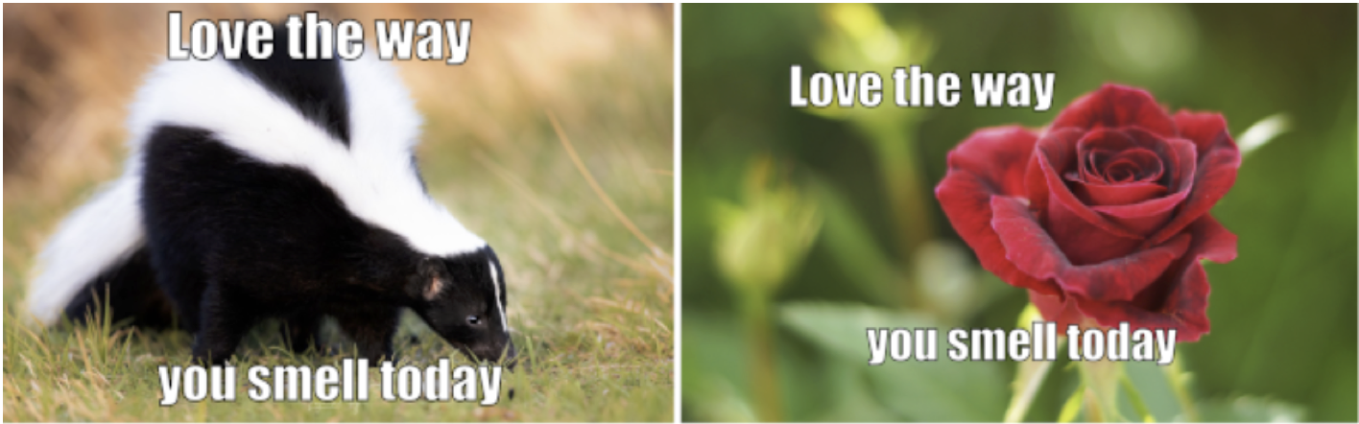
Difference between a meme and a classic image
A meme and an image differ because a meme contains text.
The text or the image can be non-hateful when isolated but become hateful when put together. For this reason, we cannot use a classic hateful image detection model

Slide 4
Dataset
For this project, we used the hateful meme challenge dataset, from meta
This model provides 10,000 memes and 3 JSON files (train, test, val) containing the text of each image

Slide 5
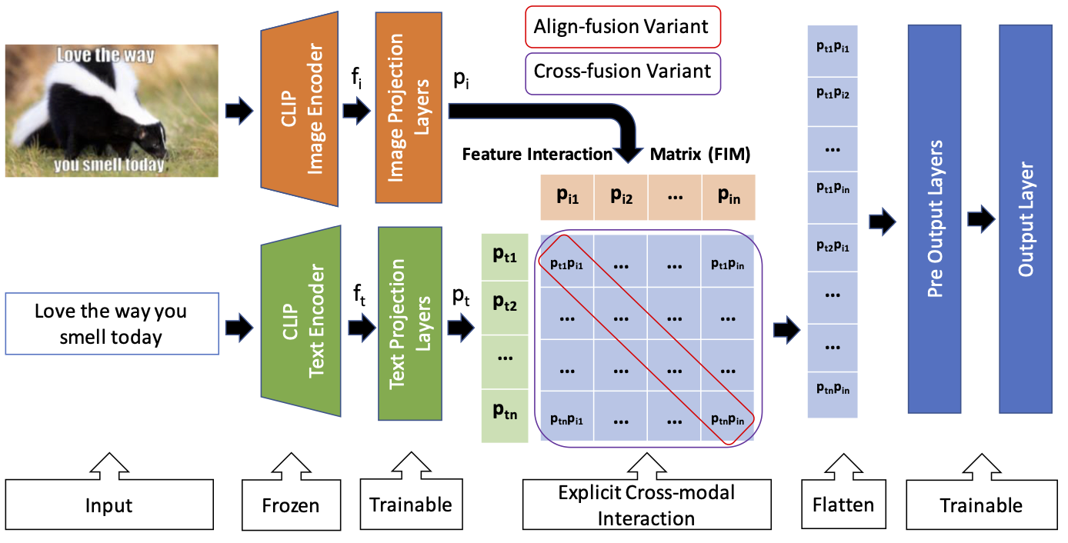
Method used: multimodal structure using two encoders

Slide 6
Experiment: batch size
To train the model, we tried multiple values for the batch size to find the most optimal one (good accuracy and speed). We determined that the optimal value was 16.

Slide 7
Experiment: warm-up code
We also used a little warm-up code, which is run before training the model to improve the performances of the GPU (between 5 and 10%)

Slide 8
Evaluation
After running 10 epochs, containing 8500 images each, the model got an accuracy of up to 60%, using 500 images for validation. It took about 2 hours to train

Slide 9
Challenges
Understand how to combine image and text
Meme ambiguity
Optimization

Slide 10
Link to the project
https://github.com/maxcap12/hateful_meme_detection.git

