Slide 1

TEAM AC/DC
Measuring Power
per LLM token
At this hackathon, we built an open-source project to show how electricity becomes LLM tokens and help data centers use limited power more efficiently.
Compare batch energy (Wh) with token output (tokens/kWh).
Team AC/DC at the hackathon.
Estimate Wh = 116 V AC × current (A) × true PF × run time (h).
Notes:
Photo supplied by the project owner in this conversation, used without alteration. The published browser code provides manual-input comparisons and calculations. The phrase successful AI task corresponds to a task passing a fixed quality acceptance test. Slide 2 shows a user-supplied UT61B apparent-power trace from the reported completed local Gemma 4 GPU test; it does not show true PF, Wh, token counts, or energy per token. No energy savings, customer adoption, or GPU integration is claimed. Repository: https://github.com/maxchamp2005-sudo/llm-energy-efficiency

Slide 2
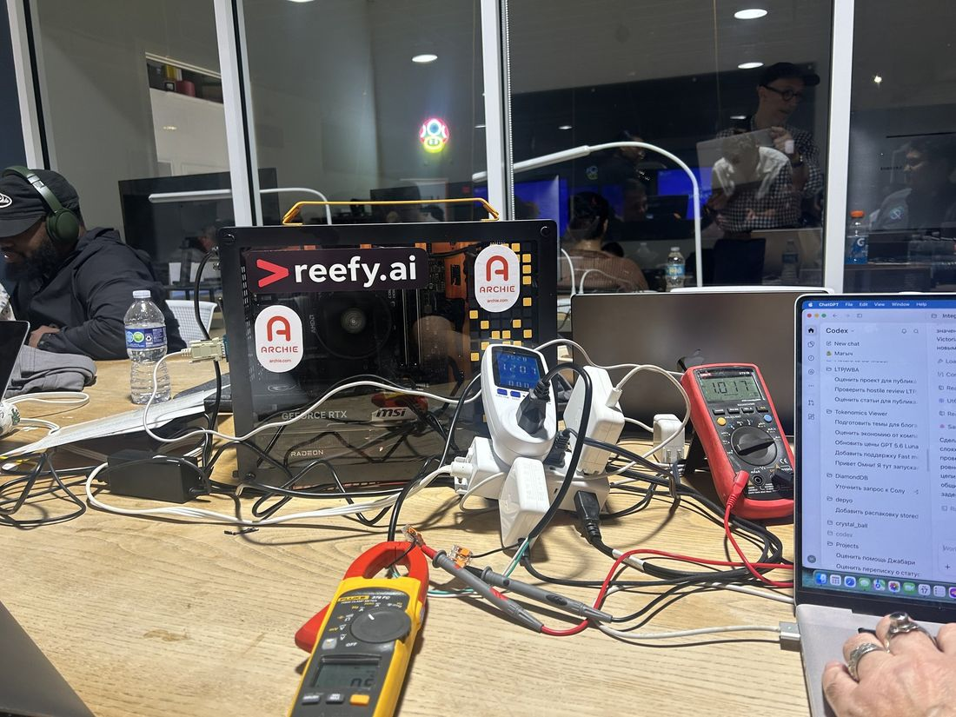
HACKATHON DEMO · ENTERPRISE CONTEXT
Isolated Enterprise Datacenter
Isolated enterprise data centers process all LLM requests on hardware within their own perimeter, without internet access. Their power budget limits the inference capacity available to users.
HACKATHON WORKSTATION
For a small-scale demonstration at the hackathon, we used a local workstation with two GPUs:
NVIDIA GeForce RTX 5060
AMD Radeon 7900
TEAM AC/DC · HACKATHON PROJECT
2 / 6
Notes:
The data-center context and wording on this slide were supplied by the project owner. No independent air-gap or network-isolation audit, facility power budget, inference capacity measurement, energy measurement, savings, or deployment result is presented.
The project owner reports a local hackathon workstation with an NVIDIA GeForce RTX 5060 and an AMD Radeon 7900. This small-scale demonstration illustrates enterprise context; it does not claim a certified air gap, simultaneous execution of the same model or workload on both GPUs, or any VRAM specification.
The workstation photo was supplied by the project owner and is placed with its full aspect ratio, without cropping.

Slide 3
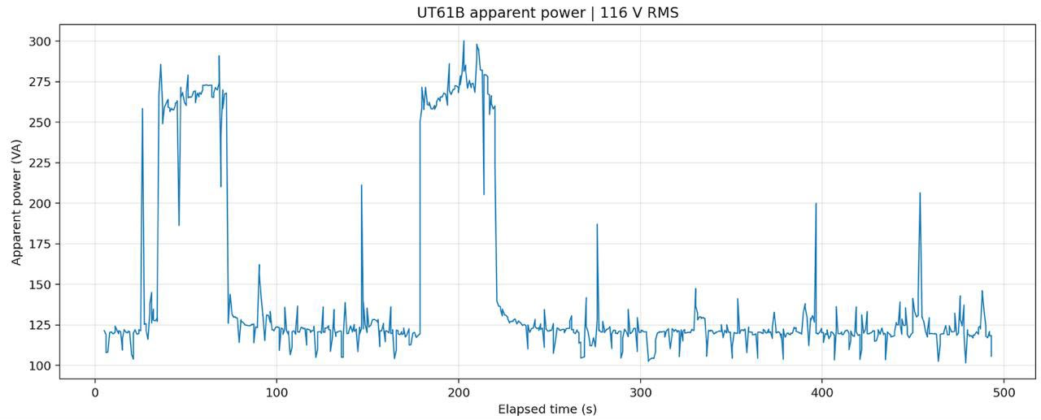
COMPLETED LOCAL GEMMA 4 GPU TEST
UT61B apparent-power trace
Apparent power (VA) at 116 V RMS. Real power (W) = apparent power (VA) × true PF.
True power factor and matched token counts are not shown in this trace.
Notes:
User-supplied raster source figure: PHOTO-2026-10-17-16-11-41.jpg.
The user reports this figure came from a completed local Gemma 4 GPU test using a USB-connected UT61B. The plotted series is labeled apparent power (VA) at 116 V RMS over elapsed time.
Apparent power is not real power or cumulative energy. The figure supplies no true power factor, raw samples, token counts, workload boundary, or synchronized timing. It does not support a real-power or Wh result, energy per token, tokens per kWh, or an energy-savings claim.
The supplied figure is displayed as-is without redrawing or digitizing its trace.

Slide 4
ILLUSTRATIVE DEMO INPUTS · NO HARDWARE RESULTS
An energy reduction must pass the service test
A passes
96% accepted · 820 ms p95
B fails
94% accepted · 1,120 ms p95
Shared limits: at least 95% accepted and p95 at most 1,000 ms
TEAM AC/DC · HACKATHON PROJECT
4 / 6
Notes:
Illustrative defaults from src/demo/demo.js; these are not measured hardware outcomes. A: 48 Wh gross batch energy, 100 submitted, 100 completed, 96 quality-accepted tasks, 12 minutes, 820 ms measured p95 field. B: 39 Wh, 100 submitted, 100 completed, 94 accepted, 11 minutes, 1120 ms p95 field. Wh per accepted task is 48/96=0.500 and 39/94=0.414893617..., displayed 0.415. Acceptance uses accepted/submitted, requiring at least 95%; end-to-end p95 must be at most 1000 ms. B fails both gates. The graph has a zero baseline and a common scale. Complete literal chart values are embedded in a new editable workbook snapshot. Source: https://github.com/maxchamp2005-sudo/llm-energy-efficiency .

Slide 5
WORKING CODE
What works in the browser
Compare two batches
Wh per accepted task, with quality and p95 limits.
Export the decision
JSON inputs, calculations and eligibility flags.
Estimate AC power
116 V × current × true power factor.
Manual inputs today · Runs locally after download
TEAM AC/DC · HACKATHON PROJECT
5 / 6
Notes:
Implemented in static HTML, CSS and vanilla JavaScript. No backend, cloud model API or API key is required for the calculations after downloading the self-contained HTML. Current inputs are supplied manually; no meter, GPU collector, inference runner or task-quality evaluator is included. The 116 V AC estimator assumes single-phase RMS voltage and true power factor: average real P=Vrms*Irms*PF; the product V*I alone gives apparent power in VA. E=P*h is valid for the constant-power estimate. These are estimates rather than a direct W/Wh meter feed. Repository: https://github.com/maxchamp2005-sudo/llm-energy-efficiency .

Slide 6
ENTERPRISE USE CASE TO VALIDATE
Deployment choices within a power limit
For an enterprise AI platform owner
Decision
Value to validate
Which model or serving setup uses less electricity for the same accepted workload?
Lower electricity cost per task—or more work inside an existing power limit.
Keep workload, quality and response-time requirements fixed.
TEAM AC/DC · HACKATHON PROJECT
6 / 6
Notes:
A proposed buyer and use case, not validated customer demand or a quantified saving. Compare a controlled workload and deployment configuration within the customer information-system perimeter. A lower energy-per-accepted-task result can inform the electricity component of operating cost if it is measured over a consistent boundary at equal useful output and an agreed tariff. Added throughput within a power limit is a separate hypothesis requiring load, memory and service validation. A small-computer demonstration cannot be multiplied directly into a 1 MW saving. Contracted or reserved capacity may not produce a smaller bill when physical use falls. No facility, interconnection or cooling expansion is solved by this browser calculator. No new market-size or industry-statistic claims are made.

