Slide 1
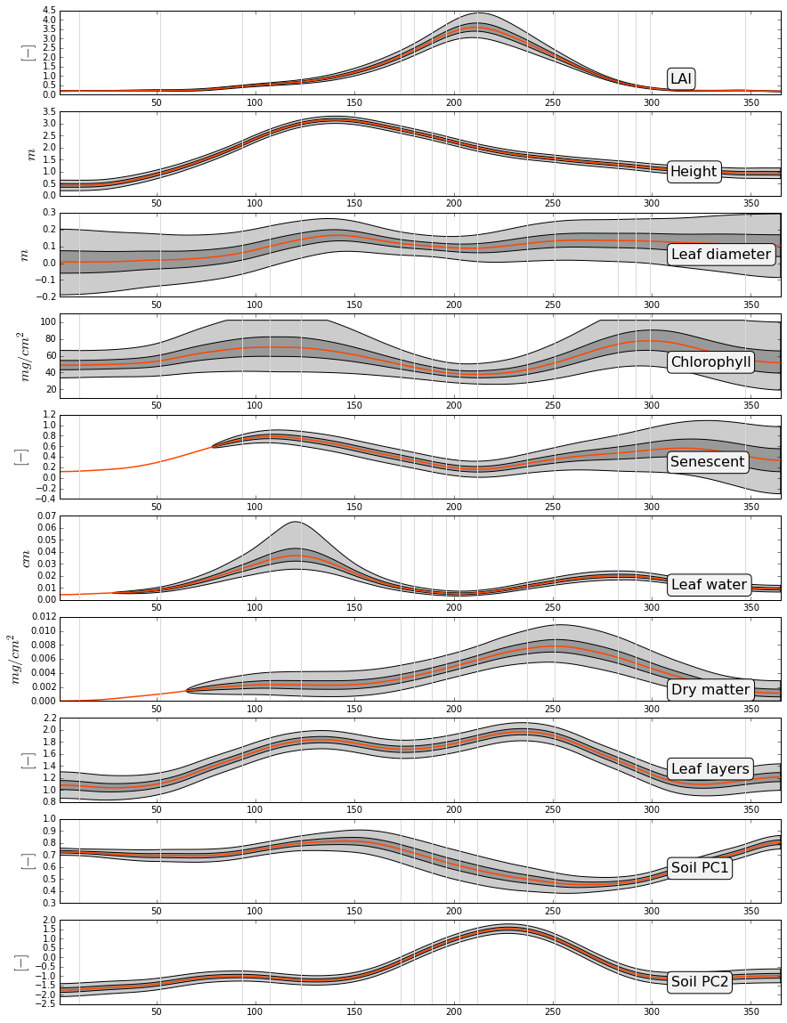
MISR retrieved parameters nadir camera only
2002
Per band uncertainties were set to
[0.004, 0.0069, 0.0099, 0.015]
Gray vertical lines are days of MISR observations

Slide 2
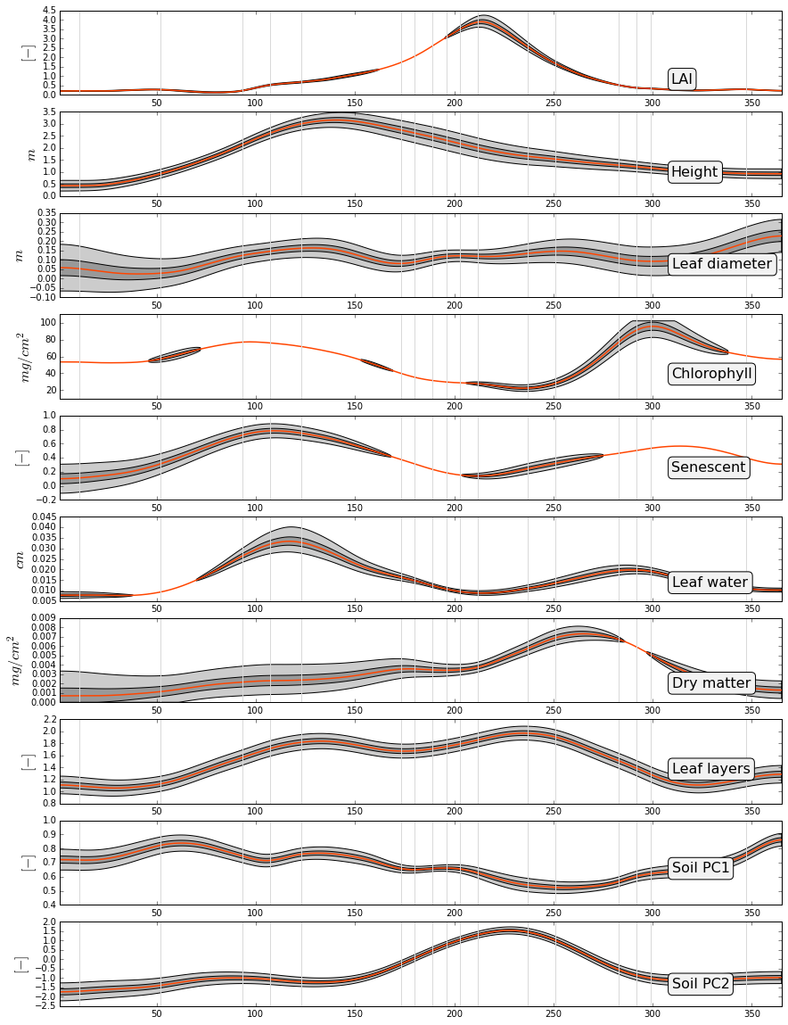
MISR retrieved parameters 7 cameras
2002

Slide 3
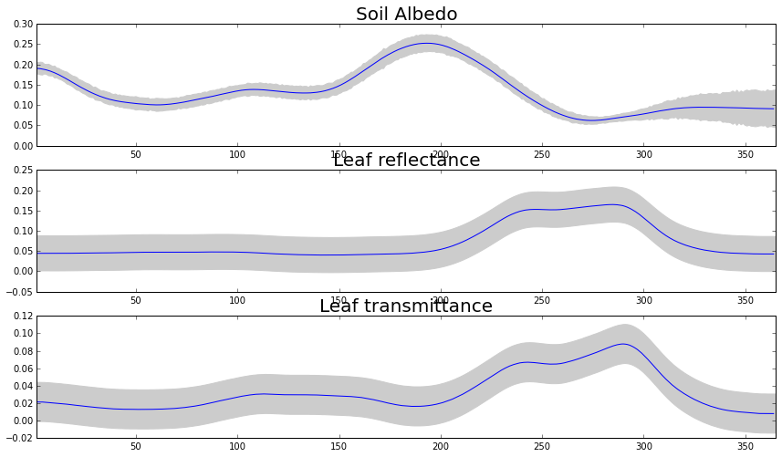
Integrated parameters required for FAPAR calculation
Based on the 7 cameras retrieval

Slide 4
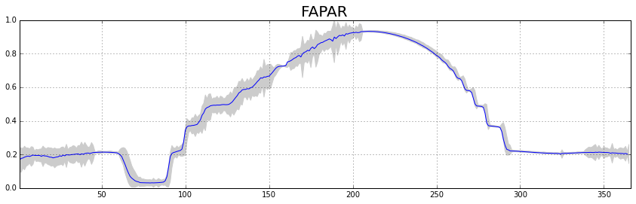
FAPAR
Uncertainties of FAPAR were calculated by generation of 50 random samples per each day. Samples were generated using random normal distribution with mean and standard deviation taken from the input variables (LAI, soil albedo, leaf reflectance/transmittance, hight, rpl).

