Slide 1
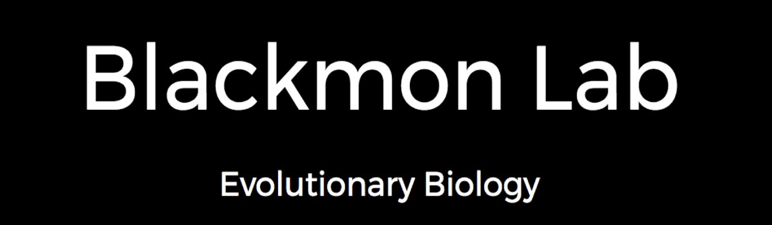

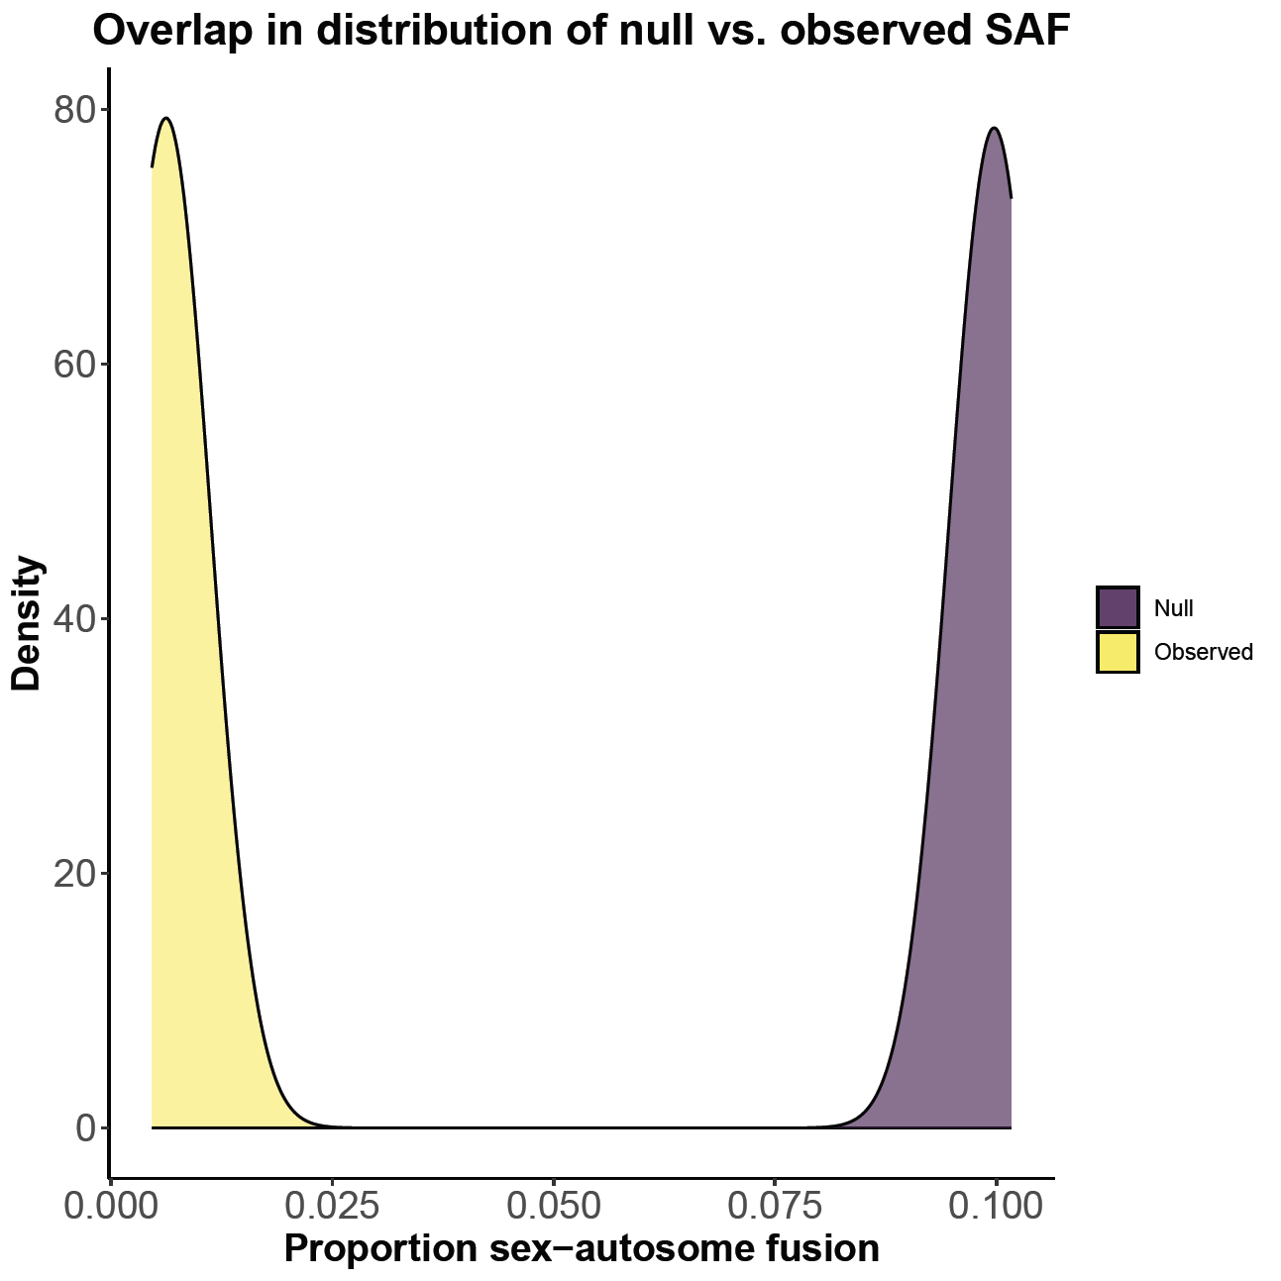
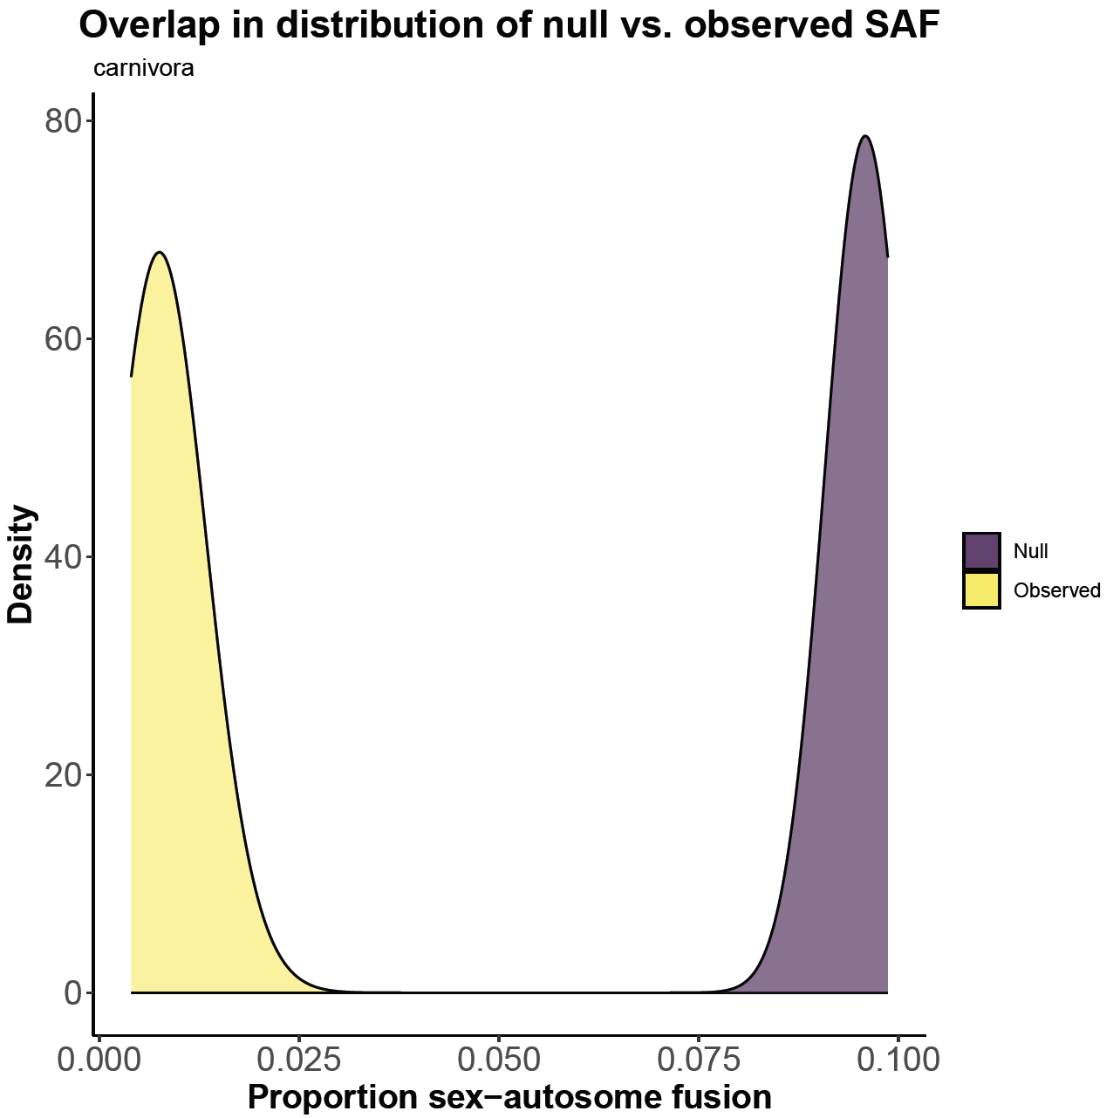
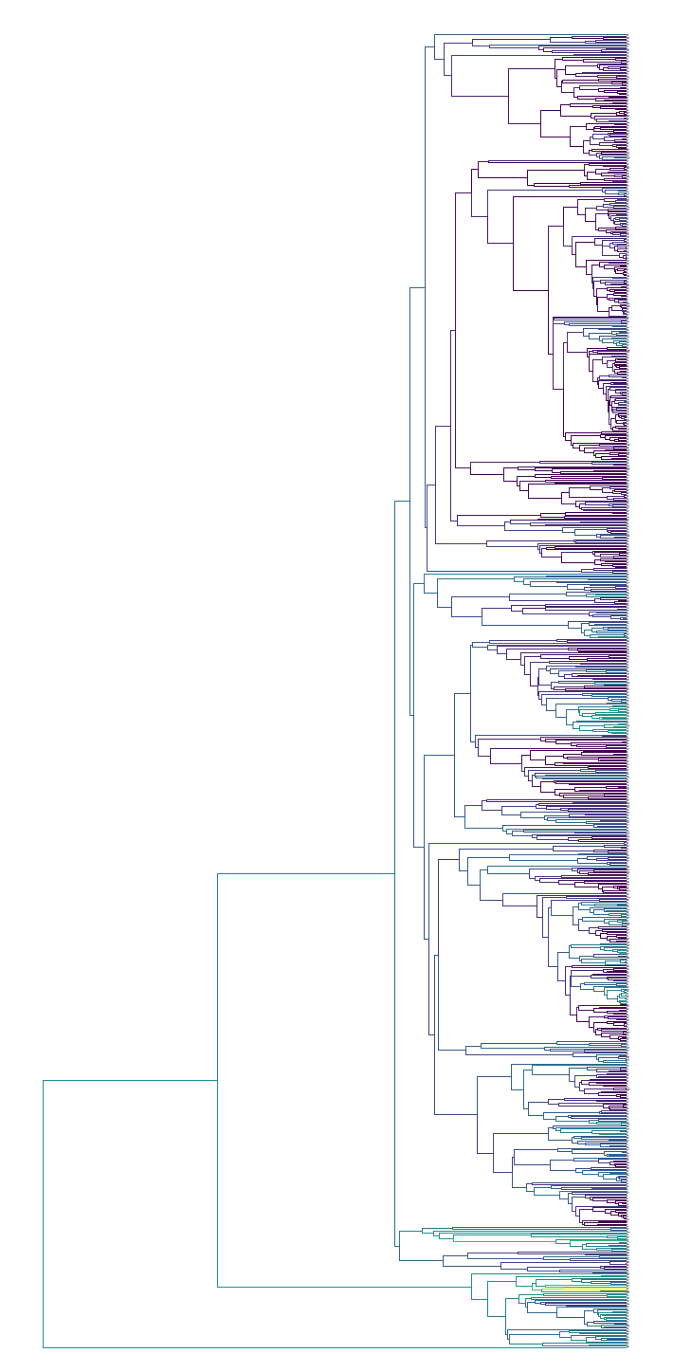
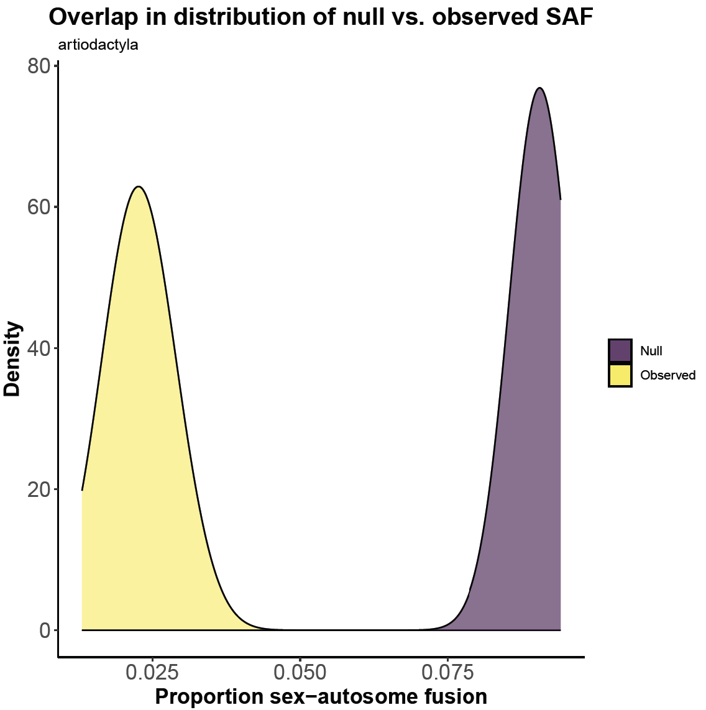

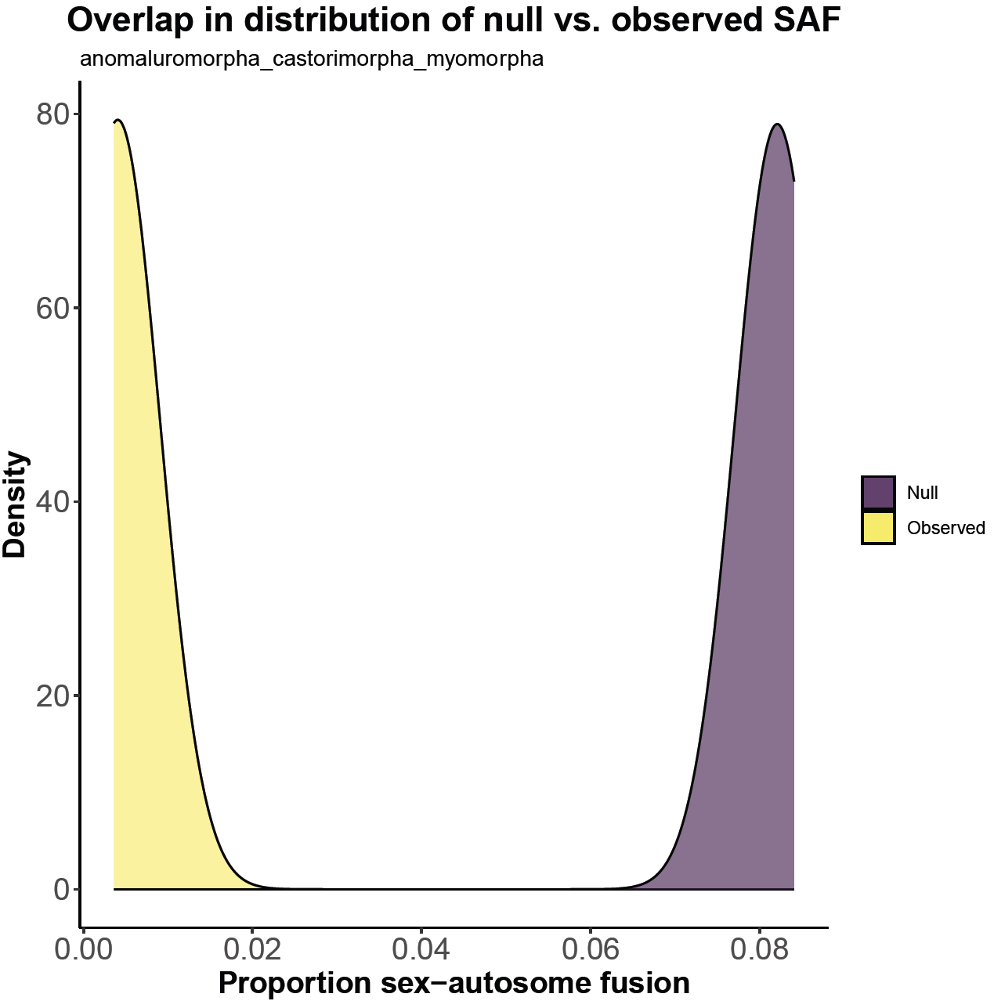
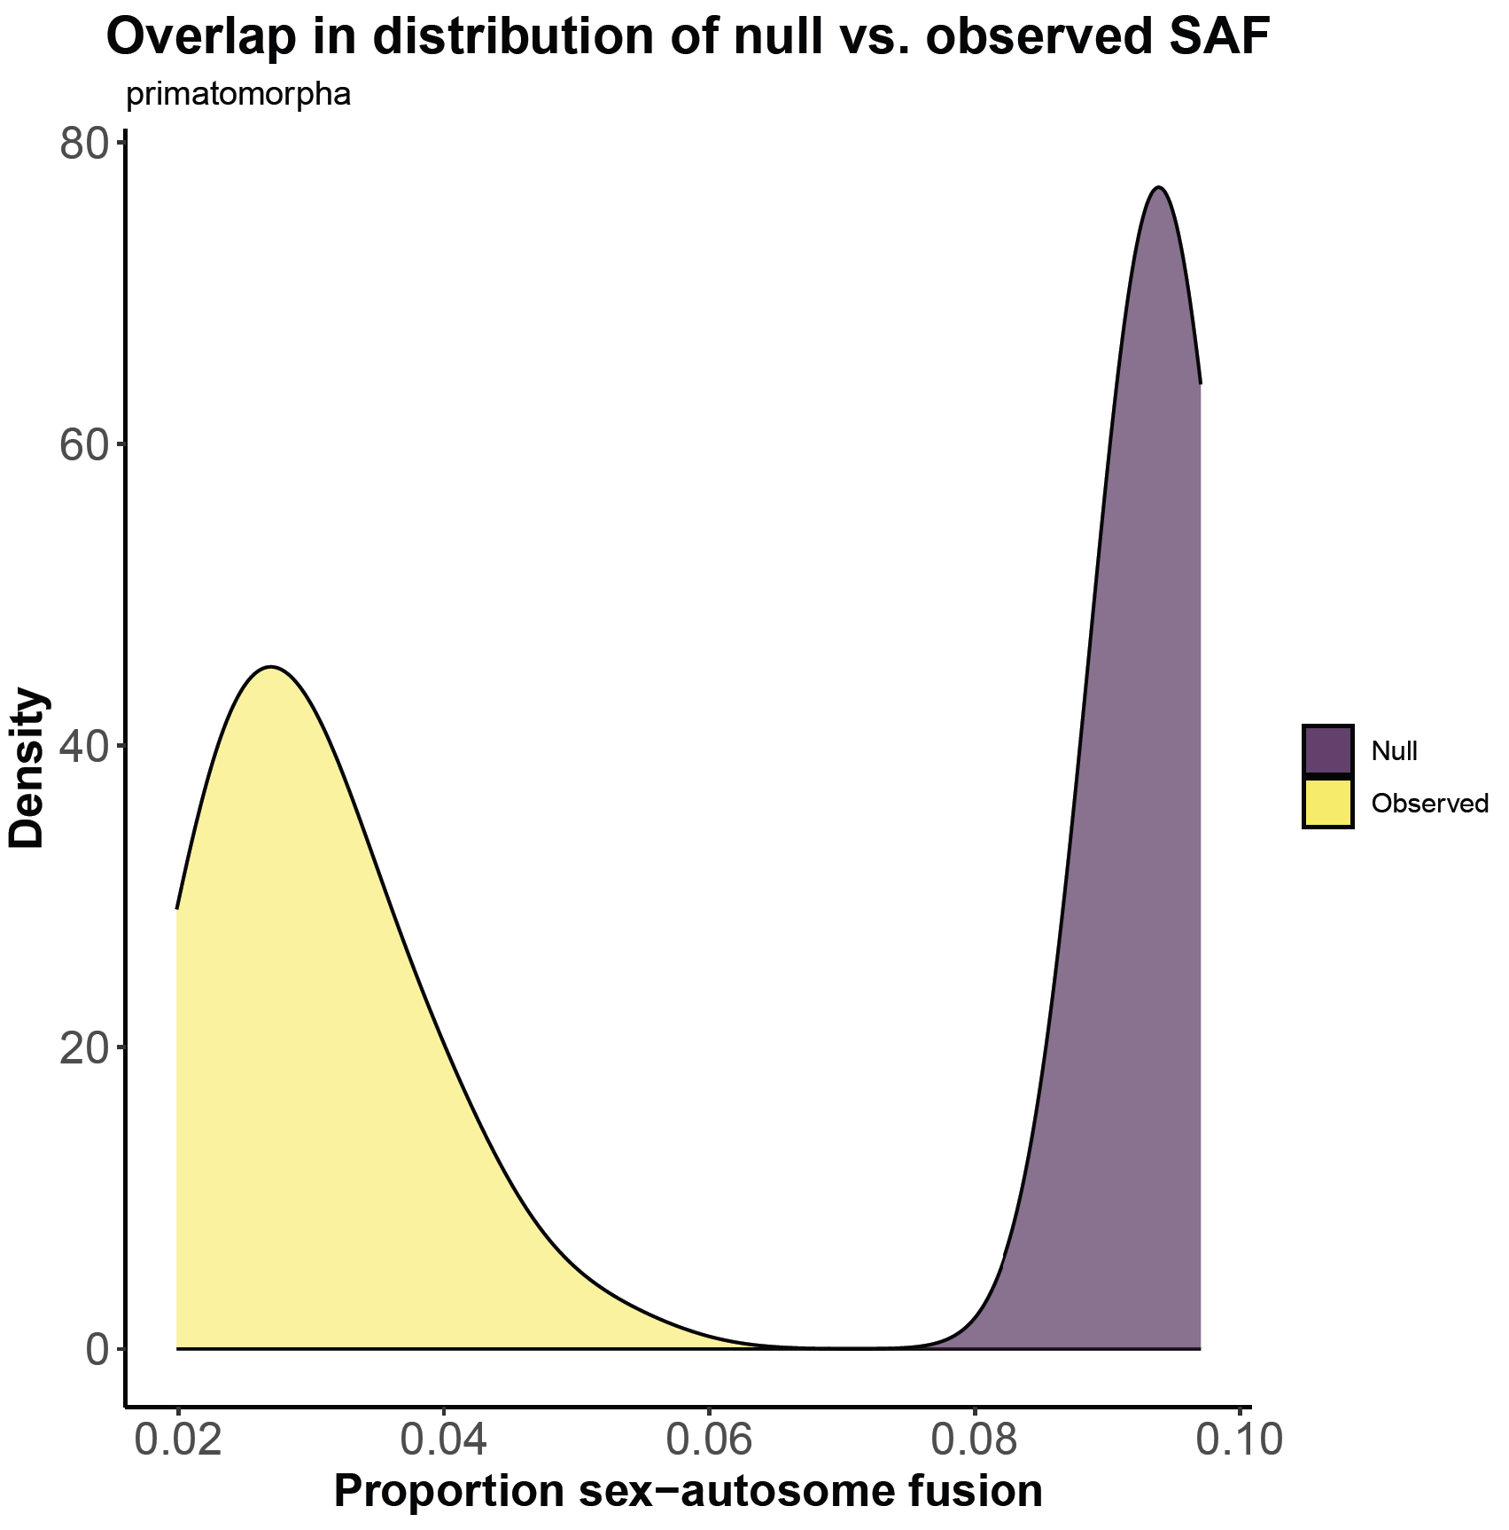


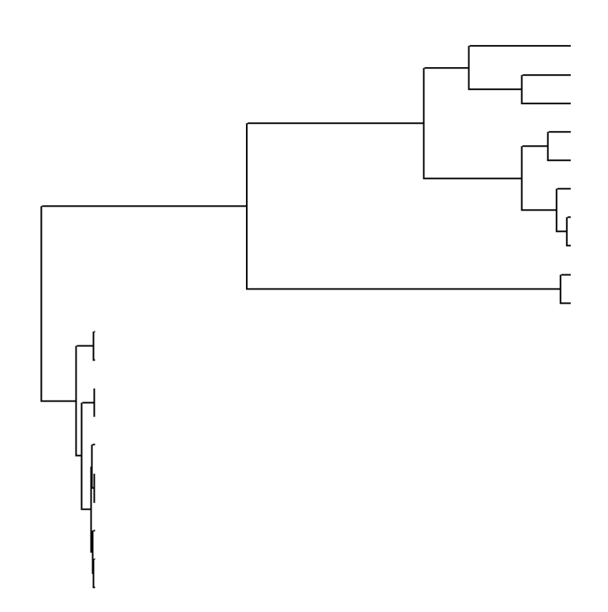
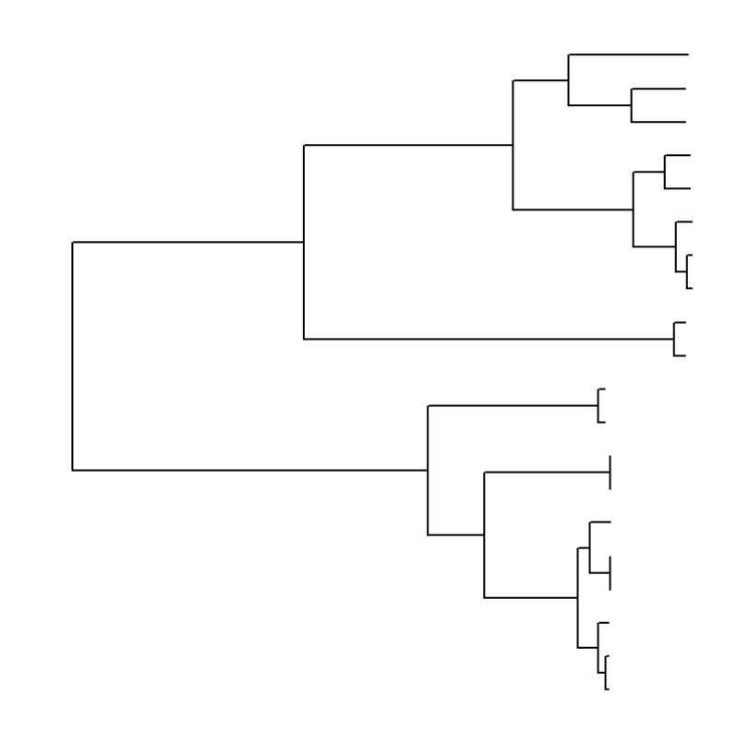
Sexual antagonism, sex chromosome fusions,
and heterogeneity in mammalian karyotypic evolution
Maximos Chin¹, Matthew Marrano^{1,} Heath Blackmon¹
1)Department of Biology. Texas A&M University, College Station, TX, USA
Introduction
Results
Resolution of intra-locus sexual antagonism has been identified as a possible selective pressure favoring centric fusions between sex chromosomes and autosomes. However, studies which attempt to evaluate this hypothesis on smaller taxonomic scales find mixed results in different clades. Diverse in karyotype and mechanisms driving the evolution of genome structure, mammals represent an ideal taxonomic clade upon which to test hypotheses regarding the role of sexual antagonism in driving fusions of sex chromosomes and autosomes on a broad scale. Here, we adapt existing phylogenetic comparative techniques, build on existing methods for visualizing heterogeneity in rates of character evolution across phylogenies, and apply these techniques to a large mammalian phylogeny in evaluating the role of sexual antagonism as a driver of sex chromosome structural evolution.
a)
b)
Methods
Species level karyotypic data: We gather basic karyotypic data (haploid autosome number and sex chromosome fusion state) for 1470 species that span across all major mammalian orders.
Phylogeny: We source our phylogeny from a timetree recently published in Álvarez-Carretero et al. (2022) which incorporates 4705 mammal species and prune our karyotypic dataset and phylogeny to each other. After pruning, our tree/dataset included 950 tips/species.
Model: We utilize a Markov model described in Anderson et al. (2020) which represents a biologically realistic model of karyotypic evolution incorporating fused sex chromosome system as a binary state.
Stochastic mapping modifications
a) b)
Figure 1: Examples of tree edges prior (a) and post (b) fixing of failed edges. Here, black represents edges which failed to coalesce to the correct tip state given a maximum of 5,000,000 rejections using current stochastic mapping techniques
Visualization of rate heterogeneity
a) b)
Figure 2: Tree with artificially extended edges onto which a binary character were simulated (a) and the ultrametric tree with edge lengths multiplied by scalars (b) which increase the likelihood of observing simulated tip states
c)
d)
e)
f)
Figure 3:Overlap in null (purple) vs. observed (yellow) proportions of sex chromosome-autosome fusion (SAF) in mammals as a whole (a) and Carnivora (b), Artiodactyla (c), Yangochiroptera (d), three rodent suborders (e), and Primatomorpha (f)
Figure 4: Heterogeneity in rates of karyotypic evolution visualized across phylogeny
Conclusions and Future Directions
Overall, we successfully adapt existing stochastic mapping techniques such that they can be applied at the level which is necessary for broad scale phylogenetic comparative analysis. We also build on existing methods to visualize heterogeneity in rates of discrete character evolution across phylogenies, developing software that allows for edge-by-edge analysis and visualization of rate variation. We demonstrate the applicability of these methods by employing them in a broad scale investigation of karyotypic evolution in mammals, with special focus on the role of intra-locus sexual antagonism in driving fusions between sex chromosomes and autosomes. Our preliminary results demonstrate large and irregular discrepancies between null and observed SAF proportions, and this is true of both mammals as a whole and several mammal subclades. We hypothesize that this is driven by high rates estimated for autosome – autosome fusions and fissions in our model. Various factors such as extreme rate heterogeneity and the inability of our current model to account for multiple SAF events may contribute to this overestimation. Our next steps are to develop a new model which allow for such multiple fusions and rerun the analyses under this new model. We predict that this should result in null and observed SAF proportions that are more aligned.`1
Notes:
Make toy tree and display tip states initially

