Slide 1
Android
Основы пользовательского
интерфейса (User Interface)

Slide 2
Что такое GUI
Графический пользовательский интерфейс (Graphical User Interface) — разновидность пользовательского интерфейса, в котором элементы интерфейса (меню, кнопки, значки, списки и т. п.), представленные пользователю на дисплее, исполнены в виде графических изображений.
https://ru.wikipedia.org/wiki/gui

Slide 3
Программирование UI с виджетами
Виджеты это элементы графического пользовательского интерфейса (GUI)
не путать с виджетами приложений, размещенными на главном экране, мини-версией приложенияWidgets are building blocks
Пользователь взаимодействует с данным виджетами
Часто используют готовые виджеты
Опытные разработчики часто создают свои собственные

Slide 4
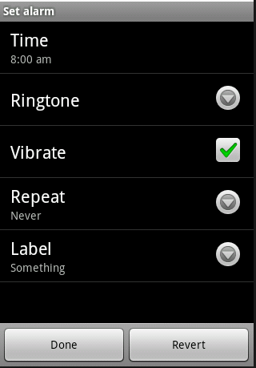
Виджеты
Включают:
Текстовые поля ввода (Text View)
Кнопки (Button)
Флажки (Check Box)
Спинеры (Spinner)
и другие

Slide 5
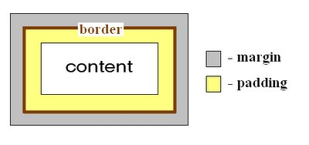
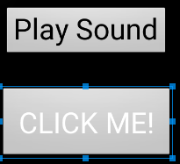
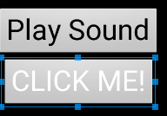
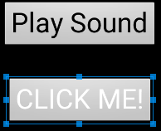
Атрибуты виджетов
Размер (size)
Ширина (layout width)
Высота (layout height)
Внешний отступ (margin)
Внутренний отступ (padding)
Отсутствует margin и padding
Margin сверху (top) 30dp (density independent pixels)
Margin сверху 30dp, и
padding 20dp

Slide 6
Размер (size)
Три варианта:
Определенный (жестко закодированный) размер в dp (независимые от плотности пиксели)
wrap_content
виджет такого размера, чтобы отображать содержимое виджета (текст, иконку)
match_parent
по размеру родителя
виджеты, хранящиеся в контейнере или ViewGroup

Slide 7
Единицы измерения
px (pixels) — пиксели. Точки на экране
dp (density-independent pixels) — независимые от плотности пиксели.
dip - синоним для dp.
sp (scale-independent pixels) — независимые от масштабирования пиксели. Полезны при работе с шрифтами;
in (inches) — дюймы, базируются на физических размерах экрана.
mm (millimeters) — миллиметры, базируются на физических размерах экрана.
pt (points) — 1/72 дюйма

Slide 8
Поддержка разных размеров экрана
Размеры экранов:
small (от 426dp x 320dp)
normal (от 470dp x 320dp)
large (от 640dp x 480dp)
xlarge (от 960dp x 720dp)

Slide 9
Плотности
Набор из шести обобщенных плотностей:
ldpi (low) ~120dpi
mdpi (medium) ~160dpi
hdpi (high) ~240dpi
xhdpi (extra-high) ~320dpi
xxhdpi (extra-extra-high) ~480dpi
xxxhdpi (extra-extra-extra-high) ~640dpi

Slide 10
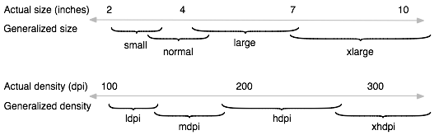
Размеры и плотности

Slide 11
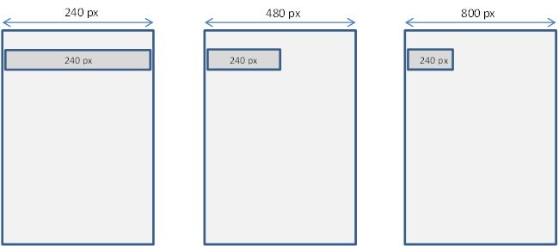
Размеры в пикселях?

Slide 12



Преобразования
Преобразование единиц dp в пиксели и обратно
$$px=\frac{dp ×dpi}{160}$$
$$dp=\frac{px ×160}{dpi}$$
где
$$\frac{dpi}{160}$$
плотность, может быть получена в активности getResources().getDisplayMetrics().density

Slide 13
Контейнеры
Контейнеры используются для организации нескольких виджетов в структуру
У контейнеров есть дети
Дети могут быть виджетами пользовательского интерфейса или другими контейнерами
Каждый контейнер имеет свои правила, размещения своих детей в пространстве экрана, которое занимает контейнер

Slide 14
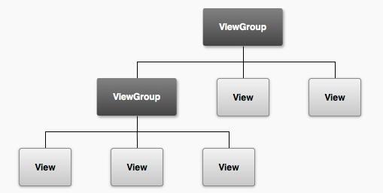
Контейнеры (ViewGroups) и виджеты (Views)
Контейнер, например LinearLayout
Контейнер, например
TableLayout
TextView (метки), ImageView,
Button, и др. виджеты.

Slide 15
XML UI конфигурация
Лайоуты могу содержать UI элементы res/layout
«Разработка через декларацию»
Зачем?
Инструменты для считывания XML и отображения разметки в дизайнере
Встроенный dnd редактор

Slide 16
UI через XML
На каждом экране вашего приложения, скорее всего, будет файл формата xml
который описывает контейнер и виджеты на экране/пользовательском интерфейсе
Возможно редактирование xml или используйте дизайнер
alter container and layout attributes for the set up you want
we will then access and manipulate the container and widgets in our Java code associated with the UI / screen.

Slide 17
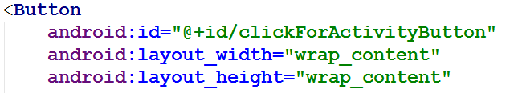
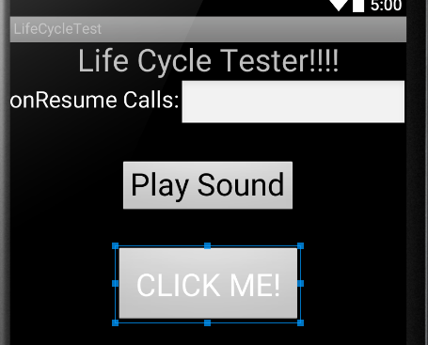
Размер – wrap_content

Slide 18
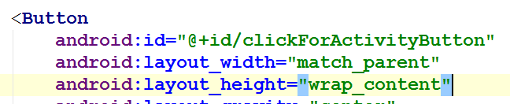
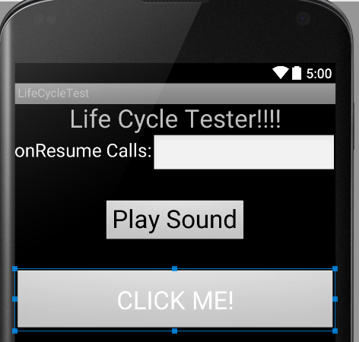
Размер – match_parent

Slide 19
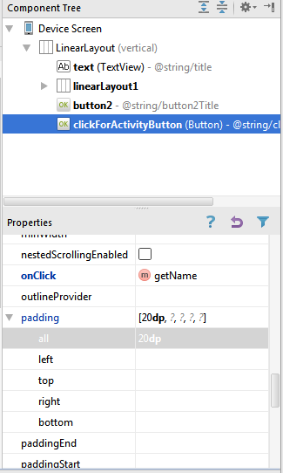
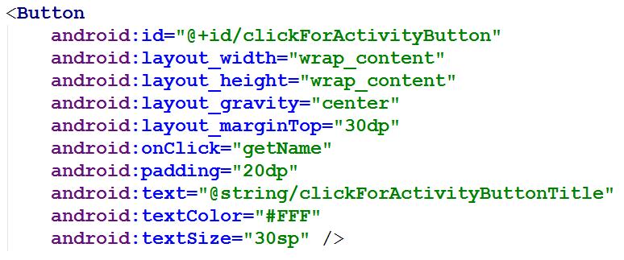
Виджеты в Android Studio
Разработки GUI через дизайнер и XML

Slide 20
Атрибуты
android:padding="20dp" appears in the xml file for the button and sets the given attribute to the specified value
see the view class or appropriate sub class for attributes
a lot of attributes
http://tinyurl.com/y8jj5eo
attributes can be set in the xml and most can changed programmatically

Slide 21
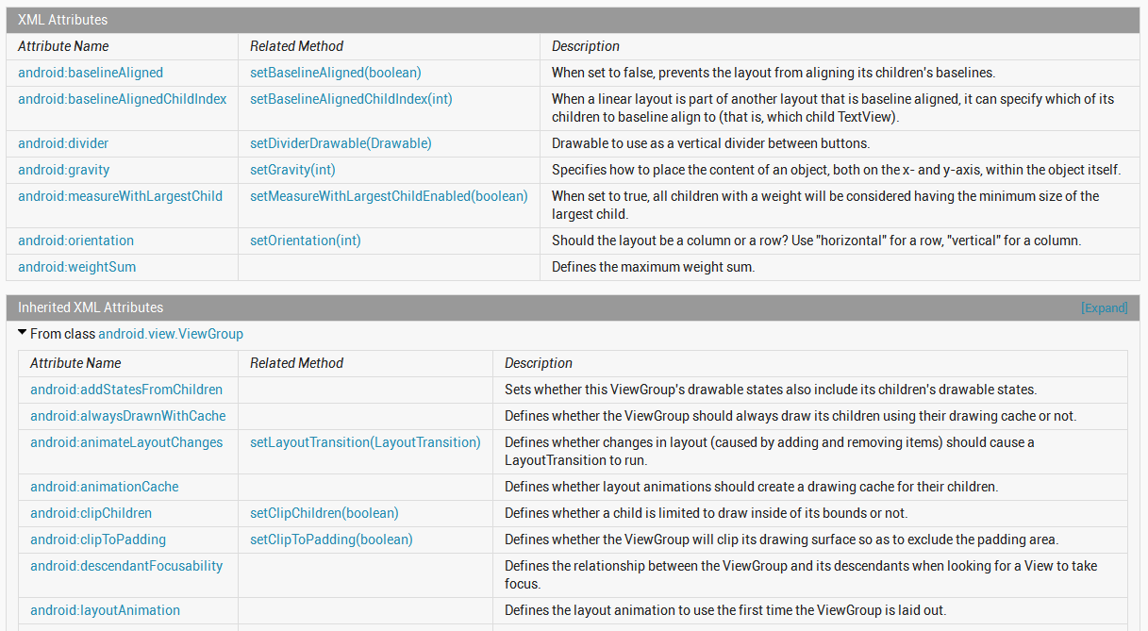
Атрибуты

Slide 22
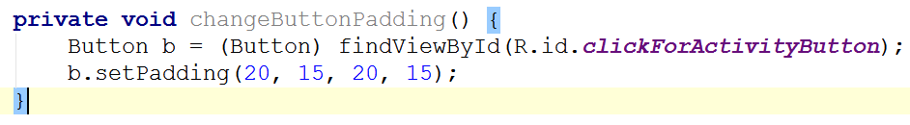
в xml файле
Программно в активности (Java код)

Slide 23
Типы виджетов

Slide 24
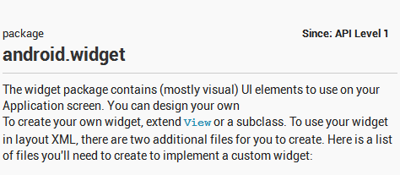
Элементы управления
android.widget пакет
Not to be confused with application widgets, mini versions of applications
Производные от класса View
interactive components of the UI
layouts are the containers

Slide 25
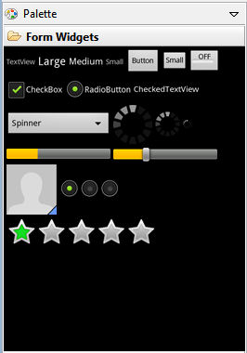
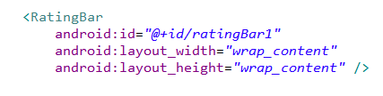
Adding Controls
Widgets can be added to the XML layout or at run time
Add component in visual editor and XML code automatically generated
tweak XML code as desired

Slide 26
Common Controls - TextView
a simple label
display information, not for interaction
common attributes: width, height, padding, visibility, text size, text color, background color
units for width / height: px (pixels), dp or dip (density-independent pixels 160 dpi base), sp (scaled pixels based on preferred font size), in (inches), mm (millimeters)
recommended units: sp for font sizes and dp for everything else
http://developer.android.com/guide/topics/resources/more-resources.html#Dimension

Slide 27
TextView
Other possible attributes:
set number of lines of text that are visible
android:lines="2"
ellipssize attribute to add … instead of simply truncating text
contextual links to email address, url, phone number,
autolink attribute set to none, web, email, phone, map, or all

Slide 28
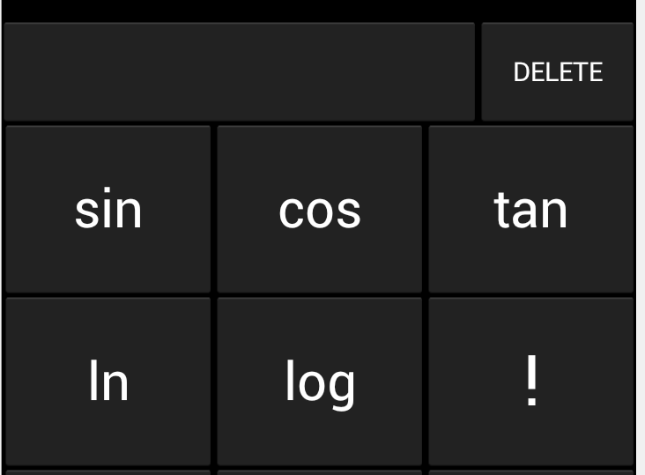
Common Controls - Button
Text or icon or both on View
button press triggers some action
set android:onClick attribute in XML file
OR create a ClickListener object, override onClick method, and register it with the checkbox
typically done with anonymous inner class
possible to customize appearance of buttons http://developer.android.com/guide/topics/ui/ controls/button.html#CustomBackground

Slide 29
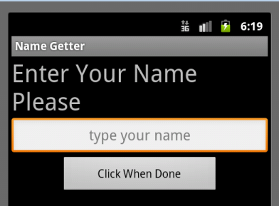
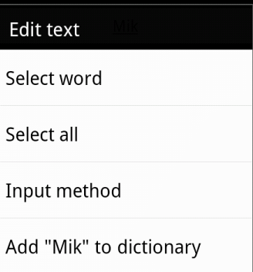
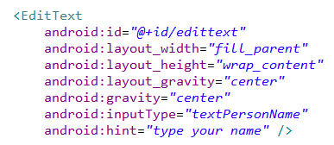
Common Controls - EditText
Common component to get information from the user
long press brings up context menu

Slide 30
EditText
can span multiple lines via android:lines attribute
Text fields can have different input types, such as number, date, password, or email address
android:inputType attribute
affects what type of keyboard pops up for user and behaviors such as is every word capitalized

Slide 31
EditText
Keyboard actions
specify action when input done
ime = input method editor
android:imeOptions attribute
actionNone, actionSearch, actionSend, others
http://developer.android.com/reference/android/widget/TextView.html#attr_android:imeOptions

Slide 32
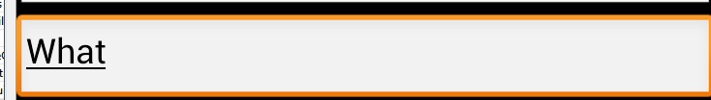

Auto Complete Options
Depending on EditText inputType suggestions can be displayed
works on actual devices
Other classes exist for auto complete from list
AutoCompleteTextView
choose one option
MultiAutoCompleteTextView
choose multiple options (examples tags, colors)

Slide 33
AutoCompleteTextView
Two types
we provide list of choices
user provides list
Developer list
use ArrayAdapter connected to array
best practice: put array in array.xml file

Slide 34
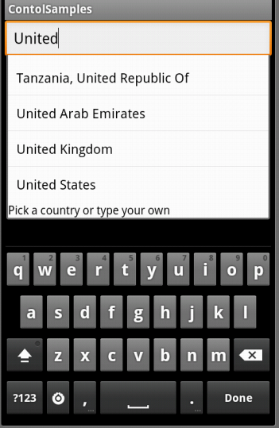
AutoComplete Using Array

Slide 35
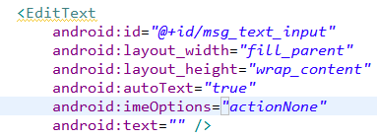
EditText
Auto complete option using device dictionary:
No dictionary on emulator!

Slide 36
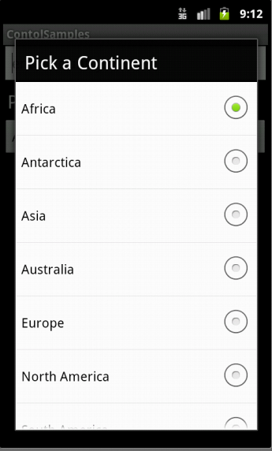
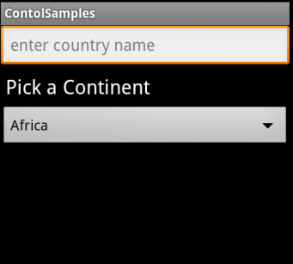
Spinner Controls
Similar to auto complete, but user must select from a set of choices

Slide 37
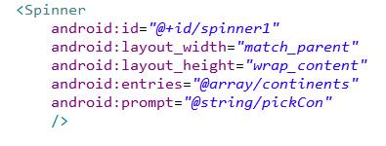
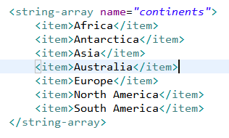
Spinner Control
arrays.xml in res/values

Slide 38
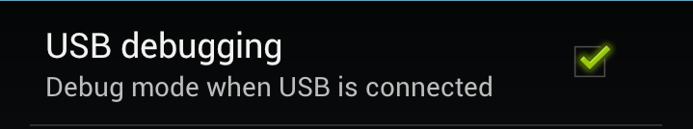
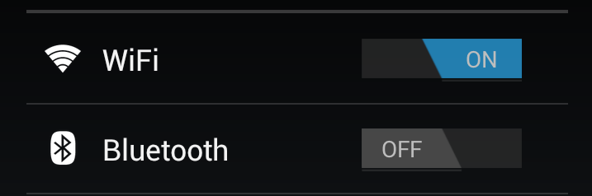

Simple User Selections
CheckBox
set android:onClick attribute or create a ClickListener object, override onClick method, and register it with the checkbox
Switches and ToggleButton
similar to CheckBox with two states, but visually shows states
on and off text

Slide 39
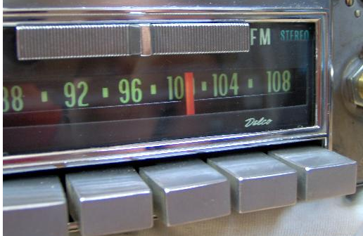
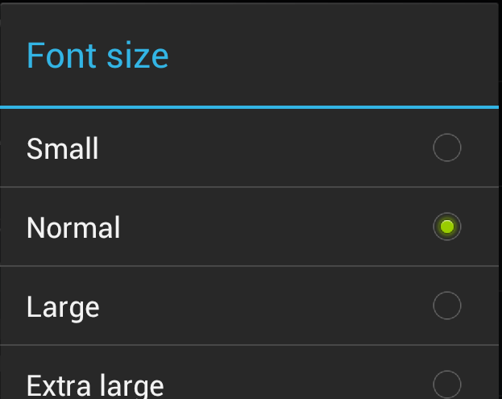
RadioButton and RadioGroup
Select one option from a set
set onClick method for each button
generally same method
Collected in RadioGroup
sub class of LinearLayout
vertical or horizontal orientation

Slide 40
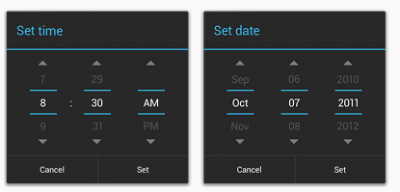
Pickers
TimePicker and DatePicker
Typically displayed in a TimePickerDialog or DatePickerDialog
dialogs are small windows that appear in front of the current activity

Slide 41
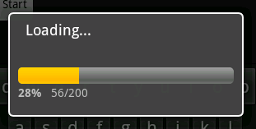
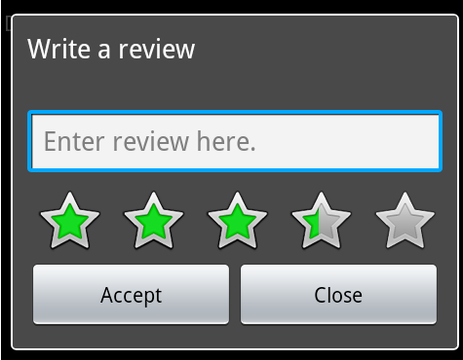
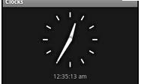
Indicators
Variety of built in indicators in addition to TextView
ProgressBar
RatingBar
Chronometer
DigitalClock
AnalogClock

Slide 42
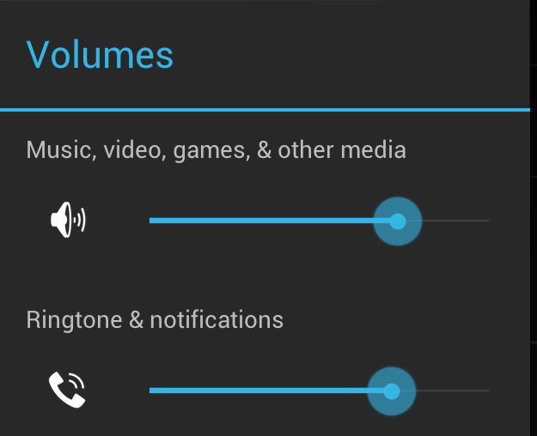
SeekBar
a slider
Subclass of progress bar
implement a SeekBar.OnSeekBarChangeListener to respond to changes in setting

Slide 43
Clicker
What is the purpose of the xml files in the res/layout directory in an Android project?
define all the Java classes in the project
define user interfaces
localize String resources
store graphic image resources such as jpeg and png files
list the permissions the app requests

Slide 44
interacting with widgets

Slide 45
Interacting with Widgets
Some widgets simply display information.
TextView, ImageView
Many widgets respond to the user.
We must implement code to respond to the user action.
Typically we implement a listener and connect to the widget in code.
logic / response in the code

Slide 46
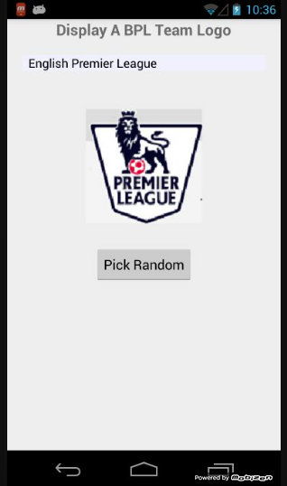
Example - Display Random Image
App to display crests of British Premier League Football teams
Allow user to select team from spinner control
Or, press button to display a random crest
TextView
Spinner
ImageView
Button

Slide 47
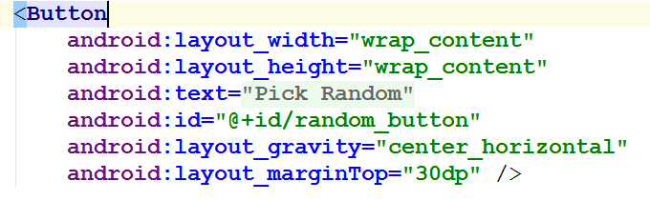
Button in XML layout file
Notice button reacts when pressed, but nothing happens
Possible to disable button so it does not react

Slide 48
Responding to Button Press
Two ways:
Hard way, create a listener and attach to the button
shorter way exists for Views, but this approach is typical for many, many other widgets behaviors besides clicking
Implement an onClickListener and attach to button

Slide 49
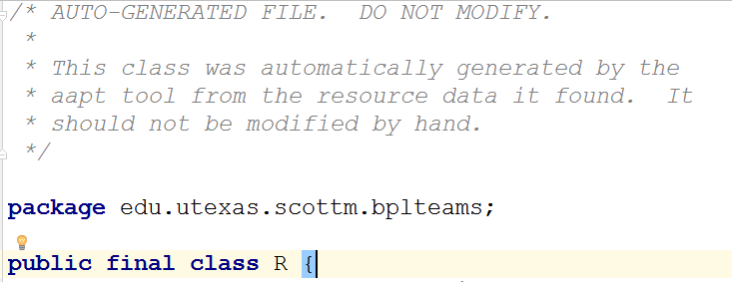
Accessing Button in Code
R.java file automatically generated and creates ids for resources in project folder
if id attribute declared

Slide 50
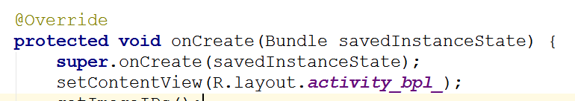
Setting Activity Layout / GUI
Usually the GUI for an Activity is set in the onCreate method.
Typically a layout file is used
set content view will inflate runtime objects for all the widgets in the layout file

Slide 51
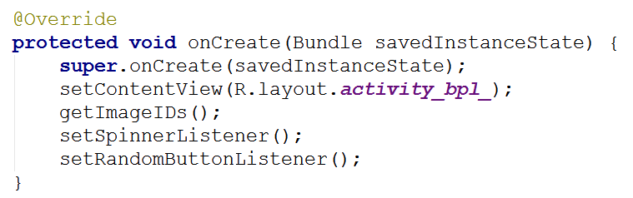
Accessing Layout Widget
To attach a listener we need a handle (reference) to the runtime object for the button (or desired widget)

Slide 52
Accessing Layout Widget
findViewById returns a View object
often necessary to cast to correct type
A whole host of methods to access resources in your /res directory programmatically

Slide 53

Creating and attaching a Listener
setOnClickerListener is method that attaches the listener
View.onClickListener is a Java interface with one method onClick
We are implementing interface with an anonymous inner class

Slide 54
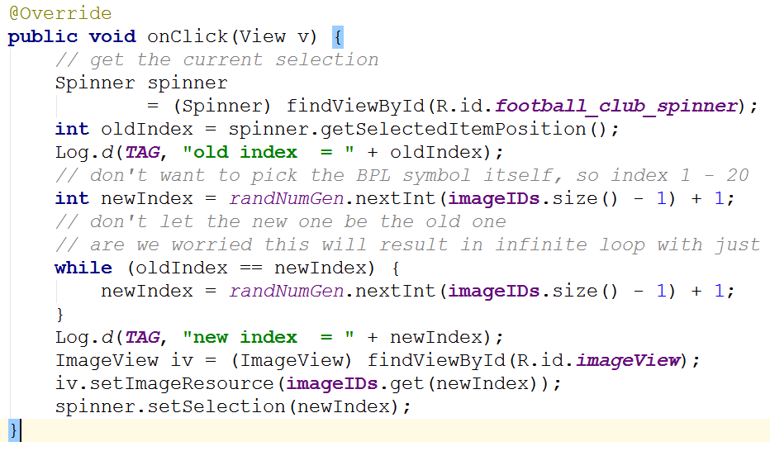
onClick Logic

Slide 55
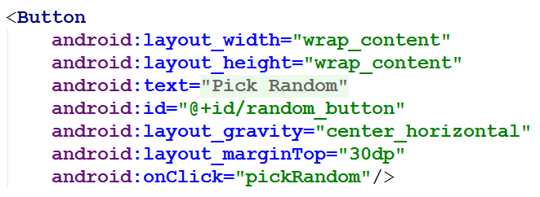
Shortcut for Clicks
All View objects have an onClick attribute
method to call when the View is clicked
Can set onClick attribute to a method in Activity that is called when View is clicked

Slide 56
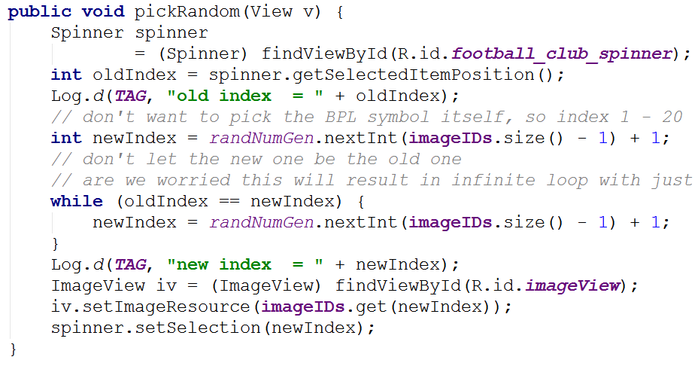
Shortcut for Clicks
In Activity:
demo when method signature wrong

Slide 57
Clicker
What method do we use to associate a variable with the runtime object of a UI component declared in a layout xml file?
setContentView()
startActivity()
onCreate()
a constructor
findViewById()

Slide 58
containers for widgets view groups

Slide 59
ViewGroups - Layouts
Layouts are subclasses of ViewGroup
Still a view but doesn't actually draw anything
serves as a container for other views
similar to Java layout managers
options on how sub views (and view groups) are arranged
Useful Layouts: FrameLayout, LinearLayout, TableLayout, GridLayout, RelativeLayout, ListView, GridView, ScrollView, DrawerLayout, ViewPager

Slide 60
FrameLayout
FrameLayout
simplest type of layout object
fill with a single object (such as a picture) that can be switched in and out
child elements pinned to top left corner of screen and cannot be move
adding a new element / child draws over the last one

Slide 61

LinearLayout
aligns child elements (such as buttons, edit text boxes, pictures, etc.) in a single direction
orientation attribute defines direction:
android:orientation="vertical"
attribute of View

Slide 62
Activity and Layout
Code on previous slide demonstrates inflating a layout for an Activity
… and programmatically changing an attribute of the layout (or view) during runtime

Slide 63

Modifying Attributes
in xml, programmatically, and visual editor

Slide 64

Gravity Attribute
Child element's gravity attribute
where to position in the outer container
center
right

Slide 65

Weight
layout_weight attribute
"importance" of a view
default = 0
if set > 0 takes up more of parent space

Slide 66


Another Weight Example
button and bottom edit text weight of 2
button weight 1 and bottom edit text weight of 2

Slide 67

LinearLayout - Horizontal Orientation
padding
background color
margins

Slide 68

TableLayout
rows and columns
rows normally TableRows (subclass of LinearLayout)
TableRows contain other elements such as buttons, text, etc.

Slide 69

RelativeLayout
children specify position relative to parent or to each other (specified by ID)
First element listed is placed in "center"
other elements placed based on position to other elements

Slide 70

RelativeLayout XML

Slide 71

RelativeLayout XML

Slide 72
GridLayout
added in Android 4.0
child views / controls can span multiple rows and columns
different than TableLayout
child views specify row and column they are in or what rows and columns they span

Slide 73
Container Control Classes
Layouts shown are useful for positioning UI elements
the layouts themselves are not interactive although the child Views may be
Other available layouts add a level of interactivity between the user and the child Views
ListView, GridView, GalleryView
Tabs with TabHost, TabControl
ScrollView, HorizontalScrollView

Slide 74
Data driven containers ListView and gridview

Slide 75

Data Driven Containers
Containers that display repetitive child Views
ListView
vertical scroll, horizontal row entries, pick item
consider using ListActivity
GridView
specified number of rows and columns
GalleryView
horizontal scrolling list, typically images

Slide 76

AdapterView
ListView, GridView, and GalleryView are all sub classes of AdapterView
Adapter generates child Views from some data source and populates the larger View
Most common Adapters
CursorAdapter used when to read from database
ArrayAdapter to read from resource, typically an XML file

Slide 77
Adapters
When using an Adapter a layout is defined for each child element (View)
The adapter creates Views based on layout for each element in data source and fills the containing View (List, Grid, Gallery) with the created Views
binding
child Views can be as simple as a TextView or more complex layouts / controls
simple ones provided in android.R.layout

Slide 78

Typical Adapter Example

Slide 79

Data Source - countries resource file

Slide 80

TextView for Data
ListView filled with TextViews
TextViews store data from ArrayAdapter

Slide 81


ListView and GridView Results

Slide 82
Selection Events
ListView, GridView, GalleryView
Typically user can select one item of data
Implement the OnItemClickListener class and set it as the listener
we will do this a lot:
create a class that implements some kind of listener
register it with a control

Slide 83
Altering the Data and Display
Previous example read data from resource file
What if we want to update list view as data changes?
add and remove items
Example: remove countries from list and view when selected

Slide 84
Altering Data
ArrayAdapter serves as a bridge between a data source and a ListView
Previous example, data was an array resource file
resource file won't change
Dump data to List (ArrayList) and create ArrayAdapter from that source

Slide 85

Source Code

Slide 86

Create ArrayList

Slide 87

Alter Data on Select

Slide 88


A Toast
"A toast provides simple feedback about an operation in a small popup."

Slide 89

Creating a Toast
Inside the OnItemClickListener anonymous inner class

Slide 90
More Complex List View Items
What if we want each item in a list to have more than simple text?
Let's add a switch to each ListView item to show if the Country listed is "safe" or not?
Each View element in the list will be a horizontal linear layout with a TextView and a switch

Slide 91

Not all of layout file shown

Slide 92

Setting Adapter
Change to use the complex layout for each ListView item

Slide 93

Result
Looks okay.
However...
Scroll the list and notice all safe switches set to Yes!
Flip a couple and scroll

Slide 94


View Recycling
Scroll
UH OH

Slide 95
View Recycling
Imagine a ListView tied to contacts on a phone or some other possibly large data set.
Some people have 1000's of contacts.
Creating a ListView with a distinct object for every list element (the Views) would require a LOT of memory.
So, the rows in a list view get recycled. Enough objects are created for the visible items, but as they scroll off the objects are reused and the data in the widgets is reset to what the user should see.

Slide 96
View Recycling
We set the switch on the row that contains Andorra to
no. The we scrolled down the list. The List View item that
contains Andorra is recycled.
The adapter we are using automatically alters the text, but
the switch is still set to no!

Slide 97
Taking Control of Recycling
We need to track the status of safe for each country and change the switch position as appropriate when a list view item gets recycled
This requires creating two classes:
one to model the data for each row
our own Adapter that extends ArrayAdapter

Slide 98

CountryRowData
Simple nested class to model and track the data in a row

Slide 99

New onCreate Method
Create list of CountryRowData objects and send to our new Adapter class

Slide 100


Extending ArrayAdapter

Slide 101

Listening for Changes to Switches

Slide 102


Set Switch to Correct Value

Slide 103
Explanation of Adapter
Our SafeAdapter class lets ArrayAdapter inflate and recycle the row
call to super.getView
this will set the country name
inflate = take an xml layout and create a runtime object to model it, measure and draw the object
Then we check to see if we have a ViewHolder in the rows tag.

Slide 104
Explanation of Adapter
If we don't have a ViewHolder for the current row we create one and associate it with the row
We add a switch listener for the switch in the row

Slide 105
ViewHolder and Tags
All View objects (all GUI widgets are descendants of View) have a setTag() and getTag() method
These methods allow us to associate an arbitrary object with the View (widget)
The holder pattern uses the widget tag to hold an object which in turn holds each of child widgets of interest

Slide 106
ViewHolder and Tags
The purpose of attaching a holder to the row Views is to avoid calling findViewById() again
can be slow

Slide 107
Recycling of ListView Elements
LOOK HERE FOR intercepting the ListView items:
http://stackoverflow.com/questions/6921462/listview-reusing-views-when-i-dont-want-it-to

Slide 108

Other Layouts - Tabbed Layouts
Uses a TabHost and TabWidget
TabHost consists of TabSpecs
can use a TabActivity to simplify some operations
Tabs can be
predefined View
Activity launched via Intent
generated View from TabContentFactory

Slide 109
Scrolling
ListView supports vertical scrolling
Other views for Scrolling:
ScrollView for vertical scrolling
HorizontalScrollView
Only one child View
but could have children of its own
examples:
scroll through large image
Linear Layout with lots of elements

Slide 110
Concrete UI Example - tip calculator

Slide 111

Concrete Example
Tip Calculator
What kind of layout to use?
Widgets:
TextView
EditText
SeekBar

Slide 112

TextViews

Slide 113
EditText
All but top EditText are
uneditable
Alternative?
TextViews?

Slide 114
SeekBar

Slide 115
Layout
TableLayout
row 0
row 1
row 2
row 3
row 4
row 5

Slide 116

Layout Attributes
android:background
#RGB, #ARGB, #RRGGBB, #AARRGGBB
can place colors in res/values/colors.xml

Slide 117


Color Resources
Good Resource / W3C colors
http://tinyurl.com/6py9huk

Slide 118
StretchColumns
columns 0 indexed
columns 1, 2, 3 stretch to fill layout width
column 0 wide as widest element, plus any padding for that element

Slide 119

Initial UI
Done via some Drag and Drop, Outline view, and editing XML
Demo outline view
properties

Slide 120


Changes to UI
Outline multiple select properties
all TextViews' textColor set to black #000000
change column for %DD labels
use center gravity for components

Slide 121

Changes to UI
change bill total and seekbar to span more columns
gravity and padding for text in column 0
align text with seekBar
set seekBar progress to 18
set seekBar focusable to false - keep keyboard on screen

Slide 122

Changes to UI
Prevent Editing in EditText
focusable, long clickable, and cursor visible properties to false
Set text in EditText to 0.00
Change weights to 1 to spread out

Slide 123

Functionality
onCreate instance variables assigned to components found via ids
update standard percents:

Slide 124

Functionality - Saving State
onSaveInstance
save BillTotal and CustomPercent to the Bundle
check for these in onCreate

Slide 125


Functionality Responding to SeekBar
customSeekBarListener instance variable
Of type OnSeekBarChangeListener

Slide 126

Create an Anonymous Inner Class
Class notified when seek bar changed and program updates custom tip and total amount
must register with the seekBar instance variable in onCreate!

Slide 127


Functionality - Total EditText
Another anonymous inner class
implement onTextChanged to converts to double and call update methods
register with EditText for total in onCreate()!

