Slide 1
CS371m - Mobile Computing
Gestures

Slide 2
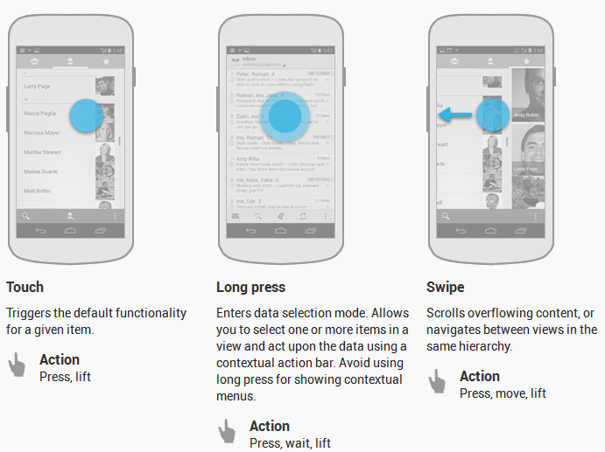
Common Gestures

Slide 3
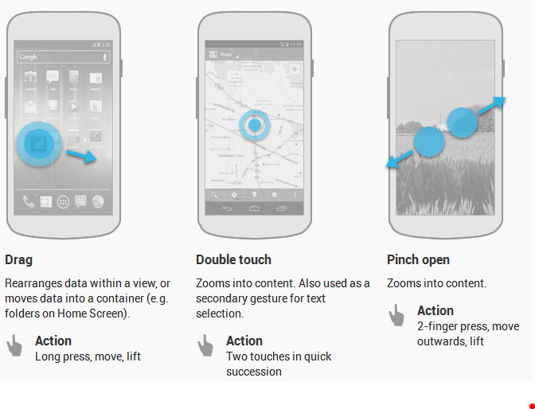
Common Gestures
http://developer.android.com/design/patterns/gestures.html

Slide 4
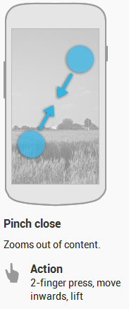
Common Gestures
Fling or flick gesture: similar to swipe or drag
scroll/swipe/drag
user presses then moves finger in steady motion before lifting finger
fling or flick
user presses then moves finger in an accelerating motion before lifting

Slide 5
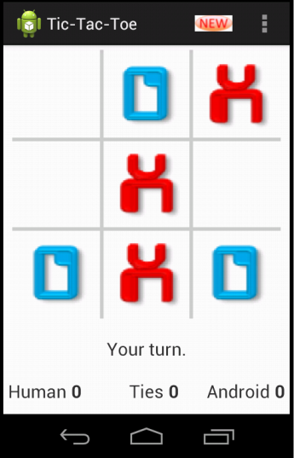
Dealing With Gestures
To handle simple touch events create View.OnTouchListener for view
Example from tutorial, screen press leads to player moving if it is their turn and they touch an open square

Slide 6
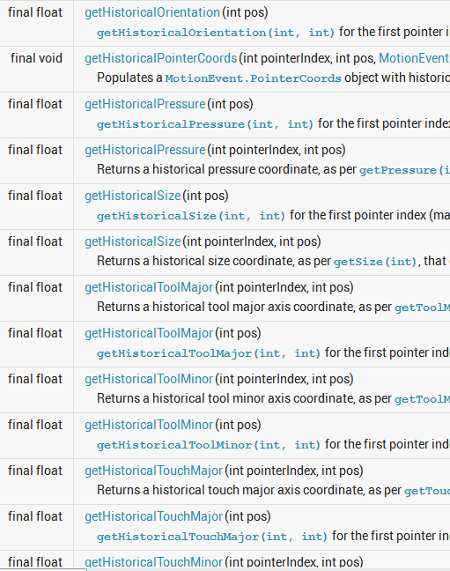
onTouchEvent
passed a MotionEvent object with a large amount of data
in tic tac toe tutorial you only use location of event (x and y)

Slide 7

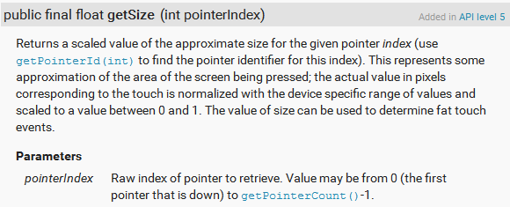
MotionEvent
Example of the astonishing amount of data packed into the motionEvent object

Slide 8
Other View Listeners
View also has ability to listen for long clicks and drags
In addition to View.OnTouchListener
View.OnLongClickListener
View.OnDragListener

Slide 9
Handling Common Gestures
Instead of trying to decode gestures from the MotionEvent passed to the on touch method …
Use the GestureDetector class
Add a GestureDetector object to View
override View.onTouchEvent method to pass MotionEvent on to the GestureDetector.onTouchEvent method

Slide 10
Handling Common Gestures
create a GestureDetector.OnGestureListener (several gestures)
or a GestureDetector.DoubleTapListener (more gestures) and register it with the GesturerDetector

Slide 11
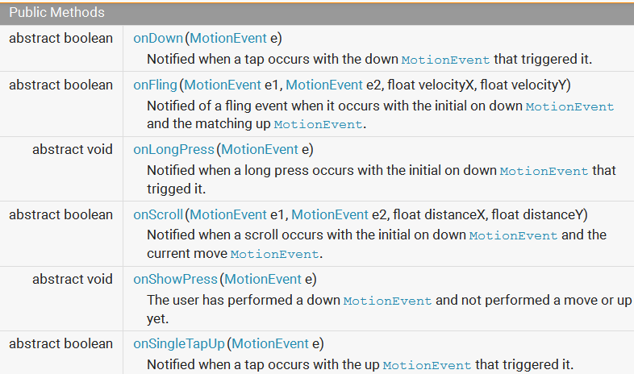
GestureDetector.OnGestureListener

Slide 12
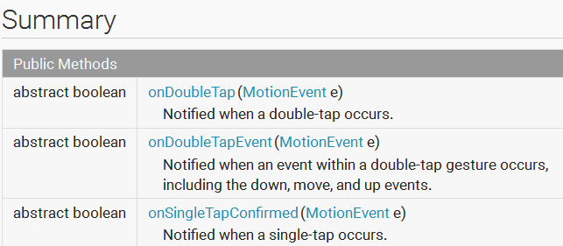
GestureDetector.DoubleTapListener

Slide 13
Adapter Classes
OOP Pattern
Create a class that implements methods of interface with minimal (or no) functionality
Standard Java Example
Interfaces for MouseListener(5), MouseWheelListener(1), and MouseMotionListener(3)
MouseAdapter class implements all three interfaces with empty methods
extend MouseAdapter and add functionality for events you care about.

Slide 14
GestureDetector.SimpleOnGestureListener
Implements all methods of GestureDetector.OnGestureListener and GestureDetector.DoubleTapListener
Does nothing but return false for all the methods
Extend this class and add more meaningful behavior

Slide 15
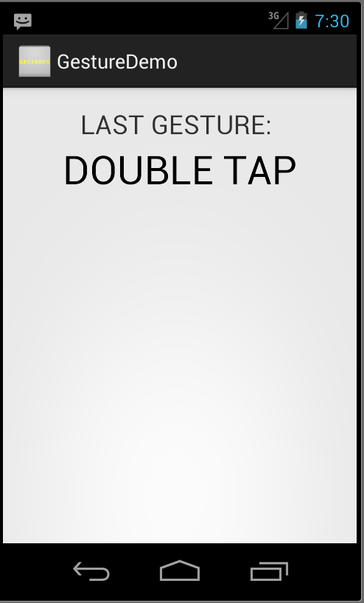
Simple Gesture Demo
App that listens for simple gestures
update lower TextView in call back methods

Slide 16
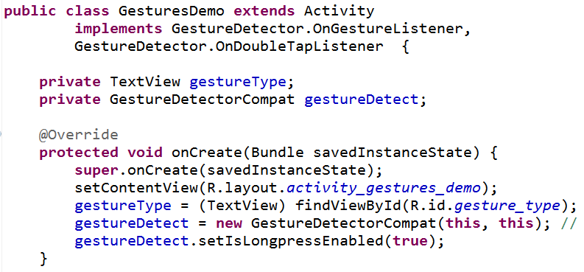
Gesture Demo

Slide 17
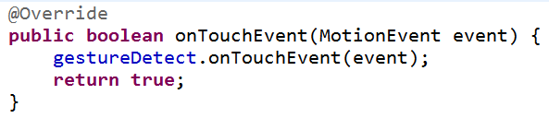
Gesture Demo
Simply pass event on to the GestureDetectorCompat object
it will call back methods

Slide 18
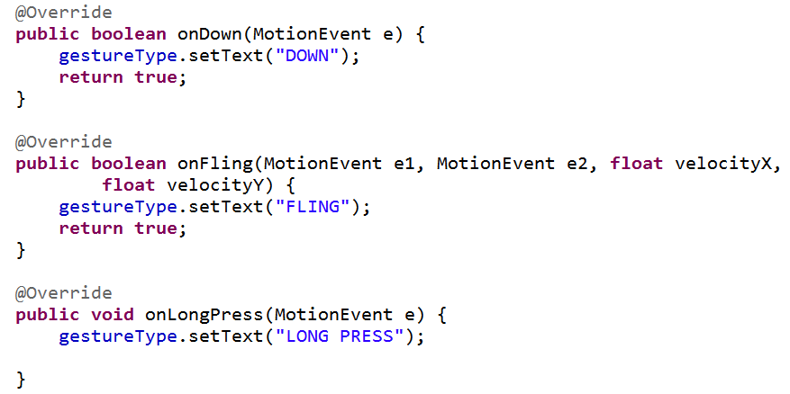
Callback Methods for OnGestureListener

Slide 19
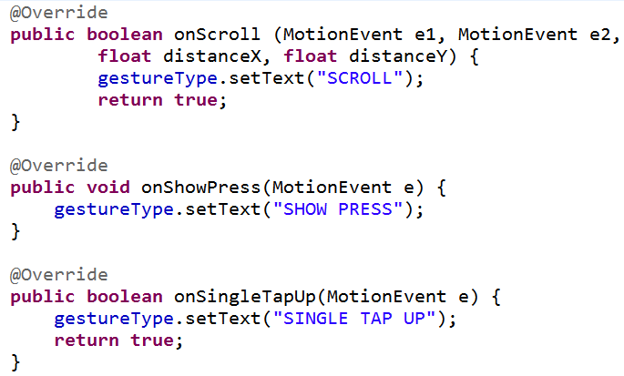
Callback Methods for OnGestureListener

Slide 20
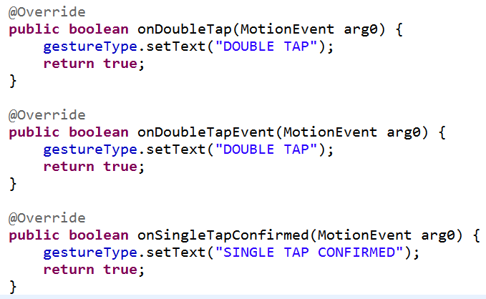
Callback Methods for DoubleTapListener

Slide 21
Multi Touch Gestures
Multiple fingers (pointers) touch screen at same time
Still handled via MotionEvents
each pointer (finger) has a MotionEvent
track via index (in array of MotionEvents) or ID
MotionEvent object sent to onTouch contains number of "pointers" involved

Slide 22
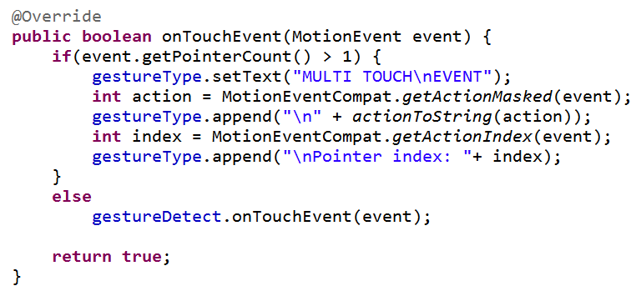
Displaying Multitouch data
static methods from MotionEventCompat class

Slide 23
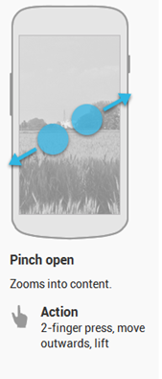
Scale Gestures
ScaleGestureDetector class from Api level 8 (API 2.2)
pinch to zoom in or out
out -> scale up
in -> scale down

Slide 24
Scale Gestures
Create class that implements ScaleGestureDetector.OnScaleGestureListener
OR create class that extends ScaleGestureDetector.SimpleOnScaleGestureListener
adapter class
implements methods from OnScaleGestureListener with dummy methods
override only the methods you care about
Create a ScaleGestureDetector with listener
pass Motion events from onTouch

Slide 25
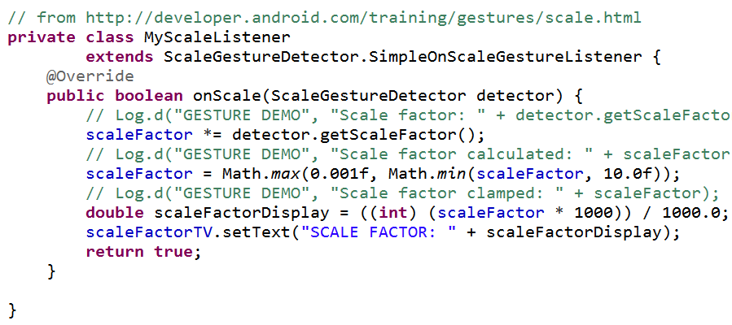
Scaling Example
listener updates overall scale factor
shows current scale factor in TextView

Slide 26
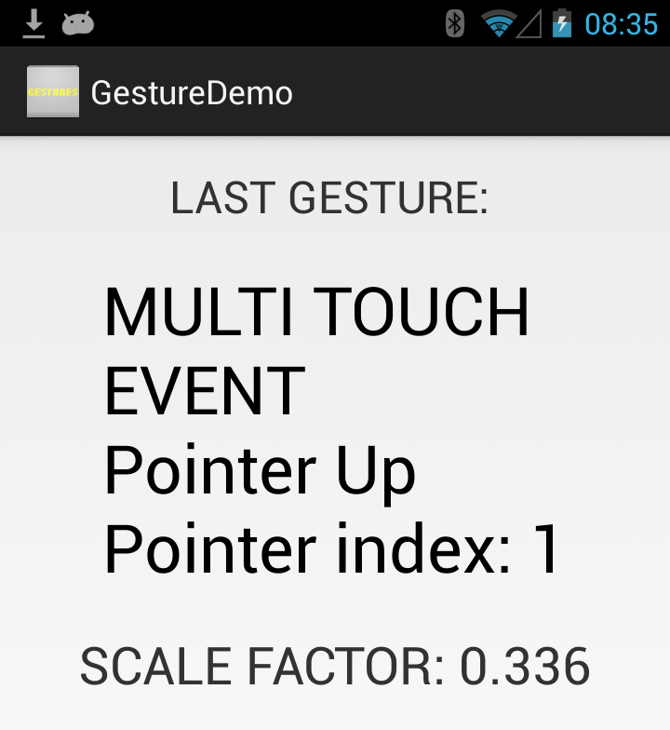
Scale Example

Slide 27
Drag Gestures
Similar to handling Scale gestures
Implement View.OnDragListener
one method, onDrag(View v, DragEvent de)
Drag event phases:
start
continuing
dropped
ended

Slide 28
Complex gestures

Slide 29
Complex Gestures
Non standard gestures require lots of code to recognize
Android 1.6 introduced new APIs to store, load, draw, and recognize gestures
Gesture Builder app on emulator
emulator must include virtual SD card
allows creating set of gestures for your application
limited success with jelly bean emulators
App on class GitHub repo

Slide 30
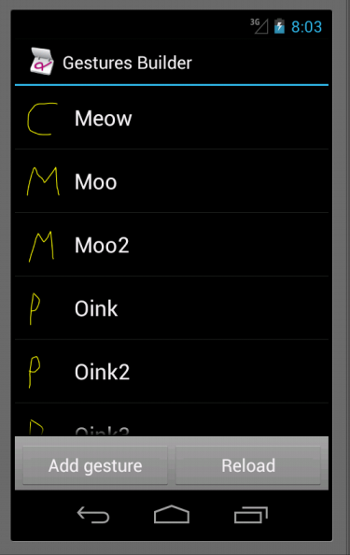
Complex Gestures
Each gesture associated with name
Limited to single pointer
multiple gestures can have same name
variations on same gesture, better chance of recognizing
Move gestures from emulator to application res/raw folder

Slide 31
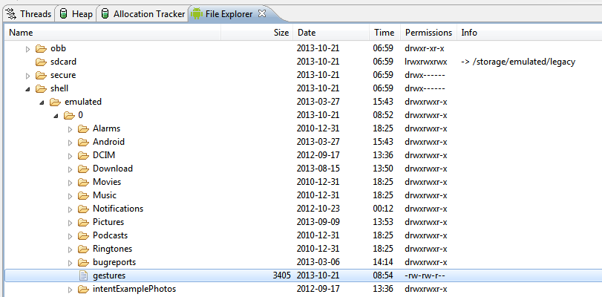
Gesture Data File
DDMS file explorer

Slide 32
Complex Gestures
Recognizing gestures via a GestureOverlayView
simple drawing board on top of view that shows and records user gestures
When gesture complete GestureLibrary queried to see if gesture is recognized
Predictions of entered gesture and those in the library

Slide 33
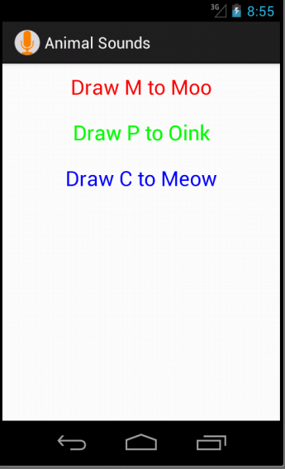
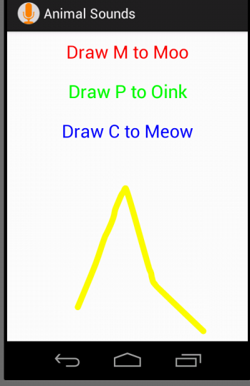
Animal Sounds App

Slide 34
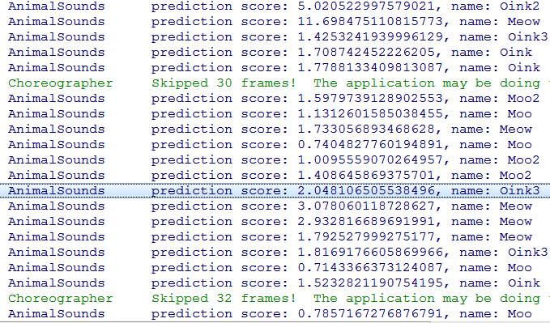
Predictions

Slide 35
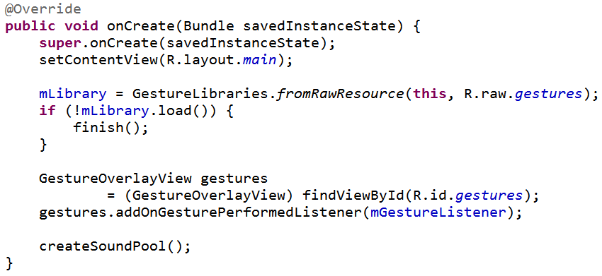
onCreate

Slide 36
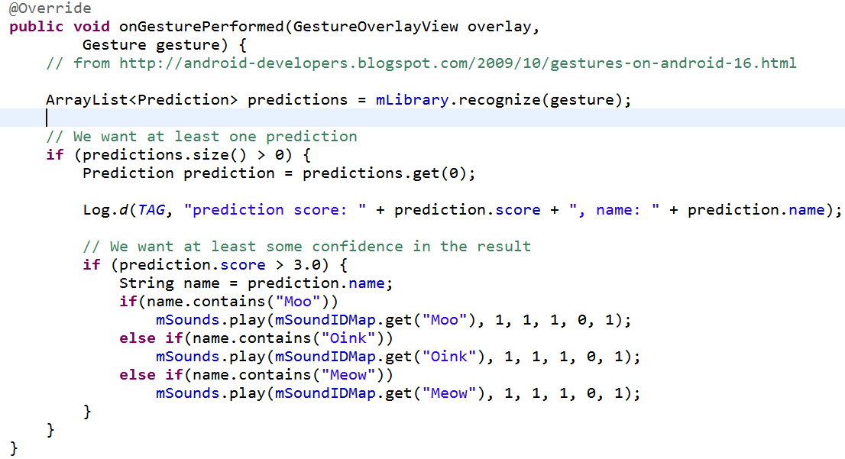
Listener

