Slide 1
CS371m - Mobile Computing
Persistence

Slide 2
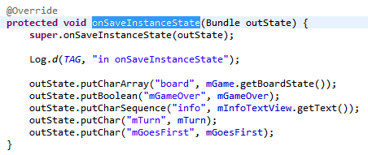
Saving State
We have already seen saving app state into a Bundle on orientation changes or when an app is killed to reclaim resources but may be recreated later

Slide 3
Storing Data
Multiple options for storing data associated with apps
Shared Preferences
Internal Storage
device memory
External Storage
SQLite Database
Network Connection

Slide 4
Sharing Data
Private data can be shared by creating a Content Provider
Android has many built in Content Providers for things such as
audio
images
video
contact information

Slide 5
shared preferences

Slide 6
Shared Preferences
Private primitive data stored in key-value pairs
SharedPreferences Class
Store and retrieve key-value pairs of data
keys are Strings
values are Strings, Sets of Strings, boolean, float, int, or long
So, somewhat limited options
Not strictly for app preferences

Slide 7
SharedPreferences
Several levels of preferences:
getPreferences(int mode) for the Activity's Preferences
name based on Activity
getSharedPreferences(String name, int mode) for a an Application's shared preferences
multiple activities
PreferenceManager. getDefaultSharedPreferences() for system wide preferences

Slide 8

Using SharedPreferences
Obtain a SharedPreferences object for application using these methods:
getSharedPreferences(String name, int mode)
getPreferences(int mode)

Slide 9
Writing to SharedPreferences
After obtaining SharedPreferences object:
call edit() method on object to get a SharedPreferences.Editor object
place data by calling put methods on the SharedPreferences.Editor object
also possible to clear all data or remove a particular key

Slide 10
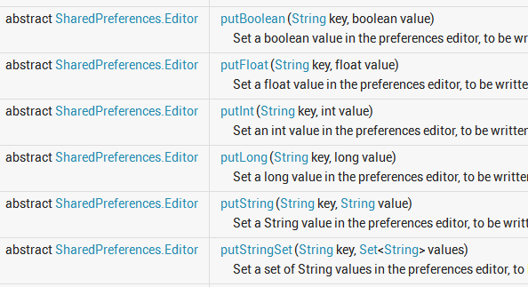
Limited Data Types for SharedPreferences

Slide 11
Writing to SharedPreferences
When done writing data via the editor call either apply() or commit()
apply() is the simpler method
used when only one process expected to write to the preferences object
commit() returns a boolean if write was successful
for when multiple process may be writing to preferences
blocking opereation, so use spariingly or in thread off of the UI thread to avoid ANR

Slide 12
Reading From Shared Preferences
After obtaining SharedPreferences object use various get methods to retrieve data
Provide key (string) and default value if key is not present
get Boolean, Float, Int, Long, String, StringSet
getAll() returns Map<String, ?> with all of the key/value pairs in the preferences

Slide 13
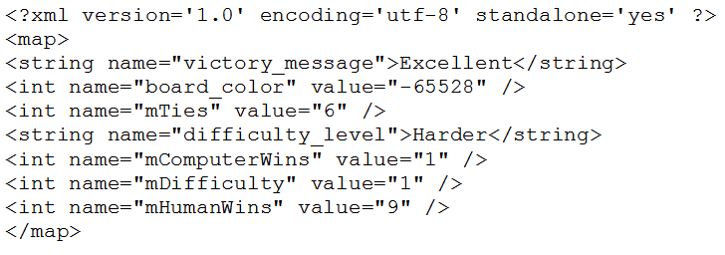
Shared Preferences File
Stored as XML

Slide 14
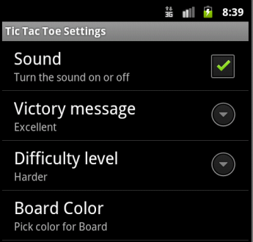
Preference Activity
An Activity framework to allow user to select and set preferences for your app
tutorial 6 had an example
difficulty, sound, color, victory message
Main Activity can start a preference activity to allow user to set preferences
Current standard is to use a PreferenceFragment instead

Slide 15
internal storage

Slide 16
Internal Storage
Private data stored on device memory
not part of apk
More like traditional file i/o
in fact not that different from Java I/O
by default files are private to your application
other apps cannot access directly
recall content providers to share data with other apps
files removed when app is uninstalled

Slide 17
Internal Storage
To create and write a private file to the device internal storage:
call openFileOutput(String name, int mode)
method inhertied from Context
file created if does not already exist
returns FileOutputStream object
regular Java class
Modes include: MODE_APPEND, MODE_PRIVATE deprecated: MODE_WORLD_READABLE, MODE_WORD_WRITEABLE

Slide 18
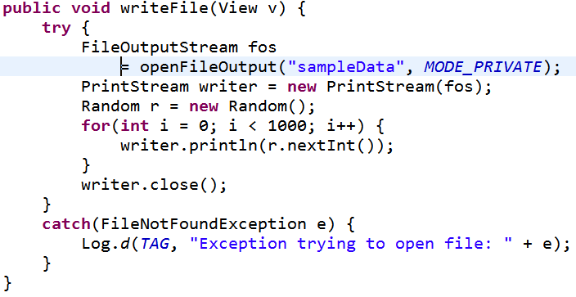
Writing to Files
FileOutputStream writes raw bytes
arrays of bytes or single bytes
Much easier to wrap the FileOutputStream in PrintStream object

Slide 19
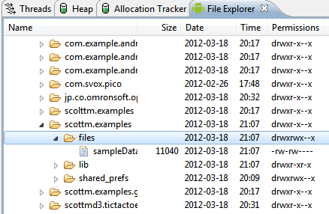
Reading from Files
files saved to device
data directory for app
call openFileInput(String name) method to obtain a FileInputStream
FileInputStream reads bytes
for convenience may connect to Scanner object or wrap in a DataInputStream object

Slide 20
Static Files
If you need or have a file with a lot of data at compile time:
create and save file in project res/raw/ directory
open file using the openRawResource(int id) method and pass the R.raw.id of file
returns an InputStream to read from file
cannot write to the file, part of the apk

Slide 21
Cache Files
If need to cache data for application instead of storing persistently:
call getCacheDir() method to obtain a File object that is a directory where you can create and save temporary cache files
files may be deleted by Android later if space needed but you should clean them up on your own
recommended to keep under 1 MB

Slide 22
Internal Files - Other Useful Methods
All of these are inherited from Context
File getFileDir()
get absolute path to filesystem directory where app files are saved
File getDir(String name, int mode)
get and create if necessary a directory for files
boolean deteleFile(String name)
get rid of files, especially cache files
String[] fileList()
get an array of Strings with files associated with Context (application)

Slide 23
External files

Slide 24
External Storage
Public data stored on shared external storage
may be removable SD (Secure Digital) card or internal, non-removable storage
files saved to external storage are world-readable
files may be unavailable when device mounts external storage to another system
files may be modified by user when they enable USB mass storage for device
request WRITE_EXTERNAL_STORAGE permission in manifest

Slide 25
Checking Media Availability
Call Environment.getExternalStorageState() method to determine if media available
may be mounted to computer, missing, read-only or in some other state that prevents accessing

Slide 26
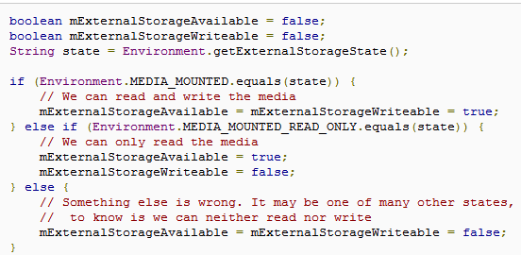
Checking Media State
other states such as media being shared, missing, and others

Slide 27
Accessing Files on External Storage
call getExternalFilesDir(String type) to obtain a directory (File object) to get directory to save files
type is String constant from Environment class
DIRECTORY_ALARMS, DIRECTORY_DCIM (Digital Camera IMages), DIRECTORY_DOWNLOADS, DIRECTORY_MOVIES, DIRECTORY_MUSIC, DIRECTORY_NOTIFICATIONS, DIRECTORY_PICTURES, DIRECTORY_PODCASTS, DIRECTORY_RINGTONES

Slide 28
External File Directory
If not a media file then send null as parameter to getExternalFilesDir() method
The DIRECTORY_<TYPE> constants allow Android's Media Scanner to categorize files in the system
External files associated with application are deleted when application uninstalled

Slide 29
External Data Shared Files
If you want to save files to be shared with other apps:
save the files (audio, images, video, etc.) to one of the public directories on the external storage device
Environment.getExternalStoragePublicDirectory( String type) method returns a File object which is a directory
same types as getExternalFilesDir method

Slide 30

Sharing Data
Example:
In the random art app
add a button to save images
if we want images to show up with other "images" save to the DIRECTORY_PICTURES directory
now, other apps can view / use these images via the media scanner
NOT deleted when app deleted

Slide 31
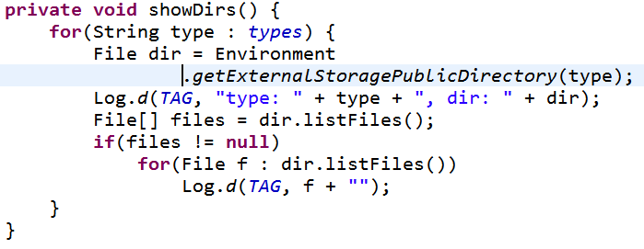
Examining Shared Directories

Slide 32
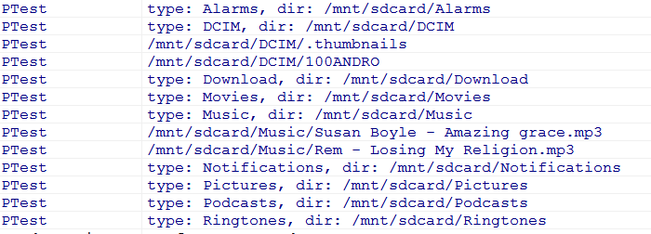
Result

Slide 33
object serialization

Slide 34
Object Serialization
Taking a runtime data structure or object and converting it to a form that can be stored and / or transmitted
converted to a byte stream
store the object in between program runs
transmit the object over a network
store the data, not the methods / ops
not the class definition

Slide 35
Object Serialization
Secondary Storage / Network
serialization
runtime Object ArrayList<Integer>
deserialization
runtime Object ArrayList<Integer>

Slide 36
Serialization - Why?
Could just do it by hand
write out fields and structure to file
read it back in
Serialization provides an abstraction in place of the "by hand" approach
Much less code to write
Example, Java has a specification for serializing objects
little effort on your part

Slide 37
Serialization in Java
java.io.Serializable interface
Here are the methods in the Serializable interface:
Really, that's it
A TAG interface
A way for a class to mark that is Serializable

Slide 38
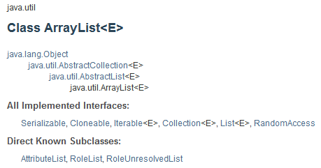
Serialization in Java

Slide 39
Serialization in Java
Data is serialized, not the class definition
Program that deserializes must have the class definition
Use an ObjectOutputStream object to write out Serializable objects
serialize, deflate, flatten, dehydrate, marshal
Later, use an ObjectInputStream to read in Serializable objects
deserialize, inflate, unflatten, hydrate, unmarshal

Slide 40
ObjectOutputStream Example
from CS307 / CS314
Evil Hangman test cases
play the game and test student results
for each guess we want the patterns and the number of words in each pattern
Map<String, Integer>

Slide 41
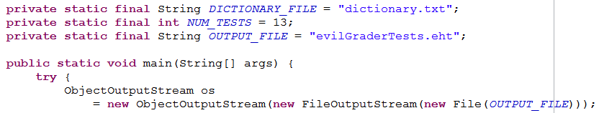
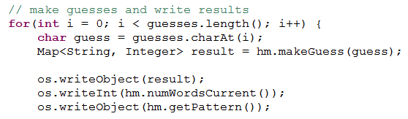
ObjectOutputStream Example Create tests
LATER FOR EACH GUESS
data methods (writeInt, …) for primitives

Slide 42
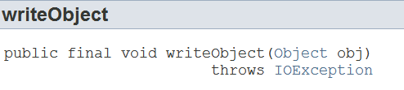
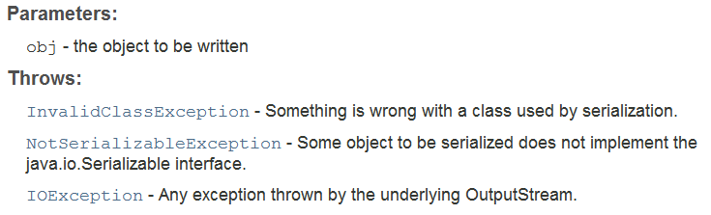
ObjectOutputStream writeObject

Slide 43
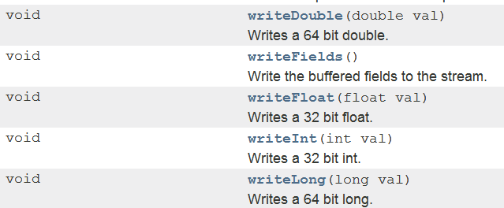
ObjectOutputStream Data Methods
… and others

Slide 44
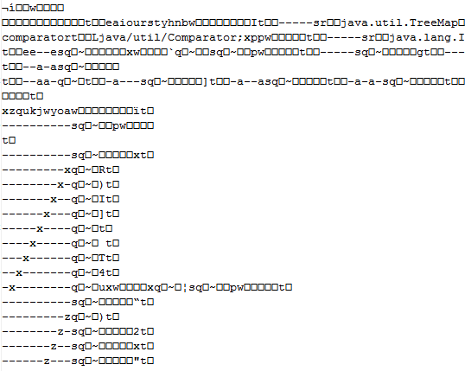
Output File - not human readable

Slide 45
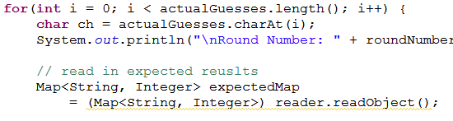
ObjectInputStream
When ready to run tests
Make the guesses

Slide 46
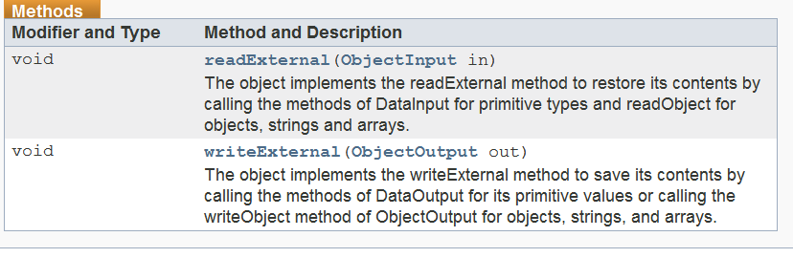
Externalizable
A sub-interface of Serializable
Gives more control over the format of the serialization to the class itself
Two methods:

Slide 47
Externalizable
ObjectOutputStream will test if object is Serializable
if not, throws an exception
Then tests if Externalizable
if so calls the writeExtenal method on the object
if not, uses default specification for serialization

Slide 48
parcel and Parcelable

Slide 49
Bundles Again
What can you add to Bundles?
Recall Bundles sent to onCreate when restoring an Activity
Bundles attached to Intents
put
Bundle, byte, char, CharSequence (includes String), float, Parcelable, Serializable, short, Size (width and height)
arrays and ArrayLists of some of those types

Slide 50
Parcelable?
Parcel:
Android class for sending data via IPC
Inter Process Communication
Send an object (data) from one process to another
Generally faster (at run time) than Serializable
long term storage vs. short term storage

Slide 51
Parcelable
interface
have class implement interface
implement writeToParcel method
not just a Tag interface
writes current state of object to Parcel
void writeToParcel (Parcel dest, int flags)
add a static field named CREATOR to class
object that implements Parcelable.Creator interface

Slide 52
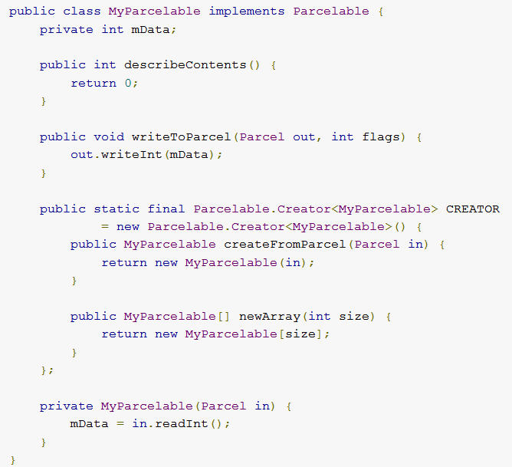
Typical Implementation

Slide 53
other storage options

Slide 54
SQLite Database
Structured data stored in a private database
More on this next lecture

Slide 55
Network Connection
Store data on web with your own network server
Use wireless or carrier network to store and retrieve data on web based server
classes from java.net and android.net

