Slide 1
CS371m - Mobile Computing
Services and Broadcast Receivers

Slide 2
Services
One of the four primary application components:
activities
content providers
services
broadcast receivers

Slide 3
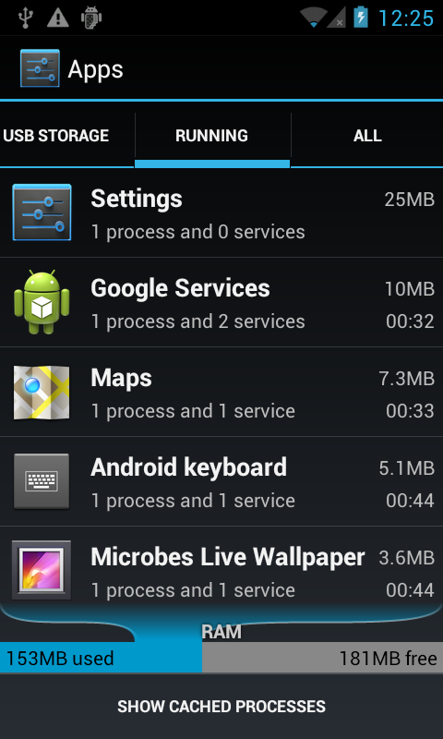
Services - Purpose
Application component that performs long-running operations in background with no UI
application starts service and service continues to run even if original application ended or user moves to another application
a way to run code when one of app's activity is not the forefront activity

Slide 4
Service - Examples
Download app from store
leave store app, but download continues
any kind of download of upload via network
Play music even when music player dismissed (if user desires)
maintain connection in chat app when phone call received
periodically poll website for updates / changes
the grade checker
may lead to notification

Slide 5
Service Basics
No User Interface Components
Belong to an app
must be declared in the app manifest
May run even if app is not at forefront, interacting with the user
May be private (usable only by the app they belong to) or public (usable by apps other than yours)

Slide 6
Starting Services
Two ways to start services:
Manually by an app using a call to the API - recall the startActivity method for Activities
Another activity tries to connect (bind) to a service via inter process communication - may be an app other than yours if your make your service public

Slide 7
Stopping Services
Services will run until shut down:
by themselves when task completed or possibly by owning app stopSelf
By the owning app via a call to stopService
If Android needs the RAM the service is using - just like it does for activities deep in the activity stack

Slide 8
Types Services - Started or Bound
Started:
application component, such as an Activity, starts the service with the method call startService()
once started service can run in background indefinitely
generally services do not return a result (see bound service)
service should stop itself when done
Most services in our projects are started

Slide 9
Forms of Services - Started or Bound
Bound
application component binds itself to existing service via the bindService() method
bound service provides client-server interface that allows application component to interact with service
interact with service, send requests, get result via IPC (inter process communication)
service runs as long as one or more applications bound to it
destroyed when no applications bound

Slide 10
Forms of Services
Service can be started and later bound to other applications
so, both started and bound
private service (manifest) cannot be bound by other applications

Slide 11
Communicating with Services
Two ways:
Commands
no lasting connection to service
example: start service, end service
Binding
creates communication channel between the service and other component
other component typically an activity or perhaps another service

Slide 12
Service or Thread
Past examples, kept UI thread responsive with other threads of execution, especially AsyncTask
Should services be used for this?
Service for actions that need to take place even if user not interacting with UI or has closed application
Example, do complex rendering of image to display to user.
Not a job for a service

Slide 13
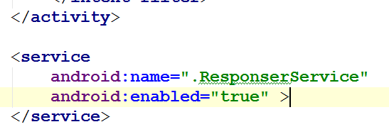
Service Setup
Must declare Services in manifest
just like activities
otherwise when Service started, app will crash
No intent filter for Service
makes it private.

Slide 14
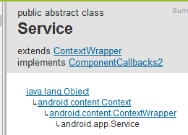
Creating a Service Class
create subclass of Android Service class or one of its existing subclasses
commonly IntentService
override callback methods that handle important aspects of service lifecycle
most important of these are:
onStartCommand
startService
onBind
onCreate
onDestroy
stopSelf
stopService

Slide 15
Service Lifecycle
If component starts service with startService method (leads to call to onStartCommand) service runs until it calls stopSelf or another activity calls stopService
if component calls bindService (onStartCommand not called) service runs as long as at least one component bound to it

Slide 16
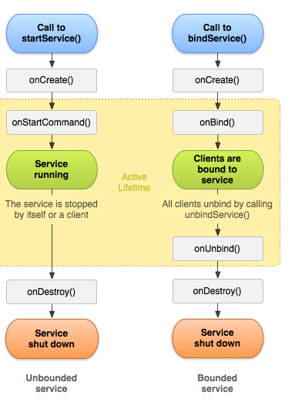
Service Lifecycle

Slide 17
Service Responsiveness
Services run on the main thread of hosting process
By default a Service does not create a separate thread of execution
If plan to do intensive CPU ops or blocking ops within Service, must still create a separate thread of execution to avoid ANRs
IntentService (subclass of Service) uses a worker thread to handle start requests

Slide 18
app example that uses a service

Slide 19

Service App Example
From Roger Wallace
Spring 2011
wanted an app that would respond to texts (SMS) received when driving and respond with a message ("Driving - Get back to you soon.")
Initial version simply auto responds to all texts
how to change it so it responds only when driving?

Slide 20
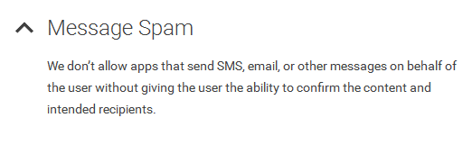

Interesting Sidetrack - Disallowed?
Google Play Developer Policy

Slide 21
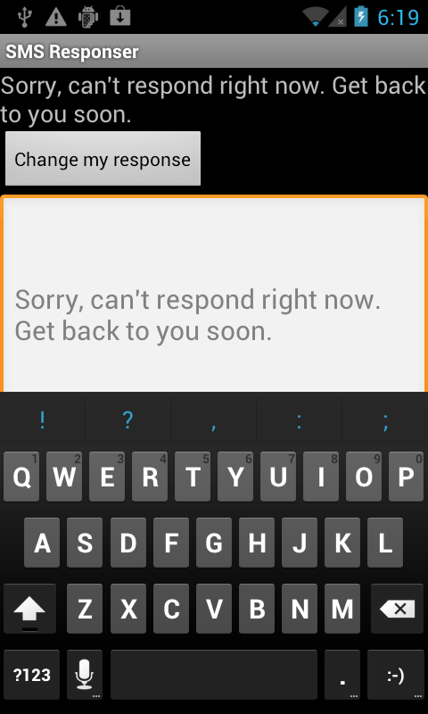
Example Service Application
From The Android Developer's Cookbook
SMSResponder Application
Response stored in shared preferences
App allows changes to message, start and stop service

Slide 22

Using SMS
Permission in manifest file to send and / or receive SMS messages

Slide 23
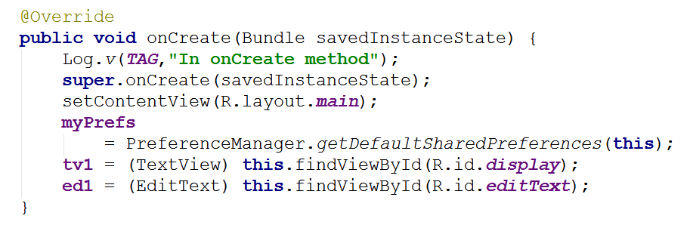
SMSResponder Basic App
onCreate
set up layout

Slide 24
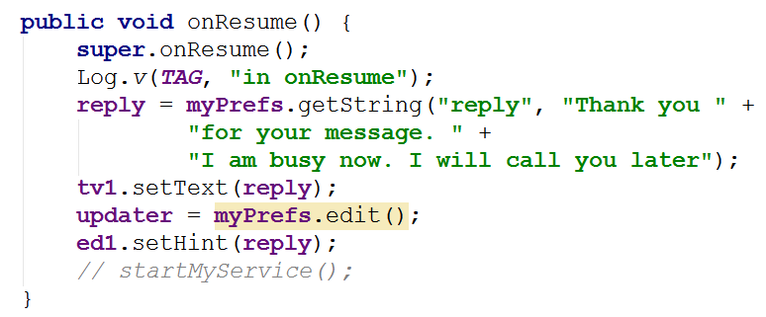
SMSResponder onResume

Slide 25
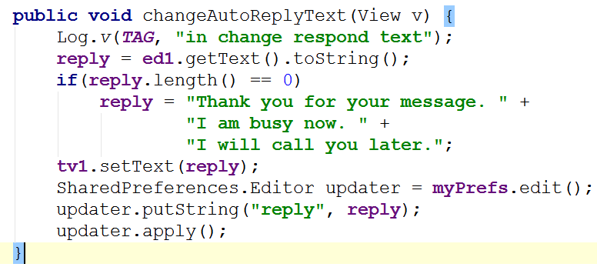
Change Auto Response Message

Slide 26
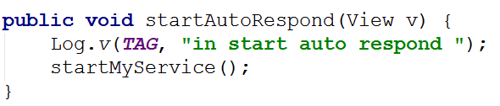
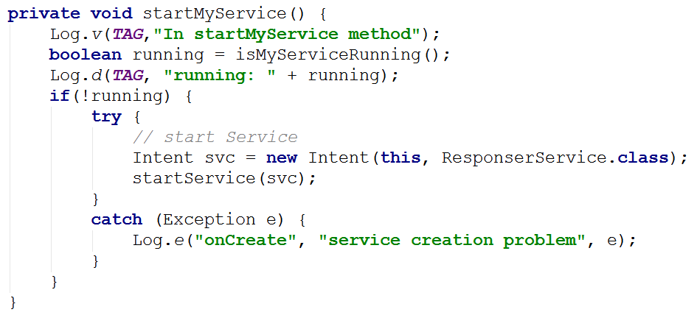
Starting Service

Slide 27
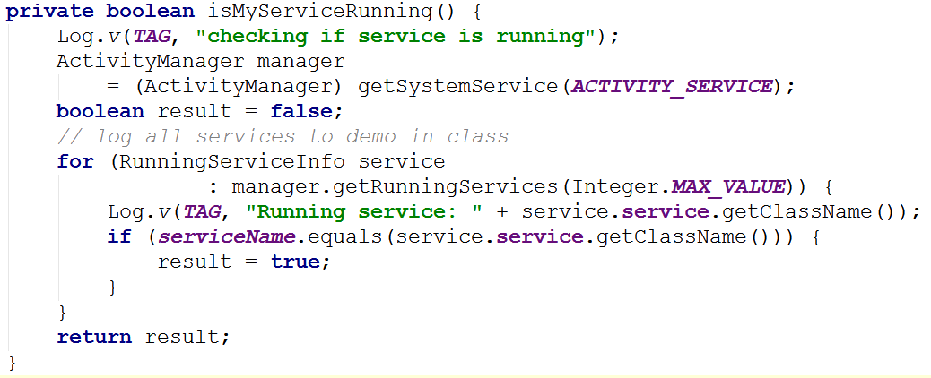
Check if Service Already Running
Alternative: Use public, static variable or method in Service class to indicate if running or not.

Slide 28
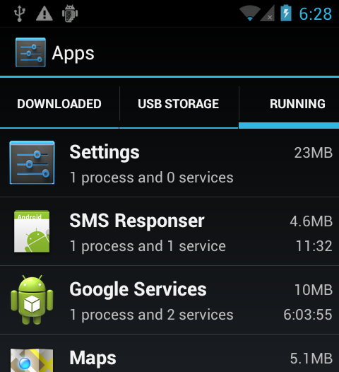
Service Running
Service is running

Slide 29
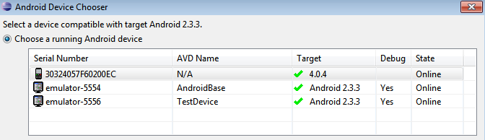
Simulating Texts
Calls and texts can be simulated between emulators
Start two emulators
Use messaging app to send text
Phone number is simply the emulator port number (visible at top of the emulator or in eclipse)

Slide 30
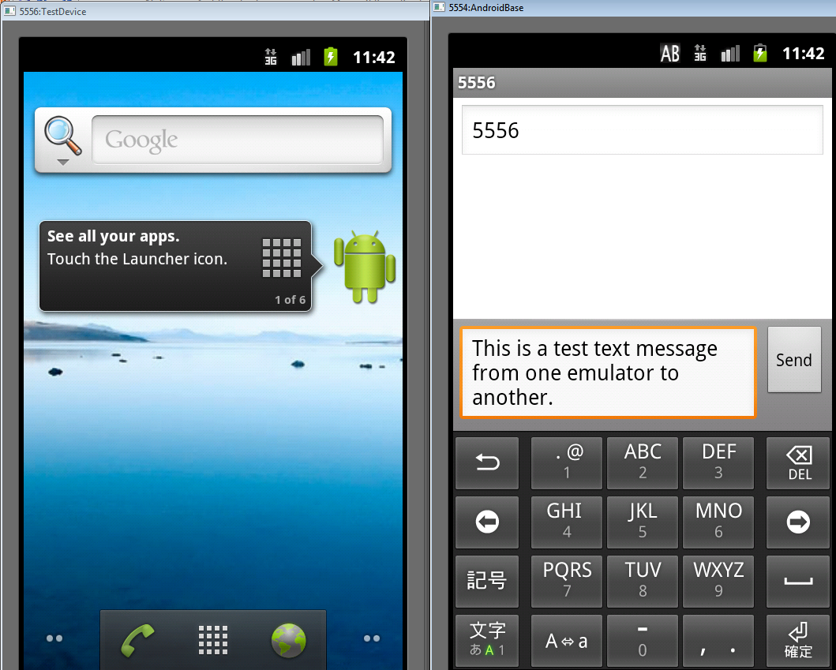
Dual Emulators

Slide 31
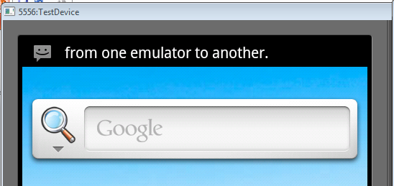
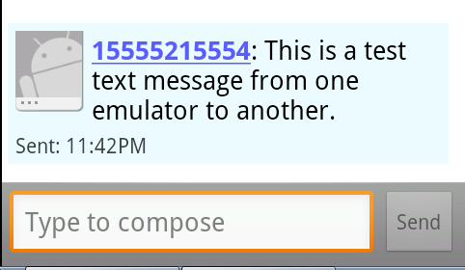
Emulator Texts

Slide 32
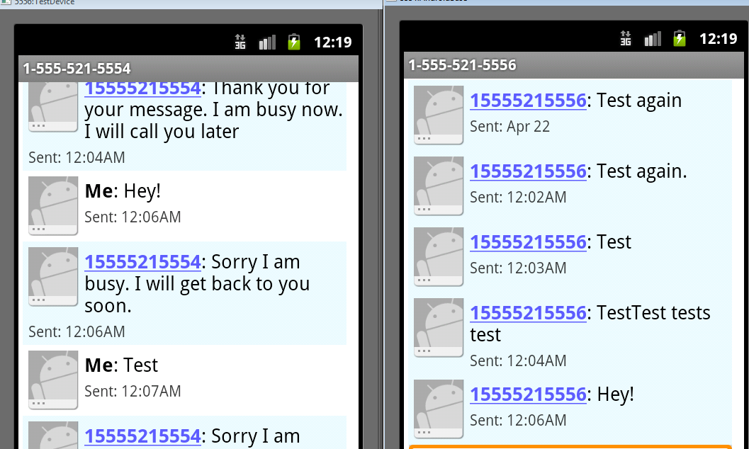
Testing Service

Slide 33
Creating a Service
Extend the Service class
adapter class exists, IntentService handles a lot of the details
override onStartCommand
return an int describing what system should do for starting service
START_NOT_STICKY, if system kills service don't restart
START_STICKY, if system kills service then recreate, but does not redeliver intent
START_REDELIVER_INTENT, if system kills service then recreate and redeliver last intent

Slide 34
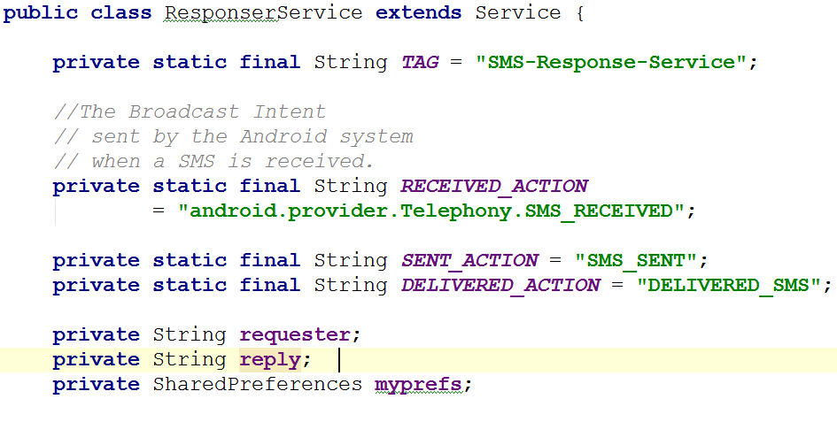
SMSResponser

Slide 35
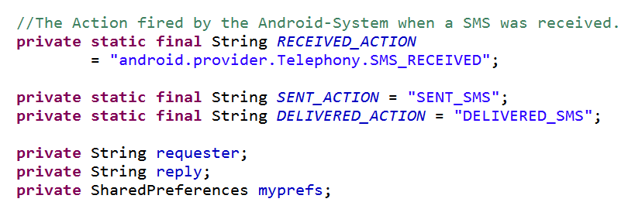
SMS Responder

Slide 36
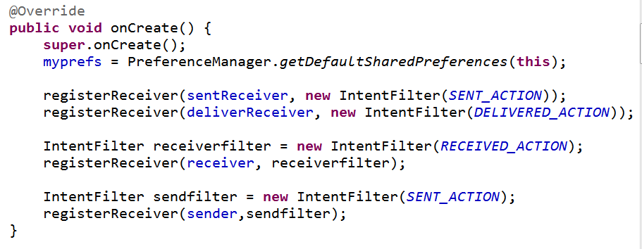
SMS Responder - onCreate

Slide 37
Broadcast receivers

Slide 38
Broadcast Receivers
The third of four application components
activities, services, broadcast receivers, content providers / receivers
"A broadcast receiver is a component that responds to system-wide broadcast announcements."
Android system sends multiple kinds of broadcasts
screen turned off, battery low, picture captured, SMS received, SMS sent, and more

Slide 39
Broadcasts
Another use of intents
Intents used to start activities and services
startActivity()
startActivityForResult()
startService()
bindService()
Also used to deliver information from system and applications to other applications
via Broadcast Intents

Slide 40
BroadcastReceivers
What broadcasts are available?
Check the Intent class
http://developer.android.com/reference/android/content/Intent.html
search for "Broadcast Action"
Also look in android-sdk\platforms\<number>\data\ broadcast_actions.txt

Slide 41
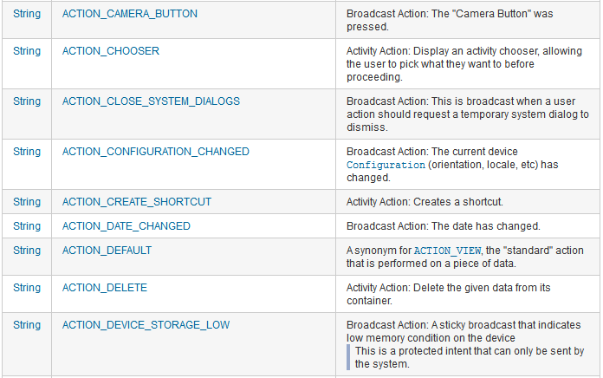
Broadcasts Listed in Intent class

Slide 42
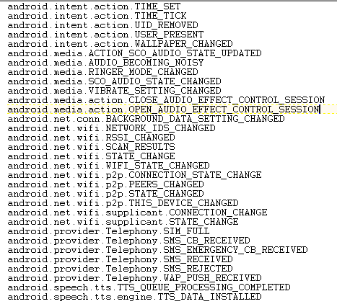
Broadcasts
from broadcast_ actions.txt in sdk files
platforms-> <api level>-> data\

Slide 43
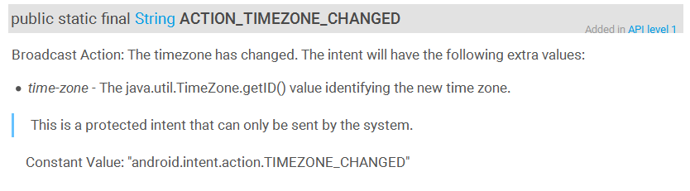
Broadcast Intents
You can create your own Broadcasts Intents
Many Intents listed in the Intent class are protected intents that may only be send by the system

Slide 44
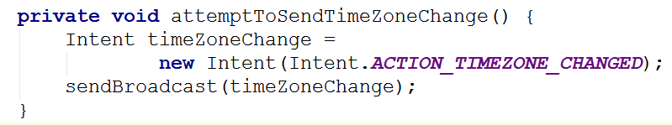
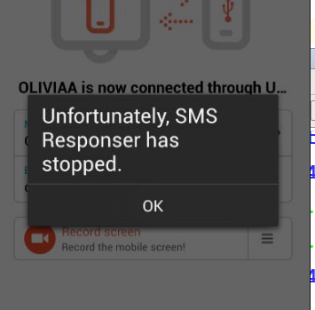
Protected Broadcasts
Try it anyway??
03-23 13:16:50.222 388-397/? W/ActivityManager: Permission Denial: not allowed to send broadcast android.intent.action.TIMEZONE_CHANGED from pid=3470, uid=10140

Slide 45
Receiving Broadcasts
Activities and Services can listen for Broadcasts
4 steps
subclass BroadcastRecevier ( implement onReceive method)
create IntentFilter object to specify the kinds of Broadcasts you want
register receiver (onResume() of Activity)
unregister receiver (onPause() of Activity)
-- alternatively use manifest to register receiver

Slide 46
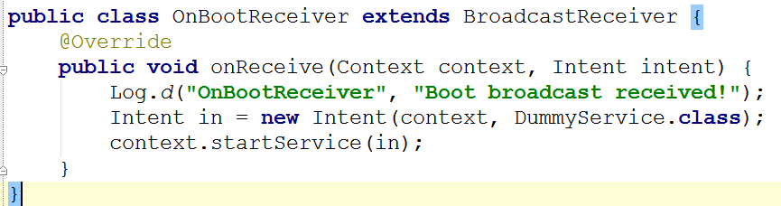
Example: Step 1
Start a service and print a toast at start up.
Step one: subclass BroadcastReceiver

Slide 47
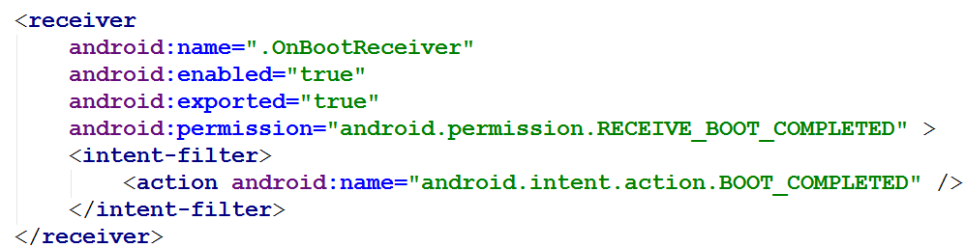
Example: Step 2
Step 2: Create intent filter to listen for broadcast
In manifest

Slide 48
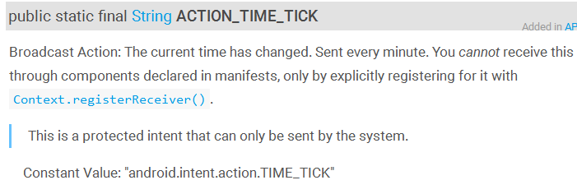
Step 2 - More on Intent Filters
For some Broadcasts you cannot use manifest to create IntentFilter
must be done programmatically

Slide 49
Example: Step 3
register receiver
normally done in onResume of activity
but no Activity on start up
so, BroadcastReceiver in manifest file
registers with System when app installed
app must be started once for this to work

Slide 50
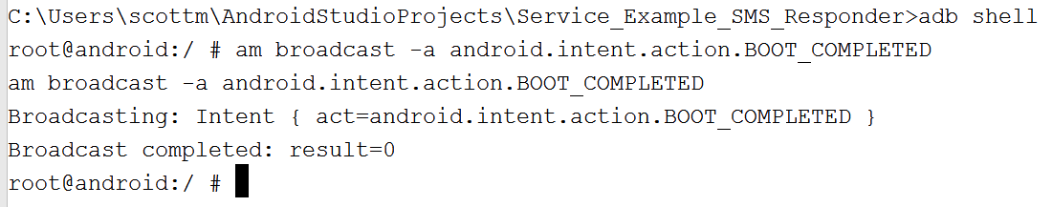
Spoofing Startup
Painful to shut down and start up device
Possible to spoof broadcasts
recommend using emulator
go to terminal
adb shell

Slide 51
Broadcast Receivers in Auto texting app

Slide 52
In SMS Responder
Service has inner classes for BroadcastReceiver that listens for Broadcast of SMS message received
create and register receivers when service stated
unregister when service destroyed
key point: override the onReceive method for BroadcastReceiver subclass

Slide 53
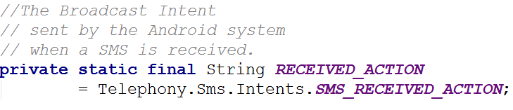
SMS Received Broadcast
from
developer.android.com/reference/android/provider/Telephony.Sms.Intents.html

Slide 54
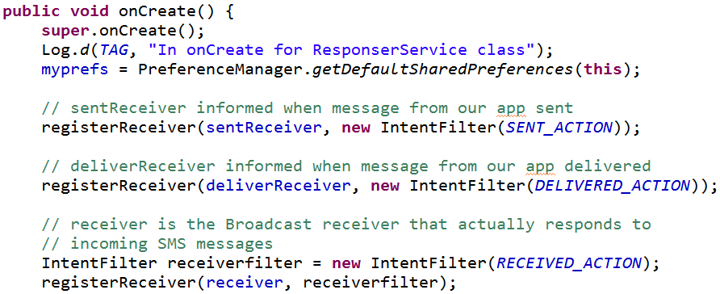
SMS Responder Service
Create and register receivers

Slide 55
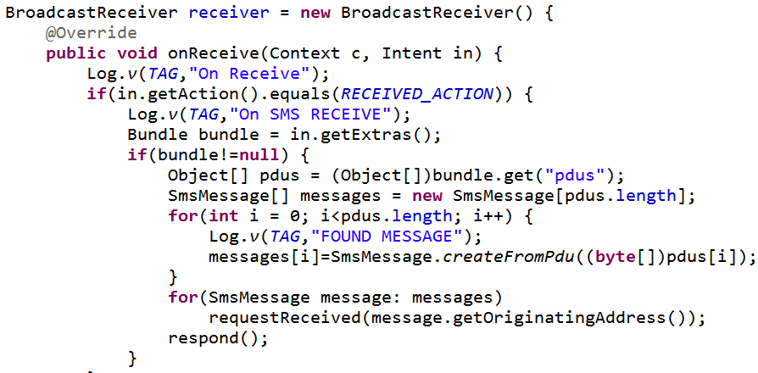
SMS Received - Broadcast Receiver

Slide 56
SMS Data
The SMS data in the Bundle (map) is under the key "pdus"
pdu, protocol data unit (some sources indicate protocol description unit)

Slide 57
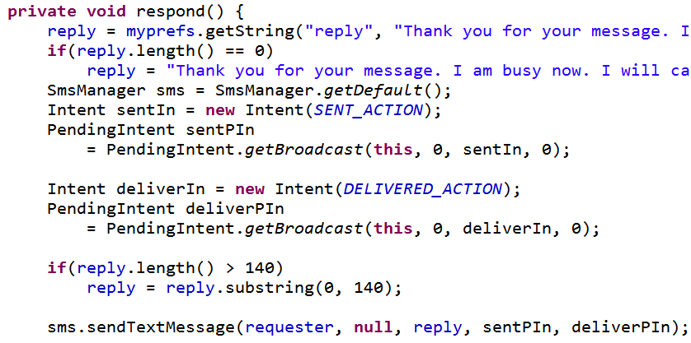
respond method

Slide 58
PendingIntent
Intent to deliver when some criteria met
Parameters:
this = context in which PendingIntent should sendBroadcast
0 = private request code for sender
sentIn = Intent to be Broadcast
0 = flags to modify send behavior

Slide 59
SMSManager.sendTextMessage
address to send text to (destination, recipient)
service center address (null = default)
text of message
pending intent to deliver when message sent
pending intent to deliver when message delivered

Slide 60
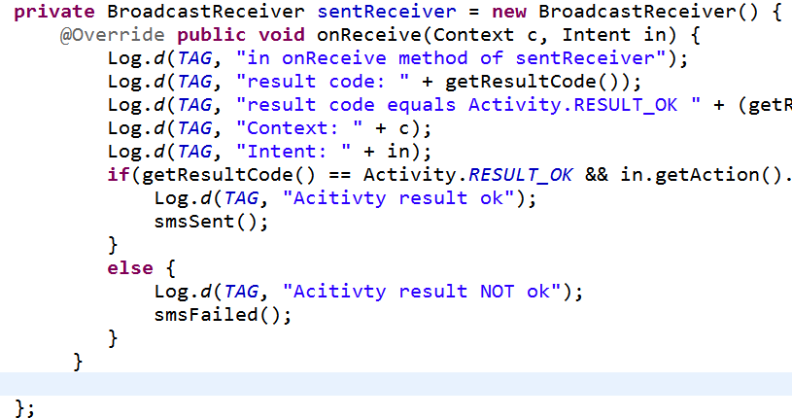
BroadcastReceiver for Sent

Slide 61
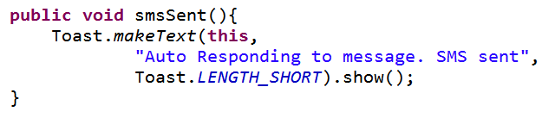
SMS Sent
Notify User with a Toast
Probably better to use Notification
Toast used so we see app in action during demonstration

Slide 62
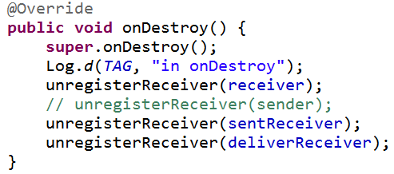
Unregistering Receivers
When no longer need unregister your receivers
In this case when the service is shut down

Slide 63
initiating broadcasts ourselves

Slide 64
Broadcast Receivers
Applications can initiate broadcasts to inform other applications of status or readiness
Don't display UI
may create status bar notifications
Usually just a gateway to other components and does very minimal work
initiate service based on some event
Broadcasts are delivered as Intents

Slide 65
Broadcast Receivers
intents sent by sendBroadcast() method
LocalBroadcastManager to send Broadcasts within your application only

Slide 66
More on Broadcast Receivers
can't initiate asynchronous actions in onReceive
like creating and starting an AsyncTask
because when method done BroadcastReceiver no longer active and system can and will kill the process
May need to use Notification Manager or start a service

Slide 67
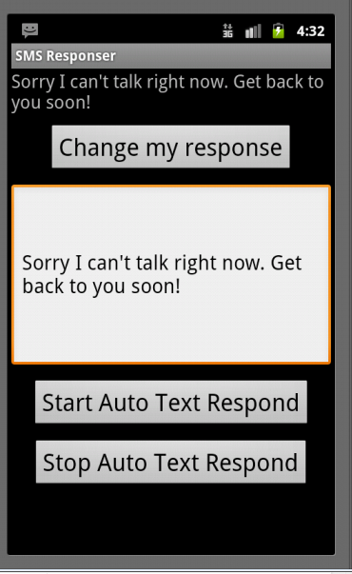
Stopping Service
Once started service runs until device shut down
Add option to start and shut down the service
Could add capability to start service on device start up

