Slide 1
CS371m - Mobile Computing
More UI
Navigation, Fragments, and Action Bars

Slide 2
Effective Android navigation

Slide 3

Back and Up
Android design and developer documentation stresses the desire for consistent global navigation in and between apps
Android 2.3 and earlier relied on the Back button for navigation within app

Slide 4

Action Bar Navigation
With addition of the action bar another navigation option was added
Up
App icon and left pointing caret

Slide 5
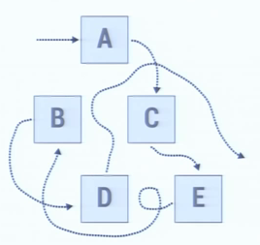
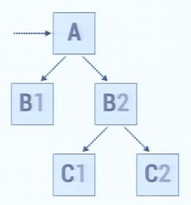
Activity Hierarchy Within Apps
from Google IO 2012
The bag of Activities
Activities with defined parents

Slide 6
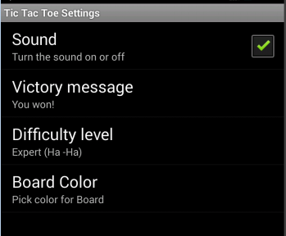
Up vs. Back
Up is used to navigate between screens / activities within an app
Up is to move through the hierarchy of screens within an app
Example: Tic Tac Toe
Settings Activity
should offer icon and Up option on action bar to get back to main Tic Tac Toe screen

Slide 7
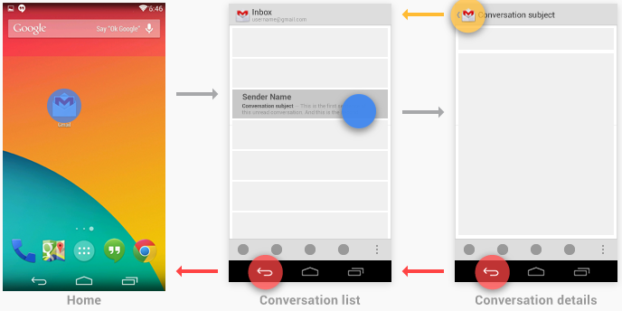
Up vs. Back
http://developer.android.com/design/patterns/navigation.html

Slide 8
Back Button Actions
Back still used to move through apps and activities in reverse time order
Back button also:
dismisses floating windows such as dialogs or popups
dismisses contextual action bars
hides the onscreen keyboard

Slide 9
Back vs. Up
Many times Up functions exactly like Back
as shown in Gmail example on previous slide
If a screen / activity accessible from multiple other screens in app
Up takes user from screen / activity to previous screen / activity
same as back

Slide 10
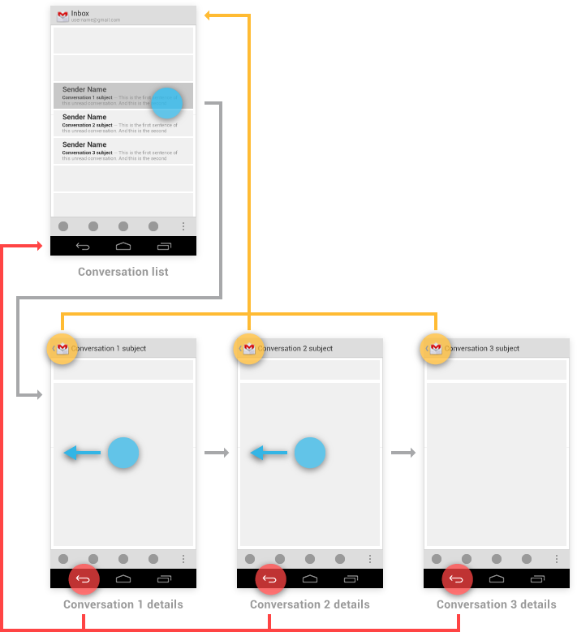
Back and Up Equivalent in Many Cases
Example: swiping between items in a list.
http://developer.android.com/design/patterns/navigation.html

Slide 11
Back vs. Up
Sometimes back and up lead to different behavior
Browsing related detailed views not tied together by list view - up hierarchy
Google Play - albums by same artist or apps by the same developer

Slide 12
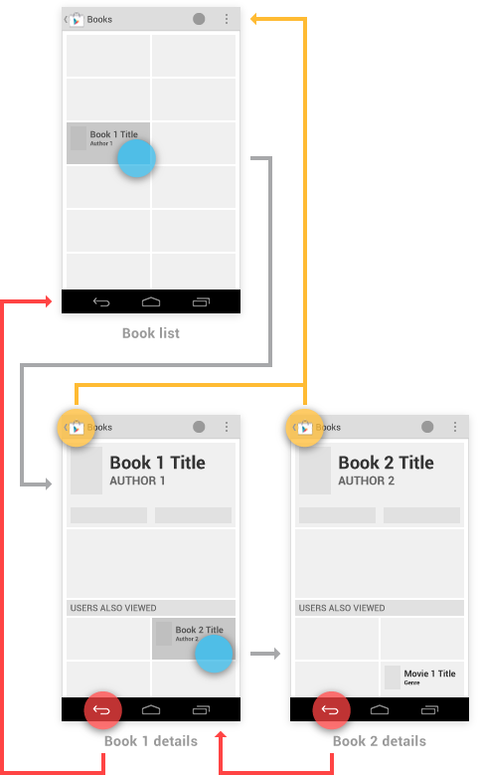
Back vs. Up

Slide 13
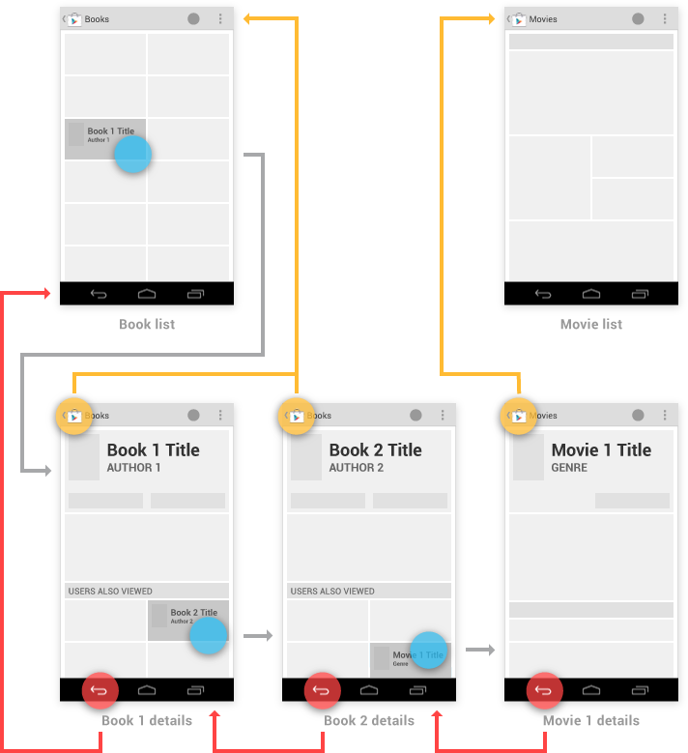
movies
books

Slide 14
Back vs. Up
Starting at screen / activity deep inside of an app
Another instance where Back and Up are not the same
Widgets on home screen, notifications, or pop up notifications may take user deep into application
In this case Up should take user to the logical parent of the screen / view / UI

Slide 15
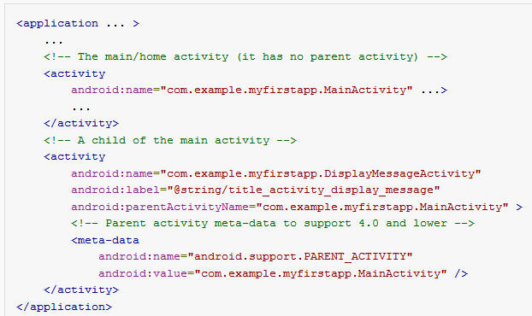
Specifying Up Button Behavior
Done in the manifest file for Android 4.0 and higher

Slide 16
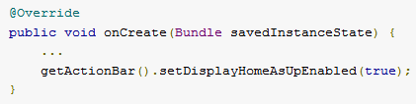
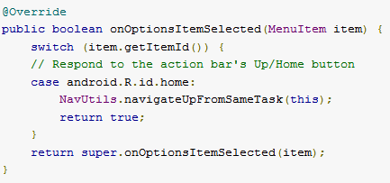
Specifying Up Button Behavior
Adding Up Action, in onCreate of Activity
When icon pressed onOptionsItemSelected called

Slide 17
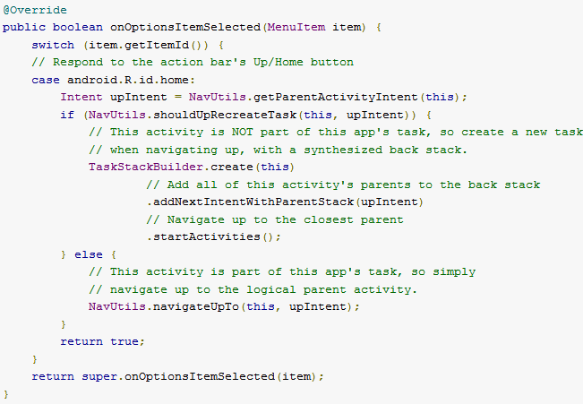
Specifying Up Behavior - Other App Started

Slide 18
fragments

Slide 19
Fragments
Added in Android 3.0 / API level 11, a release aimed at tablets
A fragment is a portion of the UI in an Activity
multiple fragments can be combined into multi-paned UI
fragments can be used in multiple activities
an attempt to create re-usable UI components

Slide 20
Fragments
Part of an activity
directly affected by Activity's lifecycle
Fragments can be swapped into and out of activities without stopping the activity
On a handset one with limited screen space, common for app to switch from one activity to another
with a larger screen swap fragments in and out, don't start new Activity

Slide 21
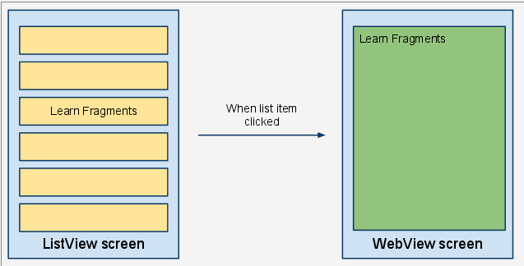
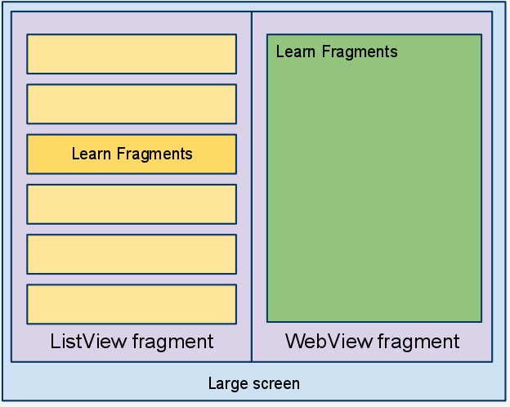
Fragments
old
new

Slide 22
Use of Fragments
For a time Android development documents recommended ALWAYS using Fragments
Now (2016) not as much
Provide for flexibility of UIs
Activity tightly coupled with its View
Fragments provide flexibility, looser coupling between Activity and UI Views
fragment becomes a building block
downside, more complexity in code, more moving parts

Slide 23
Fragments
Fragments can typically control a UI
fragment has view that is inflated from a layout file
inflate: create runtime objects for values specified in xml layout file
elements of layout measured and drawn
Activity can specify spots for fragments
in some instances one fragment
in other instance multiple fragments
can change on the fly

Slide 24
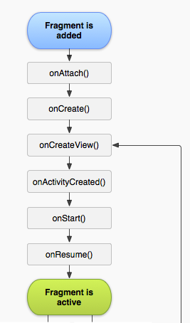
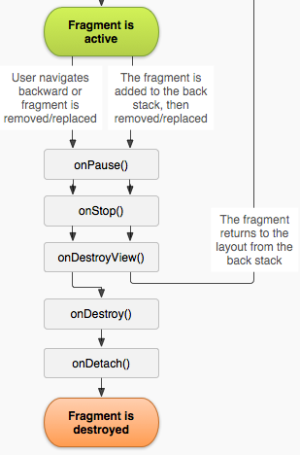
Fragments
Have a life cycle similar to Activities
But, Fragment lifecycle controlled by Activity not by the system
more complex, but more flexible

Slide 25
Fragment Example
From the apiDemos app on the emulator
part of the sample code with Android SDK
Displays Shakespeare play titles in a List
Clicking on a title displays a sample from the play
com.example.android.apis.app
FragmentLayout.java

Slide 26
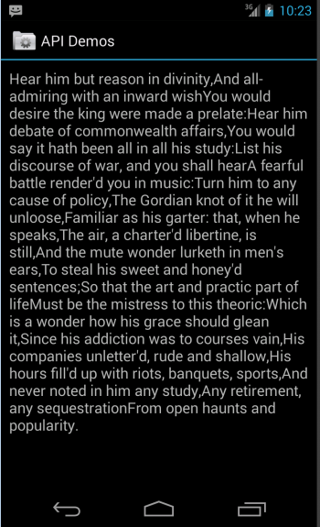
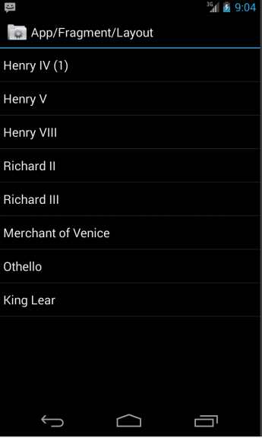
Fragment Example

Slide 27
Portrait
In portrait view app behaves as you would expect
the play titles are in a list
old approach, would be a ListView inside of an Activity
clicking a list items creates an Intent that starts another Activity with a TextView inside of a ScrollView
Click back button to go back to list

Slide 28
Landscape
When switched to landscape designer decided there is enough real estate to display list and summary side by side
imagine an app that looks one way on phone another way on a tablet

Slide 29
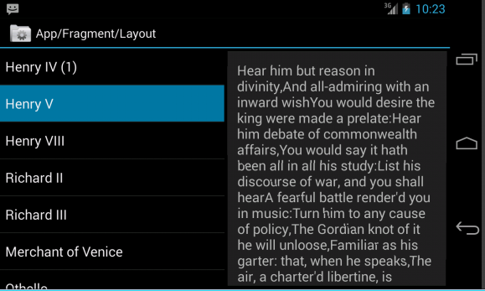
Landscape
FragmentLayout Activity
TITLES FRAGMENT
DETAILS FRAGMENT

Slide 30
TitlesFragment
extends the ListFragment class
other useful subclasses of Fragment
DialogFragment
PreferenceFragment
WebViewFragment
Displays a list of Shakespeare play titles

Slide 31
Summary - Detail Fragment
Displays some prose from the play
A subclass of Fragment
Sometimes displayed in the FragmentLayout Activity
landscape
Sometimes displayed in a DetailsActivity Activity
portrait

Slide 32
General approach for creating a Fragment:
Create user interface by defining widgets in a layout file
create Fragment class and set view to be defined layout
in the onCreateView method
wire up widgets in the fragment when inflated from layout code
From Android Programming - The Big Nerd Ranch Guide

Slide 33
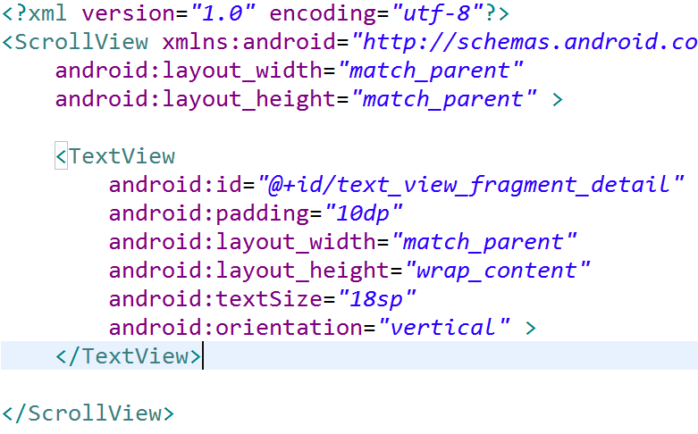
Detail Fragment Layout File

Slide 34
DetailsFragment
If necessary override onCreate(Bundle)
DO NOT inflate the View in onCreate
just complete any items for Fragment to get ready other than the View
internal logic / object data for example

Slide 35
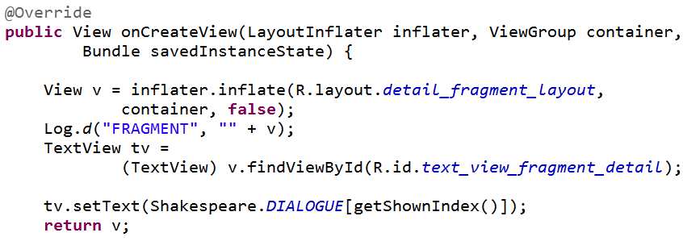
DetailFragment
onCreateView method used to inflate View
generally must override this method

Slide 36

getShownIndex
In the DetailsFragment
returns int corresponding to which play is currently displayed
used in DetailsFragment onCreateView to find proper text and in TitlesFragment to decide if new Fragment needed

Slide 37
getArguments
Fragments can have a Bundle object attached to them
referred to as arguments
Create Bundle and attach after fragment created, but before fragment added to Activity
convention: create static method newInstance that creates Fragment and bundles up arguments

Slide 38
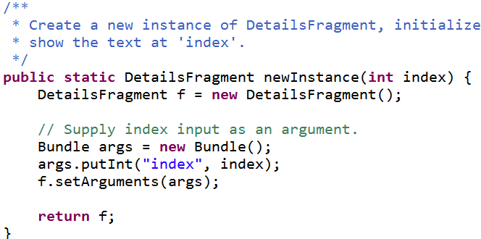
getArguments
index from Activity creating Fragment

Slide 39
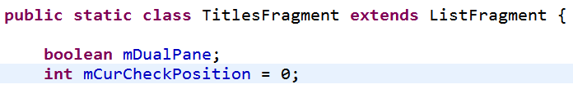
List of Titles
Uses a ListFragment
analogous to a ListActivity
Top level fragment in example

Slide 40
ListFragment
No layout necessary as ListFragments have a default layout with a single ListView
Set up done for this Fragment done in onActivityCreated

Slide 41
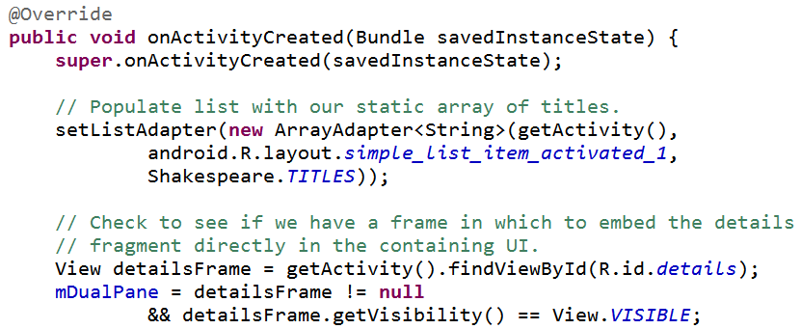
TitlesFragment onActivityCreated
Called when the Activity that holds this
Fragment has completed its onCreate method

Slide 42
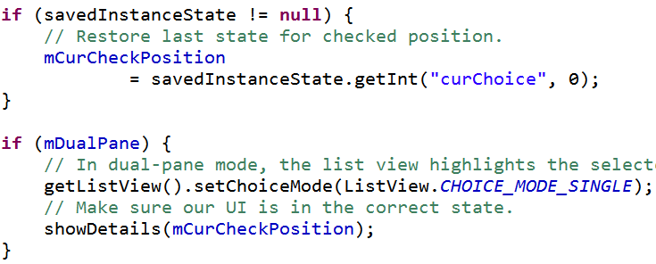
TitlesFragment onActivityCreated

Slide 43
showDetails
used to show portion of play selected from the list fragment
in portrait mode, starts a new Activity
DetailsActivity that hosts a DetailsFragment
similar to what we have seen before, one Activity, starting another Activity with an Intent
in landscape mode (mDualPane) if the DetailsFragment does not exist or is a different play, a new DetailsFragments is created

Slide 44
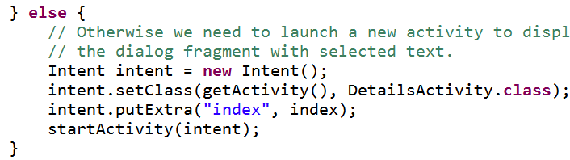
TitlesFragment ShowDetails
Portrait mode - !mDualPane
traditional start another Activity via an Intent

Slide 45
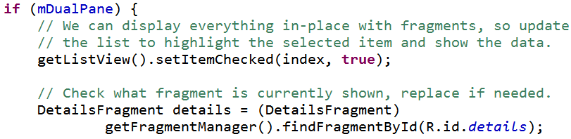
TitlesFragment ShowDetails
DetailsFragment placed side by side with titles

Slide 46
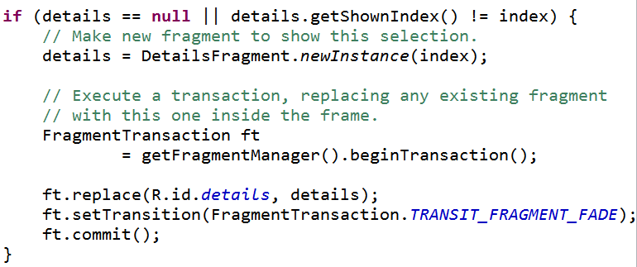
TitlesFragment ShowDetails
rest of dual pane logic

Slide 47
Using the Fragments
Activities add Fragments in two ways:
As part of the layout file (hard coded, less flexible)
Programmatically (in the code, more flexible)

Slide 48
Shakespeare Example
Titles Fragment in the layout file, hard coded
One layout file for portrait, single fragment
In landscape layout file:
the other fragment, the details fragment, is added programmatically

Slide 49
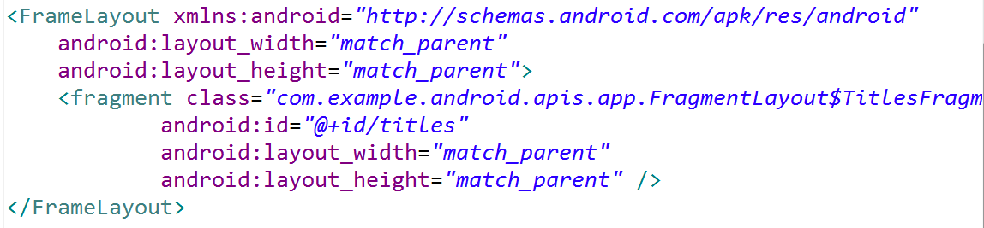
Shakespeare Portrait Layout
Name of Fragment class:
FragementLayout$TitlesFragment
an inner class

Slide 50
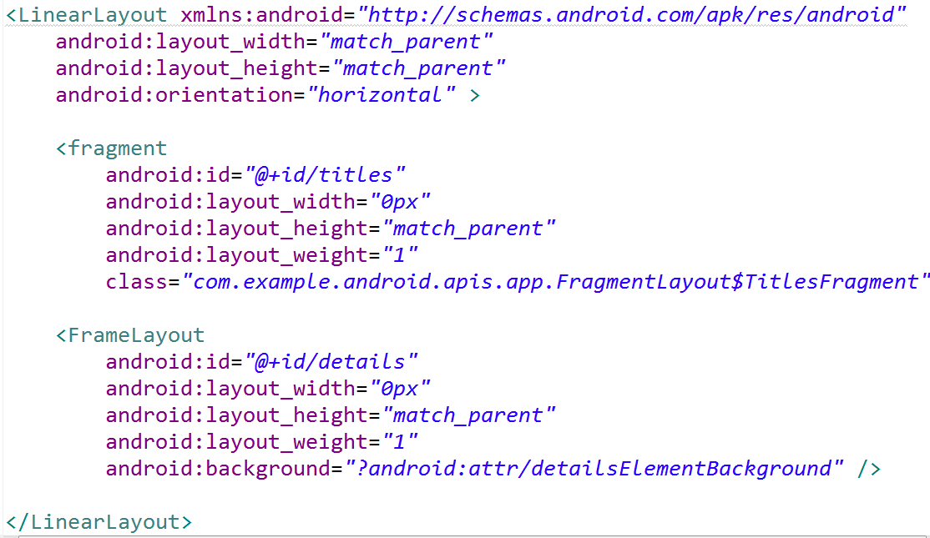
Shakespeare Landscape Layout
FrameLayout to hold details fragment

Slide 51
Adding Fragment Programmatically
Back to TitleFragment showDetails method

Slide 52
Adding Fragment Programmatically

Slide 53
Adding a Fragment
To add fragment to an Activity during runtime:
must specify a ViewGroup in the Activity's layout to place the fragment
In Shakespeare Activity it is the FrameLayout, second element in LinearLayout in the portrait layout file

Slide 54

Adding a Fragment
To actually add the Fragment must get the FragmentManager for the Activity
and perform a FragmentTransaction
Activity.getFragmentManager() and Fragment.getFragmentManager()

Slide 55
FragmentManager
In example:
A little odd that it is the TitleFragment, not the Activity managing the DetailsFragment
Fragment manager used to determine if fragment already exists
uses id for layout
for Fragments without a layout findFragmentByTag method

Slide 56
FragmentManager
maintains a Back Stack of fragment transactions
analogous to the Activity Stack
allows Activity to go back through changes to fragments, like back button and activities themselves
methods to get Fragments, work with back stack, register listeners for changes to back stack

Slide 57
FragmentTransaction
Make changes to fragments via FragmentTransactions
obtained via FragmentManager
used to add, replace, remove Fragments

Slide 58
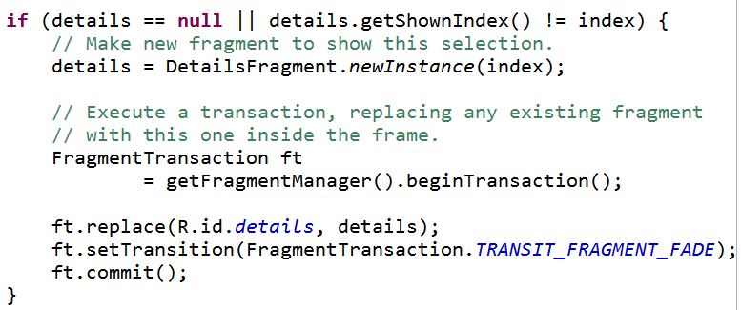
no details fragment or wrong one

Slide 59
Inter Fragment Communication
In an Activity with multiple Fragments, the Fragments sometimes have to send information back and forth
Fragment to Fragment communication is frowned upon
Instead use the Activity that holds the Fragments to pass messages around
Create your own interface with call back methods
fragment defines the interface
Activity implements the interface

Slide 60
action bar

Slide 61
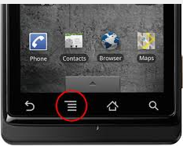
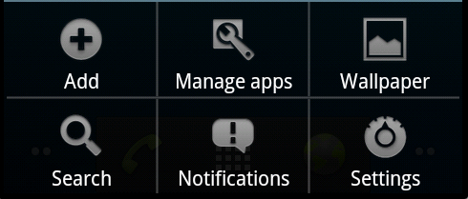
Options Menu and Action Bar
prior to Android 3.0 / API level 11 Android devices required a dedicated menu button
Pressing the menu button brought up the options menu
menu

Slide 62
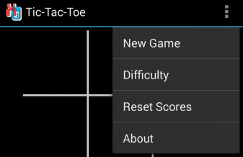
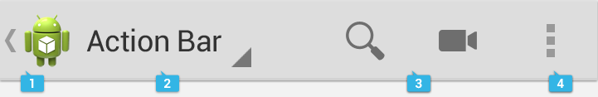
action bar
menu button no longer required
shift options menu to action bar
action bar is a combination of on-screen action items and overflow options
Action items overflow options overflow menu
action bar

Slide 63

Action Bar
identify app and users location in app
display important actions
old options menu
support consistent navigation and view switching within the app
Navigation Tabs
Overflow Menu
Action Item
Icon / Logo

Slide 64
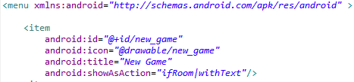
Action Bar
ActionBar items declared in menu.xml

Slide 65
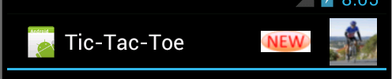
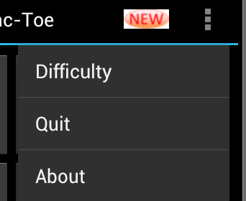

Action Bar
If menu items declared in xml, added to menu in order they appear
Extra items brought up with overflow button

Slide 66
Action Bar
When activity starts
Action Bar populated by a call to Activity's onCreateOptionsMenu method
This method inflates (converts XML into runtime objects) the menu resource that defines all the action items

Slide 67
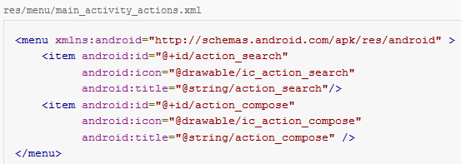
Action Bar Items in XML

Slide 68
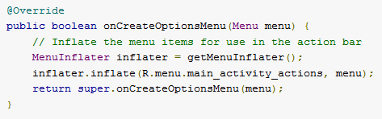
sample onCreateOptionsMenu()
Request item be shown on Action Bar
(instead of overflow menu) with ifRoom attribute

Slide 69
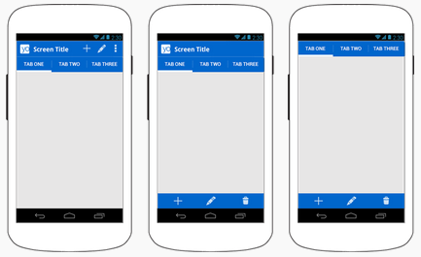
Split Action Bar
Split Action Bar between top and bottom of screen
especially if narrow screen
more room for action items
declartion in manifest file

Slide 70
Navigation Tabs
Used to switch between fragments
http://developer.android.com/guide/topics/fundamentals/fragments.html

Slide 71
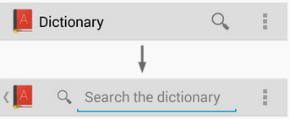
Action Views
Action views appear in the action bar in place of action buttons
Accomplish some common action
Such as searching

Slide 72
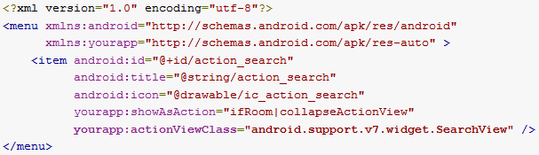
Enabling ActionViews
use either the actionLayout or actionViewClass attribute
specify either a layout resource or widget class to use, respectively

Slide 73
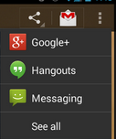
ActionProviders
Similar to ActionView in that it replaces an action button with a customized layout
but can also display a submenu
create your own subclass of ActionProvider
or use a prebuilt ActionProvider such as ShareActionProvider (shown above) or MediaRouteActionProvider

Slide 74
More action bar navigation

Slide 75
Action Bar Navigation
Action Bar can also be used for in app navigation beyond the Up button
Two Options:
Navigation Tabs
Drop Down Navigation

Slide 76

Action Bar Navigation Tabs
wide screen action bar
narrow screen stacked action bar

Slide 77
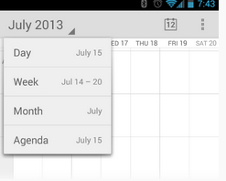
Action Bar Drop Down Navigation
Alternative to tabbed navigation in action bar
Create a spinner drop down list that is accessed with "down triangle"

Slide 78

Action Bar on pre Android 3.0
pre 3.0 a little more than 25% of Android OS versions as of November 2013
Support library includes provides code and classes to allow some newer features of Android to be used on older versions
Example: ActionBar
3rd Party tool - ActionBarSherlock
deal with Action Bar via single API
http://actionbarsherlock.com/

Slide 79
other menus

Slide 80
Menus
Three types of menus:
options menu or action bar
context menu and contextual action mode
popup menu

Slide 81
ContextMenu
pre 3.0, aka Floating Menus
subtype of Menu
display when a long press is performed on a View
Activity is a descendant of View
Activity may be broken up into multiple views
implement onCreateContextMenu method
must call registerForContextMenu method and pass View

Slide 82
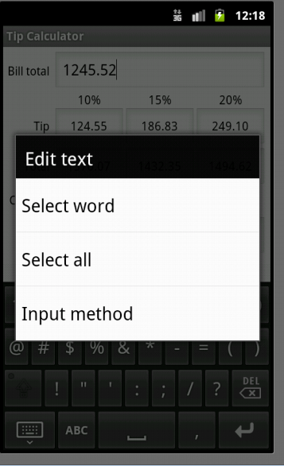
ContextMenu
From Tip Calculator
Long press on total amount EditText
Default behavior for EditText
Nothing added in TipCalculator to create this

Slide 83
Contextual Action Mode
Android 3.0 and later
Menu that affects a specific item in the UI
typically a View
used most often for elements in ListView or GridView

Slide 84
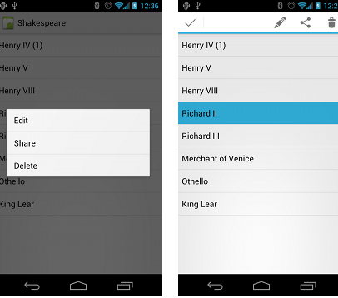
floating context menu
http://developer.android.com/guide/topics/ui/menus.html#CAB

Slide 85
floating context menu
register View with Activity.registerForContextMenu()
can send ListView or GridView to method to register all elements
Implement View.OnCreateContextMenuListener
long click leads to method call
inflate menu (like action items/ options menu)
Implement Activity.onContextItemSelected

Slide 86
contextual action mode
alternative to floating context menu
causes contextual action bar to appear at top of screen
independent of regular action bar but, does overtake position of action bar
For Android 3.0 and higher preferred to floating context menus
Implement ActionMode.Callback interface
similar to options menu methods

Slide 87
styles

Slide 88
Styles
Defined in XML file
res/values/style
similar to a cascading style sheet as used in html
group layout attributes in a style and apply to various View objects (TextView, EditText, Button)

Slide 89
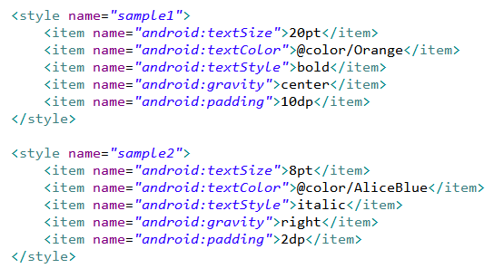
Sample Styles, in styles.xml

Slide 90
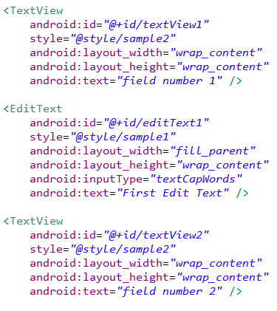
Apply Style - in main xml

Slide 91
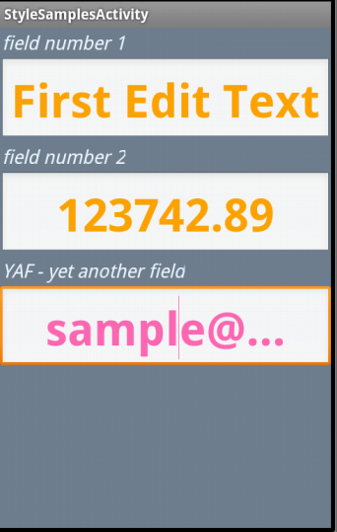
Result of Styles
can override elements of style
bottom edit text overrides color
one style can inherit from another
use UI editor to create view and then extract to style

