Slide 1
CS371m - Mobile Computing
Persistence - Web Based Storage

Slide 2


The Cloud ……….

Slide 3
Backend
No clear definition of backend
front end - user interface
backend - data, server, programs the user does not interact with directly
With 1,000,000s of mobile and web apps …
rise of Backend as a Service (Baas)
Sometimes MBaaS, M for mobile

Slide 4
Back End As a Service - May Provide:
cloud storage of data
integration with social networks
push notifications
server initiates communication, not the client
messaging and chat functions
user management
user analysis tools
abstractions for dealing with the backend

Slide 5
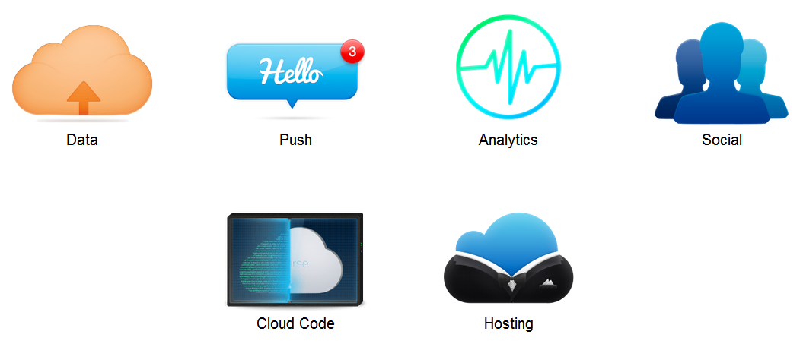
MBaaS

Slide 6
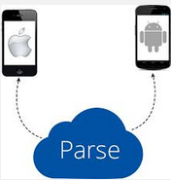





Some Examples of MBaas
Parse
Amazon Web Services
Google Cloud Platform
Heroku
PythonAnywhere
Rackspace Cloud
BaasBox (Open Source)
Usergrid (Open Source)

Slide 7
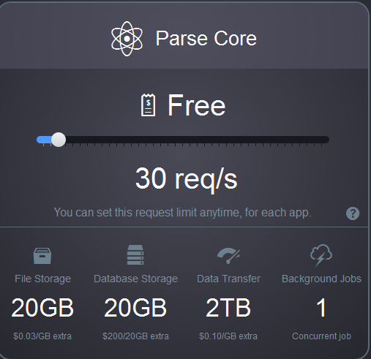
Example of Using a MBaaS
Parse
www.parse.com
various pricing models
relatively easy to set up and use
Going away 1/28/2017

Slide 8
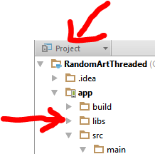
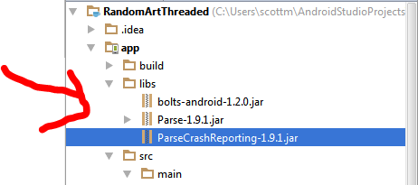
Parse Set Up in AndroidStudio
request api key
Download Parse SDK
Unzip files
Create libs directory in app directory (select Project view)
Drag jar files to libs directory

Slide 9
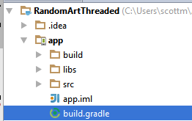
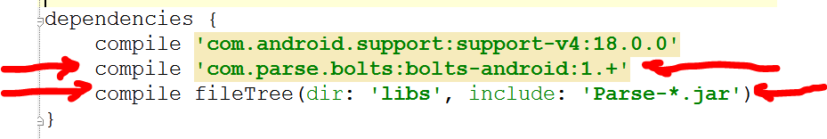
Parse Set Up in AndroidStudio
add dependencies to gradle build file under app like so:
https://www.parse.com/apps/quickstart# parse_data/mobile/android/native/new

Slide 10

Testing Parse
Add permissions to manifest to access network state and use internet
initialize Parse in onCreate method
keys for account and app

Slide 11
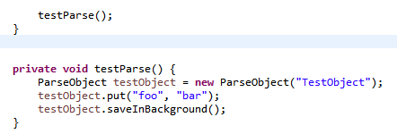
Testing Parse
at the end of onCreate()
create and send a test object to Parse
abstraction
handles doing this in the background, off the UI thread

Slide 12
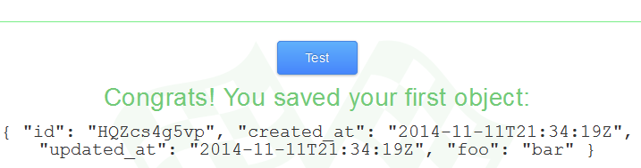
Result of Test
JSON
JavaScript Object Notation

Slide 13
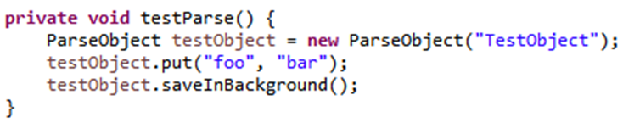
ParseObject
Local representation of data (on the device) that can be saved and retrieved from the Parse
String in constructor is class name
like a table in a data base
put to add key - value pairs
String - Object
keys must be alphanumerics
like a column in the row

Slide 14
ParseObject
saveInBackground method saves object to Parse in a background thread
multiple options for saving
saveAll(List)
saveEventually() - if server or network not available
saveInBackground(SaveCallback)

Slide 15

Parse and RandomArt
add ability to save equations
save to parse database
allow multiple users to save equations
functionality to display a random equation others liked
up and down votes

Slide 16
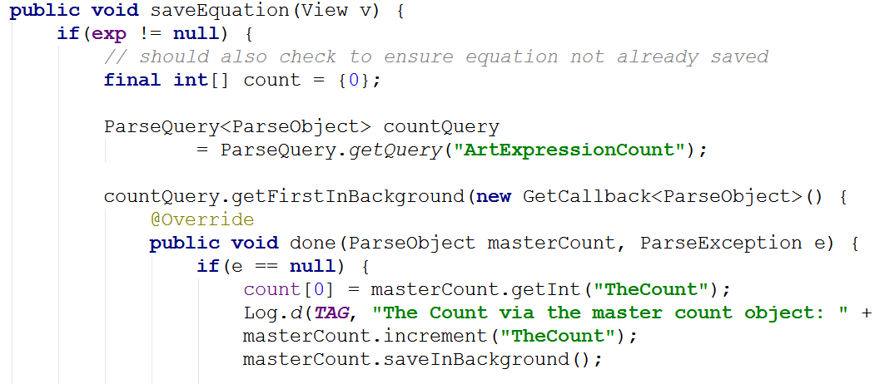
onClick for Keep This

Slide 17
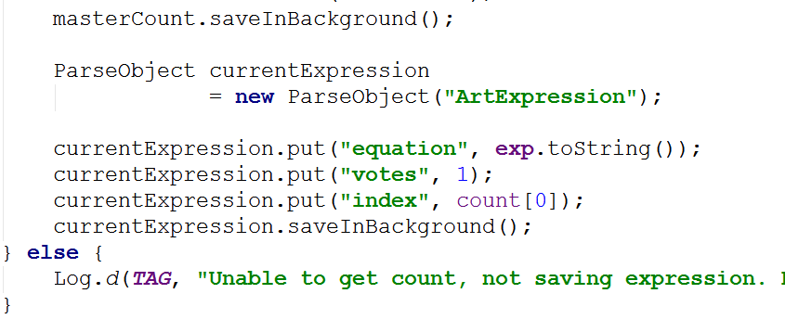
onClick for Save Equation - cont.

Slide 18
saveEquation
Makes a query to get the number of rows in the expression table
uses another table with one row with one column (GACK, no auto increment function)
callback method for completed query
checks the count
creates new ParseObject
makes the index for this new expression the count (0 based indexing)
saves the object and updates count object

Slide 19
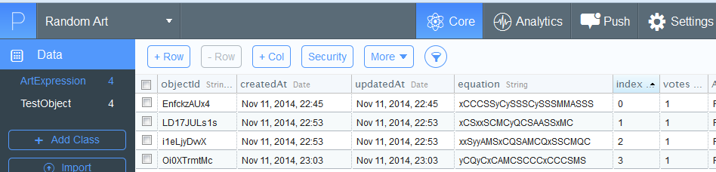
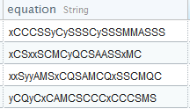
Parse Dashboard
Examine data uploaded from apps

Slide 20

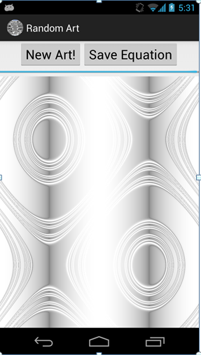
demo Saving an Equation

Slide 21
Get Random Saved Art
When user presses button pick a random saved expression and render that image
We just save the expression so we must recreate image
time vs. space trade off
check count of values and pick random index

Slide 22
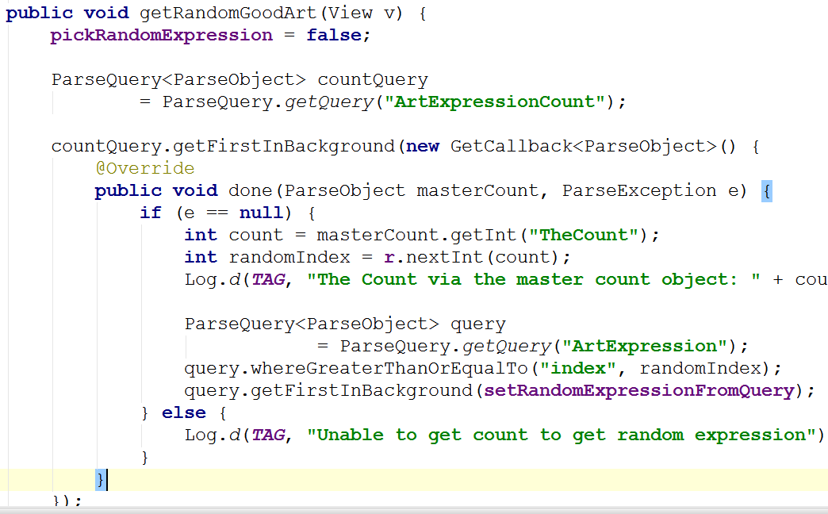
getRandomGoodArt

Slide 23
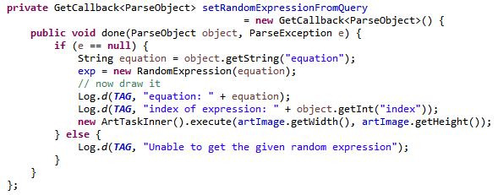
callback object
pull out the String from the returned object and build expression based on equation

Slide 24
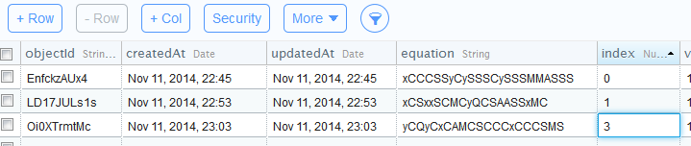
good one logcat

Slide 25
More Parse
Includes capability to do local data store
save objects on device, save to cloud later
abstracts away a lot of the details
Kyle Norton: "Assume you WON'T be connected to the network."
Parse objects meant to be "small"
less than 128 kb
not for images
Parse files for large pieces of data

