Slide 1
CS371m - Mobile Computing
WebView and Web Services

Slide 2
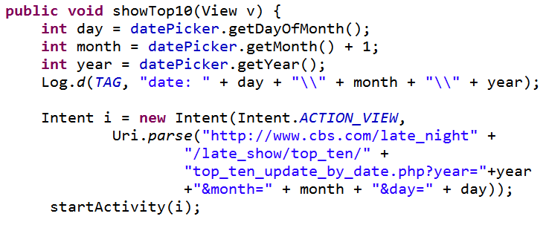
Using Built In Browser App
To use the built in browser create an Intent and start the Activity

Slide 3

WebView
A View that display web pages
basis for creating your own web browser
OR just display some online content inside of your Activity
Uses WebKit rendering engine
http://www.webkit.org/

Slide 4


WebView
Android 4.4, API level 19 added an alternative to WebKit
Chromium
"Chromium WebView provides broad support for HTML5, CSS3, and JavaScript. It supports most of the HTML5 features available in Chrome for Android 30. It also brings an updated version of the JavaScript Engine (V8) that delivers dramatically improved JavaScript performance. "
https://developer.android.com/about/versions/kitkat.html

Slide 5
WebView
Built in functionality to:
display page
navigate forward and backwards through a history
zoom in and out
perform searches
and more:
capture images of page, search page for string, deal with cookies on a per application basis,

Slide 6
More on WebView
Scenarios for using WebView in app instead of built in browser:
provide info the app might need to update such as end user agreement or user guide (instead of doing app update)
display documents hosted online
OR application provides data that ALWAYS requires internet connect to retrieve data
as opposed to performing network request and parsing data to display in Android layout
OR display ads (blah)
http://developer.android.com/guide/webapps/webview.html

Slide 7
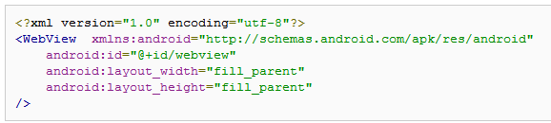
WebView Example
Simple app to view and navigate web pages - demo WebView class
res/layout/main.xml

Slide 8
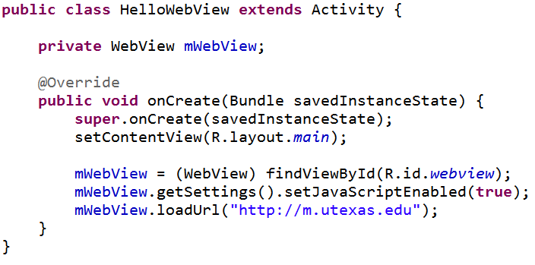
WebView Activity
override onCreate
go to UT mobile site

Slide 9
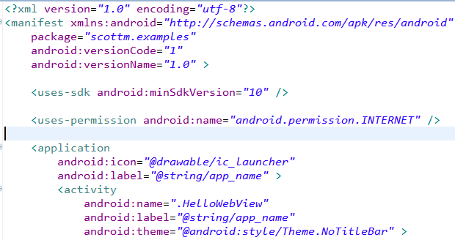
WebView Example
Must add permission for app to use Internet
Also change style so no title bar

Slide 10
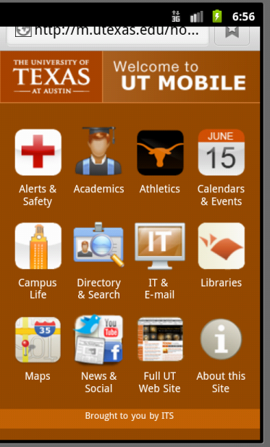
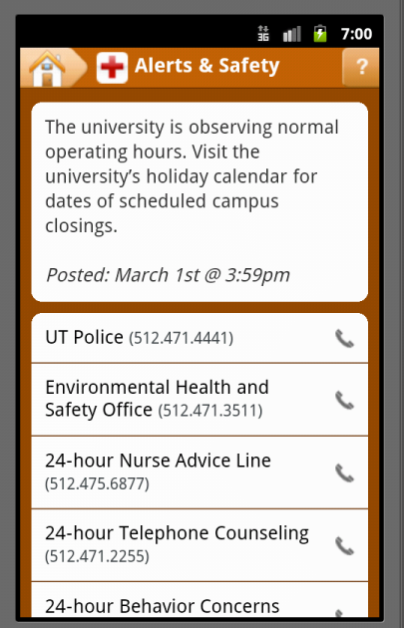
Current Result
Clicking link actually leads to the default Android browser

Slide 11
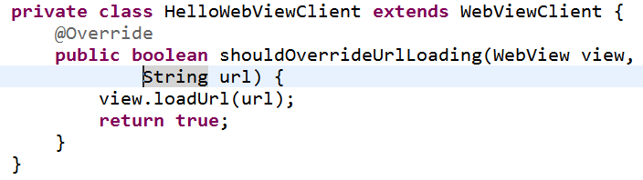
Handling URL Requests
To enable activity to handle its own URL requests create an inner class that extends WebViewClient
set client for mWebView

Slide 12
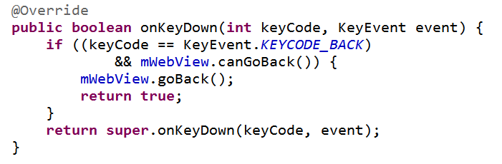
Navigating
Making previous changes disables the back button
Must override onKey down method
Use WebView object to see if possible to go back

Slide 13
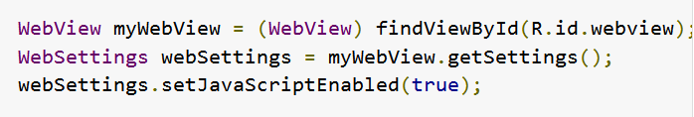
Javascript
If web page displayed in simple WebiView contains JavaScript ...
enable JavaScript:
create interface to act as bridge between JavaScript and Android
Example: convert JavaScript alert to Android Dialog

Slide 14
Web services

Slide 15
Web Services
"Web services are a means of exposing an API over a technology-neutral network endpoint."
"They are a means to call a remote method or operation that's not tied to a specific platform or vendor and get a result."
Android in Action 3rd edition

Slide 16
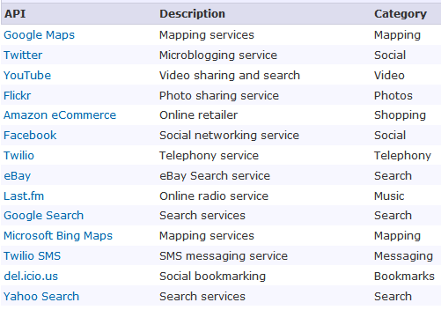
Web Services Sources
http://www.programmableweb.com/apis/directory/1?sort=mashups

Slide 17
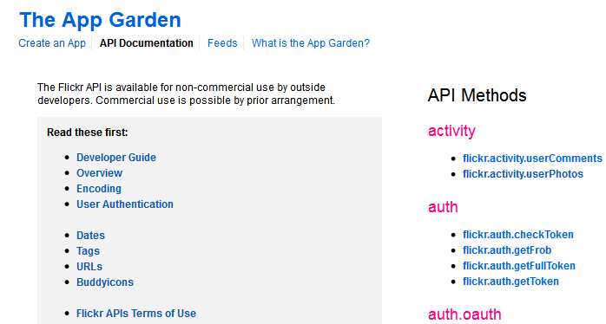
Example: Flickr API
http://www.flickr.com/services/api/

Slide 18


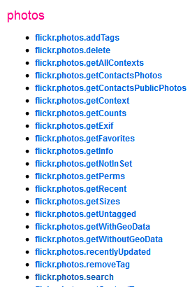
Flickr API Methods
create url using API method name and parameters, plus api key
3 request formats
REST
XML-RPC
SOAP
Multiple Response Formats

Slide 19
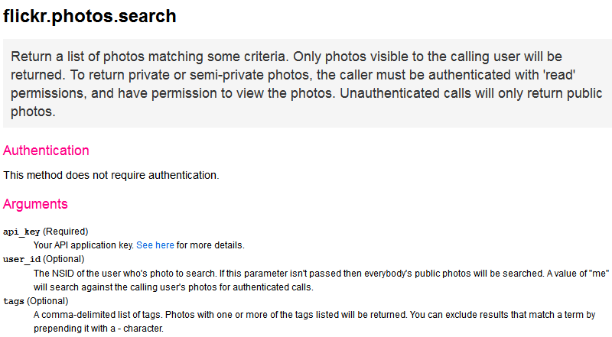
Flickr API Methods

Slide 20
Sample Request URL
https://api.flickr.com/services/rest/ ?method=flickr.photos.search &api_key=754a89ad04e0b72f42ffb77f412c021e &tags=blue,cool,pretty
https://api.flickr.com/services/rest/?method=flickr.photos.search&api_key=754a89ad04e0b72f42ffb77f412c021e&tags=blue,cool,pretty

Slide 21
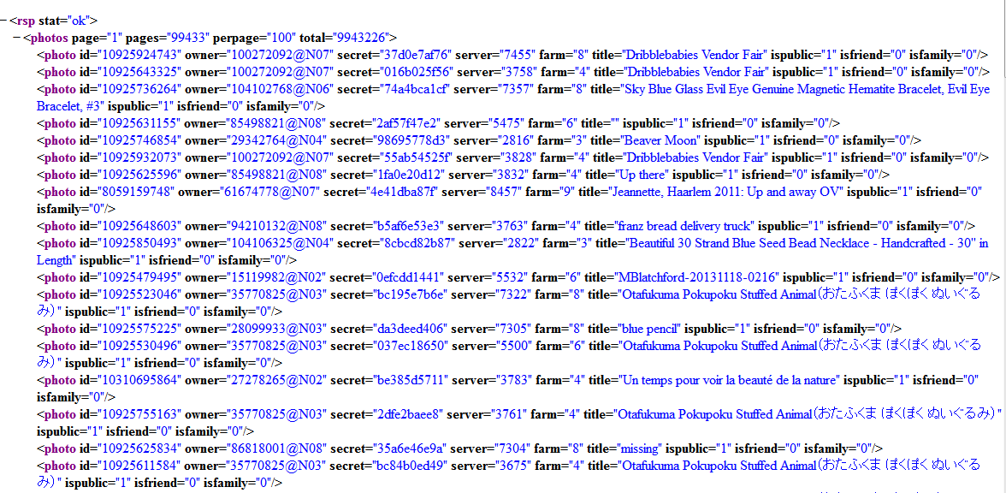
Result

Slide 22
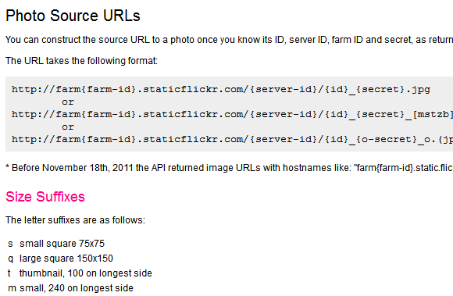
Parse Result to URL for Picture

Slide 23
Photo URL and Result
http://farm3.staticflickr.com/2816/ 10925746854_98695778d3.jpg
http://farm3.staticflickr.com/2816/10925746854_98695778d3.jpg

Slide 24
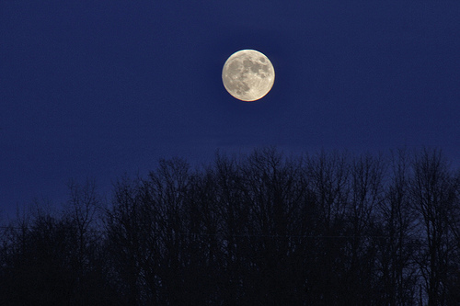
Flickr Example

Slide 25
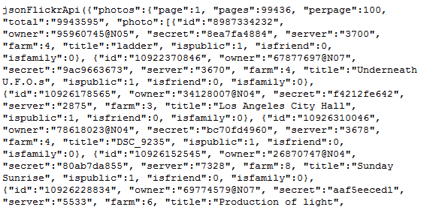
JSON Format
Flickr allows request for response format
one example, JSON

Slide 26
weather bug example

Slide 27
WeatherBug Example
From Deitel Android Programmers: An App-Driven Approach
Example for Tablets
Fragments
tabbed navigation in Action Bar
Widget for home screen
Our focus is on the use of Web Services

Slide 28
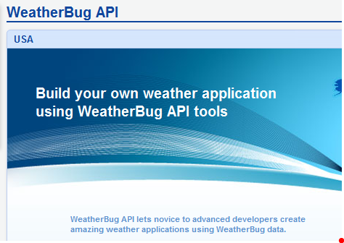
WeatherBug API

Slide 29
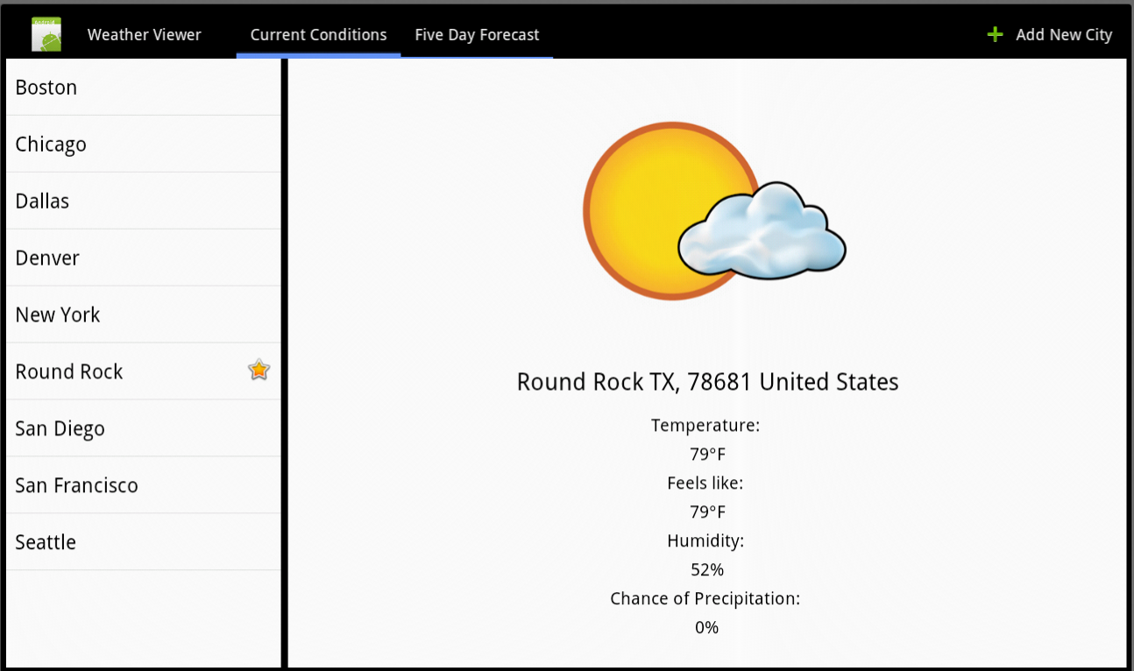
WeatherView App - Current

Slide 30
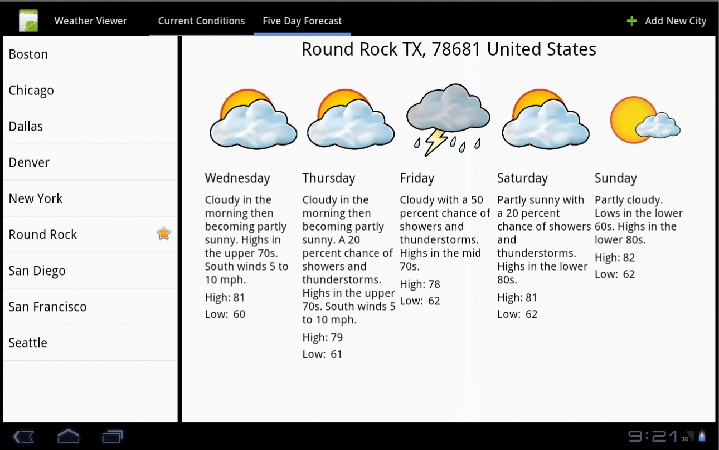
WeatherView App - Five Day

Slide 31
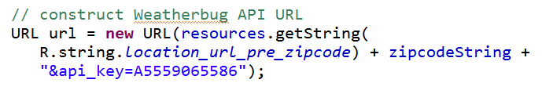
Use of API
most API's require registration and a key value
key used in requests

Slide 32
WeatherBug Web Services
Three classes deal with making requests via the WeatherBug API in WeatherView
ReadLocationTask
use zip to get location information
ReadForecastTask
read current forecast for given zip code
ReadFiveDayForecastTask
get forecast for next five days for given zip

Slide 33
Tasks
All three class use AsyncTask
chose to extend
constructors
override doInBackground method
override onPostExecute method
define their own listeners
Keep the UI thread responsive by using AsyncTask to perform potentially slow tasks

Slide 34
AsyncTask
"AsyncTask allows you to perform asynchronous work on your user interface. It performs the blocking operations in a worker thread and then publishes the results on the UI thread, without requiring you to handle threads and/or handlers yourself."
Task started by invoking the execute method
http://developer.android.com/reference/android/os/AsyncTask.html

Slide 35
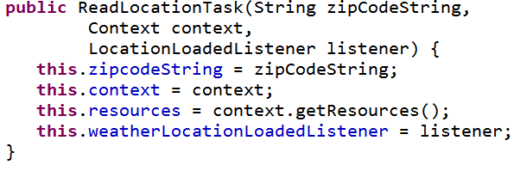
ReadLocationTask
Created with Context, zip code, and Listener
Listener updated in postExecute method

Slide 36
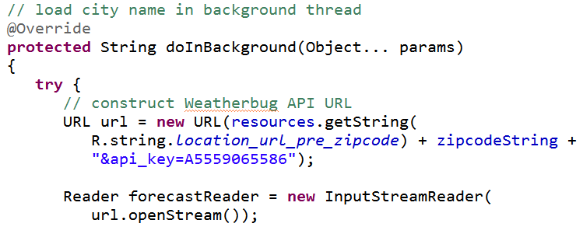
ReadLocationTask - doInBackground
Creates URL using zip code and API key

Slide 37

JSON
JavaScript Object Notation
a way to represent JavaScript objects as Strings
alternative to XML for passing data between servers and clients
designed for data interchange format that humans can also read and write

Slide 38
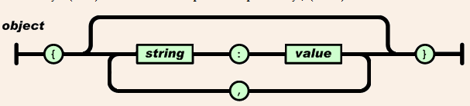
JSON Format
Built on two structures
collection of name-value pairs: a.k.a. objects, records, structs, etc.
an ordered list of values: a.k.a. an array
objects

Slide 39
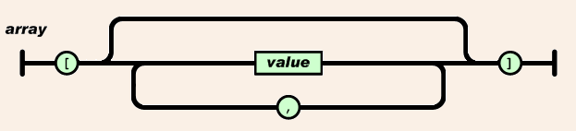
JSON Format
arrays
values
string, number, object, array, true, false, null

Slide 40
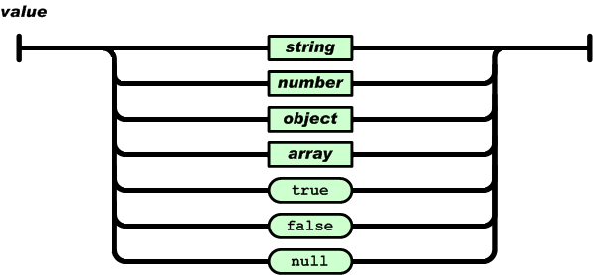
JSON Values
Syntax Diagrams for string and number: http://www.json.org/

Slide 41
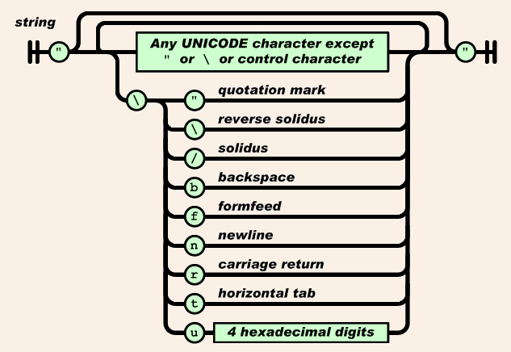
JSON Strings

Slide 42
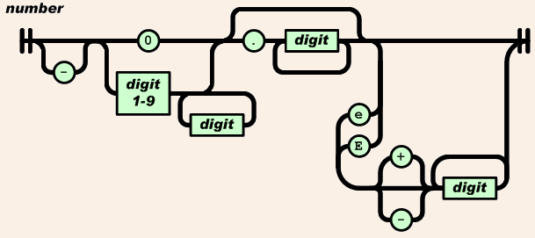
JSON Numbers

Slide 43
JSON Examples
value (String):
"Round Rock"
array:
["Round Rock", "Dallas", "Houston"]
object
{"height":70,"weight":165}

Slide 44
Results For ReadLocationTask
http://i.wxbug.net/REST/Direct/ GetLocation.ashx?zip=78681&api_key=xxxxx
where xxxxx is your API key
Result:
{"location":{"city":"Round Rock","cityCode":null,"country":"United States","dma":"635","isUs":true, "lat":30.5123,"lon":-97.7117, "state":"TX","zipCode":"78681"}}

Slide 45
Parsing JSON
JsonReader class in Android API
Read JSON encoded values as a stream of tokens
ReadLocationTask uses a JsonReader to parse the JSON returned by the web request
Pulls out city, state, and country string to display in View

Slide 46
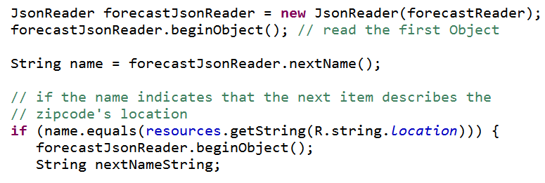
Creating JsonReader
and check given zip returns a valid location

Slide 47
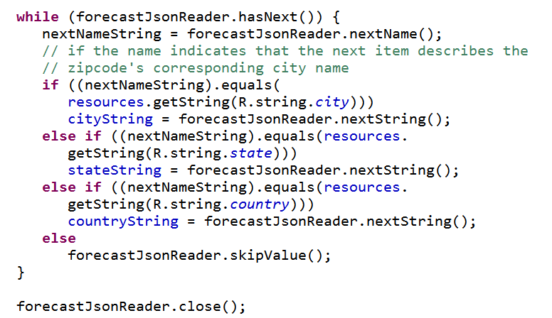
Reading Location Data

Slide 48
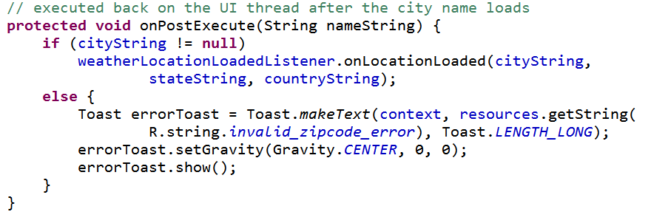
onPostExecute
Send the city, state, and country data to the listener

Slide 49
ReadForecastTask
Similar in nature to ReadLocationTask, but different url for different data
{"forecastHourlyList": [{"chancePrecip":"10","dateTime":1332882000000, "desc":"PartlyCloudy","dewPoint":64,"feelsLike":73, "feelsLikeLabel":"Heat Index","humidity":"74", "icon":"cond002","skyCover":null, "temperature":73,"windDir":null,"windSpeed":10}, {"chancePrecip":"10","dateTime":1332885600000, "desc":"Partly Cloudy","dewPoint":64,"feelsLike":70, "feelsLikeLabel":"Heat Index","humidity":"81", "icon":"cond002","skyCover":null, "temperature":70,"windDir":null,"windSpeed":11},
and on for another 158 hours

Slide 50
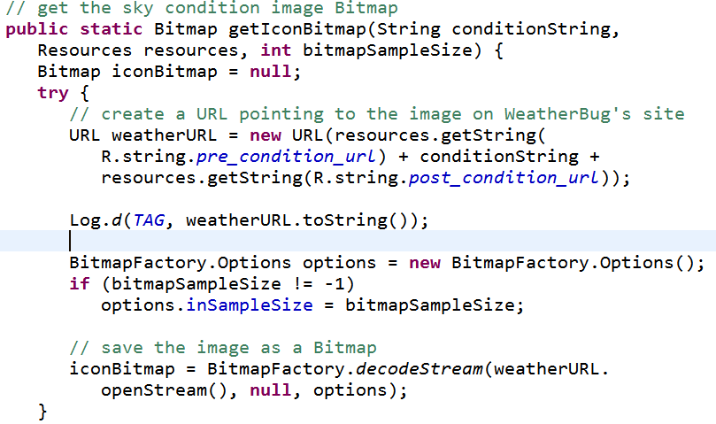
ReadForecastTask
Also downloads image for current condition

Slide 51



Icons Obtained From WeatherBug

Slide 52
ReadFiveDayForecastTask
{"dateTime":1332892800000, "dayDesc":"Partly Cloudy","dayIcon":"cond003", "dayPred":"Cloudy in the morning...becoming partly cloudy. Patchy fog in the morning. Highs 61 to 66. Light winds becoming west 15 mph with gusts to 25 mph in the afternoon.", "dayTitle":"Wednesday","hasDay":true, "hasNight":true,"high":"66","hourly":null,"low":"54","nightDesc":"Drizzle","nightIcon":"cond162", "nightPred":"Partly cloudy in the evening...becoming cloudy. Patchy fog and patchy drizzle overnight. Lows 49 to 55. Areas of winds northwest 15 to 20 mph with gusts to 25 mph in the evening becoming light.", "nightTitle":"WednesdayNight","title":"Wednesday"},

Slide 53
Displaying Data
App does not try and display all data, just chooses "most important"
icon
day of week
day prediction
high temp
low temp

