Slide 1
CS371m - Mobile Computing
Audio

Slide 2
Audio on Device
Devices have multiple audio streams:
music, alarms, notifications, incoming call ringer, in call volume, system sounds, DTMF tones (dual tone multi frequency, the "traditional" phone sounds and tones)
Most of the streams are restricted to system events, so we almost always use STREAM_MUSIC via a MediaPlayer or SoundPool

Slide 3
media player

Slide 4
Android Audio
Using the MediaPlayer class
Common Audio Formats supported:
MP3, MIDI (.mid and others), Vorbis (.ogg), WAVE (.wav) and others
Sources of audio
local resources (part of app)
internal URIs (Content Provider for other audio available)
External URLs (streaming)

Slide 5
Audio Resources
res/raw directory
assets/ directory
reference as file://andorid_asset in a URI
can share with other apps via URI
Store media in application local directory, pull from network / web and store locally
Store and use media on SD card
Stream via the Internet

Slide 6
MediaPlayer
Playback control of MediaPlayer managed as a state machine
Idle
Initialized
Preparing
Prepared
Started
Paused
Playback Complete
Stopped
End
Invalid state transitions result in errors

Slide 7
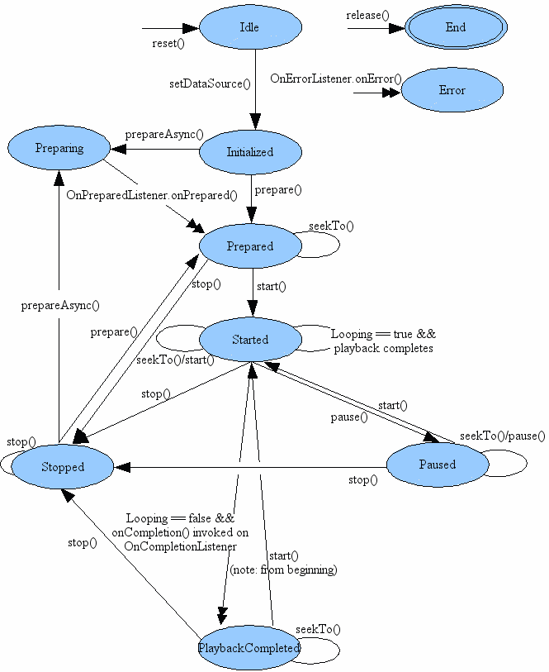
MediaPlayer State Diagram
Single arrows are synchronous transitions
Double arrows are asynchronous transitions

Slide 8
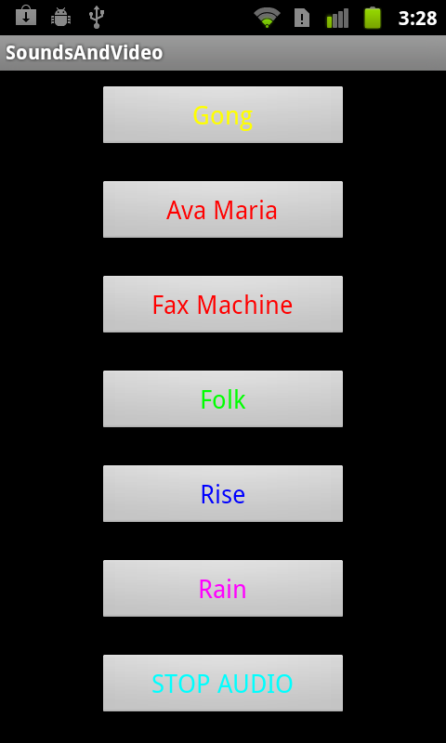
Simple Sound Demo App
audio files local to app placed in res/raw
CAUTION
large sound files difficult to install on emulator:
http://tinyurl.com/3pwljfj
better success with dev phones / actual devices

Slide 9
Using MediaPlayer
MediaPlayer.create() method used for raw resources
MediaPlayer.create() method for URIs
various MediaPlayer.setDataSource() methods if not a raw resource and not a URI

Slide 10
Playing Local Audio
To play audio local to the app
use the MediaPlayer.create convenience method
when complete MediaPlayer in the prepared state
start MediaPlayer
approach:
build listeners for each button to call the playSound method with appropriate song id when clicked

Slide 11
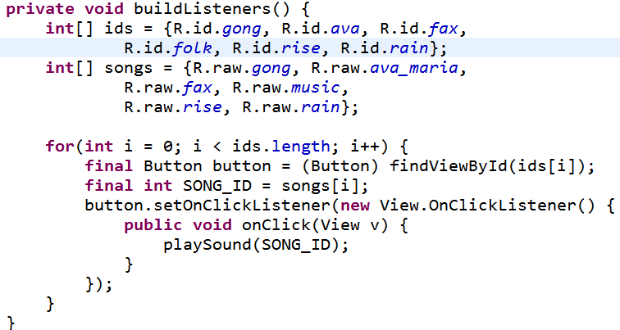
Simple Approach
button ids
ids for sound files

Slide 12
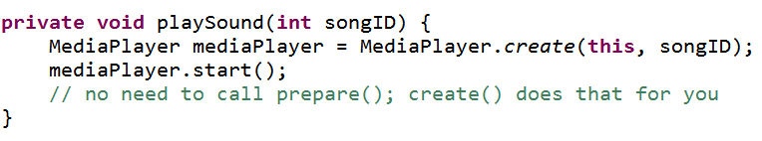
playSound method initial version
useful for short sounds
downsides:
plays to completion
multiple sounds play at same time (desirable in some cases)
audio continues to play when app paused

Slide 13
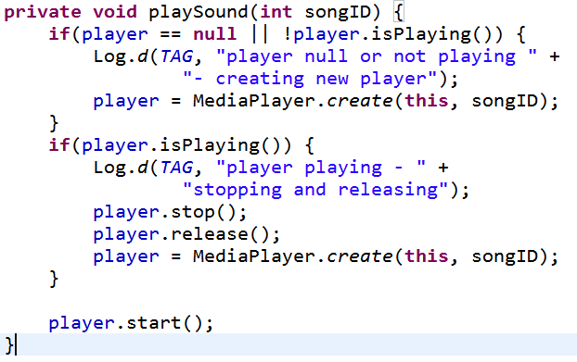
Changing Behavior
Add instance variable for MediaPlayer
If playing stop and release before creating new Player

Slide 14
Cleaning Up
Initial version did not end well
Audio continued to play if back button pressed and even if home button pressed!
Activity Life Cycle
in onPause for app we should stop MediaPlayer and release

Slide 15
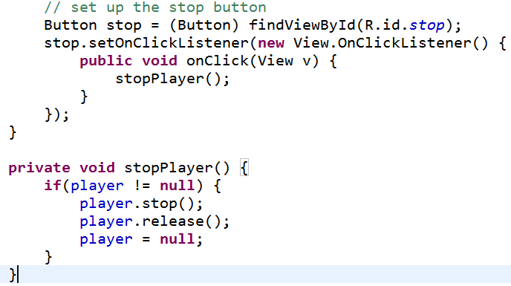
stopPlayer method
Connect app stop button to stopPlayer
could use XML onClick and add View parameter or set up listener ourselves
in buildListeners method

Slide 16
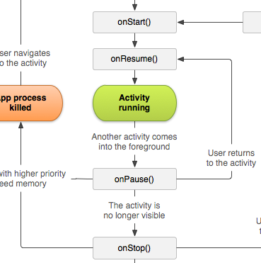
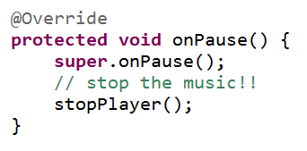
onPause
onPause() should call the stopPlayer method
what happens if activity resumed?

Slide 17
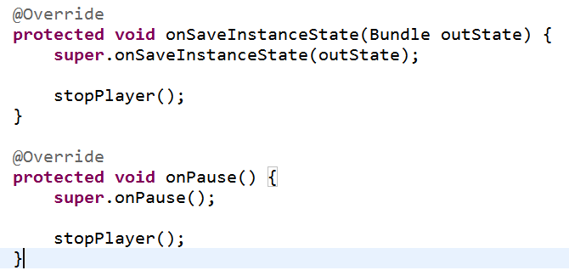
Saving State
Resume music where we left off if paused or activity destroyed due to orientation change

Slide 18
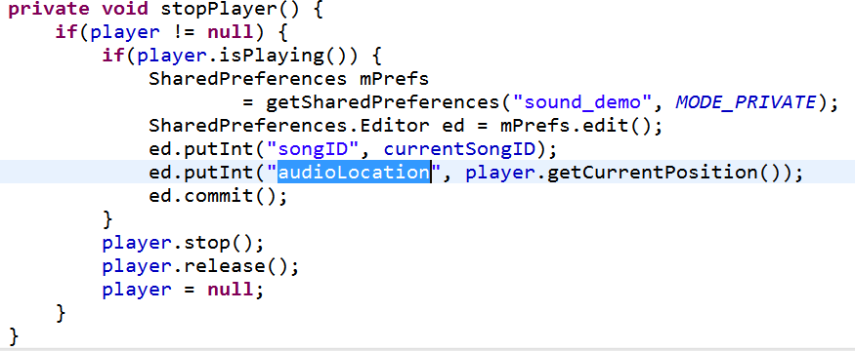
Saving MediaPlayer State
Not a lot of data so used the SharedPreferences

Slide 19
Restarting Audio
In onResume check if audio was interrupted recreate player with same id and move to correct position
Can write data to shared preferences or bundle (onSaveInstanceState) and pull out in onResume

Slide 20
audio sources

Slide 21
Playing Audio from Phone
If audio is on device / system, but not local to app use a URI
Obtain URIs of Music via a Content Resolver
Example of simply listing URIs to the logcat

Slide 22
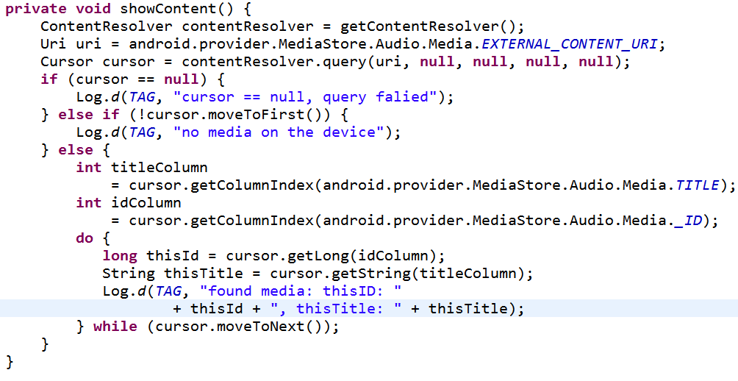
Retrieving Music URIs Using a Content Resolver

Slide 23
MediaPlayer and System Audio
After URI retrieved can play audio with MediaPlayer
this approach requires calling MediaPlayer prepare yourself
Or could use MediaPlayer create method that takes a URI

Slide 24
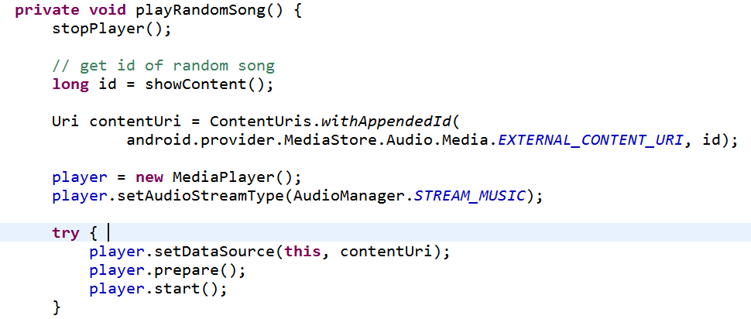
Playing Audio Via Local URI
id obtained via approach from showContent method

Slide 25
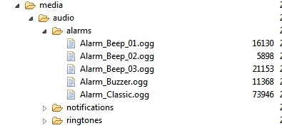
Other Audio
Other audio for ringtones, notifications, and alarms can be accessed via a RingtoneManager
Obtain URIs and play with media player
from DDMS:

Slide 26
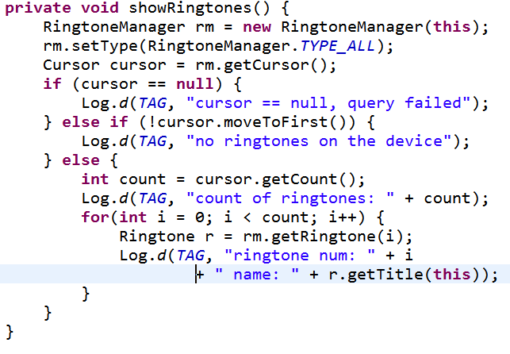
Listing Other Audio

Slide 27
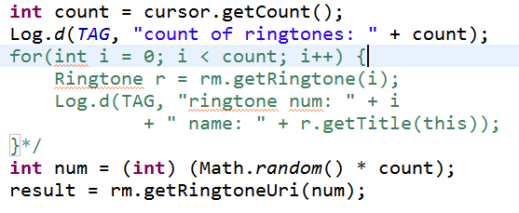
Playing Other Audio
Once the URI is obtained, playing other audio is same as playing song

Slide 28
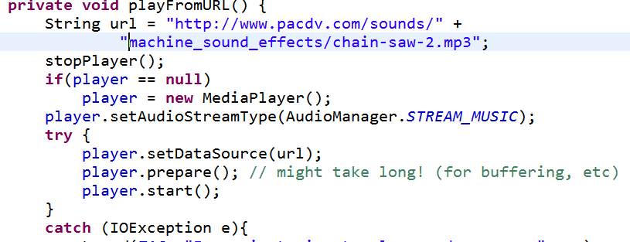
Playing Audio from Remote URL
Straightforward given the URL

Slide 29
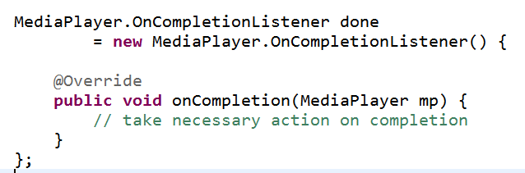
Completion of Audio
If action required when audio done playing implement the MediaPlayer.onCompletionListener interface
could make activity the listener

Slide 30
Looping
to loop sound (play over and over) simply set the isLooping method of the MediaPlayer to true

Slide 31
sound pool

Slide 32
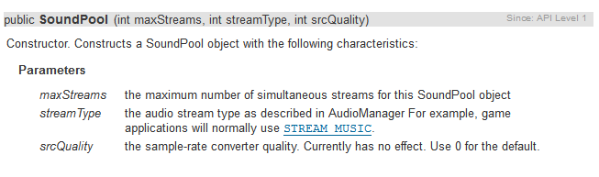
SoundPool
Another Android class
Used in tutorials

Slide 33
Using SoundPool
Great for applications with a number of short sound samples
maxStreams parameter sets maximum number of sounds that can be played at once via this SoundPool
If max is exceeded stream with lowest priority stopped
and then by age (oldest) with lowest priority

Slide 34
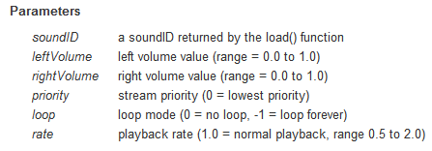
SoundPool play

Slide 35
Using SoundPool
Looping of sounds:
0 no looping
-1 loop forever
>0, play that many times
frequency (speed) can be changed
range from 0.5 to 2.0
0.5 twice as long to play
2.0 half as long to play

Slide 36
SoundPool.Builder
Added in API level 21, Android 5.0 Lollipop
static methods to
set audio attributes
set max number of streams
build and return a SoundPool object given the current audio attributes and number of streams
Audio Attributes include why, what and how for sound
USAGE_GAME, CONTENT_TYPE_SONIFICATION, various flags

Slide 37
Other Sources of Sound
AudioTrack
http://developer.android.com/reference/android/media/AudioTrack.html
low level API for handling audio streams in formats MediaPlayer cannot handle
ToneGenerator
http://developer.android.com/reference/android/media/ToneGenerator.html
Traditional phone tones
Dual-Tone Multi-Frequency (DTMF)
Just to make sounds, not send tones over phone network

Slide 38
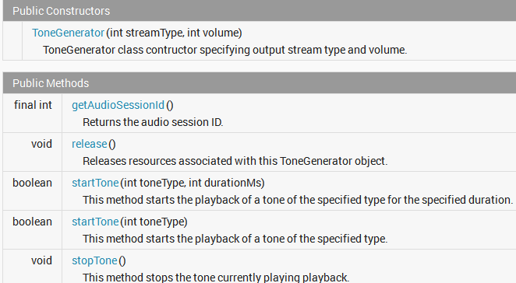
ToneGenerator

Slide 39
haptic feedback

Slide 40
Haptic Feedback
haptic: "of or relating to the sense of touch"
Easy to add this kind of feedback to an app
can enable haptic feedback for any view

Slide 41
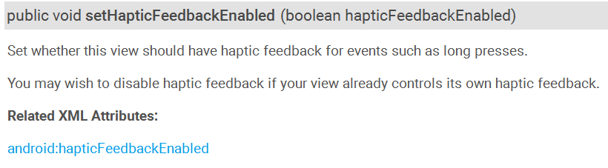
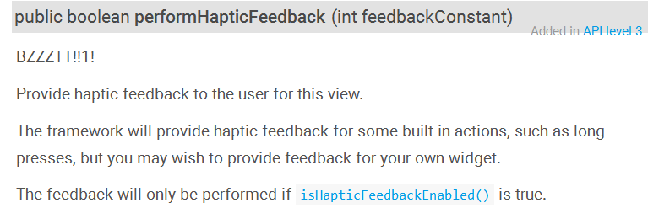
Haptic Feedback on a View
Methods from View class

Slide 42
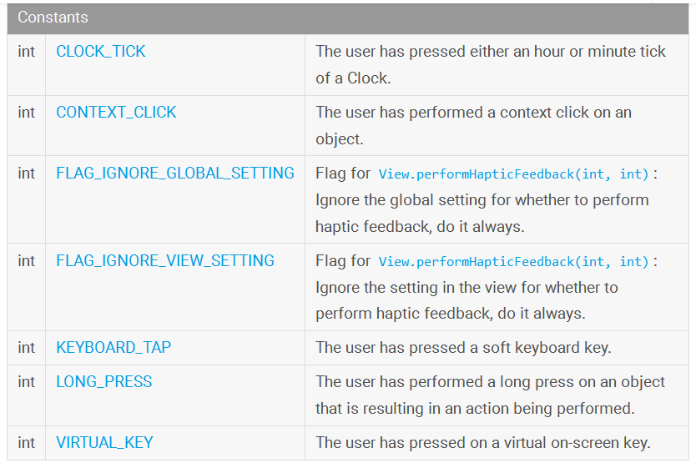
HapticFeedbackConstants Class

Slide 43
More Complex Feedback
Also possible to create more complex haptic feedback for apps:
Request permission
Get the Vibrator object from the system
call vibrate method

Slide 44

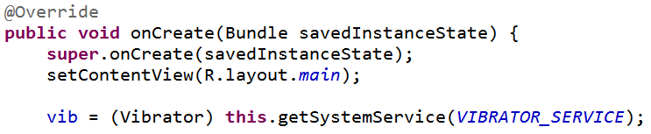
Haptic Feedback
Request Permission
Get Vibrator

Slide 45
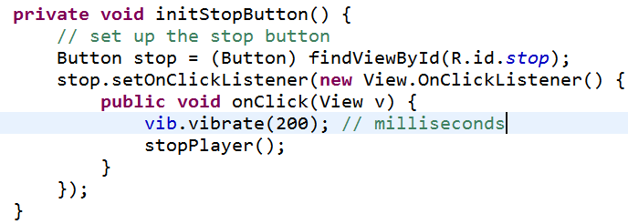
Haptic Feedback
Create feedback

Slide 46
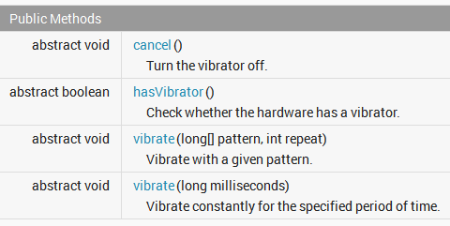
Vibrator Methods

Slide 47
recording audio

Slide 48
Recording Audio - MediaRecorder
create MediaRecorder object
set audio source
set audio format
set file format for audio
set file name to record to
prepare MediaRecorder for recording
start recording
stop and release MediaRecorder

Slide 49
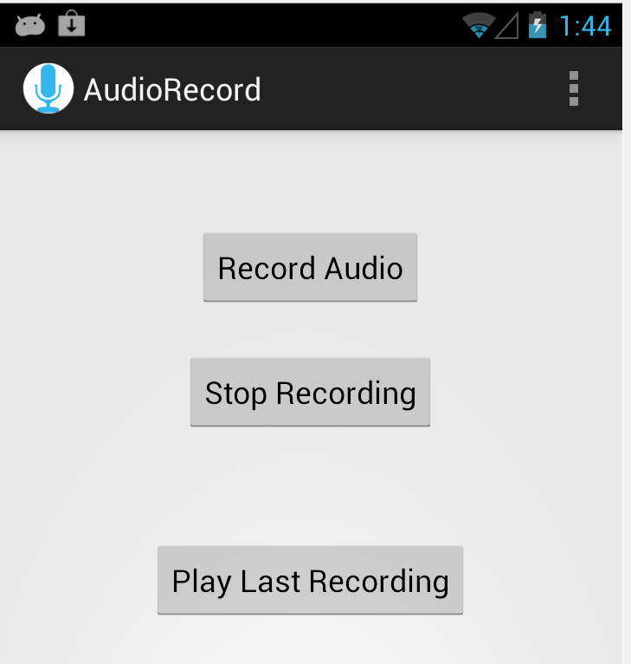
Record Audio
Simple View with buttons to start and stop recording
alternatively could change text on record audio button
single button or toggle switch

Slide 50
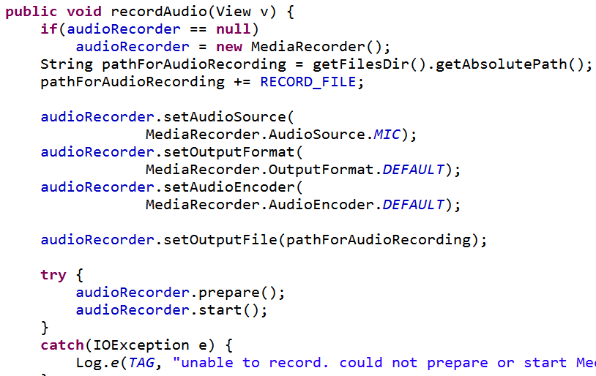
Record Audio

Slide 51
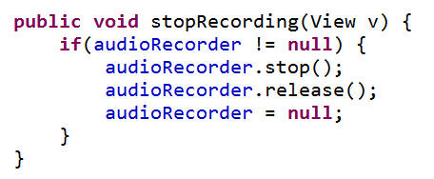
Stop Recording
a few seconds of audio results in a file size of ~ 10 kb with default settings
PERMISSIONS! -- must request RECORD_AUDIO and WRITE_EXTERNAL_STORAGE permissions in manifest file

Slide 52
speech recognition

Slide 53
Speech Recognition
android.speech package
Simplest example - start an Intent for a result
RecognizerIntent.ACTION_RECOGNIZE_SPEECH
uses network
true on the dev phones
doesn't work on emulator

Slide 54
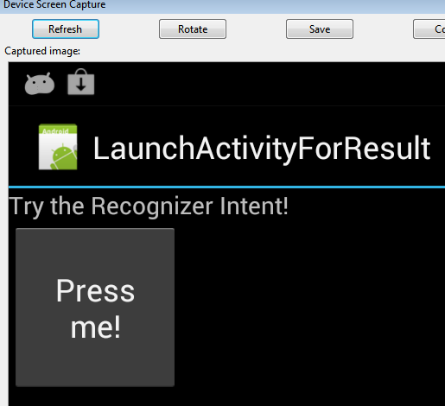
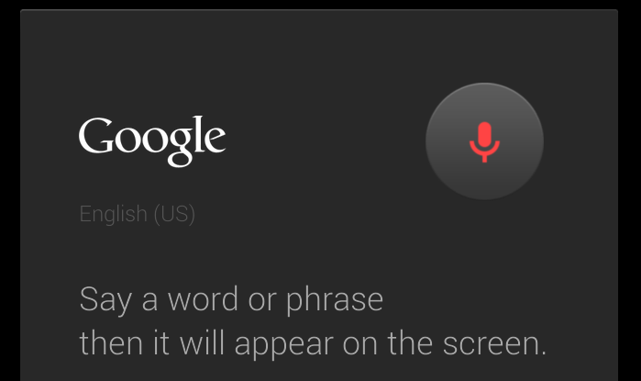
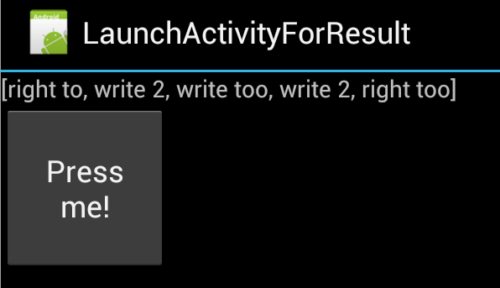
Speech Recognition

Slide 55
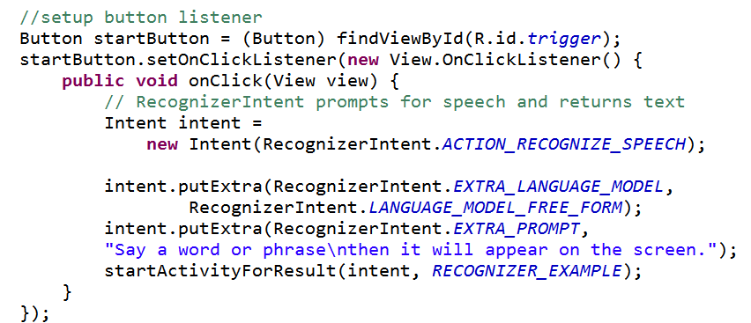
Starting Intent

Slide 56
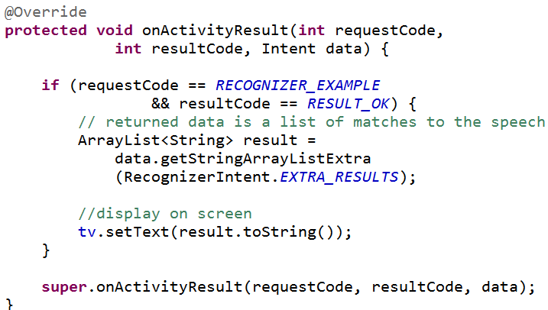
Responding to Result
Note: list of results, ordered by confidence

Slide 57



Results

