Slide 1
CS371M - Mobile Computing
Class Intro

Slide 2
Teaching Staff
Mike Scott
Lecturer
UT since 2000
scottm@cs.utexas.edu
office hours MW 2 – 4 pm, F 8:30 – 9:30 am
TA: Chandana Amanchi lab hours, W 4 – 5, F 2- 4

Slide 3

The Course
Mobile computing with focus on application development for the Android operating system
Large, self-selected project with 3 students

Slide 4
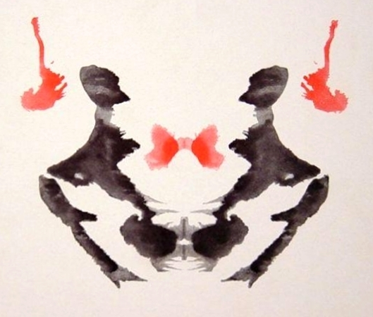
Mobile Computing is …

Slide 5
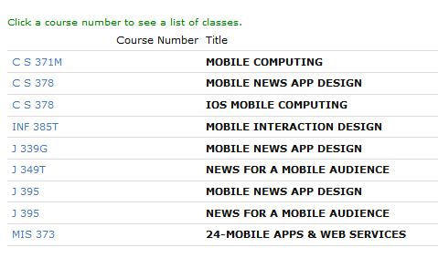
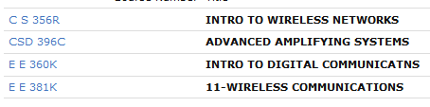
Mobile Computing is …

Slide 6
Clicker Question
Have you ever written an Android App?
yes
no
Have you ever written an iOS App?
yes
no
Have you ever published an app on Google Play or the Apple app store?
yes
no

Slide 7
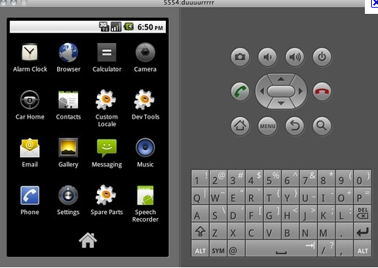
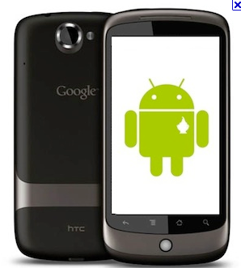
NDR = No Device Required
Android application development in Java using Android Studio
Emulator part of development environment
limitations
dev phones and tablets available for check out
wireless access only

Slide 8
Work Products
Tutorials
step by step guide to creating a small application
tic - tac - toe
Individual assignments
mostly written
Project
design and implement an app and hopefully publish it on Google Play
broken into various milestones
3 students per project
Point break down on syllabus

Slide 9
Posters and Demos
In class poster days 2/13, 2/15, 2/17
Group demo last weeks of class

Slide 10
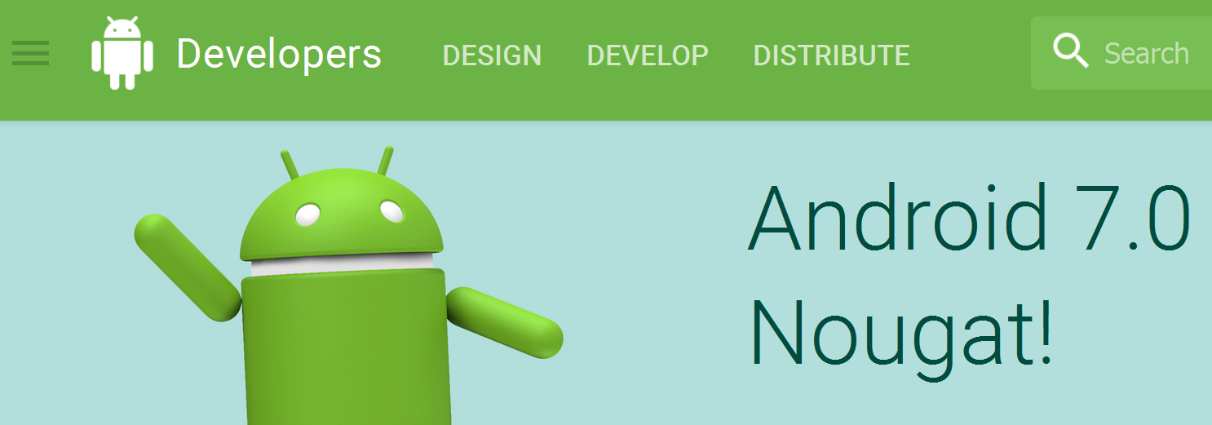


Resources
Google's Android Development website
Commonwares
The Busy Coder's Guide to Android Development
StackOverflow for very specific questions
Other tutorials??

Slide 11
Class Materials
Syllabus, Schedule, and Resource Page
www.cs.utexas.edu/~scottm/cs371m
Assignments, tutorials, grades on Canvas
Discussion group on Piazza
Linux machines have development environment
strongly recommend using your own system
Tutorial 1 - setting up dev environment on your own machine and using dev environment
Hello Android!!

Slide 12
Course Material
Working in a system
not just a stand alone application
Heavy use of library / API
Primary language for Android is Java
User Interfaces and XML
ever create an anonymous inner class in Java?
Location and Sensing
Responsiveness
Graphics and Events
Gestures
data bases / SQLite

Slide 13
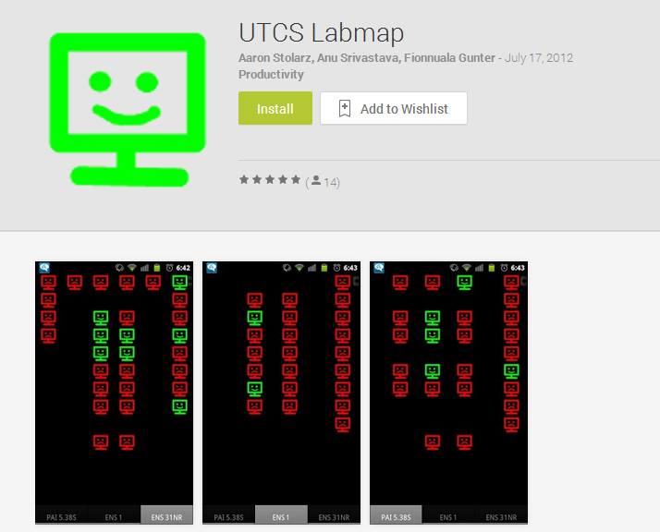
Past Apps

Slide 14
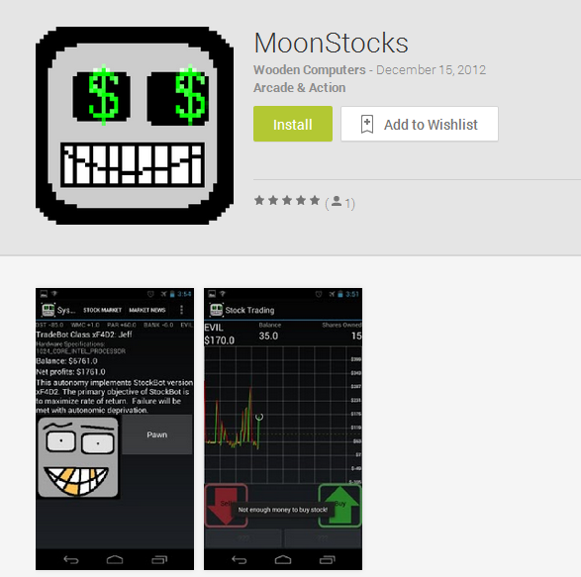
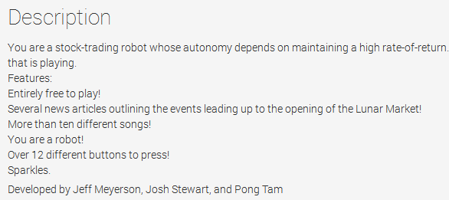

Slide 15
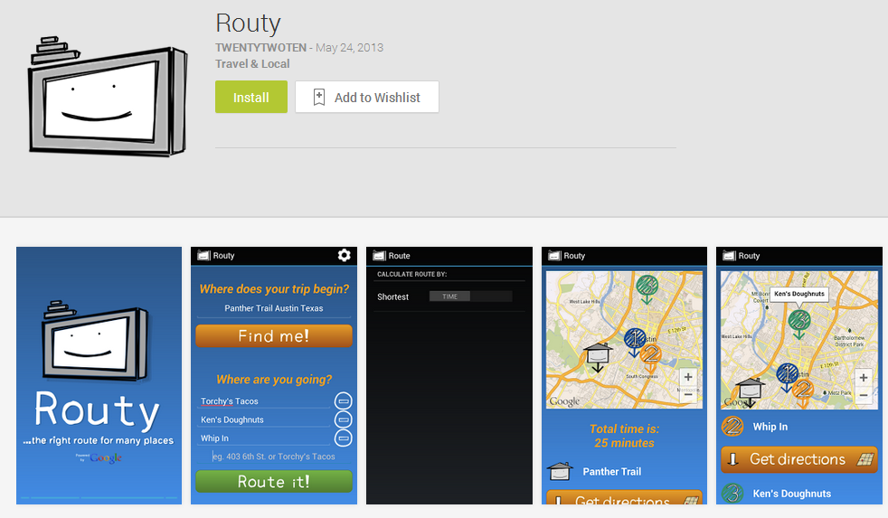

Slide 16
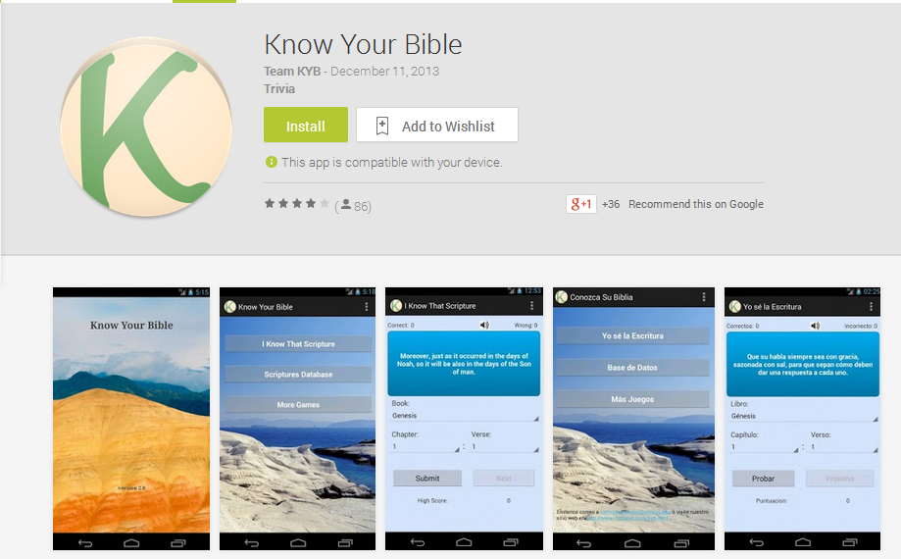

Slide 17
Questions???

Slide 18
More Past Projects
Uncommon Books
Trace Me
Android Army
Austin Recycling
Pulsar
Austin Art Viewer

