Slide 1
CS371m - Mobile Computing
UI Redux, Navigation Patterns, Tabbed Views, Pagers, Drawers

Slide 2
User interface navigation options

Slide 3
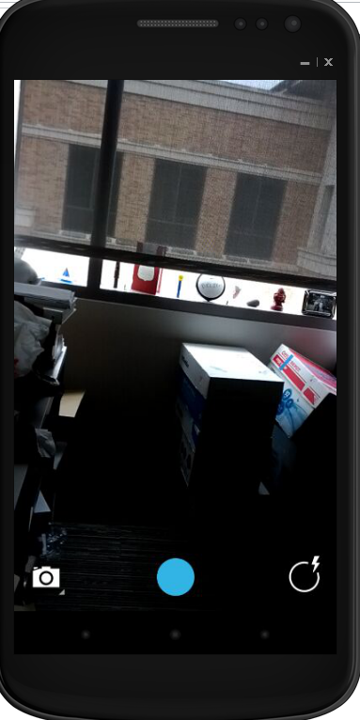
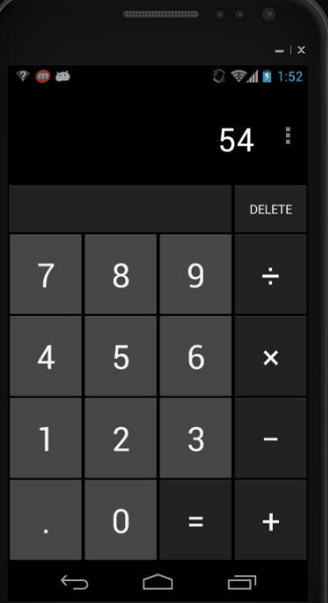
App Navigation Structures
the Single Activity app
focus on a Single Activity
calculator
camera

Slide 4
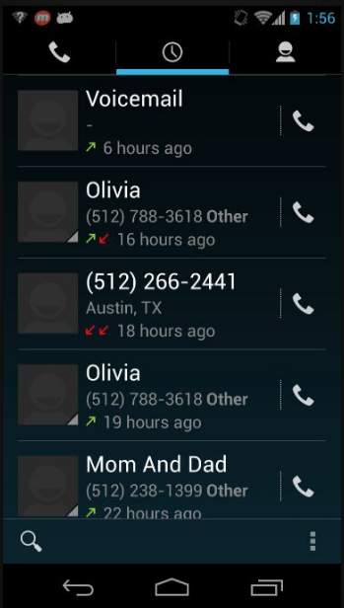
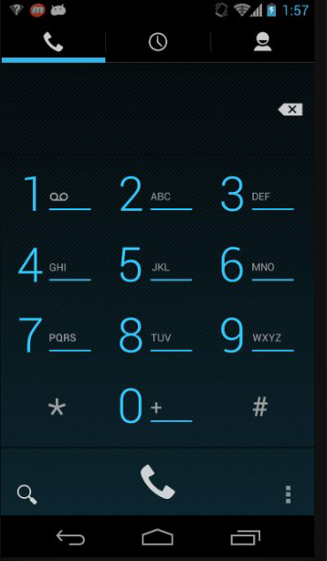
App Navigation Structures
the Multiple Peer Activities app
multiple activities, but all on same level
no deeper navigation
phone app

Slide 5
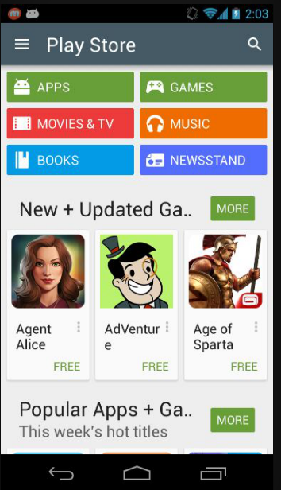
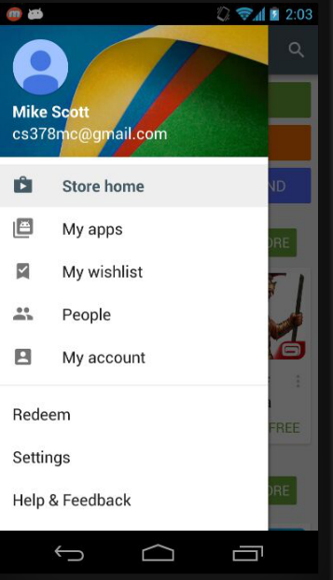
App Navigation Structures
the Rabbit Hole apps
deep levels of navigation
multiple data views
Facebook, Play Store

Slide 6
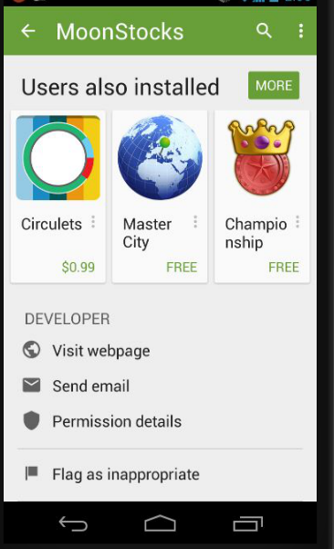
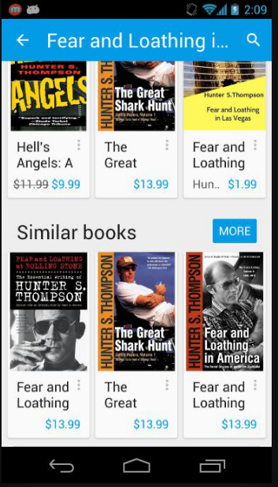
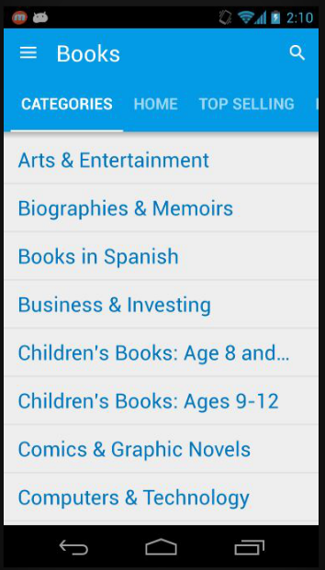
Multiple Layers of Navigation

Slide 7
User Interface Patterns
Just like software patterns, solutions to recurring UI design problems and situations
Popular Android navigation patterns:
Buttons and Simple Targets
Lists and Grids
Tabs
Horizontal Paging
The Navigation Drawer

Slide 8
navigation patterns

Slide 9
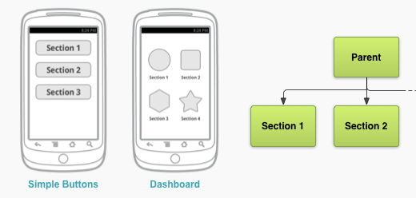
Buttons and Simple Targets
Simple and familiar

Slide 10
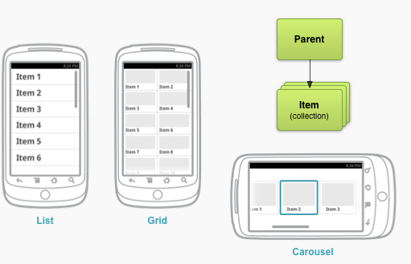
Lists and Grids
For collection related screens, especially textual information
ListView and GridView
For photos and videos a scrolling list

Slide 11
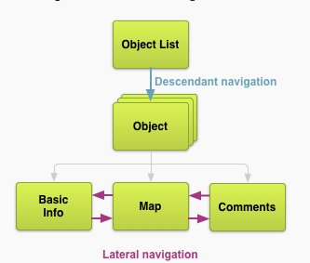
Tabbed Navigation
Apps (should) have a navigation hierarchy
Part of UI design is providing navigation between the different screens and activities
developers need to think about the navigation so that users don't
An alternative is Drawer Navigation

Slide 12
Navigation
Descendant Navigation
moving from high level to low level
Lateral navigation
moving between siblings
section siblings (in image)
content siblings
think image gallery

Slide 13
tabbed navigation

Slide 14
Tabs
Very popular
used for sibling screens / activities
Tabs should persist when changing screens
content changes to new screen, but tabs remain the same
changing tabs should not create history
pressing back does should not cause a tab back
tabs should always be at the top of the screen

Slide 15
Tabs vs. Buttons
initially selected tab in "parent" screen provides immediate access to content
user navigation between screens without backtracking to parent
… but, tabs take away space from the content screens

Slide 16
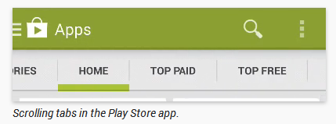
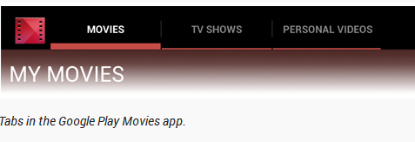
Tabs
Tabs can be fixed or scrollable

Slide 17
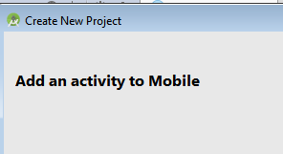
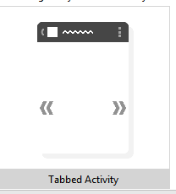

Implementing Tabs
Android Studio project creation

Slide 18
Implementing Tabs
Swipe Views such as Tabs or Lateral Swipe Navigation use a ViewPager
An descendant of ViewGroup
like LinearLayout, TableLayout, …
Part of the support library
A set of libraries to allow backward compatibility of apps
example, allow use of ActionBar on pre Android 3.0 devices

Slide 19

ViewPager in layout XML
add child views with a PageAdapter
recall the Adapter for the ListView
FragmentPagerAdapter for fixed # of siblings
FragmentStatePagerAdapter for a variable number of views, for example images

Slide 20
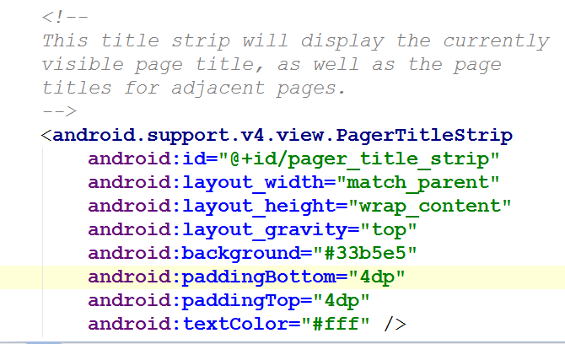
Rest of Layout File
PagerTitleStrip Widget

Slide 21
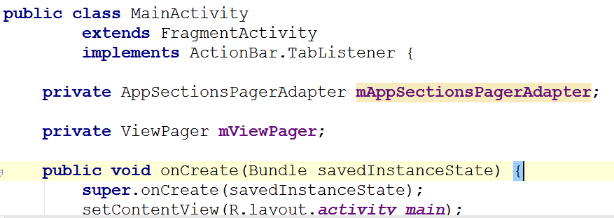
Activity with Tabbed Navigation

Slide 22
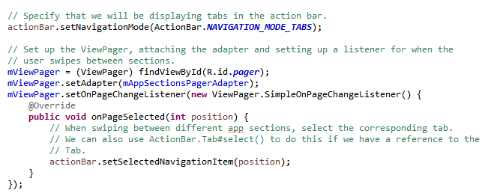
Setting Up The Navigation in onCreate()

Slide 23
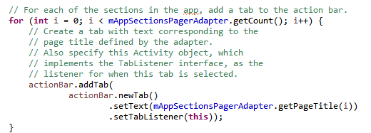
Adding Tabs to ActionBar

Slide 24
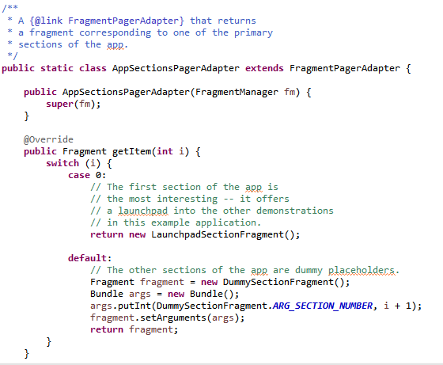
PagerAdapter

Slide 25
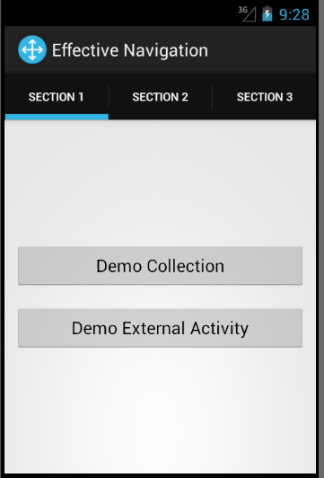
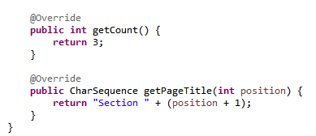
PagerAdapter

Slide 26
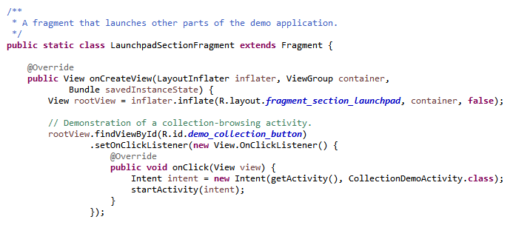
Subviews are Fragments

Slide 27
navigation drawer

Slide 28
Navigation Drawer
A Drawer is an alternative for providing navigation through an app
especially between peer activities
The drawer moves from the left edge of the screen when swiped in
or touch the app icon in the action bar
action bar altered when drawer displayed
Drawer philosophy:
make the current view less cluttered
easier to move to important activities from anywhere within app

Slide 29
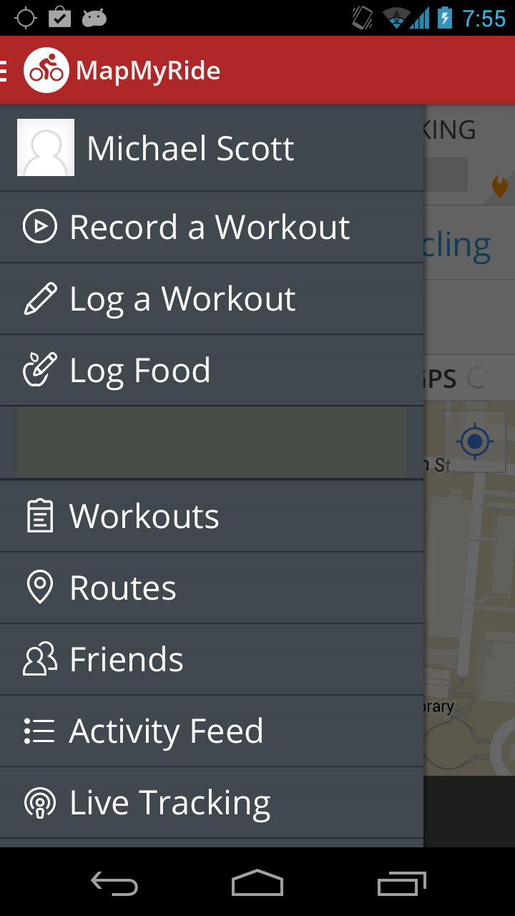
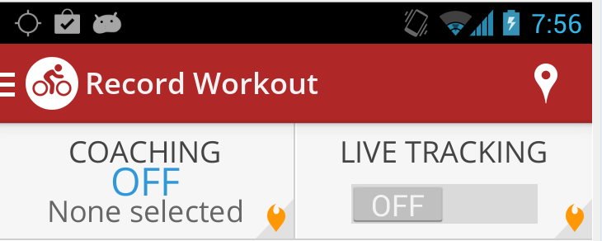
Example Navigation Drawers

Slide 30
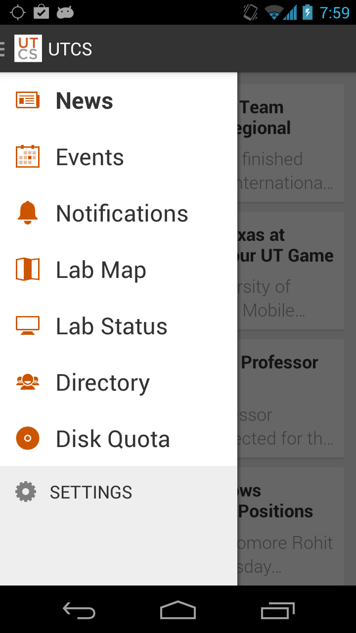
Example Navigation Drawers
The Drawer becomes the primary Navigation tool for the app
Able to open from most Activities
Different paradigm:
from a content view, back generally exits the app

Slide 31
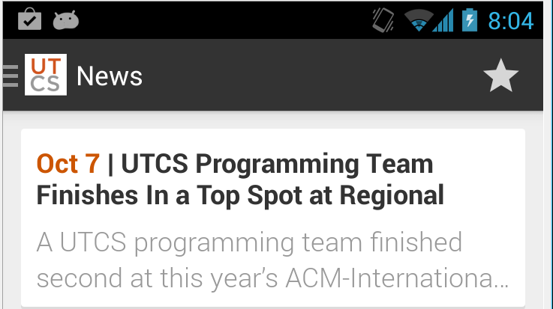
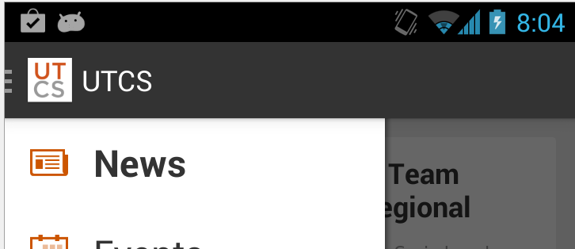
Action Bar Changes
Drawer overlays content, but not Action Bar
Action Bar title should change from Activity Name to App name
Hide any Action Bar items based on context of Activity

Slide 32
When to Use a Drawer
Alternative top level navigation mechanism
not a replacement for tabs or spinners
Navigation Drawers are a good option when:
many (>= 4) top level views
app requires lateral navigation between low level activities
deep navigation branches to ease pain of going back, back, back, back, …

Slide 33
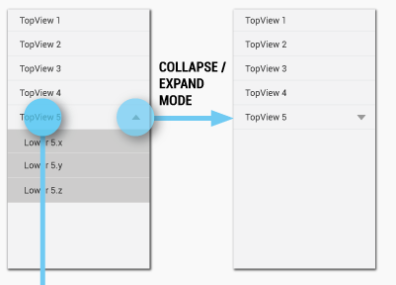
Navigation Drawer Design
Items in drawer broken up into rows
Each row has a title and optional icon
Possible to collapse multiple items into a single row

Slide 34
Navigation Bar Design Checklist
The action bar remains in place and adjusts its content.
Your navigation drawer overlays the content.
Any view represented in the drawer has a navigation drawer indicator in its action bar that allows the drawer to be opened by touching the app icon.
You take advantage of the new visual drawer transition.
Any view not represented in the drawer maintains the traditional Up indicator in its action bar.
You stay in sync with the general navigation patterns for Up and Back.
http://developer.android.com/design/patterns/navigation-drawer.html

Slide 35
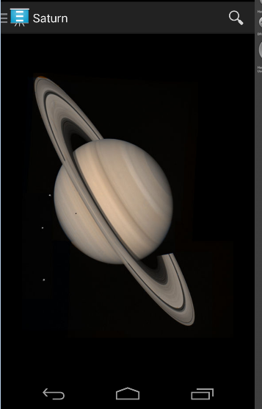
Navigation Drawer Example
Display Planets
Image of planet from app
ActionBar item to search web for planet
Drawer to change planets

Slide 36
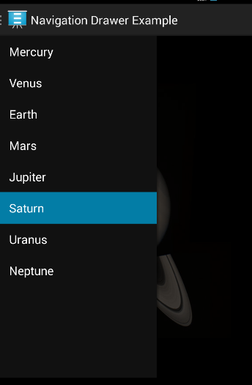
Drawer Open
Note: Action Bar title change
Note: removal of Action Item, search
Note: drawer does not cover entire content view

Slide 37
Implementing a Navigation Drawer
DrawerLayout APIs in the support library
Create layout file with DrawerLayout as the root container
recall, LinearLayout, FrameLayout, …
Inside Layout add two components
one for the regular content
and another for the Drawer content
likely a ListView, like the Countries app

Slide 38
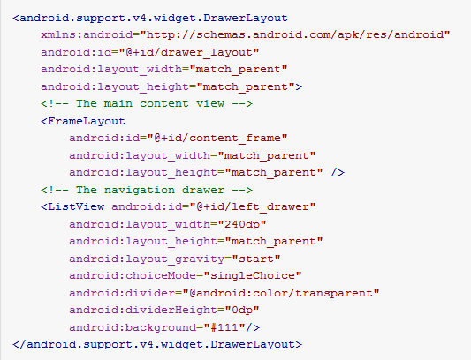
DrawerLayout xml

Slide 39
DrawerLayout xml
main content must be first
order in layout file sets z ordering, later items appear on top of earlier items
main content matches parent width and height, entire UI when drawer hidden
drawer view must specify layout gravity
"start", instead of "left" to support right to left languages
height of drawer matches parent, width hard coded and should be no more than 320 dp so some portion of main content still visible

Slide 40
Populating Drawer
Container for drawer is a ListView in example
typical, although other layouts allowed
Recall, populate a ListView with an adapter
ArrayAdapter or SimpleCursorAdapter (for reading from a data base)
Example with planets creates ArrayAdapter attached to String array from a resource file

Slide 41
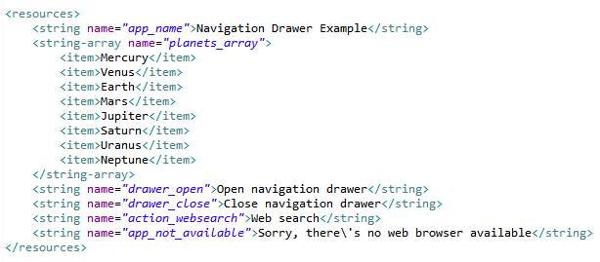
String Array Resource File

Slide 42
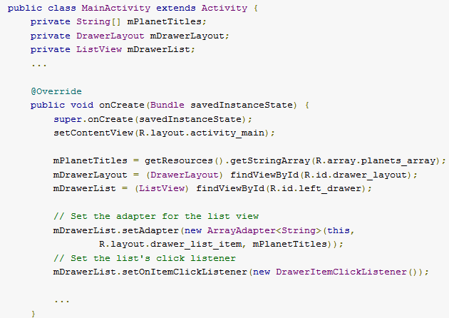
Populating Drawer in onCreate()

Slide 43
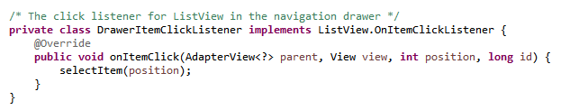
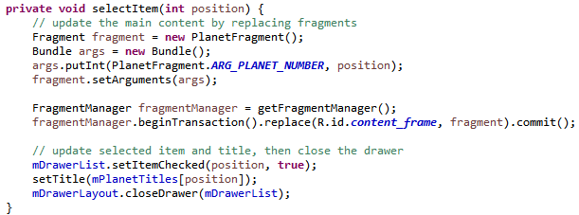
DrawerItemClickListener and selectItem()
drawer closing with animation

Slide 44
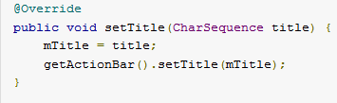
Responding to Click
in example selecting a drawer item replaces the content in the DrawerLayout with a new fragment

Slide 45
Opening and Closing
YAL!, yet another listener
call setDrawerListener() on DrawerLayout and pass an implementation of DrawerLayout.DrawerListener
Methods such as
onDrawerOpened()
onDrawerClosed()

Slide 46
open / close Alternative
If app has an ActionBar:
extend ActionBarDrawerToggle class
implements the DrawerListener class
still have to override methods for drawerOpen and drawerClose
… but, this class helps handle the interaction between drawer and action bar (title, action items)

Slide 47
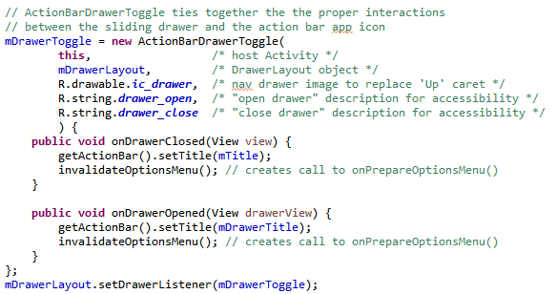
More from onCreate()

Slide 48
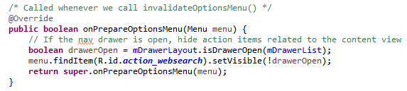
Changing Action Bar Items
In this instance only one action bar item, search web for planet name
hide if drawer is open

Slide 49
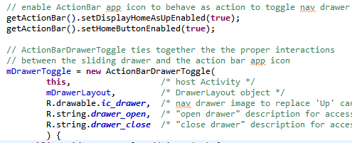
Action Bar interaction
If app has an Action Bar should:
allow user to open and close drawer by tapping the app icon
have an icon indicating the app has a drawer

Slide 50
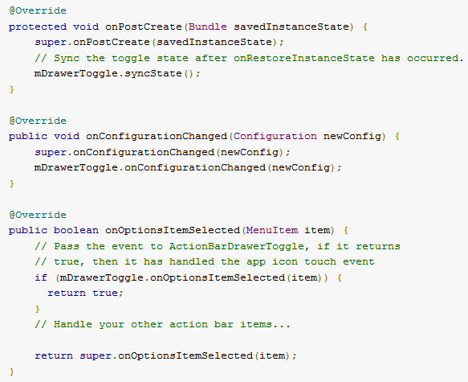
ActionBarToggle and Lifecycle

Slide 51
Multiple Drawers
Possible to have another drawer
left / start drawer for app navigation
right / end drawer for options with the current content view
General Android design: Navigation on the LEFT Actions on the RIGHT
http://tinyurl.com/lnb2jb3

Slide 52
dialogs

Slide 53
Dialogs - Old Way
Dialogs from tutorials were cut and paste
Implementing Dialogs demonstrates evolution of Android SDK
legacy approach has Activity manage its own Dialogs
created, initialized, updated, and destroyed using Activity class call back methods

Slide 54
Dialogs - New Way
Android evolving from smartphone OS to smart device OS
API level 11 (Android 3.0, the tablet release) introduced Fragments
A fragment represents a behavior or a portion of a UI in an Activity
like a sub activity
multiple fragments combined in multi-pane UI
reuse fragments in multiple activities

Slide 55
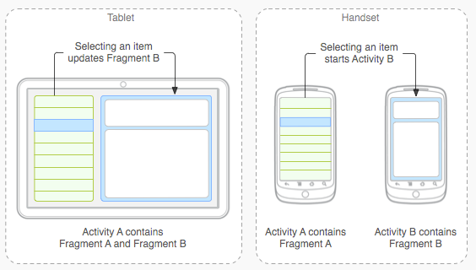
Fragments

Slide 56
Dialogs as Fragments
Dialogs are special type of Fragment
managed by the FragmentManager class
still part of an activity, but lifecycle not managed by the Activity
life cycle issues of Dialogs as Fragments will be more difficult to deal with
must save state and restore instance

Slide 57
Types of Dialogs
Used to organize information and react to user events without creating a whole new activity
Old Dialogs:
Dialog, AlertDialog, DatePickerDialog, TimePickerDialog, ProgressDialog
New Dialogs:
DialogFragment

Slide 58
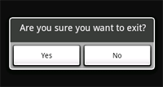

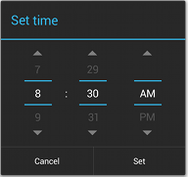
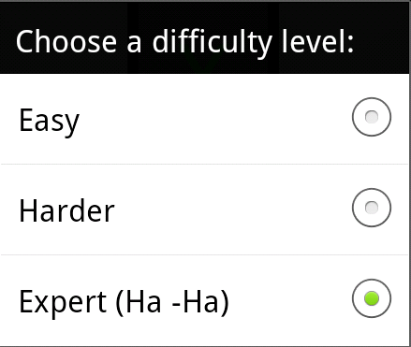
Sample Dialogs

Slide 59
Legacy Approach
Dialog defined in Activity it is used
Activity maintains a pool of Dialogs
showDialog() method displays Dialog
dismissDialog() method used to stop showing a Dialog
in tutorial, when we have difficulty
removeDialog removes from pool

Slide 60

Legacy Approach - Steps
Define unique indentifier for the Dialog in Activity (constants)
implement onCreateDialog method, returns Dialog of appropriate type

Slide 61
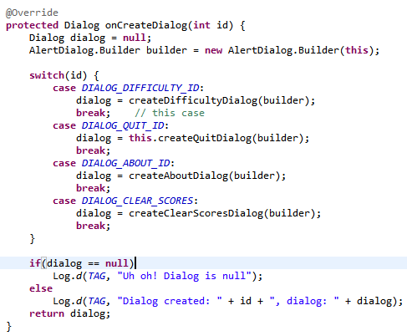
onCreateDialog

Slide 62
Dialog Steps - Legacy Approach
implement onPrepareDialog() if necessary
if necessary to update dialog each time it is displayed
for example, a time picker, update with the current time
launch dialog with showDialog()
in tutorials done when a menu or action bar menu item selected
could launch Dialogs for other reasons

Slide 63
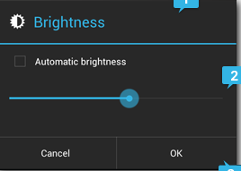
Alert Dialogs
Most common type
Title, Content Area, Action buttons (up to 3)
Content area could be message, list, seekbar, etc.
set positive, set negative, set neutral

Slide 64
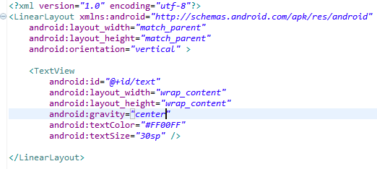
Custom Dialogs
AlertDialog very flexible, but you can create CustomDialogs
Create a layout

Slide 65
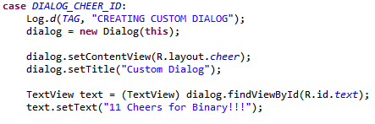
Custom Dialogs
from onCreateDialog

Slide 66

Custom Dialog
Simple dialogs are dismissed with the back button
dialog title

Slide 67
Dialogs - Fragment Method
Decouple Dialogs from the Activity
good SE approach?
TicTacToe UI is almost 500 lines long!
Implement a class that is a subclass of DialogFragment
DifficultyFragment
Send info to newInstance method (current difficulty, listener for updates)
onCreateDialog now in DifficultyFragment

Slide 68

DifficultyFragment

Slide 69

DifficultyFragment - onCreateDialog

Slide 70

Using DifficultyFragment
In AndroidTicTacToe create a listener to pass to the newInstance method
create and show Dialog as part of onOptionsItemSelected()

Slide 71

DifficultyListener

Slide 72

Using Fragments
Fragments added in API level 11, Android 3.0, the tablet release
Developers behind Android think fragments are so important that can be used in pre API 11 builds using the Android Support Library
Froyo and Gingerbread pre API 11

Slide 73

Android Support Library (ASL)
add library to project and application
android.support.v4.app.DialogFragment
for example
instead of android.app.DialogFragment
ASL does not support action bar in earlier versions of API
discover ActionBarSherlock

Slide 74


Fragment Lifecycle
Common error:
not dealing with orientation change when Dialog is open
http://developer.android.com/guide/components/fragments.html

Slide 75
Themes

Slide 76

Consistency
Themes are Android's mechanism for a consistent style in an app or activity
Theme is a predefined style
sets properties of layouts and widgets such as
color
height
padding
font size.
HOLO DARK THEME

Slide 77

New Themes
Holo light and dark were the Honeycomb (3.0) themes
Lollipop (5.0) added the Material Design theme
System Widgets that allow you to pick color palette (customize)
Touch feedback animations for system Widgets
Activity transition animations
LIGHT MATERIAL THEME

Slide 78

Setting a Theme
App theme set in the Manifest

Slide 79

Using Built in Styles
R.style class
not to be confused with our R class

Slide 80

R.style

Slide 81
R.style
Our widgets (buttons, seek bars, edit texts, etc.) are using the android R.style
We are overriding some attributes
Also for Views:
"@android:style/Theme.NoTitleBar"

Slide 82
R.style
Not well documented
Suggestion is too look at the actual xml
Styles at http://tinyurl.com/nz3j3ak
Themes at http://tinyurl.com/ls9cxbf

Slide 83

Example Android Style

Slide 84

Example Android Theme

Slide 85

More of the Theme

Slide 86
styles

Slide 87
Styles
Defined in XML file
res/values/style
similar to a cascading style sheet as used in html
group layout attributes in a style and apply to various View objects (TextView, EditText, Button)

Slide 88

Sample Styles, in styles.xml

Slide 89

Apply Style - in main xml

Slide 90

Result of Styles
can override elements of style
bottom edit text overrides color
one style can inherit from another
use UI editor to create view and then extract to style

