Slide 1
CS371m - Mobile Computing
Content Providers And Content Resolvers

Slide 2
Content Providers
One of the four primary application components:
activities
content providers / content resolvers
services
broadcast receivers

Slide 3
Android Applications
Recall…
Each application runs as a different user on the OS
private files, user id, separate process with its own instance of the Dalvik VM
Content Providers and Content Resolvers act as a bridge between applications to share data

Slide 4
Content Providers
Standard mechanism / interface to allow code in one process (app, content resolver) to access data from another process (app, content provider)
example, app to remind you to call certain people
content resolver accesses call log to check last contact
manage access to a structured data
encapsulate the data and provide mechanisms for defining data security

Slide 5
Content Provider - Content Resolver
Calendar App Data
Content Provider
Content Resolver
data
Your App
Content Resolver
Content Provider
Call Log Data
data

Slide 6
Content Providers
Many of the built in applications on devices have content providers to allow other apps to access data
Examples of built in content providers
AlarmClock
CalendarContract (API level 14)
CallLog (sent and received calls)
ContactsContract
MediaStore (audio / visual data)
UserDictionary
VoicemailContract
many, many more
http://developer.android.com/reference/android/provider/package-summary.html

Slide 7
Content Providers
Provide access to a central data repository
ability to read and write to centralized data
data presented by Content Provider in the form of a table
like table from relational database
Each row in data table one "piece" of data in repository

Slide 8
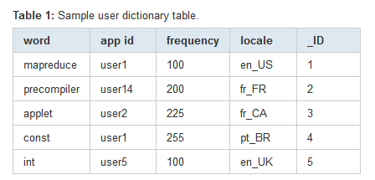
Example Table
Data from user dictionary
primary key optional
_ID column required to bind data from provider to a ListView

Slide 9
ConentProvider Theory
Abstraction facilitated by having URI for data from content provider
content://<more to follow> is the URI for the content
Don't know where data (content is actually stored)
sqlite data base, flat file, server accessible via network
content://contacts/people

Slide 10
using Content providers and content resolvers

Slide 11
Accessing Data
Use a ContentResolver client object in your app
ContentResolver communicates with ContentProvider
provides "CRUD" functionality, Create, Retrieve, Update, Delete
matching methods in Content Resolver / Content Provider
example: query() method
Create a cursor via content resolver to move through rows of table

Slide 12
Using Content Providers
Unlike Activities, Services, and Broadcast Receivers we won't declare ContentResolvers in our AndroidManifest.xml file
In practice you may not even realize you are using a ContentProvider
we call the getContentResolver() method inherited from Context and then the query method on the returned ContentResolver

Slide 13
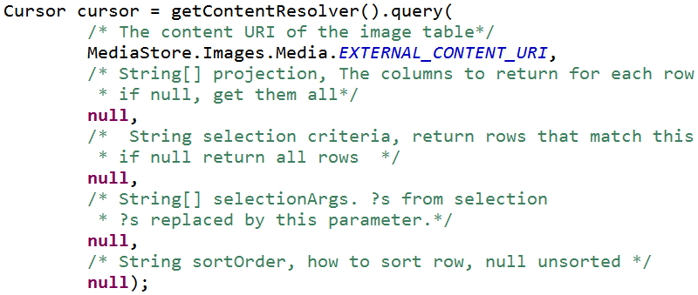
Accessing Content via Provider
Example: Exploring Images on a device
MediaStore.Images.Media class presents various Content Providers
get the cursor:

Slide 14
Query
5 parameters
uri for content, URI
look at class documentation, generally a constant
projection, String[]
what columns to get from the table, null = all, can be inefficient
selection clause, String
filter, what rows to include, a SQL WHERE clause
selection args, String[]
replace ?'s in selection with these
sortOrder, String
how to order the rows

Slide 15
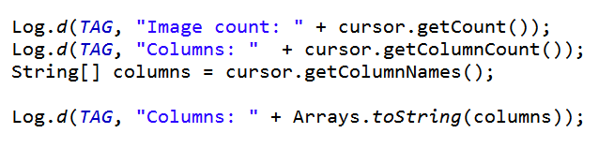
Accessing Content via Provider
After obtaining cursor:
result:

Slide 16
MediaStore.Images.Media
Columns from table:
According to Logcat:
[_id, _data, _size, _display_name, mime_type, title, date_added, date_modified, description, picasa_id, isprivate, latitude, longitude, datetaken, orientation, mini_thumb_magic, bucket_id, bucket_display_name, width, height]

Slide 17
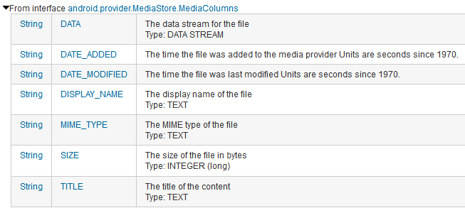
MediaStore.Images.Media
Columns documented in ContentProvider classes and interfaces

Slide 18
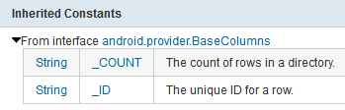
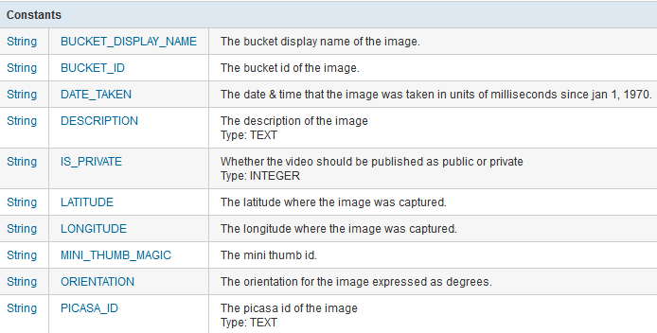
MediaStore.Images.Media Columns

Slide 19
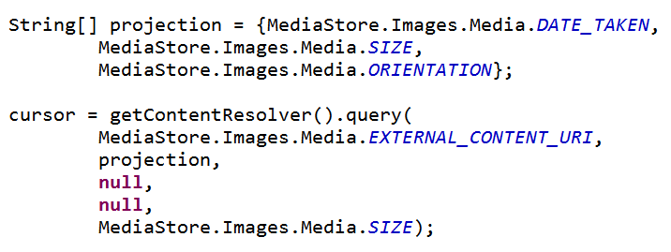
Selection Columns
Limit Columns returned with projection argument to query method that creates Cursor

Slide 20
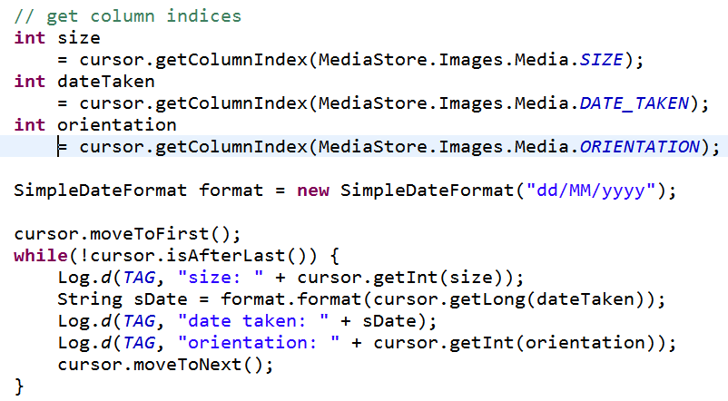
Showing Data in Logcat

Slide 21
Cursor
The ContentResolver query method creates and returns a Cursor
Similar to a Database Cursor
similar to Scanner or Iterator
Move through the data (rows) one element at a time
Process data with loop or bind cursor to a ListView with an Adapter

Slide 22
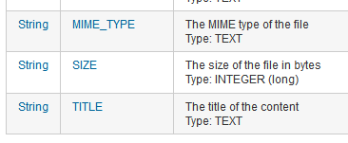
Getting Data from Row
Must determine what type column data is in, use getX method
refer to constants from ContentProvider class
careful - some INTEGERS longs

Slide 23
Using Selection Criteria
Example gets rows in table
the selection criteria and selection args allow picking only certain rows
essentially an SQL WHERE clause
http://www.w3schools.com/sql/sql_where.asp
specify a criteria that must be met
? is value filled in with selectionArgs
multiple criteria possible, AND, OR, NOT

Slide 24
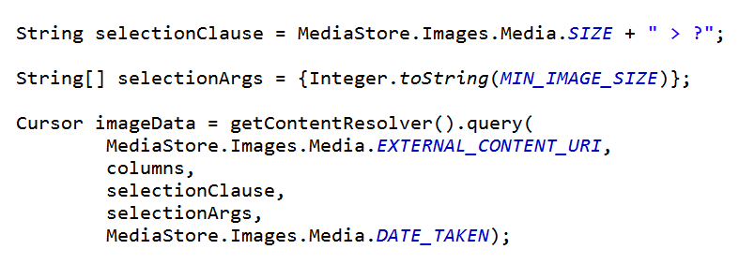
Using Selection Criteria
Instead of selecting all rows, only select rows with image size greater than some minimum value
recall: null, null returns all rows

Slide 25
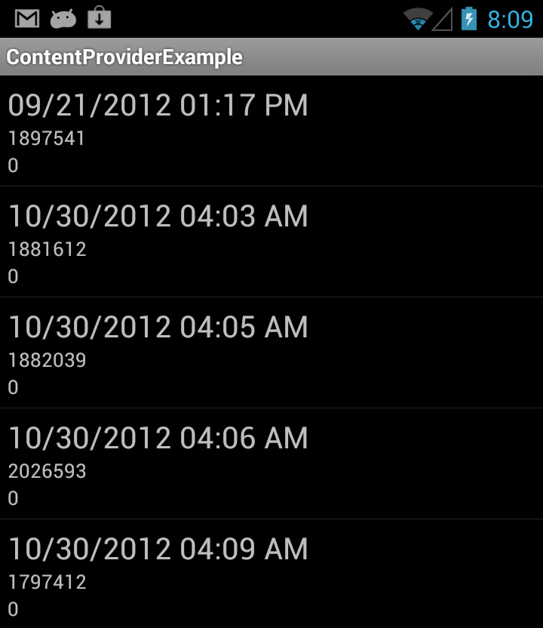
Result

Slide 26
Why selectionCriteria and selectionArgs??
Why not just say:
selectionCriteria = "MediaStore.Images.Media.SIZE > 1750000"
SECURITY
If selection criteria is based on user input, user could insert malicious SQL statements to attempt to delete data base table
example:
" MediaStore.Images.Media.SIZE > " + "nothing; DROP TABLE *;"

Slide 27
Displaying Data in ListView
Specify columns to get from ContentProvider
Create view that will hold data
one row
Obtain cursor from ContentProvider
Use ListAdapter to convert data from Cursor to Views
Sub class adapter to format text

Slide 28
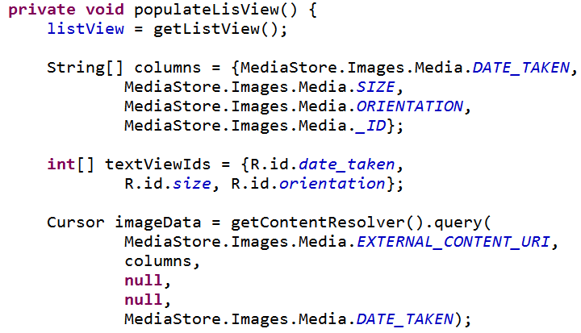
Display Data from ContentProvider

Slide 29
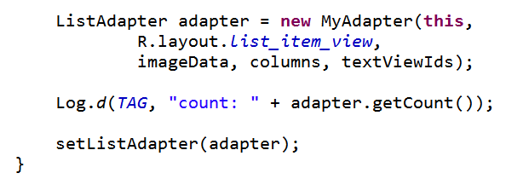
Display Data from ContentProvider
rest of populateListView from ListActivity

Slide 30
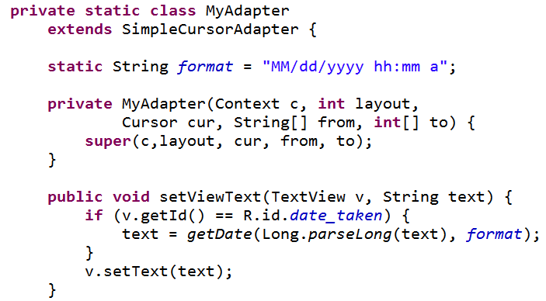
Subclass Adapter

Slide 31
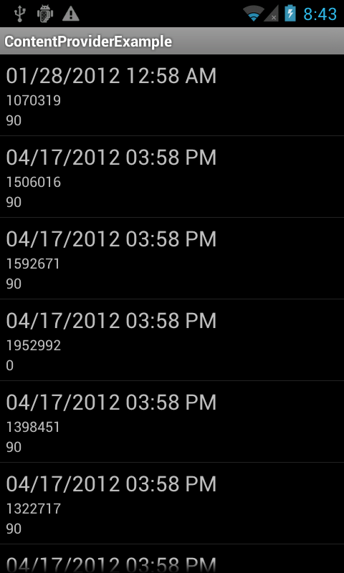
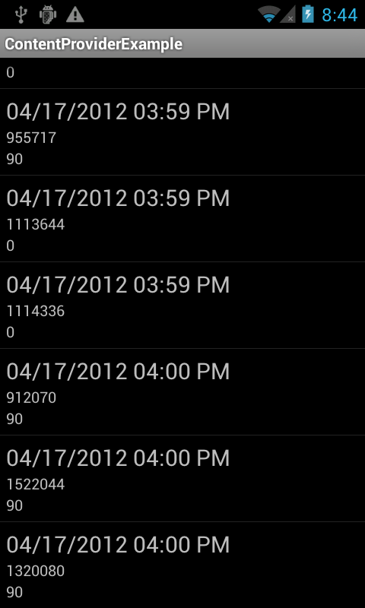
Results

Slide 32


Permissions
Using certain content providers require an application request permission
so user aware what content the application will access and possibly modify

Slide 33
Content Provider Capabilities
Possible to update, insert, and delete data via a ContentProvider
CRUD
insert, update, and delete methods part of ContentResolver class
for example insert new calendar data or modify existing calendar data

Slide 34
ContentProviders and Intents
Some Content Providers have common activities
created Intent Filters to handle the operation
Example
Calendar has Intent Filter so other applications can add events
opens form with data filled in, finish creation, go back to original app, event added to calendar

Slide 35
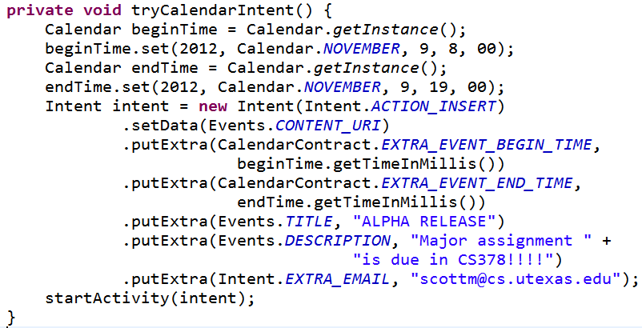
Calendar Event Add

Slide 36
Single Data Elements
Sometimes you don't want all the data from a Content Provider
you want one piece of data, one row from the table
must have the ID value of the row and the Content Provider must support this functionality

Slide 37
Special providers and contracts

Slide 38
Calendar Provider and Contact Provider
Special providers
Calendar and Contact data considered central to user experience
Android has built in components to work with Calendar and Contact data

Slide 39
Contacts Provider
Built to accommodate a wide range of data and manage as much data as possible for each contact
flexible, powerful, … complicated
provides contract classes to access and modify Contacts data

Slide 40
Contracts
Some apps that have content providers provide Contract classes
"help work with Content provider Uris, column names, intent actions, and other features of the content provider"
Adds a layer of abstraction and encapsulation

Slide 41
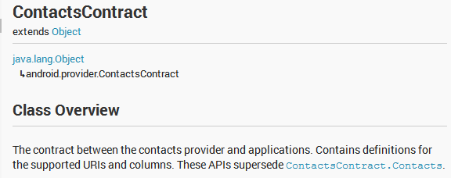
Contacts Contract
Many nested classes
Provide information on the tables in the content provider
… and some convenience methods for accessing that data

Slide 42
Contacts Contract
Example of abstraction
Possible to create cursor and pull out the last time a contact was contacted

Slide 43
Calendar and Contacts Providers
The Calendar and Contacts data used by many of the apps on the device
Each have their own APIs to perform CRUD operations
create, read, update, delete
Calendar provider has tables for
Calendars, Events, Instances, Attendees, Reminders
Contact provider manages as much data for each contact as possible leading to a complex organization
multiple contract classes for retrieval and modification of contact data

Slide 44
creating content providers

Slide 45
Creating ContentProvider
It is possible to implement a ContentProvider for your app
You may need / want to provide a ContentProvider if:
You want to offer complex data or files to other applications.
You want to allow users to copy complex data from your app into other apps.
You want to provide custom search suggestions using the search framework.
Not normally necessary until you create that million download app
These are declared in manifest

Slide 46
LOADERS

Slide 47
Loaders
Alternative approach to getting Cursor from a ContentProvider
Accessing data from ContentProvider may be a lengthy operation
doing this on the UI thread may lead to ANR, unresponsiveness
Loader interfaces and classes used to do this on a separate thread
create their own AsynchTask

Slide 48
CursorLoader
create a loader
API level 11 or greater
ListView or ListFragment, but not ListActivity
implement a class with the proper callback methods for when the CursorLoader is finished and data is ready for access
public Loader<Cursor> onCreateLoader(int id, Bundle args)
public void onLoadFinished(Loader<Cursor> loader, Cursor data)
public void onLoaderReset(Loader<Cursor> loader)

